Slide 1
Automated Test Cases Singer Official Website
Nisansala Amarasinghe
BSc(hons) In Information Technology
Horizon Campus
sumudunisansala999@gmail.com

Slide 2
Contents
Introduction.
Login Test Cases.
New Registration Test Cases.
Navigation Test Cases.
Selection Test Cases.
Place Order Test Cases.

Slide 3
1. Introduction
Selenium Webdriver was used to automate test cases.
IntelliJ IDEA was the tool which was used.
Selectors Hub was the extension that used to get correct identities of elements.
Maven Projects were used to the project.
Knowledge about Java language and TestNG were used.
Xpaths, id were used to identify the related elements.
Method Chaining was used to improve the efficiency.
Chrome Options were used to match the Chrome version to the browser version.

Slide 4
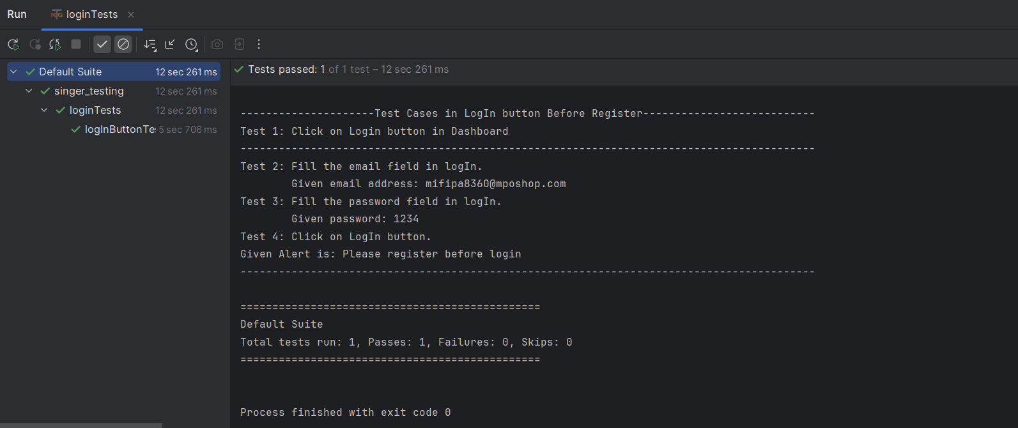
2. Login Test Cases

Slide 5
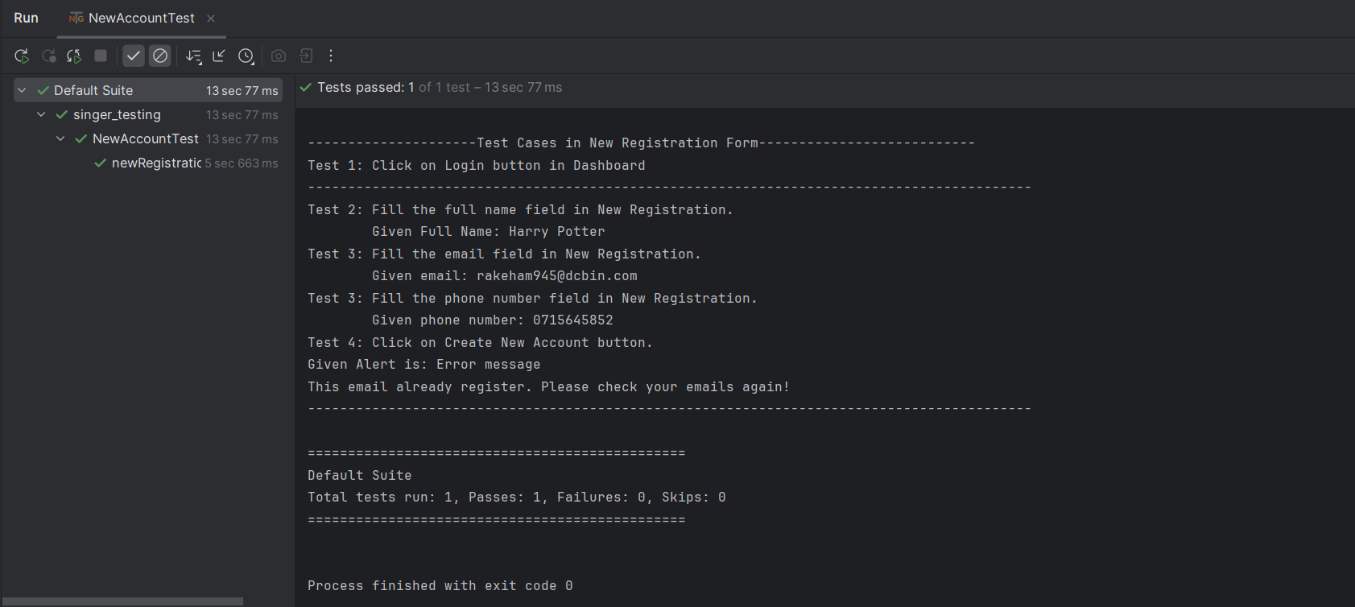
3. New Registration Test Cases

Slide 6
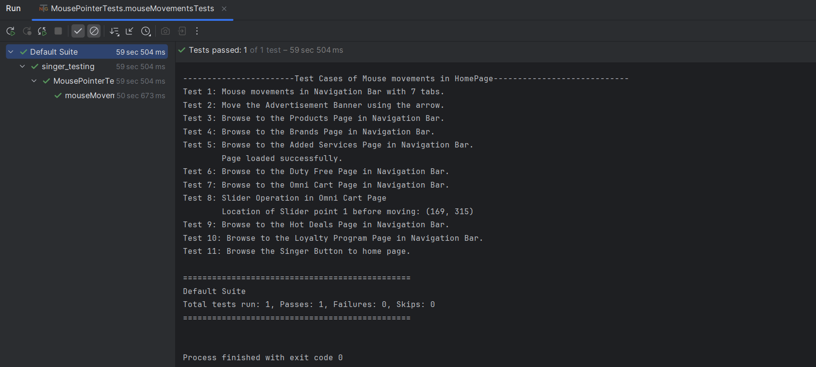
4. Navigation Test Cases

Slide 7
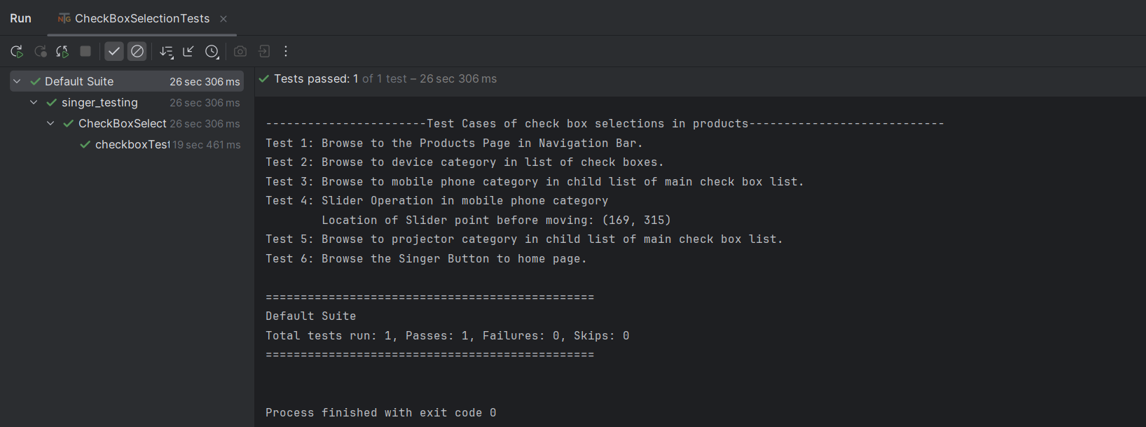
5. Selection Test Cases

Slide 8
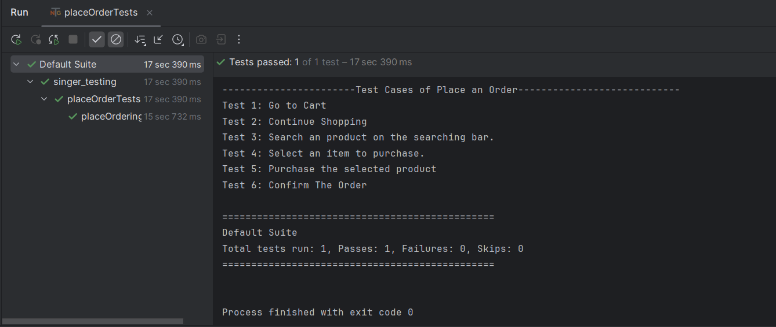
6. Place Order Test Cases

Slide 9
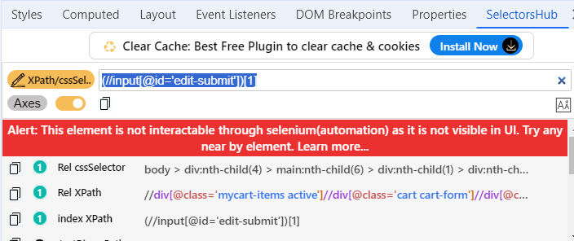
In above Test case 6, Place Order button was not supported. The error which was identified by the SelectorsHub has mentioned below. Because of that error, further test cases couldn’t automated.

Slide 10
Thank You..!

