Slide 1

TTC Subway Delay Visualization
Group members
Nisargkumar Patel
Gursimran Kaur
Anusha Gundeti
Darshan Ruparel

Slide 2
Today’s Objective
Data Collection and Understanding
Data Preparation
Data Preprocessing
EDA + Visualization
Binary Classification
Conclusion

Slide 3
Data Collection and Understanding
City of Toronto Open Data Portal
TTC subway and service delay
Data belongs to year 2022
Approx. 20k records and 10 columns
Latitude and Longitude of station using MapQuest API

Slide 4
Data Collection and Understanding
Date, time and day of the week
Station Name
Delay Code
Minimum Delay
Minimum Gap
Bound
Line

Slide 5
Data Preparation
Handling Missing Values
5536 missing values in Bound column - set it to Unknown
Line column had 39 missing values
Based on station name, line column was rectified
Dropping the vehicle column
Removed duplicates(around 15 records)

Slide 6
Data Preparation
Cleaning Station column – lot of wrong data entries
Spelling mistakes, no space in between words, different names for similar stations
259 unique stations whereas TTC only has 75 stations
Regular expression to clean the station column
Rows having station count < 40 were dropped
Generating numeric values for line column
Based on station name, line no was decided

Slide 7
Data Pre-Processing
Column Name | Mean | Standard Deviation | Variance | Median | IQR
Min Delay | 3.68 | 11.61 | 134.89 | 0 | 5
Min Gap | 5.35 | 12.27 | 150.76 | 0 | 8
Mean does not represent the data as there is lot of skewness
To detect the outlier – better to go with median as the measure of central tendency and IQR as more than 50% records represent the median

Slide 8
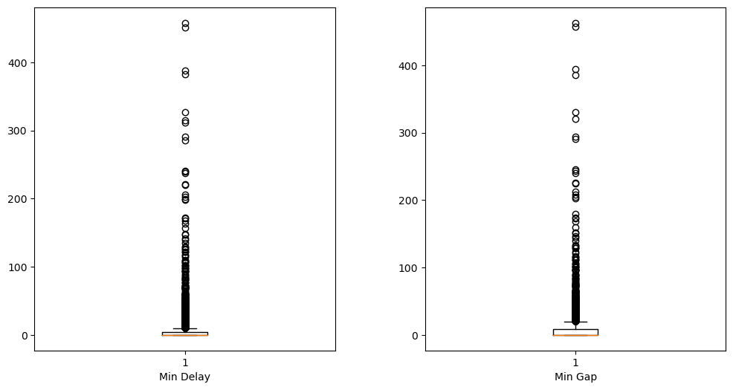
Outlier Detection

Slide 9
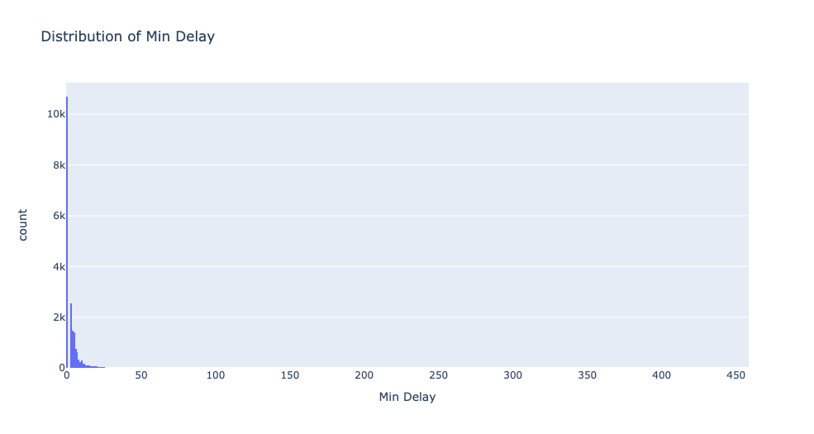
Distribution Plot

Slide 10
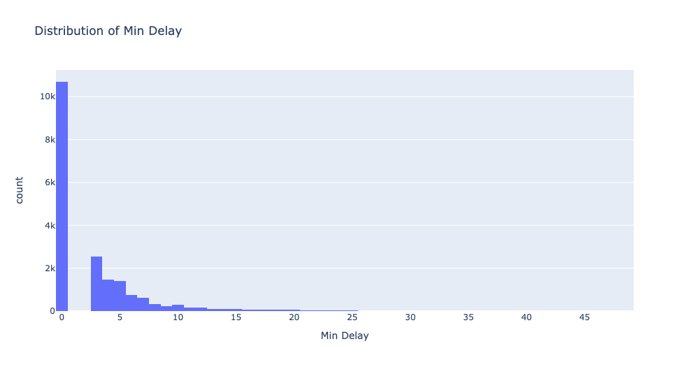
Distribution Plot

Slide 11
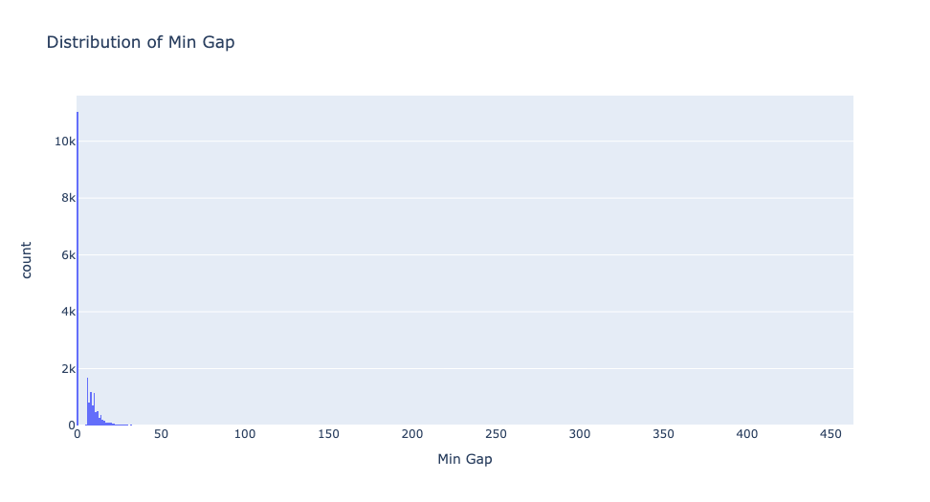
Distribution Plot

Slide 12
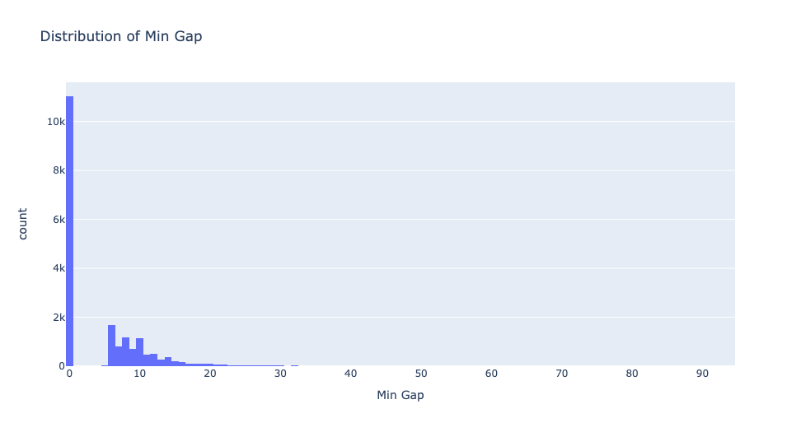
Distribution Plot

Slide 13
Outlier Treatment - Log Transformation & Flooring and Capping
Column Name | Before | After
Min Delay | 17.00 | 0.77
Min Gap | 14.07 | 0.48
Skewness improved after log transformation
Used flooring and capping to remove the outliers by using the upper and lower whiskers of particular columns as the threshold

Slide 14
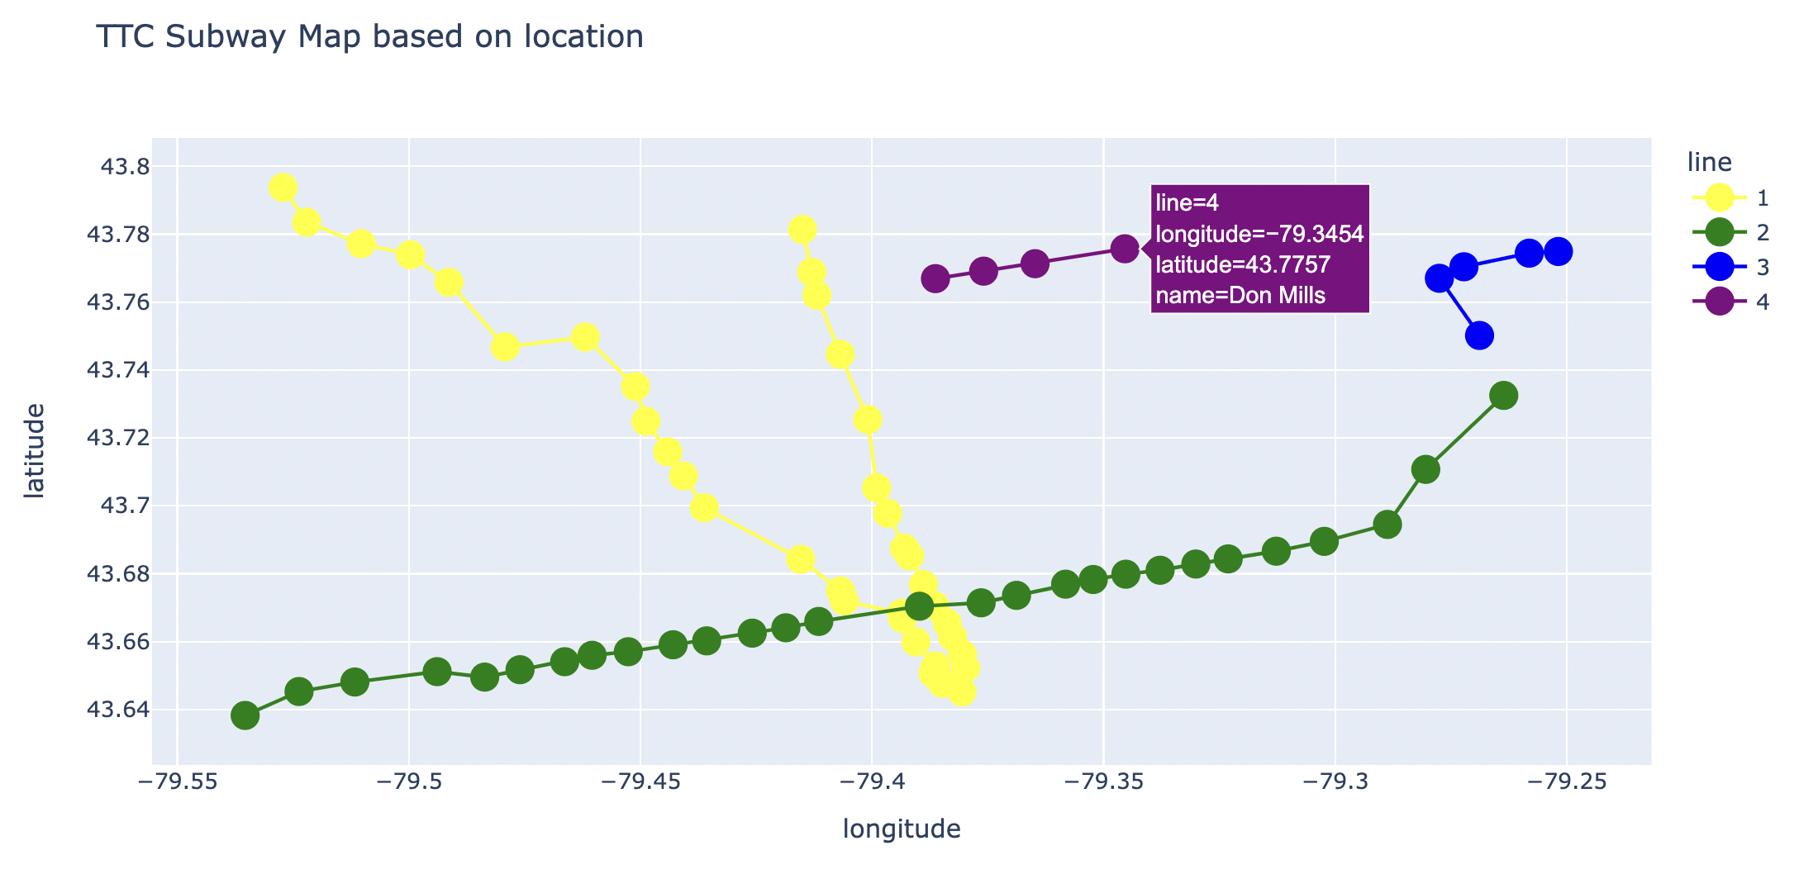
EDA + Visualization
Scatter Plot(Plotly) of Stations in Toronto

Slide 15
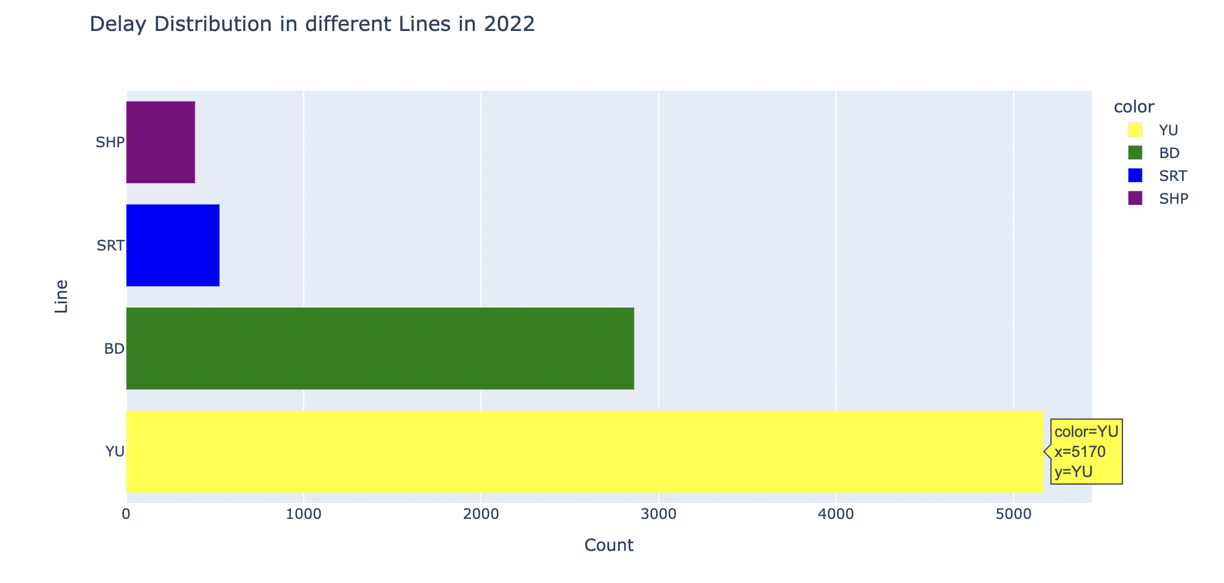

Slide 16
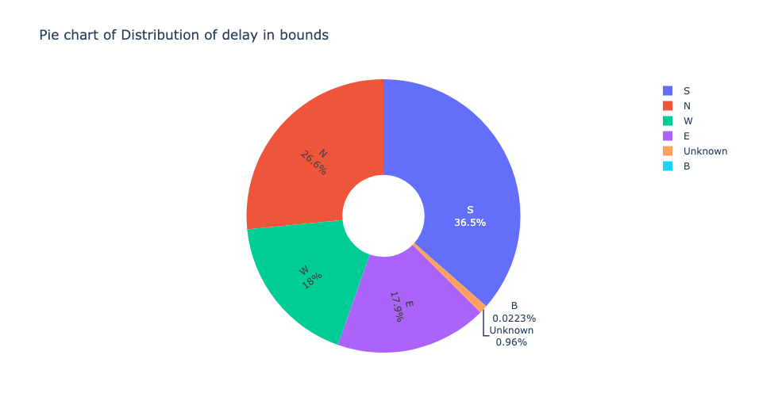
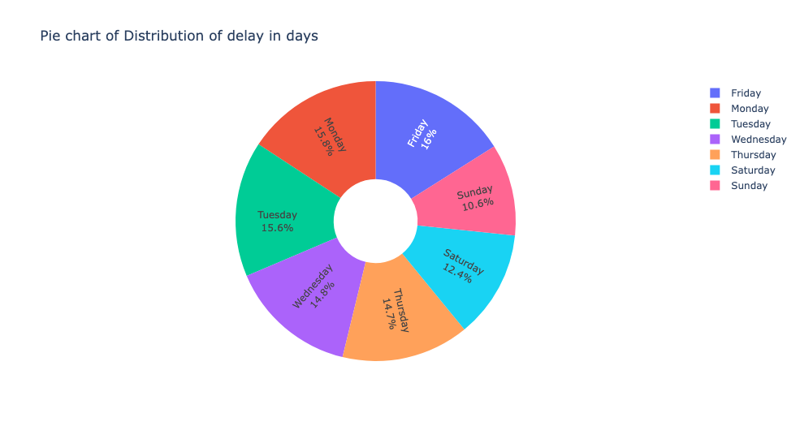

Slide 17
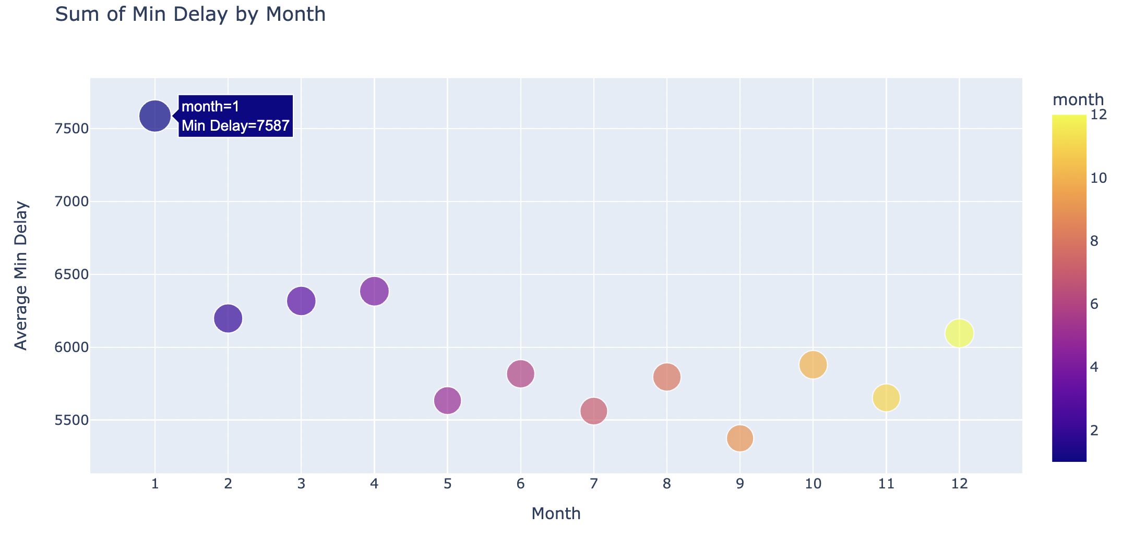

Slide 18
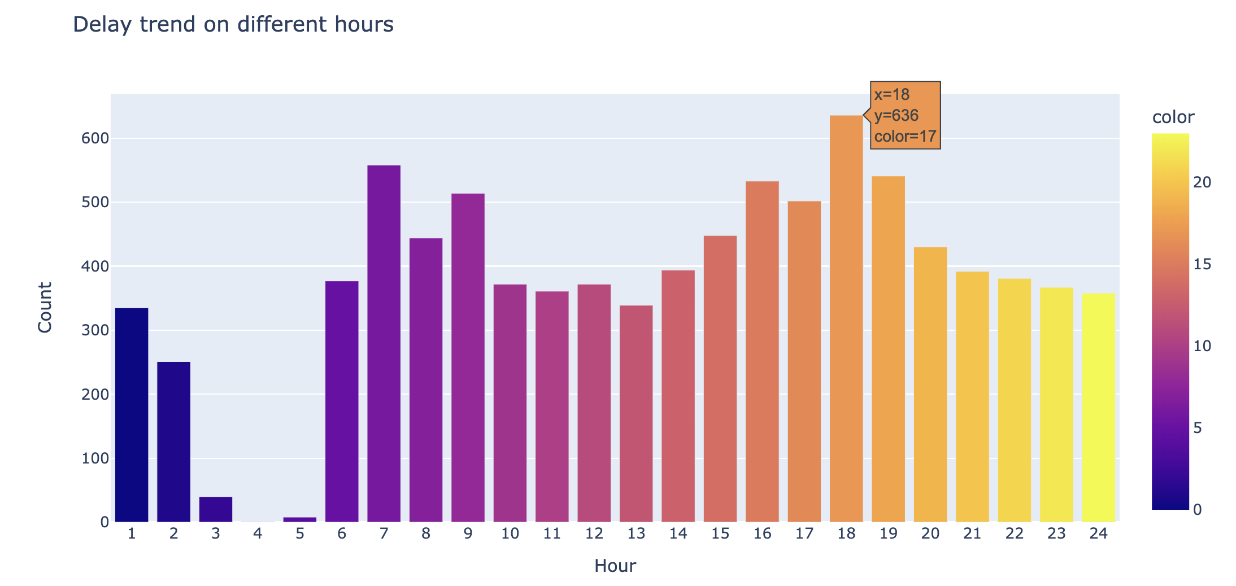

Slide 19
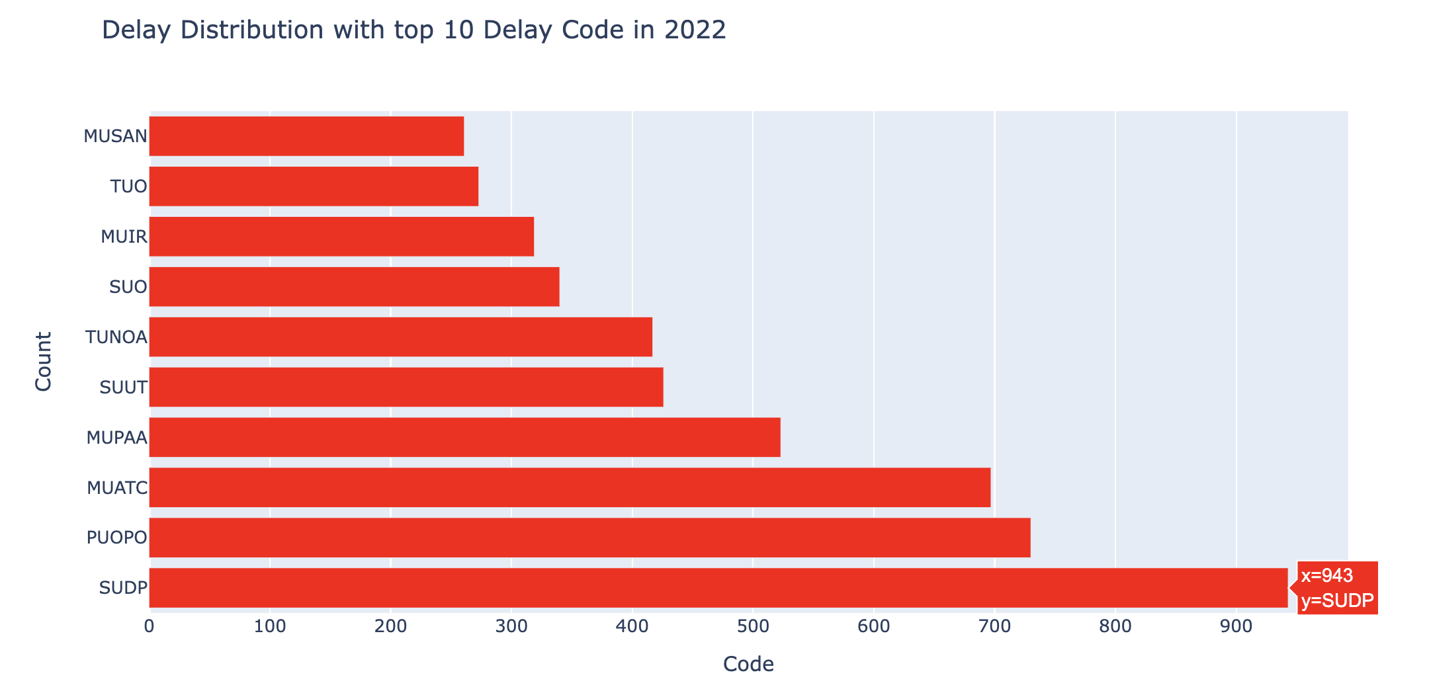
SUDP – Disorderly Patron
PUOPO – Train Door Monitoring
MUPAA – Passenger Assistance Alarm Activated – no trouble found

Slide 20
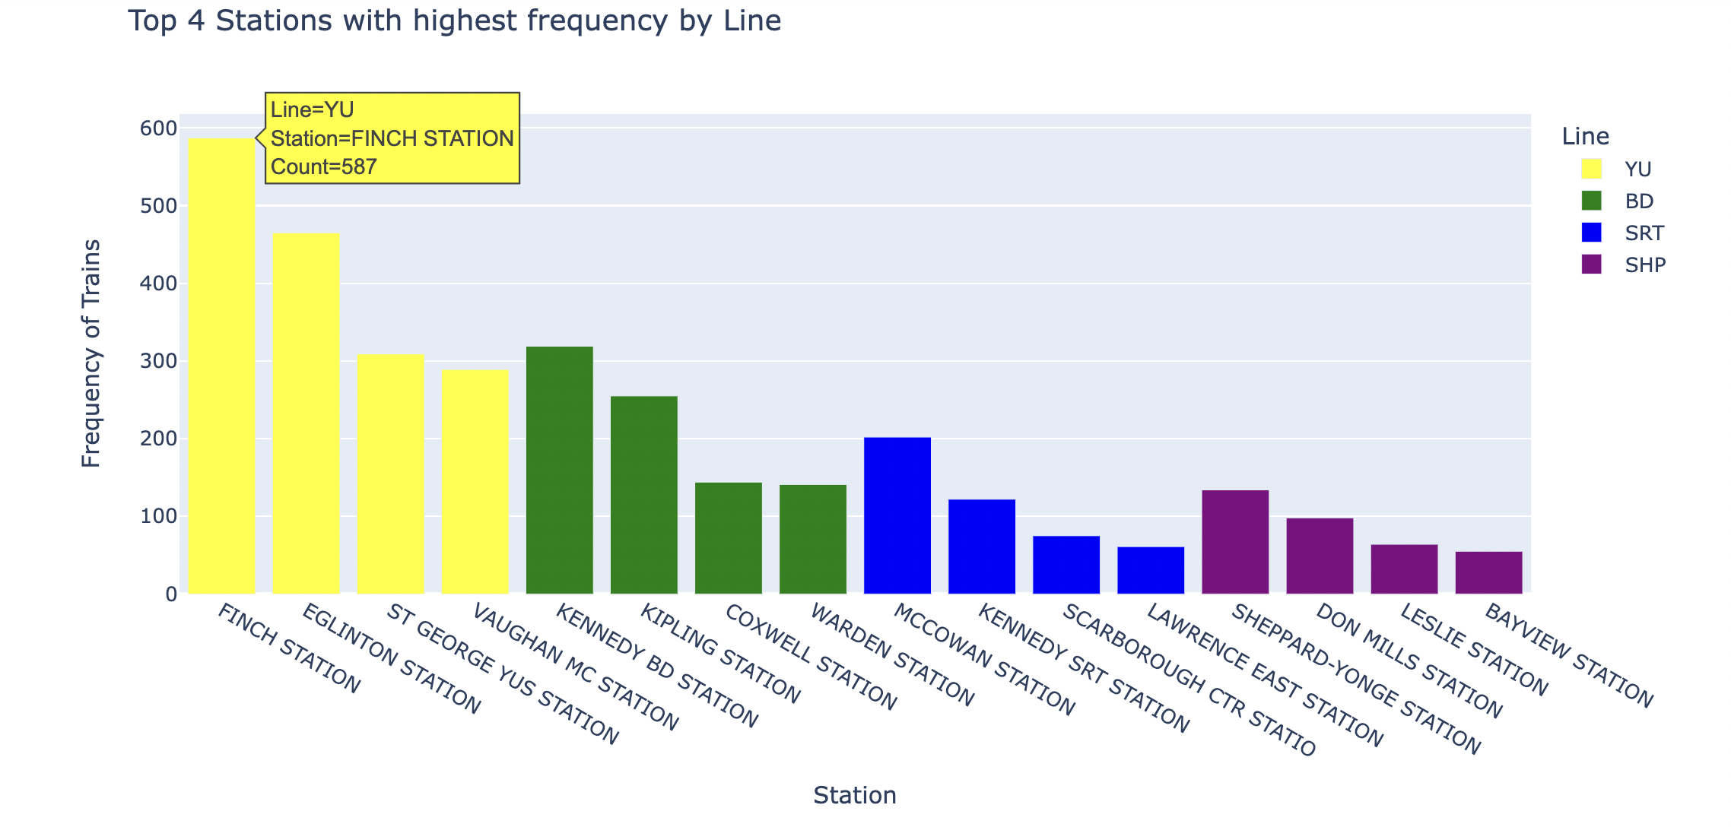

Slide 21
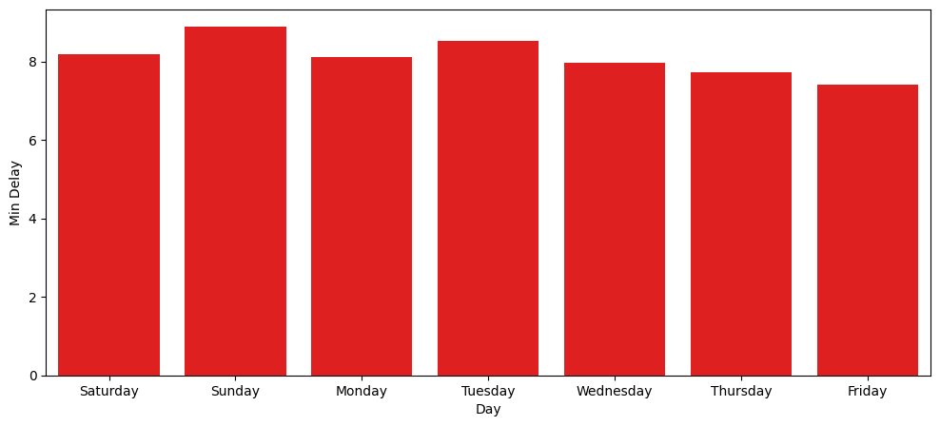
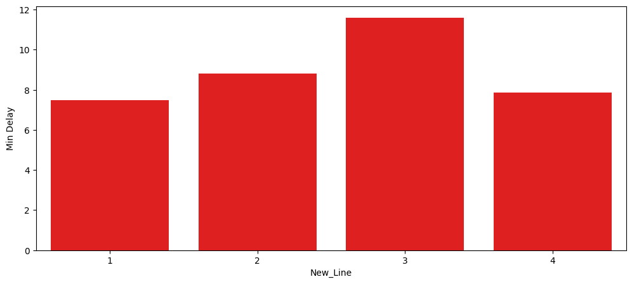
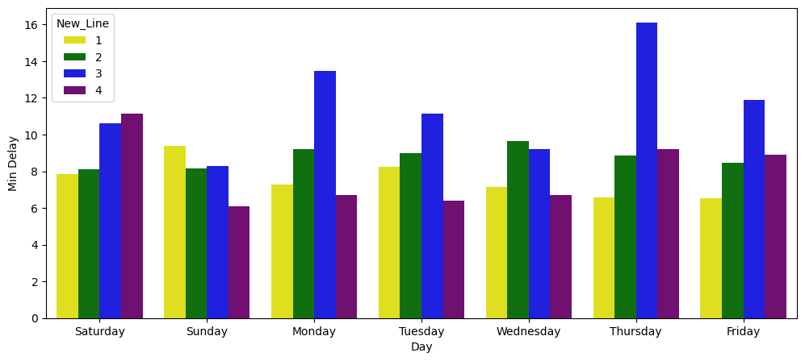

Slide 22
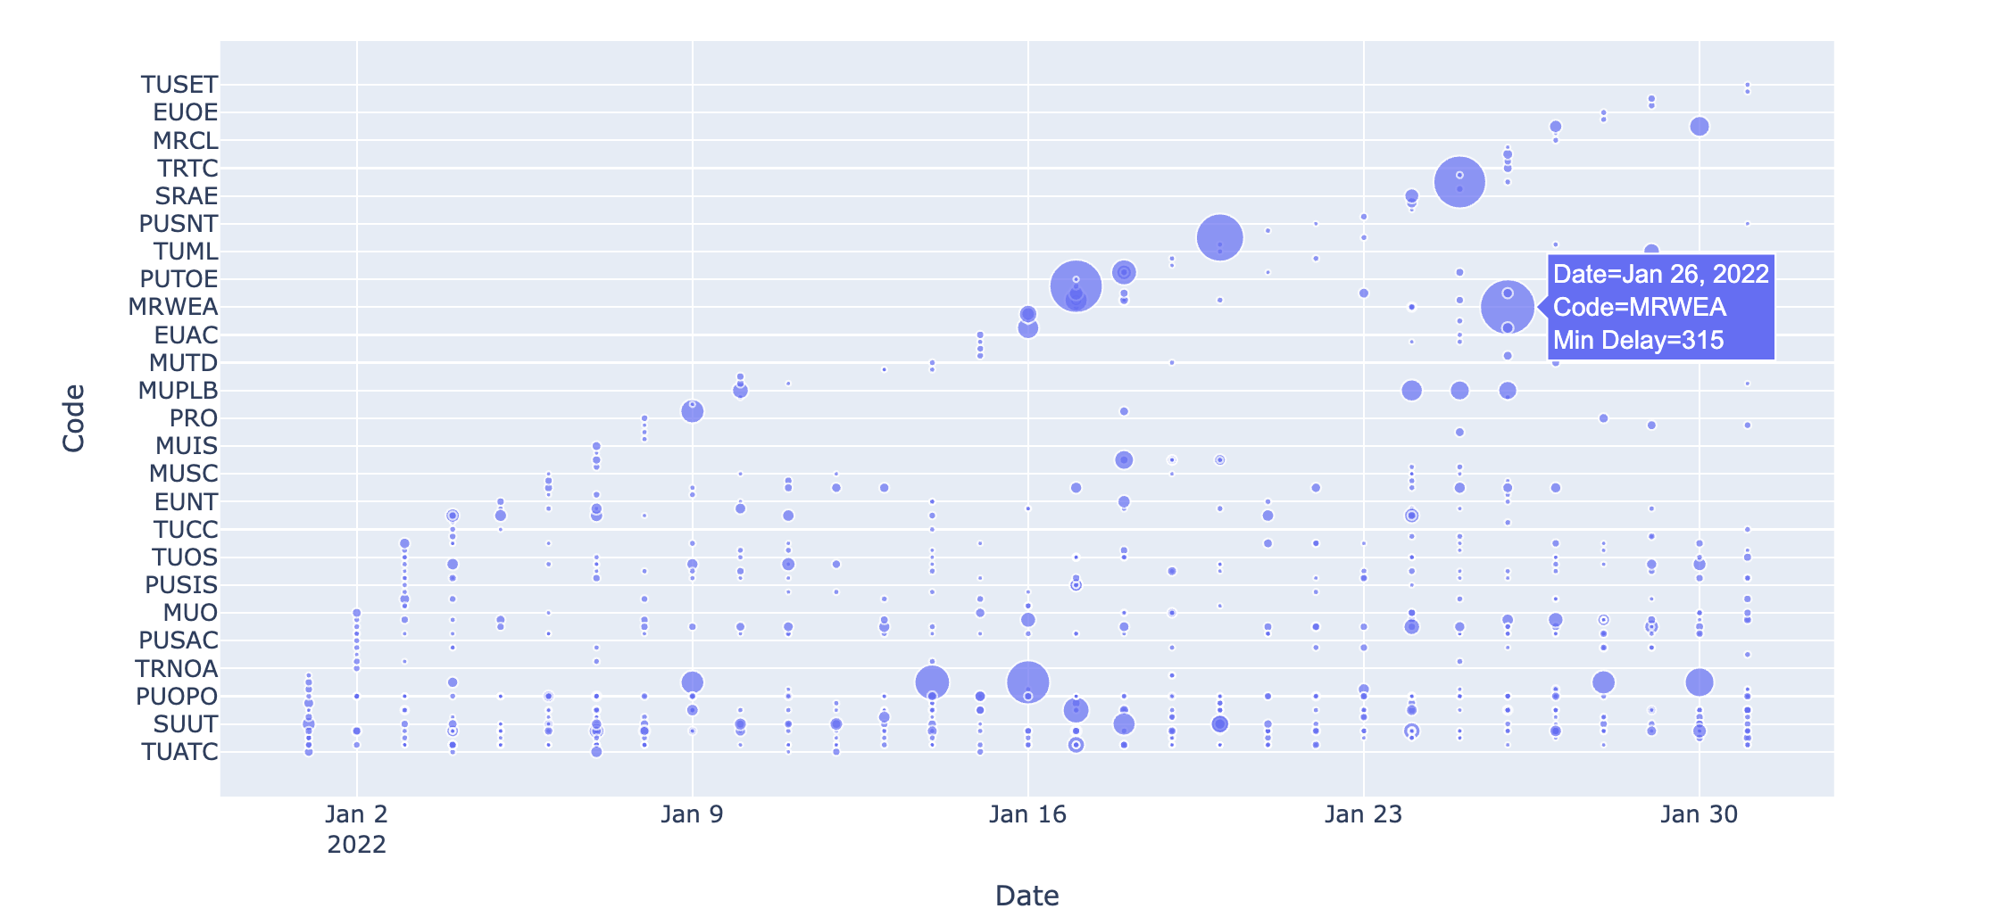

Slide 23
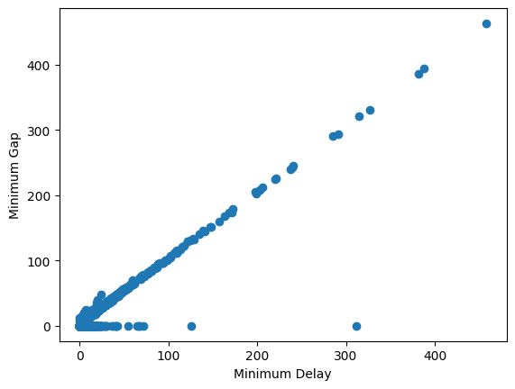
Both are highly correlated
This would be helpful in prediction of delay

Slide 24
Delay Prediction – Random Forest
Label encoding on categorical columns
Train Test split
Accuracy – 98%

Slide 25
Conclusion
TTC needs to improve the service as almost 50% times there is delay
People should play their role in making TTC a better transport service
Line 1 and 2 contains the major delays
South bound trains seems to be contributing the highest number of delays
More delays on weekdays during business hours, impacting job market
Substantial delay during winter with January being the highest due to extreme weather
Delays are not only because of TTC it is caused by people as well
Around 4 am the delay is the highest
Line 3 is taking to much time to commute
In month of Jan, delay is not only because of weather but due to loop failures as well

Slide 26
Future Work
Try different color palettes
Create tableau dashboard
Try to improve the Station Map in Plotly

Slide 27
References
(n.d.). City of Toronto Open Data Portal. Open.Toronto.ca. https://open.toronto.ca/dataset/ttc-subway-delay-data/

Slide 28
THANK YOU

