Slide 1

High Performance Computing
Autumn’ 17 Course Project
Instructor - Prof. Bhaskar Chaudhary
Authors,
Aagam P. Mehta (201501133)
Nisarg S. Patel (201501134)

Slide 2
N - Body Problem
Introduction:
Given N- bodies and position, calculating the total force acting on each particle due to all other particles is known as N-body problem.
Ex: Gravitational Force, Electrostatic Force etc.
For this assignment we will be calculating the Gravitational Force between N-bodies.

Slide 3

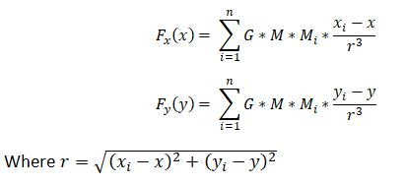
N- Body Problem
Mathematical Statement of problem:
Assume a system of N particles, located at X_{i} and having a mass of M_{i}.
The pairwise interaction force between two bodies is given by,
Thus, the total force on any particle is equal to the sum of pairwise interaction forces.

Slide 4
N - Body Problem
Problem Statement:
Calculate the total force on each of the particle for a system of n particles.
Total force on 1 particle using the above equation requires O(n) operations.
N such particles, the complexity becomes O(n2).
Hence the following algorithm aims at reducing the complexity to O(n*log n) by using efficient methods to approximate the sum in RHS in the force equation.

Slide 5
Barnes-Hut Algorithm
Three steps of the algorithm are,
a) Build a Quad tree
b) Traverse the Quad Tree from the leaves to the root, computing centre mass and total mass for each parent node.
c) For each particle, traverse the tree from the root, calculating the force.

Slide 6
Barnes Hut algorithm for 2-body problem
Consider a system of 2 bodies
A(1,1) with mass 1.
B(2,5) with mass 5.
First step is to build a quad-tree of size 8.
Point A and B will be included in quad tree as follows:

Slide 7
Quad Tree Formation Example
1
5

Slide 8
Calculation of Force
Next step is to calculate the center of mass of each of the sub quadtrees.
Next if the distance of quad tree is comparatively large then it will consider it as a single particle with position as center of mass with mass as the total mass of the particles in subquad-tree.
Thus we get force on A by using mass and distance between them.

Slide 9
Barnes Hut Algorithm vs PP Method
Particle-Particle method gives exact precise output but takes O(n²) complexity whereas Barnes Hut Algorithm uses some approximation and computes the force in O(n * Log n) complexity

Slide 10
Parallelisation of Barnes Hut Algorithm
Scope of parallelism:
Since, we have N particles to compute force on we can do this work parallel.
Also, since the force on any particle is not dependent upon the output/total force of any other particle, hence we can completely parallelise calculation of forces.
We can also use dynamic scheduling of cores so as to see that none of the threads are ideal.

Slide 11
Parallelisation of Barnes Hut Algorithm
Parallelisation Techniques:
1) Static Schedules – #pragma omp parallel for
2) Dynamic Schedules - #pragma omp parallel for schedule(dynamic)
3) Chunk Size with dynamic scheduling - #pragma omp parallel for schedule (dynamic, chunk_size)
4) Guided Schedules - #pragma omp parallel for schedule(guided)

Slide 12
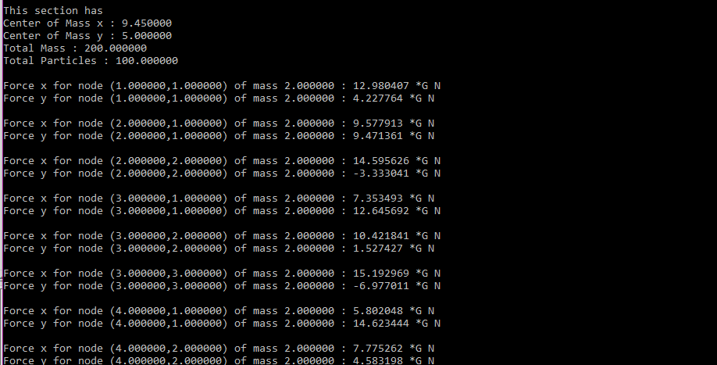
Output of the Barnes-Hut Algorithm
We can see a
Screenshot of
output screen
displaying the force
on each particle.

Slide 13
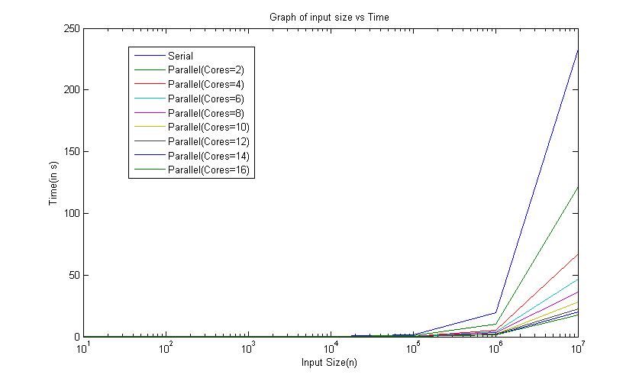
Results And Analysis through Graphs
Static Scheduling - Input Size vs Time

Slide 14
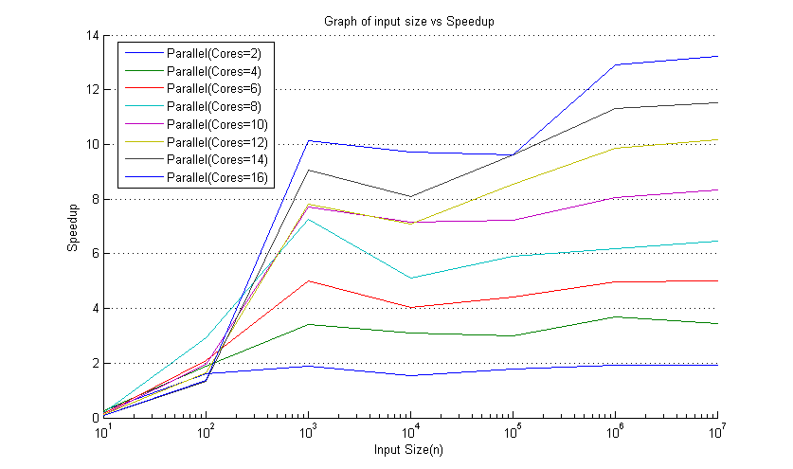
Results And Analysis through Graphs
Static Scheduling - Input Size vs Speed Up

Slide 15
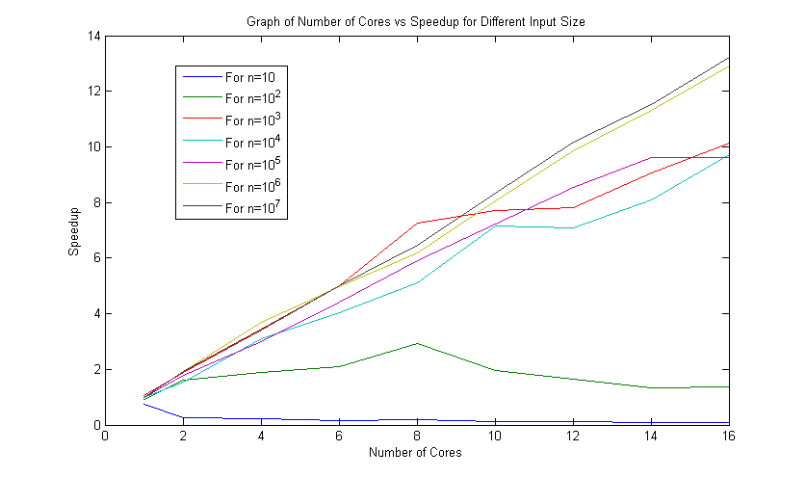
Results And Analysis through Graphs
Number of Cores vs Speed up

Slide 16
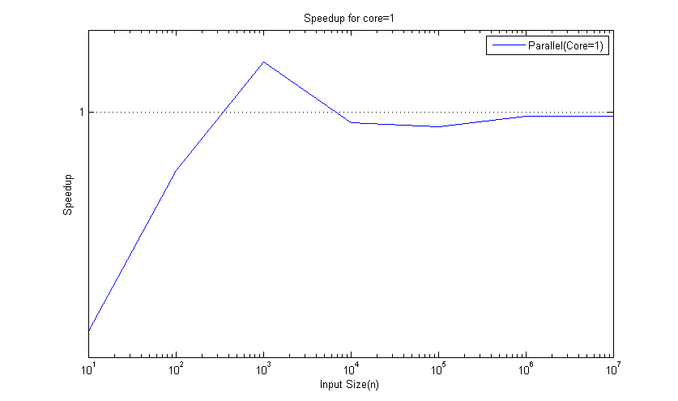
Results And Analysis through Graphs
Serial vs Parallel (Core = 1) i.e. Parallel Overhead

Slide 17
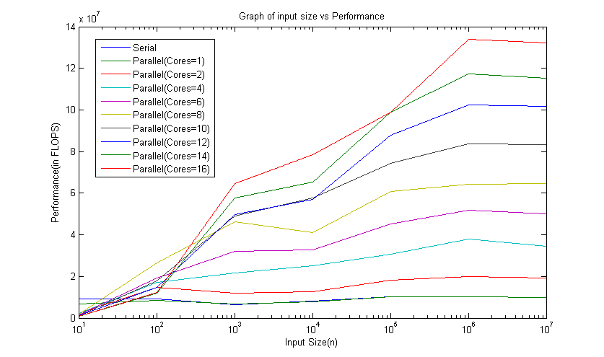
Results And Analysis through Graphs
Input Size vs Performance

Slide 18
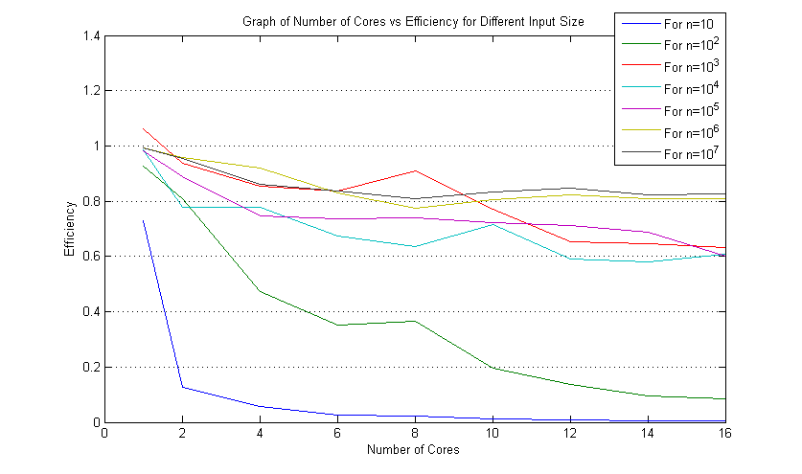
Results And Analysis through Graphs
Number of Cores vs Efficiency

Slide 19
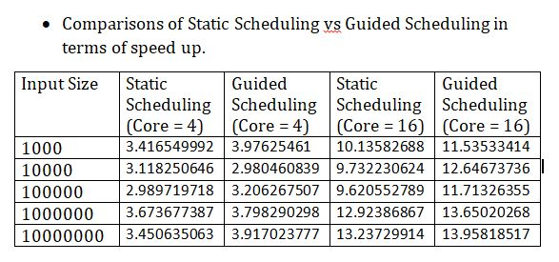
Comparison:
Static/Dynamic vs Guided Scheduling

