Slide 1

Computer Vision-Based Body Weight Estimation of Dairy Cattle
A Deep Learning Approach for Indian Smallholder Dairy Systems
Nisarg Vakharia | Faculty Guide: Dr. Jayashree Prasad
Experiential Learning — MIT School of Computing

Slide 2






Domain & Motivation
Feeding & Nutrition
Health & Breeding
The Measurement Gap
Accurate body weight is critical for making precise feeding decisions, optimizing nutritional intake, and ensuring healthy livestock development.
Weight tracking aids in determining optimal breeding times and supports active monitoring of animal health and medical dosages.
Smallholder farms lack access to expensive weighing scales. Manual tape measurement is labor-intensive, stressful to animals, and often inaccurate.

Slide 3

Existing Literature Overview
Year | Methodology Focus | Key Results & Accuracy
2018 | Top-view 3D camera; extract hip height & width | RMSEP ~41 kg (approx. 5.2% of mean body weight)
2020 | CNN models analyzing beef cattle images | CNN architecture performed best with MAE of 23.19 kg
2023 | 3D contour features using Random Forest/CatBoost | Correlation r = 0.94, RMSE 33 kg, MAPE 4.0%
2024 | RGB-D depth images & semantic segmentation | RGB-D fusion yielded high accuracy: MAE 14.35 kg

Slide 4


Identified Research Gaps
Hardware Dependency
Smallholder Applicability
The vast majority of existing methods rely heavily on 3D or depth cameras (RGB-D sensors). This equipment is too expensive and fragile for rural, resource-constrained environments.
Current datasets are highly controlled and collected in commercial research barns. There is a lack of simple, field-worker-friendly tools designed specifically for the unique conditions of Indian smallholder farms.

Slide 5
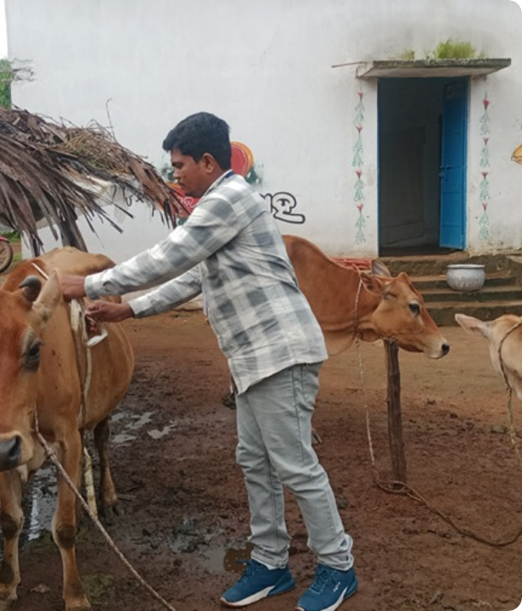
Question & Hypothesis
Research Question
Can standard 2D smartphone images accurately estimate the body weight of dairy cattle in smallholder farms using deep learning?
Hypothesis
Deep learning segmentation and morphometric feature extraction (length, height, girth, area) from a single 2D image will yield a highly accurate weight prediction model, overcoming the need for 3D hardware.

Slide 6

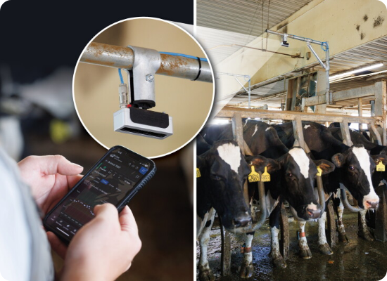
Proposed Solution & Scope
•
System Architecture: An end-to-end pipeline covering Image Preprocessing → Cattle Segmentation → Morphometric Feature Extraction → Weight Prediction.
•
Hardware Independence: Utilizes standard smartphone photos, eliminating the need for expensive 3D cameras or physical animal restraint.
•
Accessible Interface: Delivered through a lightweight web portal, empowering field workers to obtain instant estimations.
•
Future Expansion: The framework can easily be extended to buffaloes and integrated into a fully native mobile application for offline use.

