Slide 1

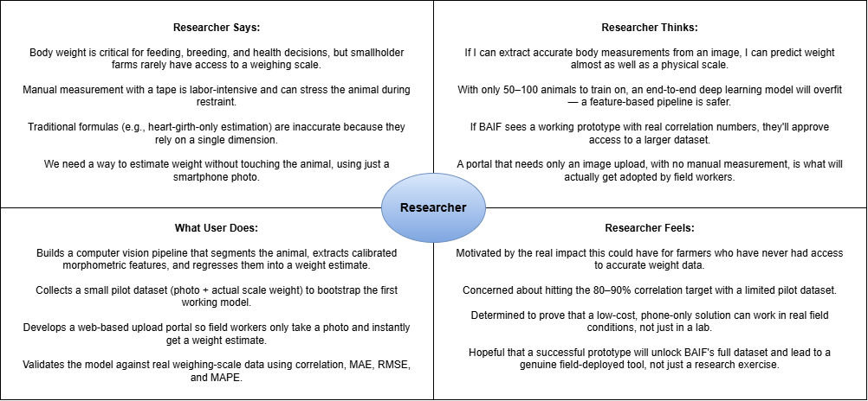
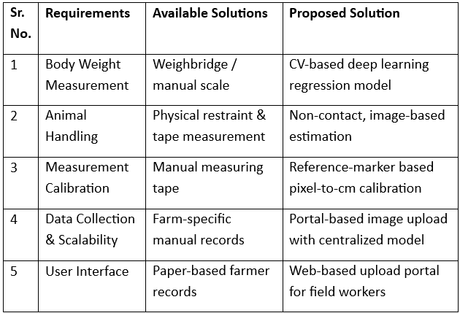
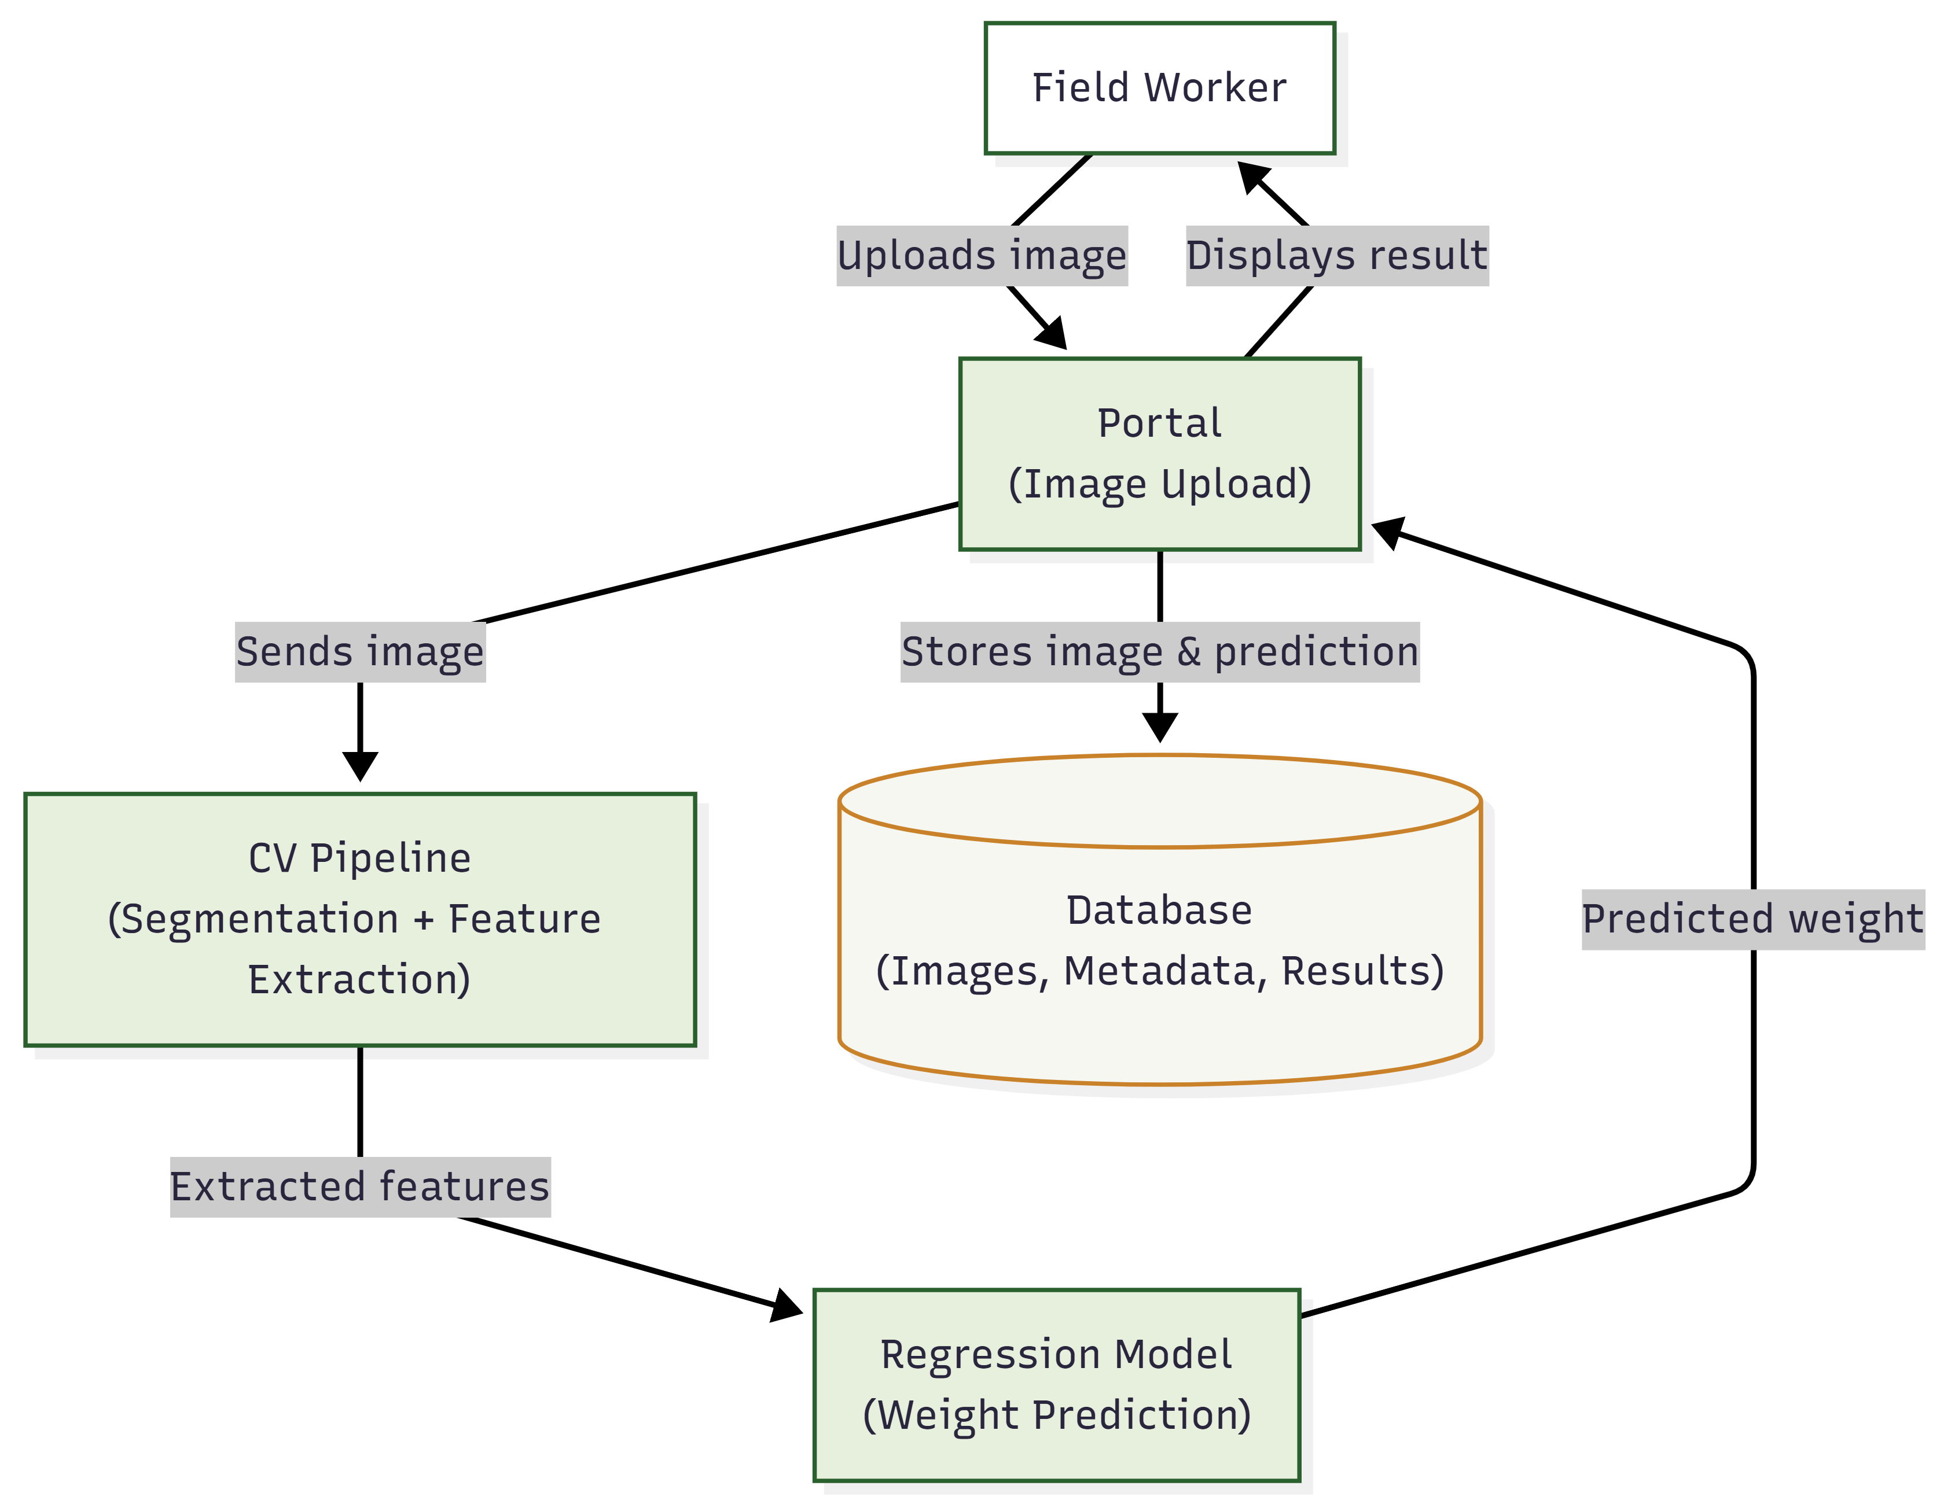
MIT SCHOOL OF COMPUTING
Class : FY MSc.
DEPARTMENT OF COMPUTER SCIENCE & ENGINEERING
Computer Vision-Based Body Weight Estimation of Dairy Cattle
A Deep Learning Approach for Indian Smallholder Dairy Systems
Nisarg Vakharia
Faculty Guide:
Dr. Jayashree Prasad
Proposed Architecture/ Diagram:
Problem Statement
Smallholder dairy farmers rarely have access to weighing scales, so body weight — critical for feeding, breeding, and health decisions — is estimated by eye, often inaccurately, and manual measurement is labor-intensive and can stress animals during handling.
This project develops a computer vision-based system that estimates cattle body weight directly from a smartphone image, without physical contact, specialized hardware, or manual restraint.
Proposed Solution
Segment the animal from a smartphone image using a deep learning model, extract calibrated morphometric features (length, height, girth, area), and regress these into a predicted body weight using a model trained on animals with known actual weight.
Deliver this through a web portal where field workers upload an image and receive an instant weight estimate — no manual measurement needed in routine use.
Scope and Feasibility
Scope: Image-based body weight estimation for dairy cows (buffaloes as a future extension), built and validated on 50–100 animals with actual weighing-scale ground truth.
Feasibility: Fully achievable using open-source CV/ML libraries (OpenCV, PyTorch, scikit-learn), a laptop or free-tier cloud GPU for training, and smartphone-only image capture — no 3D/depth camera hardware required.

