Slide 1
Face Swap (Deep Fake)
19BCE145 Nisarg Patel
19BCE152 Payal Panjwani

Slide 2
Index
Introduction
Data Preparation
Model Architecture
Model Training
Output

Slide 3
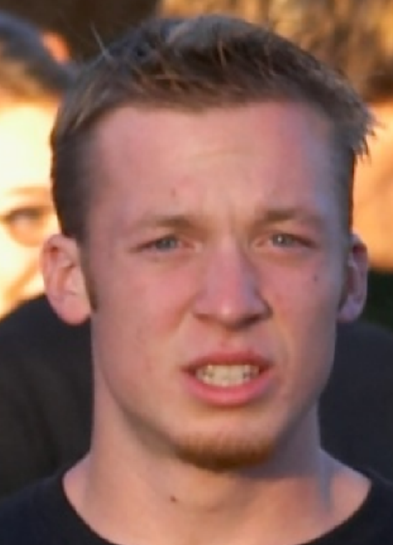
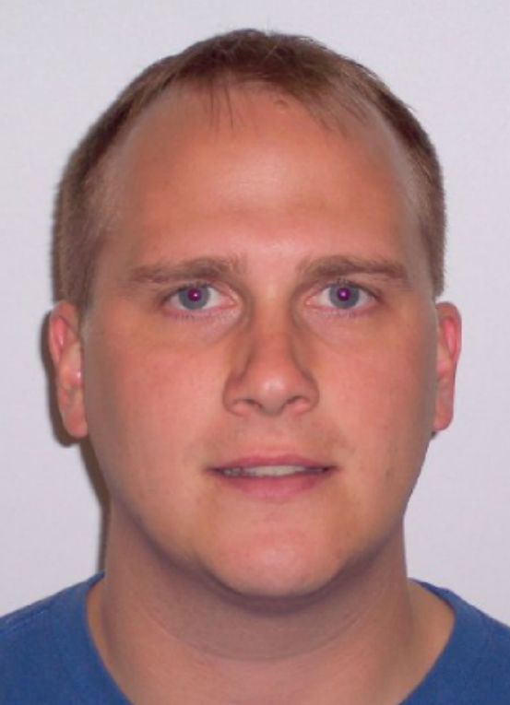
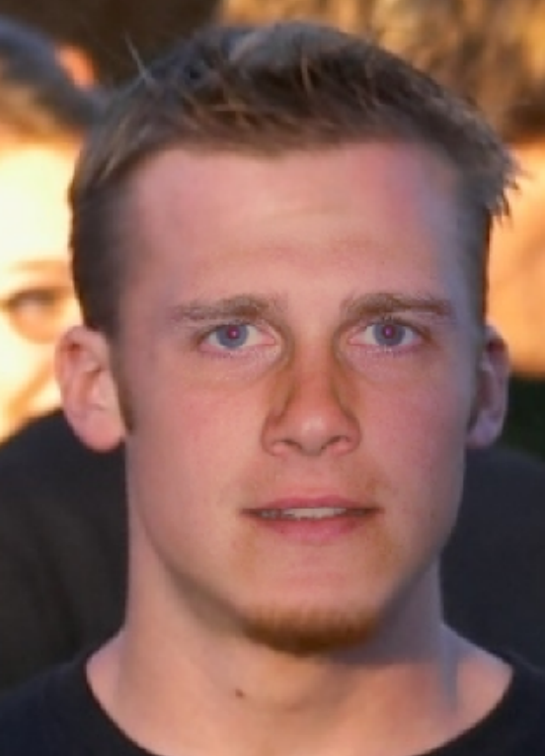
Introduction
Our aim is to convert a facial image into a target image preserving its pose, expression and lightning.
Input Image
Target Subject
Swapped Image

Slide 4
Data Preparation

Slide 5
What we basically did was to extract the faces from the full images.

Slide 6
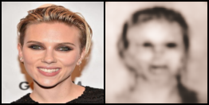
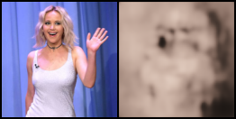
Why ?
Because training on the whole images resulted in the outputs having the correct orientation but distorted shape.
After cropping the images to the face using MTCNN , we applied data augmentation to make our model more robust.
Outputs :

Slide 7
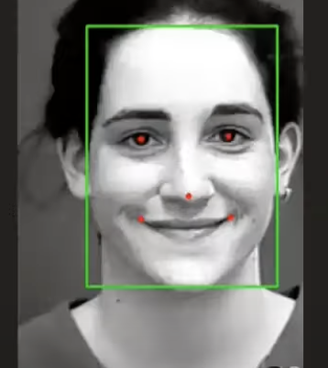
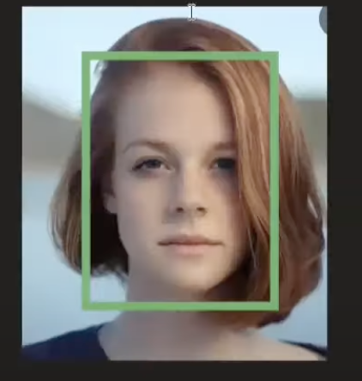
Facial Landmark Detection
Bounding Box Generation
Tasks of MTCNN

Slide 8
Model Architecture

Slide 9
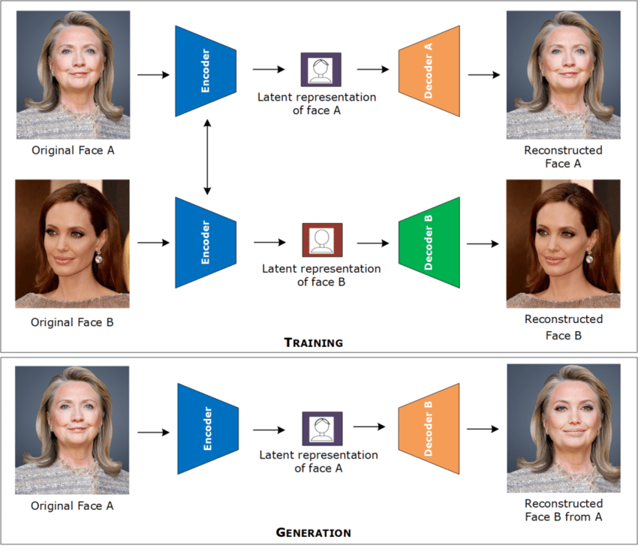
Traditional Approach

Slide 10
Our Approach
To perform the task, we use swap auto-encoders for capturing the latent representation of both the images.
Shared encoding
Decoder A
Image A
Encoder
Latent Representation
Separate Decoding
Decoder B
Image B

Slide 11
Model Training

Slide 12
Training
Generator
Decoder A
SSIM
loss
Shared encoding
Image A
Encoder
Latent Representation
Separate Decoding
Image B
Decoder B
Discriminator
loss
After training them using generator discriminator architecture we decode the original image using the target decoder.
Discriminator
Real / Fake

Slide 13
Output

Slide 14
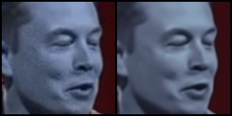
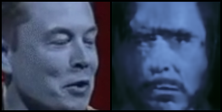
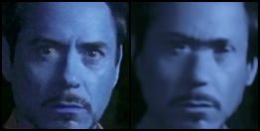
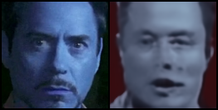
Image A
A swapped with B
Image B
B swapped with A

Slide 15
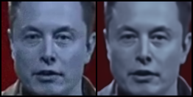
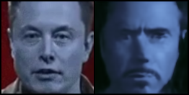
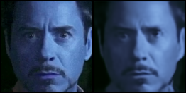
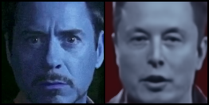
Image A
A swapped with B
Image B
B swapped with A

Slide 16
Conclusion
To conclude we were able to train the model to swap just the face part , for the further work we would be using opencv to superimpose it on the frames of the original video.

