Slide 1


Gujarat University﻿
School of Emerging Science and Technology ﻿
M.Sc. Artificial Intelligence and Machine Learning CC – 314 & 315 Mini-Project Inventory Problem
Topic: Inventory Planning for COVID-19 Supplies (PPE and Ventilators)
Mentor: Dr. Nita Shah
Gautam Chauhan
Name: Leuva Nisarg
(AIML-13)
Enrollment No.:202222700011​
Name: Shastri Mohit
(DS-36)
Enrollment No.:202222600019

Slide 2
Abstract:
This study represents an Inventory Problem Method to maintain stock levels as efficiently as possible. The model is based on the analysis of Re-order Point (ROP) and Economic Order Quantity (EOQ). EOQ determines how many units to order in each cycle of replenishment in order to keep overall inventory costs as low as possible. While Re-order Point (ROP) determines when inventory should be replenished to maintain stock levels and prevent shortages, Visual tools such as pie and bar charts were used to manage inventory effectively.

Slide 3
Introduction:
The COVID-19 Virus led to a sudden rise in demand for critical supplies like Personal Protective Equipment(PPE) and Ventilators.
Managing these supplies became difficult due to unexpected demand and limited resources.

Slide 4
Objective:
The goal of this project is to minimize stock shortage for a hospital by calculating Re-order Point (ROP) and Economic Order Quantity (EOQ) using Inventory Problems Method. Focused on minimizing inventory cost by finding optimal order quantities and timing to balance supply with demand fluctuations

Slide 5
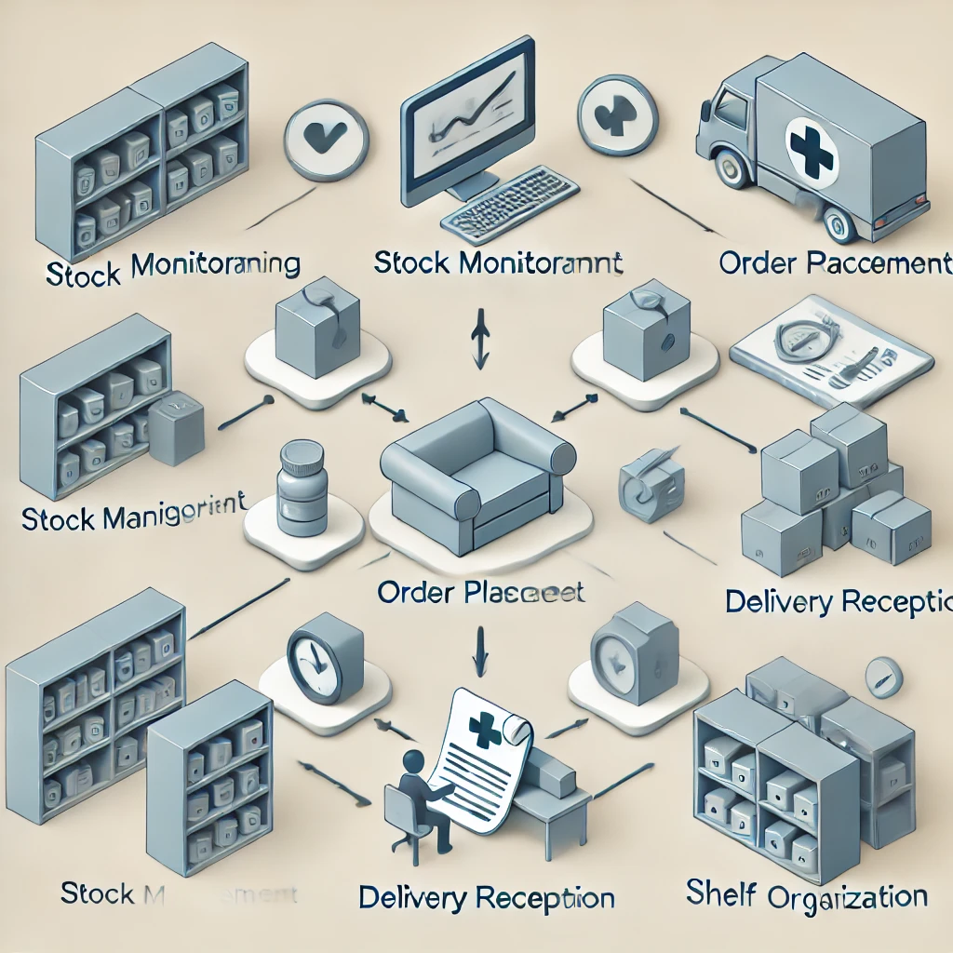
Objective:
Minimizing stock shortage ensures that:
Reliable Supplies: Patients always have what they need.
Efficient Workflow: Fewer rush orders keep operations smooth.
Cost Savings: Avoiding emergency orders reduces extra expenses

Slide 6

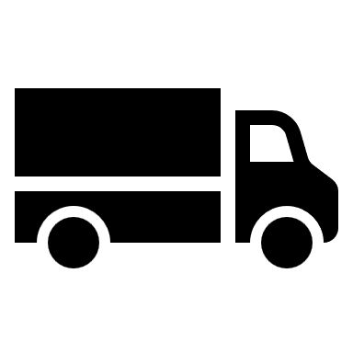
Constrains:
1. Demand Uncertainty:
Due to the outbreak of the COVID-19 virus, the demand for PPE kits and ventilators fluctuates unpredictably.
2. Lead Time Variability:
Due to lockdown, the time required for suppliers to deliver new stock is inconsistent.

Slide 7


Constrains:
3. Storage Capacity Constraints:
Hospitals have limited storage space, overstocking can lead to additional storage costs, while understocking may result in supply shortages.
4. Cost Management Constraints:
Balancing the cost of supply is crucial. Ordering too frequently increases its costs, where bulk order can lead to higher holding costs.

Slide 8
Literature Review:
The problem of minimizing stock shortages has been a critical area of study in Inventory Problems.
Several studies and methodologies have been developed to tackle challenges in managing inventory, such as minimizing shortages, reduce holding cost and addressing real-world constraints like Demand Uncertainty, Lead Time Variability, Storage Capacity Constraints and Cost Management Constraints
Here are some significant contributions from the literature:

Slide 9
Literature Review:
1.
YEAR & AUTHOR | Title | OBJECTIVE | CONTRIBUTION | CONCLUSION
1913, Harris | Factory, The Magazine of Management. | To determine an optimal order quantity that minimizes total inventory costs. | Introduced the Economic Order Quantity (EOQ) model by balancing ordering and holding costs. | EOQ effectively minimizes overall inventory costs.
2.
YEAR & AUTHOR | Title | OBJECTIVE | CONTRIBUTION | CONCLUSION
2021, Gupta, et, al. | Competence-Based Supply Chain Management in the Age of Pandemics. | To optimize PPE and ventilator inventory during COVID-19 | Dynamic EOQ/ROP models tailored for pandemic-driven demand surges. | Dynamic models reduce shortages by 32% compared to static approaches.

Slide 10
Methodology:
Data Input:
Data Sources:
Two CSV files are used:
PPE KIT data
Ventilator data
Each file contains monthly records with fields such as stock level, demand, lead time, and safety stock.
Data Extraction:
Use the Pandas library to load the data.

Slide 11
Methodology
Data Sources - 1.PPE KIT Data:
Month | Stock (PPE) | Demand (PPE) | Lead Time (PPE) | Safety Stock (PPE) | RE-order without safety stock
April | 50000 | 12500 | 2 | 5000 | 25000
May | 37500 | 7550 | 1 | 1510 | 7550
June | 29950 | 5000 | 1 | 1000 | 5000
July | 44950 | 7000 | 1 | 1400 | 7000
August | 37950 | 4000 | 2 | 1600 | 8000
September | 62390 | 10000 | 2 | 4000 | 20000
October | 52390 | 6000 | 2 | 2400 | 12000
1:re order without=demand * lead time
2:ss=(0.2*re-order without)

Slide 12
Methodology
Data Sources – 2.Ventilator Data:
Month | Stock | Demand | Lead Time | Safety Stock | RE-order without safety stock
April | 25000 | 7000 | 2 | 2800 | 14000
May | 18000 | 5000 | 1 | 1000 | 5000
June | 13000 | 8000 | 1 | 1600 | 8000
July | 19000 | 1000 | 1 | 2000 | 10000
August | 14000 | 4000 | 2 | 1600 | 8000
September | 10000 | 6000 | 2 | 2400 | 12000
October | 12000 | 2000 | 2 | 4000 | 20000

Slide 13
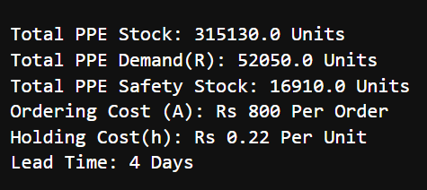
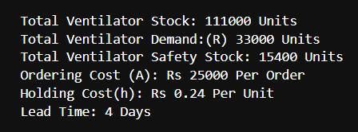
Inventory Calculations:
Total Demand, Stock, and Safety Stock:
Sum the relevant columns for each item (PPE and Ventilators) to obtain Total Stock, Total Demand, and Total Safety Stock over the period.

Slide 14

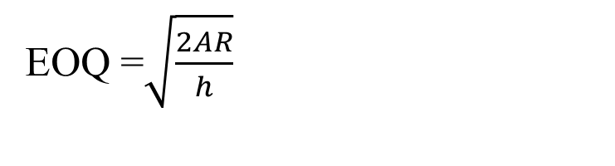
Inventory Calculations:
II. Calculates EOQ with the formula:
where,
R = Total Demand
A = Ordering Cost
h = Holding Cost
This determines the Economic Order Quantity(EOQ) that minimizes the cost of ordering and holding inventory.
EOQ =$\sqrt{\frac{2AR}{h}}$

Slide 15
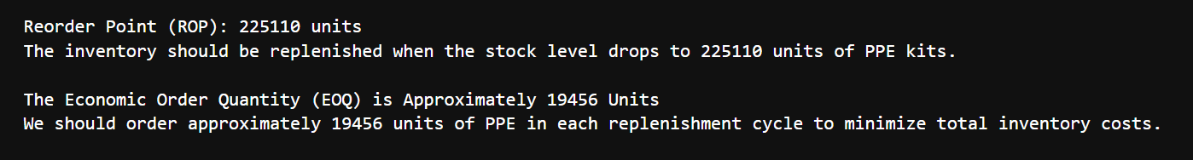
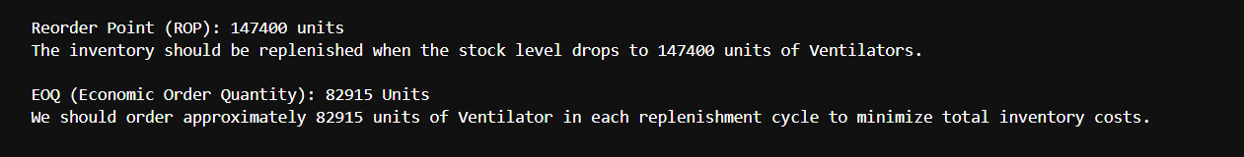

Inventory Calculations:
III. Calculates Re-Order Point(ROP) with the formula:
$\text{ROP}=\left(Total Demand ×Lead Time\right)+ Total Safety Stock$
This indicates when to place a new order to replenish the inventory.

Slide 16
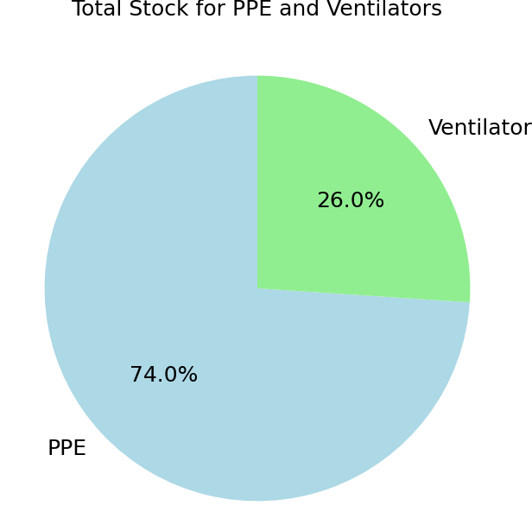
3) Visualization:
Pie Chart: Displays the proportion of Total stock between PPE and Ventilators in Inventory. This helps in understanding the allocation of resources and ensuring balanced stock levels.

Slide 17
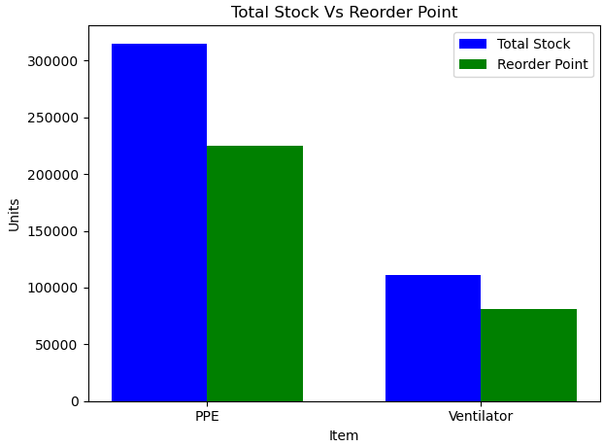
3) Visualization:
II. Bar Chart: Comparing the Total Stock v/s Reorder Point, makes easy to spot shortages.

Slide 18
4) Code Structure:
Data Loading
Load the Data using pandas Library
Calculate Total
Calculate Total
Computation
Compute EOQ and ROP
Display Results
Display EOQ and ROP Values and Charts

Slide 19
Conclusion:
This study optimizes inventory management for PPE and Ventilator Supplies using Inventory Problems Method by calculating Re-order Point (ROP) and Economic Order Quantity (EOQ), The model prevents inventory from shortages.
Visual Insights:
Pie and bar charts provide clear stock distribution and reorder point comparison

Slide 20
References:
Harris, F. W. (1913). How Many Parts to Make at Once. Factory, The Magazine of Management.
Article Link: https://www.scirp.org/reference/referencespapers?referenceid=1812416
2. Gupta, V., Ivanov, D., & Choi, T. M. (2021). Competence-Based Supply Chain Management in the Age of Pandemics. International Journal of Logistics Management.
3. Istiningrum, A. A., Sono, S., & Putri, V. A. (2021). Inventory Cost Reduction and EOQ for Personal Protective Equipment.
Retrieved from:
10.31334/logistik.v5i2.1880
4. Holistiquetraining.com. (2024). Economic Order Quantity (EOQ): Definition, Formula & Benefits. Retrieved from:
https://holistiquetraining.com/en/news/economic-order-quantity-eoq-definition-formula-benefits

