Slide 1
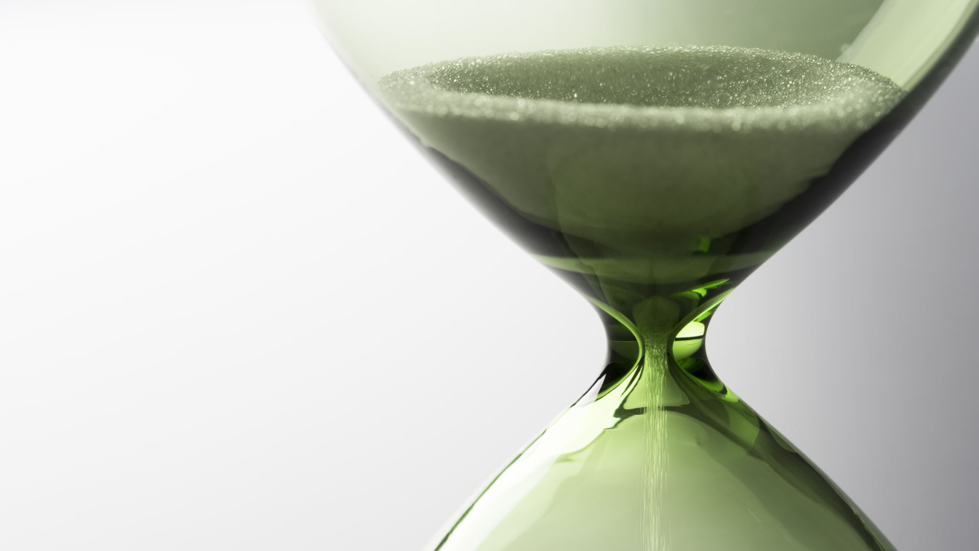
KRONOS Because you value 'TIME'
Features implemented till now:-
Body Framework added – Navbar, Carousel, Footer, Product Cards
Basic CSS implemented
Images included

Slide 2
KRONOS Because you value 'TIME'
Changes made in proposed features:-
No changes yet
Extra added features:-
Modal added to Login/SignUp
Features to be added:-
Customization Feature
Transparent Modal
Collapsible Menu Bar
Add to Cart
Improvement in UI

