Slide 1


UI/UX Assignment 02:
Personas and User Journey
Domain: UPI Payment Apps (GPay, PhonePe, Paytm)
Name: Nisarg Malhotra
PRN: 1262243207
TY AI_DS Panel-F Batch-F2

Slide 2
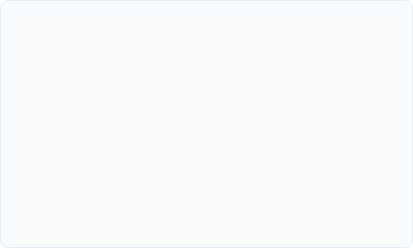
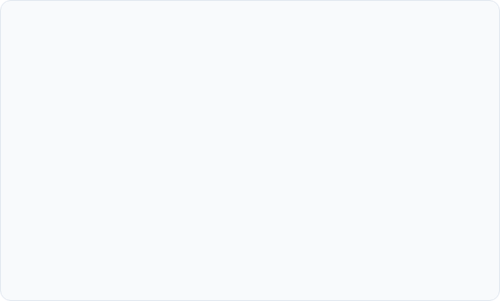
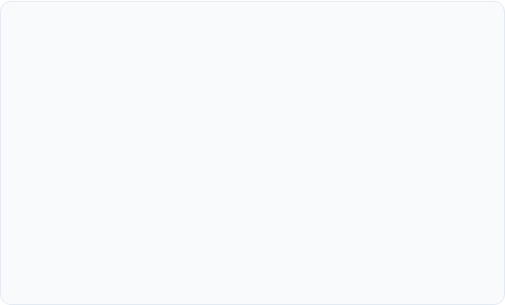
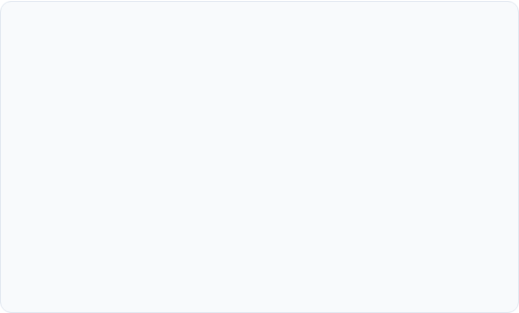
Empathy Map
Understanding the mindset of everyday UPI payment app users
SAYS
THINKS
•
"Did you receive the money?"
•
Wonders if their money is safe when the network drops mid-transaction.
•
"Why did the layout change again?"
•
"Scan my code, my camera isn't working."
•
Believes the app assumes everyone knows how to read English fluently.
•
"It says processing, should I pay again?"
•
Worries that a slightly different UI means they clicked a spam link.
DOES
FEELS
•
Double-checks the receiver's name out loud before entering the PIN.
•
Anxious about typing the wrong PIN in a crowded space.
•
Relies completely on the merchant's soundbox for payment confirmation.
•
Relieved the moment they hear the confirmation chime.
•
Frustrated and overwhelmed by pop-up ads and dense mini-app menus.
•
Sticks strictly to the "Scan QR" button and ignores all other features.

Slide 3



Payment App Practitioner
User Pain Points in Modern UPI Interfaces
1
Clutter Obscures Core Actions
2
Layout Instability
Users open the app simply to pay, but are bombarded with loans, games, and ads. The core action gets buried, leading to cognitive overload.
Constant UI updates completely break the spatial memory of semi-literate users who rely heavily on muscle memory to navigate the app.
3
Ambiguous Error States
4
Over-reliance on Text
When a payment says "Processing", users panic. Unclear guidance leads them to hit 'pay' again, resulting in stressful duplicate transactions.
Critical financial alerts rely on tiny English text rather than universally understood visual cues or color codes, alienating non-fluent users.

Slide 4
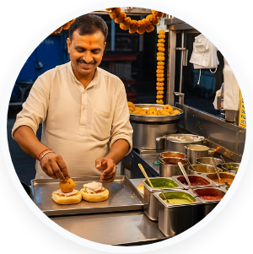
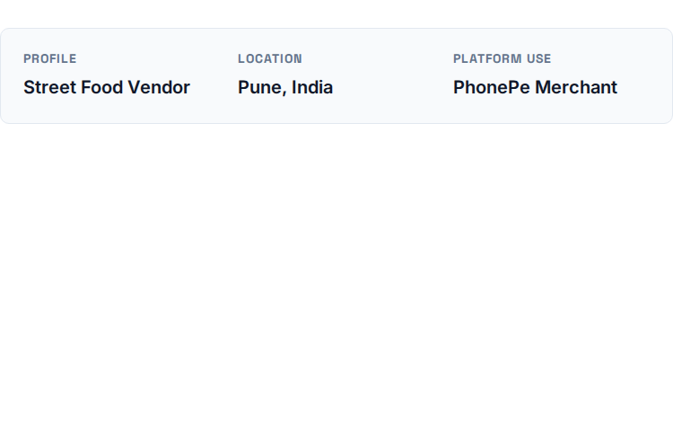
Personas
Domain: UPI Payment Apps
Goals
Frustrations
•
Instant, undeniable confirmation that a payment was received.
•
Customers showing fake screenshot confirmations.
•
An interface that requires zero reading during peak rush hours.
•
Network drops causing the speaker to delay its announcement.
Raju Sharma
"Just scan the code and show me the green tick, I am busy."
•
Clear, loud audio cues via the smart speaker (Soundbox).
•
Small text on the phone screen that is hard to read in sunlight.

Slide 5

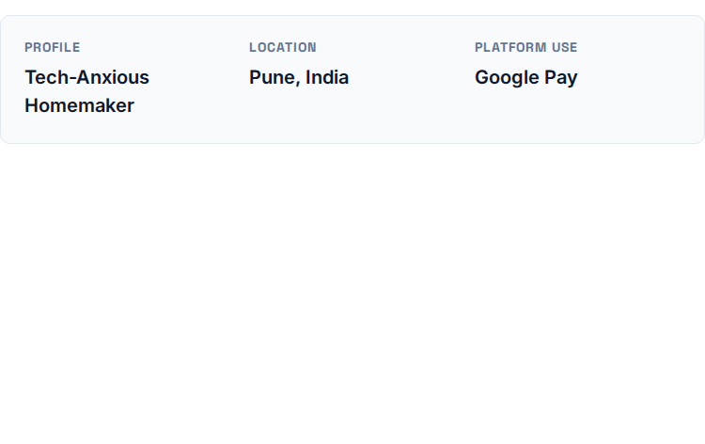
Personas
Domain: UPI Payment Apps
Goals
Frustrations
•
Absolute confidence that her money is going to the correct person.
•
Too many unfamiliar buttons on the screen make her nervous.
Sunita Patel
•
A simple, unchanging interface that she can memorize visually.
•
Fear of accidentally clicking the wrong thing and losing her money.
"I always double-check the phone number with my son before pressing send."
•
Easy access to recurring payments like electricity and dish TV.
•
Error messages that use confusing technical banking terms.

Slide 6

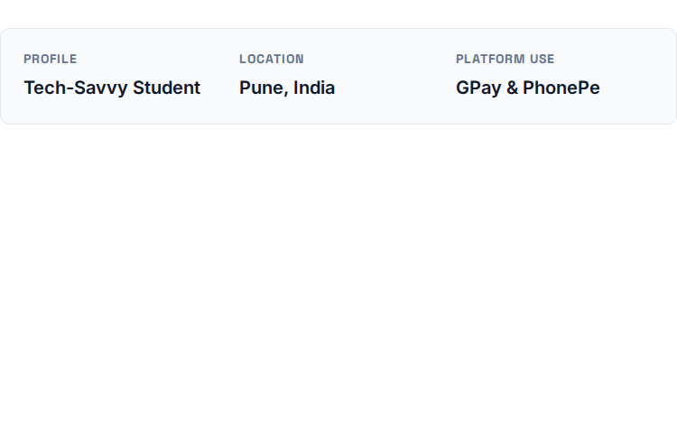
Personas
Domain: UPI Payment Apps
Goals
Frustrations
•
A lightning-fast way to scan, pay, and get out of the checkout line.
•
Apps that take too long to load due to heavy promotional graphics.
•
Seamless tools to split dinner bills and cab fares with friends.
•
Having to manually calculate splits outside of the payment app.
Aditi Desai
"I use GPay for friends and PhonePe for stores, whichever opens faster."
•
An easy way to track her monthly allowance and spending habits.
•
Awkwardly waiting to ensure a friend received a transferred amount.

Slide 7

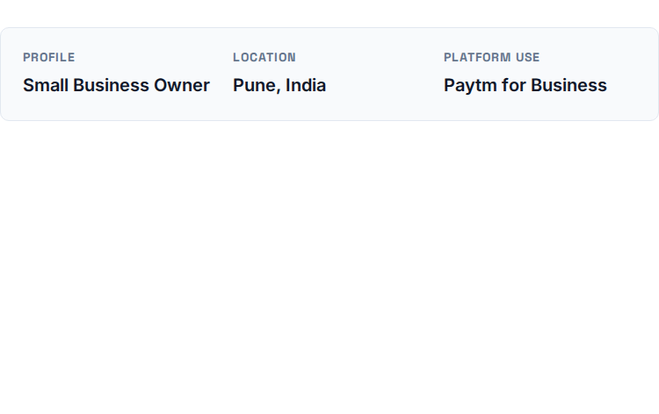
Personas
Domain: UPI Payment Apps
Goals
Frustrations
•
A clear, accessible daily ledger to match with physical cash registers.
•
Business dashboards cluttered with unrelated consumer loan ads.
•
Instant settlements directly to his connected bank account.
•
Hidden transaction fees for certain types of credit card scans.
Vikram Singh
"I need to know my end-of-day settlement without digging through menus."
•
One-click tools for initiating customer refunds securely.
•
Delayed settlements that disrupt his cash flow for the next day.

Slide 8

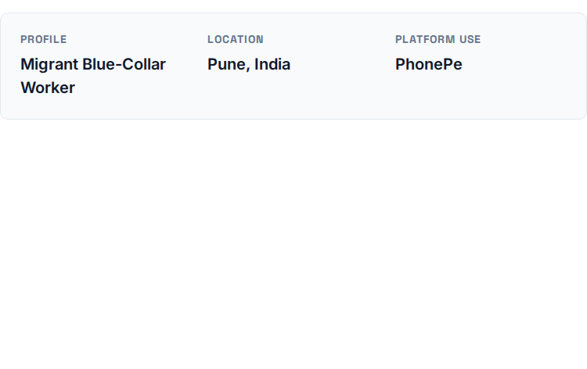
Personas
Domain: UPI Payment Apps
Goals
Frustrations
•
An app that works flawlessly on a budget smartphone with 3G speeds.
•
Heavy animations causing the app to freeze mid-transaction.
Rahul Kumar
•
A simple, visual interface that supports regional languages (Hindi).
•
Error prompts displayed entirely in technical English.
"I just want to send money to my village without the app hanging."
•
Clear feedback if a transaction is pending or failed.
•
Fear of losing a day's wages to a glitchy server timeout.

Slide 9




User Journey Map
Persona: Raju (Street Food Vendor)
ACTION
TASK LIST
FEELING
OPPORTUNITY
•
Handling peak rush hour at the stall.
•
Hands over the food package.
•
Rushed and highly focused.
•
Implement a full-screen visual flash (Bright Green/Red) on the phone screen.
•
Customer scans the QR code to pay.
•
Points to the printed QR code.
•
Anxious when there is a delay in the network.
•
Allows him to verify success from a distance without needing to read any text.
•
Waiting for the payment confirmation.
•
Listens for the speaker announcement.
•
Relieved instantly by the audio confirmation.
•
Moving quickly to the next customer.
•
Interrupts workflow to check phone screen if the speaker fails.

Slide 10



User Journey Map
Persona: Sunita (Homemaker)
ACTION
TASK LIST
FEELING
OPPORTUNITY
•
Decides to pay the monthly electricity bill.
•
Opens app and navigates to 'Bills'.
•
Nervous about making a typo.
•
Auto-fetch connected household billers via her registered phone number.
•
Enters the complex consumer number.
•
Types the 12-digit number very carefully.
•
Cautious before hitting the final button.
•
Eliminates the fear of manual data entry errors completely.
•
Types in her secret UPI PIN.
•
Asks her son to verify the name on the screen.
•
Confused and scared if it hangs on processing.
•
Encounters a "Processing" screen.
•
Presses pay and waits anxiously.

Slide 11
User Journey Map
Persona: Aditi (College Student)
ACTION
TASK LIST
FEELING
OPPORTUNITY
•
Finishes dinner with a group of friends.
•
Pays the full bill at the restaurant counter.
•
Generous for covering the initial bill.
•
A built-in, automated bill-splitting workflow that pops up directly on the transaction success screen.
•
Calculating who owes what for the meal.
•
Opens phone calculator to divide the total by 4.
•
Annoyed by the manual math and switching apps.
•
Sending out payment requests.
•
Opens UPI app to manually send 3 requests.
•
Frustrated having to remind friends to pay.
•
Tracking who has paid her back.
•
Checks app daily to see pending requests.

Slide 12
User Journey Map
Persona: Vikram (Shopkeeper)
ACTION
TASK LIST
FEELING
OPPORTUNITY
•
Closing the shop late at night.
•
Opens the Merchant specific app.
•
Exhausted from a long day of work.
•
A clean, ad-free merchant dashboard that opens directly to the day's ledger.
•
Tallying the day's digital payments.
•
Navigates past promotional loan banners.
•
Focused on ensuring the numbers match exactly.
•
Remove all consumer-facing clutter from the B2B app.
•
Checking the bank settlement status.
•
Satisfied once the settlement is confirmed.
•
Finds the daily total and compares it with the physical cash register.
•
Locking up and going home.

Slide 13
User Journey Map
Persona: Rahul (Migrant Worker)
ACTION
TASK LIST
FEELING
OPPORTUNITY
•
Receives monthly salary in cash/account.
•
Opens app and waits patiently for heavy UI to load.
•
Happy to be sending support home.
•
Introduce a 'Lite' mode that disables heavy graphics and animations.
•
Opening app on a weak 3G connection.
•
Tense during the slow loading animations.
•
Scrolls to find the correct saved contact.
•
Ensures lightning-fast loading on low-end smartphones and poor networks.
•
Selecting family contact back in the village.
•
Massively relieved when the success tick appears.
•
Enters the amount and PIN.
•
Initiating the money transfer.
•
Prays the network holds during the processing phase.

Slide 14
Thankyou

