Slide 1
Audio Sentiment Detection System
Emotion Detection through Speech using NLP

Slide 2
Introduction
AI systems are increasingly designed to understand human emotions.
Speech is a natural medium that conveys emotional cues.
System detects emotions from speech in real time.
Uses speech recognition, sentiment analysis (VADER), and TTS.

Slide 3
Objectives
Capture speech from the user.
Convert speech to text using recognizer.
Analyze sentiment and classify emotion.
Generate verbal feedback based on emotion.
Enable real-time interaction loop.

Slide 4
Functional Requirements
Speech Recognition
Sentiment Analysis
Emotion Classification
Contextual Response Generation
Real-Time Processing
Exit Command Detection

Slide 5
Non-Functional & Hardware Requirements
Accuracy and Responsiveness
Usability and Modularity
Processor: Dual-core 2.0 GHz+
RAM: 4 GB minimum
Microphone and Audio Output required

Slide 6
Software Requirements
OS: Windows / Linux / macOS
Python 3.7 or higher
Libraries: speech_recognition, nltk, pyttsx3, pyaudio
Development Tool: PyCharm
Internet for Google Speech API

Slide 7
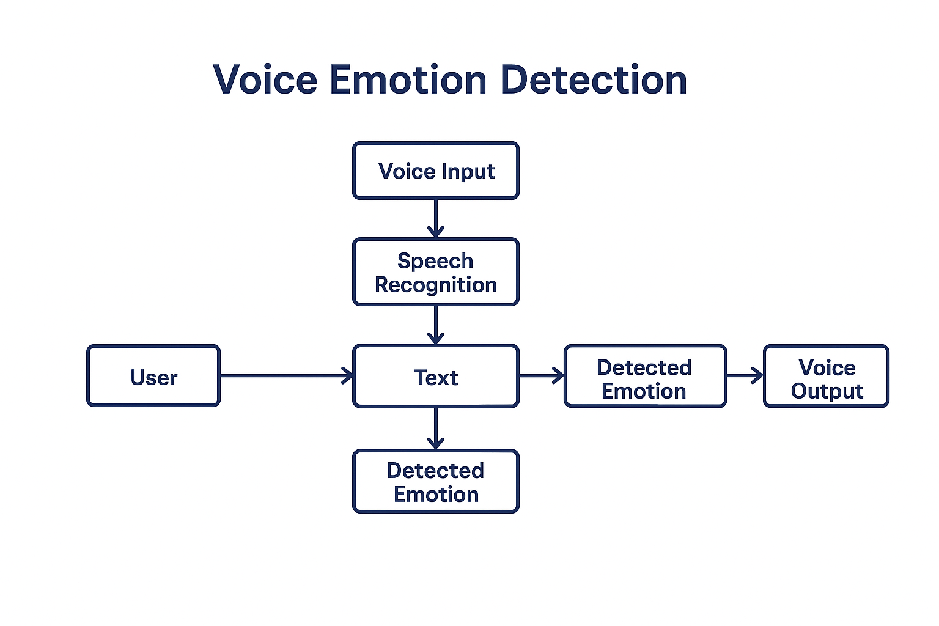
System Architecture

Slide 8
Module Breakdown
Speech Input Module: Captures and transcribes speech
Sentiment Analysis Module: Uses VADER to analyze sentiment
Emotion Mapping Module: Maps score to emotion
Response Generation Module: Converts response to speech
Command Listener: Detects exit/quit

Slide 9
Code Logic Overview
Use speech_recognition to capture voice
Use VADER from nltk to get sentiment score
Map score to emotion (e.g., happy, calm, sad)
Use pyttsx3 for spoken response
Loop runs until 'exit' or 'quit' is spoken

Slide 10
Testing and Results
Input: 'I am feeling awesome today!' → Detected: Happy
Input: 'Just a normal day.' → Detected: Calm
Input: 'It’s been a tough day.' → Detected: Sad
Input: 'Why is everything going wrong?!' → Detected: Angry
Accurate and responsive in controlled environments

Slide 11
Conclusion
Successfully detects emotional tone from voice input.
Provides real-time, spoken feedback.
Applications: virtual assistants, mental health, customer support.
Future work: multi-language support, deeper emotion modeling, personalization.

