Slide 1
MUTUAL FUND ANALYTICS PLATFORM
End-to-End Data Engineering • Performance Analytics • Risk • Investor Intelligence
Bluestock Fintech Capstone
40 mutual-fund schemes • 10 datasets
Prepared by: Nisarga P
Bluestock Fintech | Mutual Fund Analytics Capstone

Slide 2
01 | CONTEXT
02
Problem, Business Need & Objectives
DATA FRAGMENTATION
PERFORMANCE GAP
BENCHMARK BLIND SPOT
NAV, AUM, SIP and holdings arrive in different formats and locations.
Raw NAV does not provide risk-adjusted comparison across funds.
Investors need benchmark-relative performance and tracking error.
INVESTOR BLIND SPOT
SLOW REPORTING
OBJECTIVE
• Build a reproducible ETL pipeline
• Design a normalized SQLite data layer
• Perform deep EDA and quantify risk-adjusted performance
• Analyse investor behaviour and portfolio concentration
• Present insights through an interactive Power BI dashboard
Demographic, geographic and SIP behaviours need structured analysis.
Static reporting needs a refreshable self-service BI layer.
Source: Bluestock capstone brief + project datasets / executed analysis

Slide 3
02 | DATA
03
Data Sources & Dataset Inventory
SCHEMES
NAV ROWS
TRANSACTIONS
BENCHMARK ROWS
40
46,000
32,778
8,050
Fund master
Daily NAV history
Synthetic investor records
Daily index values
01
Fund Master
02
NAV History
Scheme, AMC, category, benchmark, expense ratio, risk grade
Daily NAV from Jan-2022 to May-2026
03
AUM by Fund House
04
Monthly SIP Inflows
Quarterly AMC AUM across 10 fund houses
SIP flows, active accounts, new registrations
05
Category Inflows
06
Industry Folios
Net flows by category
Total folios and category breakdown
07
Scheme Performance
08
Investor Transactions
Return, Sharpe, Sortino, Alpha, Beta, drawdown
SIP, lumpsum, redemption + demographics
09
Portfolio Holdings
10
Benchmark Indices
Stock, sector and weight %
NIFTY 50/100, Midcap, BSE, CRISIL
Source: Bluestock capstone brief + project datasets / executed analysis

Slide 4
03 | ENGINEERING
04
System Architecture & ETL Pipeline
EXTRACT
TRANSFORM
LOAD
ANALYSE
VISUALISE
AMFI • mfapi.in • NSE/BSE • supplied CSVs
Pandas • validation • joins • daily returns • cleaning
SQLite • star schema • indexed facts/dimensions
EDA • performance • risk • cohorts • HHI
Power BI • KPIs • slicers • drill-through
5-TABLE STAR SCHEMA
QUALITY & REPRODUCIBILITY
dim_fund • dim_date • fact_nav • fact_transactions • fact_performance
Validate AMFI codes • handle missing NAVs • standardise types • separate raw / processed / database / reports
Source: Bluestock capstone brief + project datasets / executed analysis

Slide 5
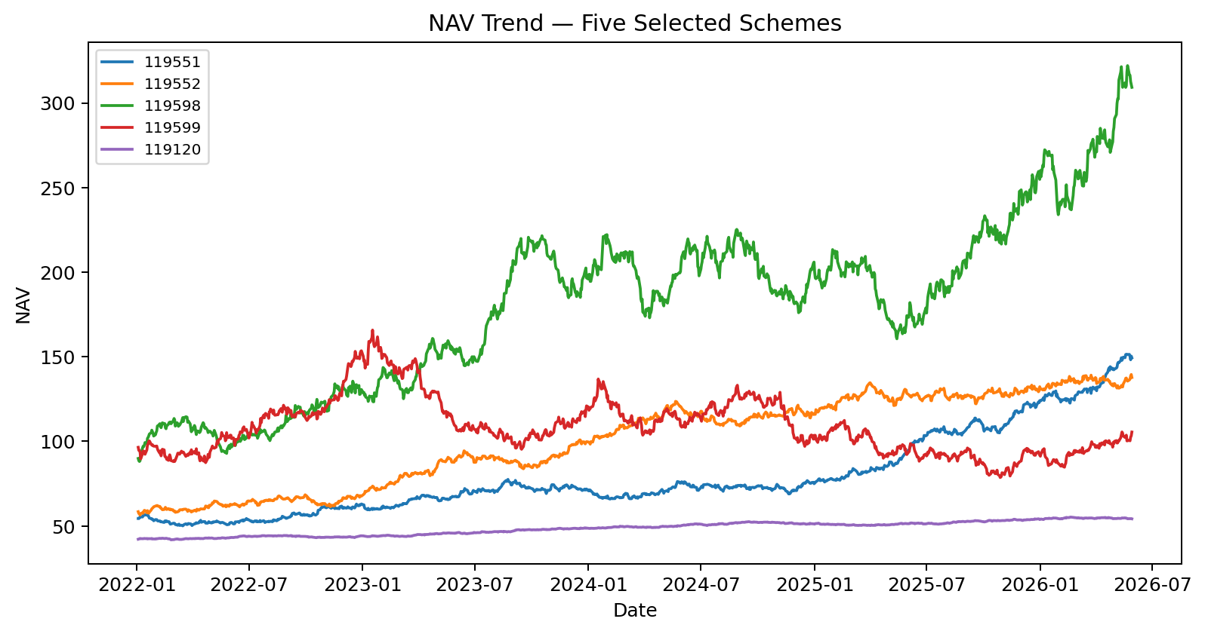
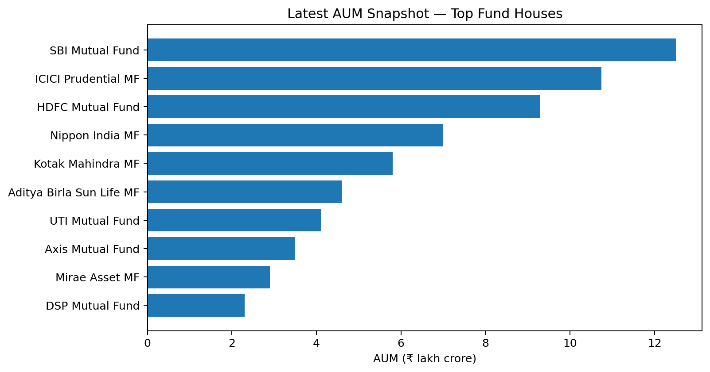
04 | EXPLORATORY ANALYSIS
05
EDA Highlights — Market & Fund Behaviour
NAV DATA QUALITY
FOLIO GROWTH
SIP MILESTONE
46,000 rows
13.26 Cr → 26.12 Cr
₹31,002 Cr
40 funds • no missing / duplicate fund-date records in executed checks
Jan-2022 to Dec-2025
Dec-2025 all-time high in project dataset
Source: Bluestock capstone brief + project datasets / executed analysis

Slide 6
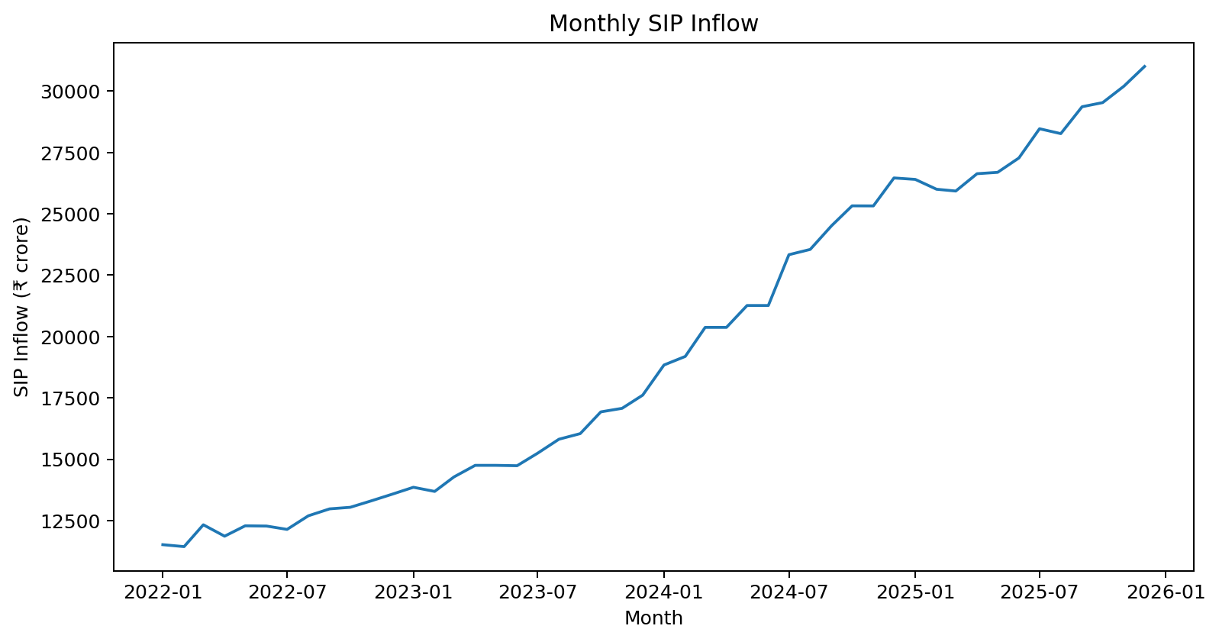
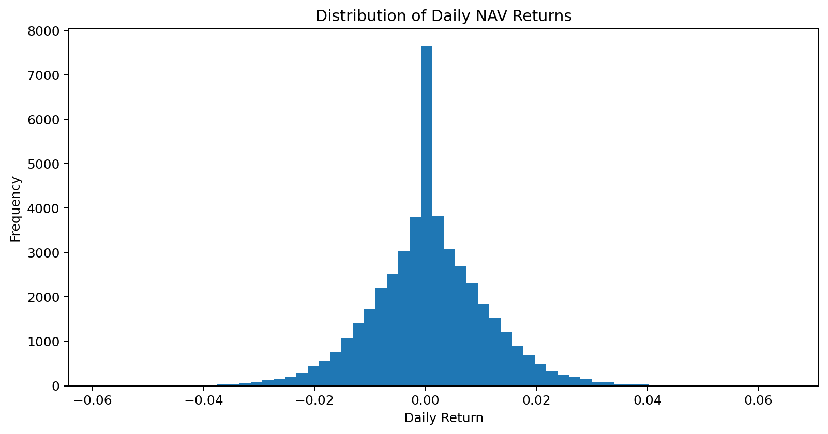
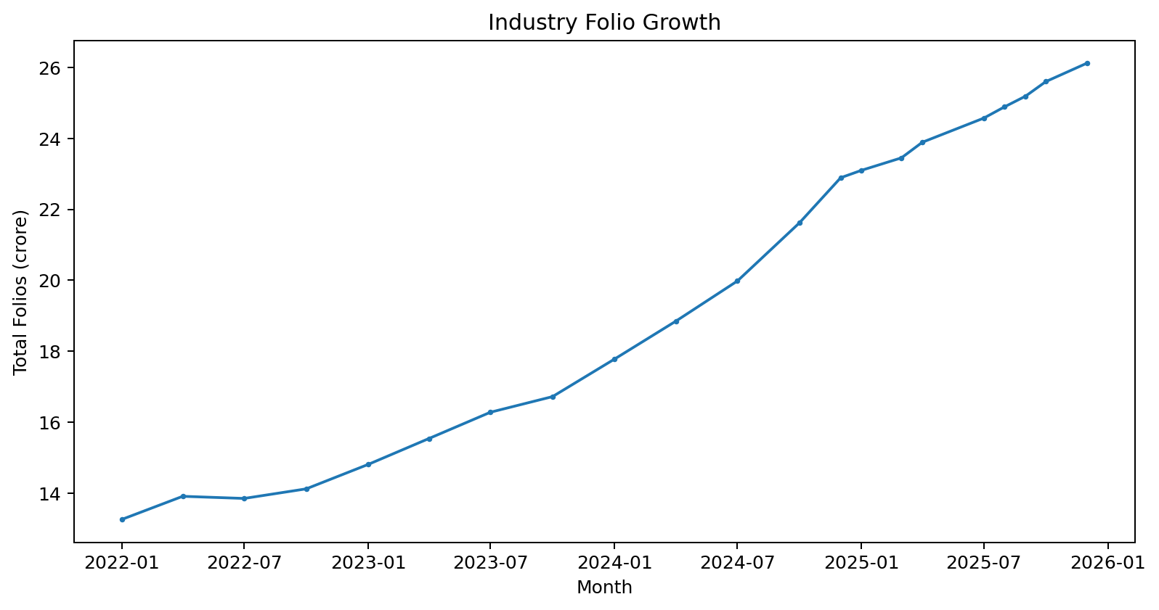
05 | EXPLORATORY ANALYSIS
06
EDA Highlights — Flows, Returns & Distribution
KEY OBSERVATIONS
• Daily returns are concentrated near zero with visible tails.
• SIP activity strengthens materially over the 2022–2025 period.
• Industry folio count approximately doubles across the analysed period.
Source: Bluestock capstone brief + project datasets / executed analysis

Slide 7
06 | PERFORMANCE
07
Performance Analytics — How Funds Are Compared
TOP 3-YEAR RETURN
TOP 5-YEAR RETURN
HIGHEST SHARPE
23.39%
23.80%
7.68
SBI Small Cap Fund - Regular Plan - Growth
ABSL Small Cap Fund - Regular - Growth
ICICI Pru Liquid Fund - Regular - Growth
CORE METRICS
CAGR
Sharpe
Sortino
Annualised growth over 1/3/5 years
Excess return per unit of total risk
Excess return relative to downside risk
Alpha / Beta
Max Drawdown
Tracking Error
Benchmark-adjusted return and sensitivity
Worst peak-to-trough decline
Variability of active return vs benchmark
COMPOSITE FUND SCORE
30% 3Y return rank + 25% Sharpe + 20% Alpha + 15% inverse expense ratio + 10% inverse max drawdown
Source: Bluestock capstone brief + project datasets / executed analysis

Slide 8
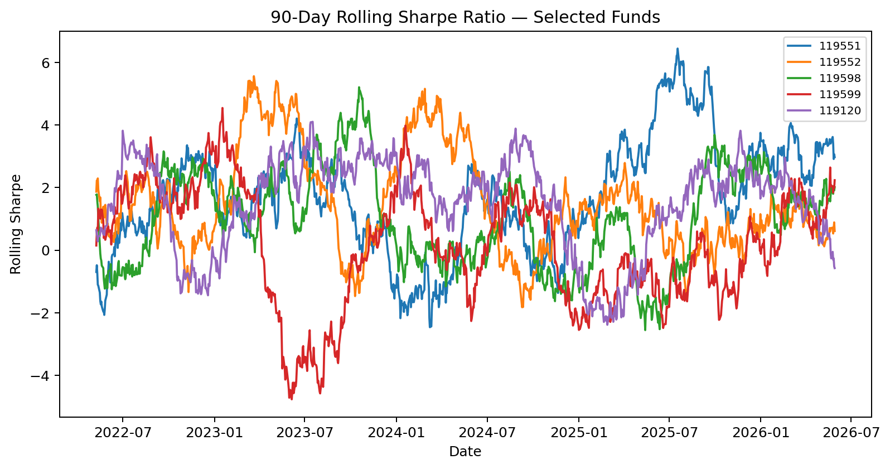
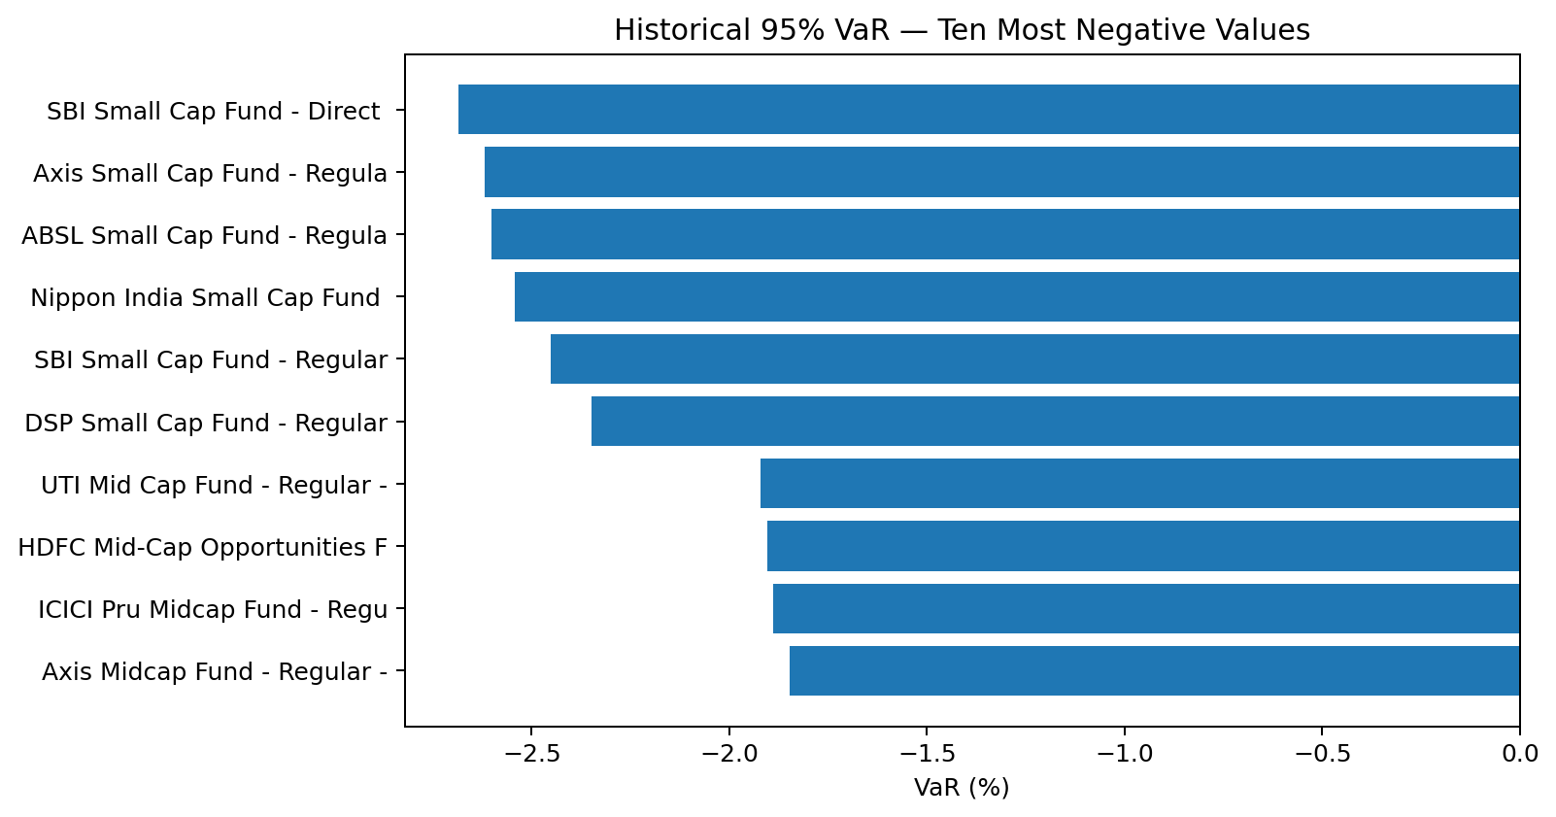
07 | PERFORMANCE + RISK
08
Advanced Risk & Benchmark Results
ROLLING SHARPE
VaR / CVaR
BENCHMARK
90-day window
95% historical
NIFTY 50 / 100
5 selected funds • 5,750 observations in executed analysis
5th percentile + mean of losses beyond threshold
Normalised comparison + tracking error
Source: Bluestock capstone brief + project datasets / executed analysis

Slide 9
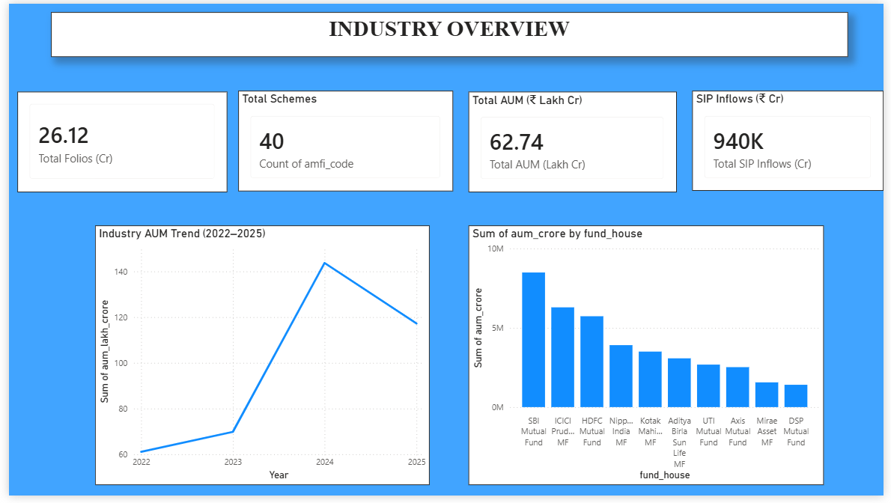
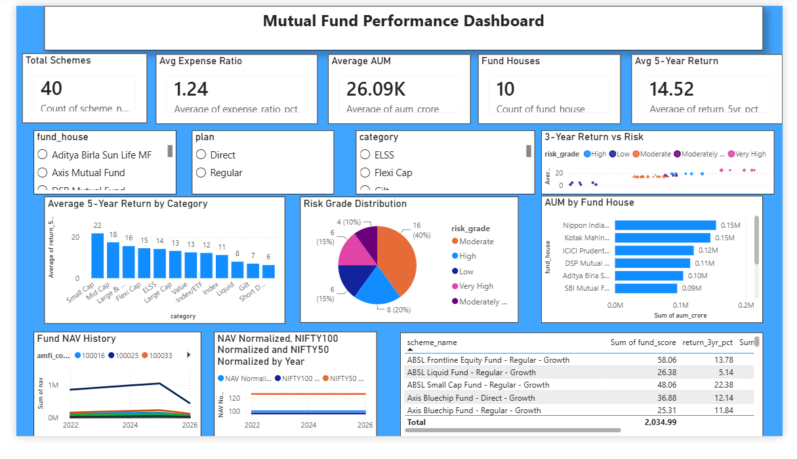
08 | BUSINESS INTELLIGENCE
09
Power BI Dashboard — Industry Overview + Fund Performance
Actual Power BI screenshots supplied by the project team

Slide 10
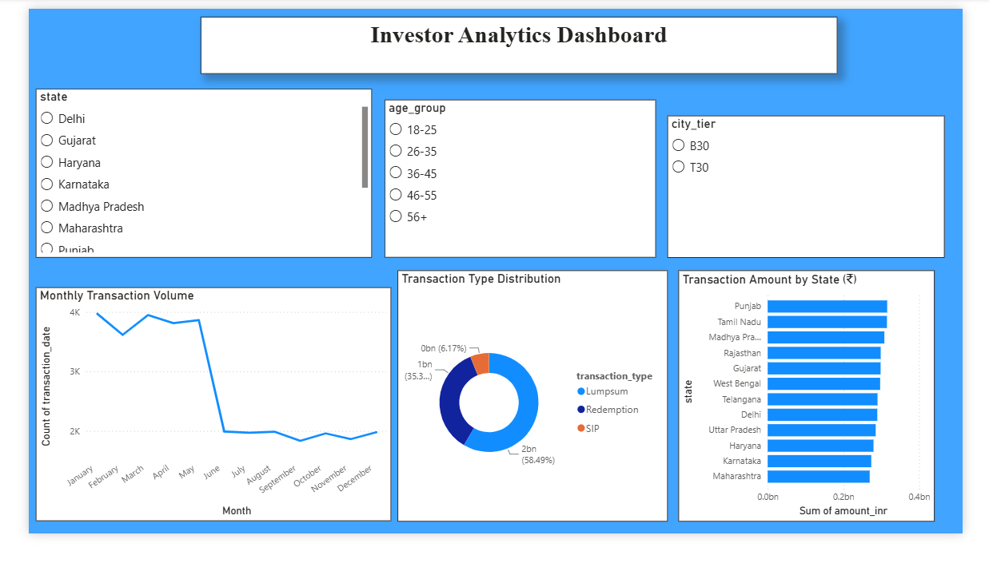
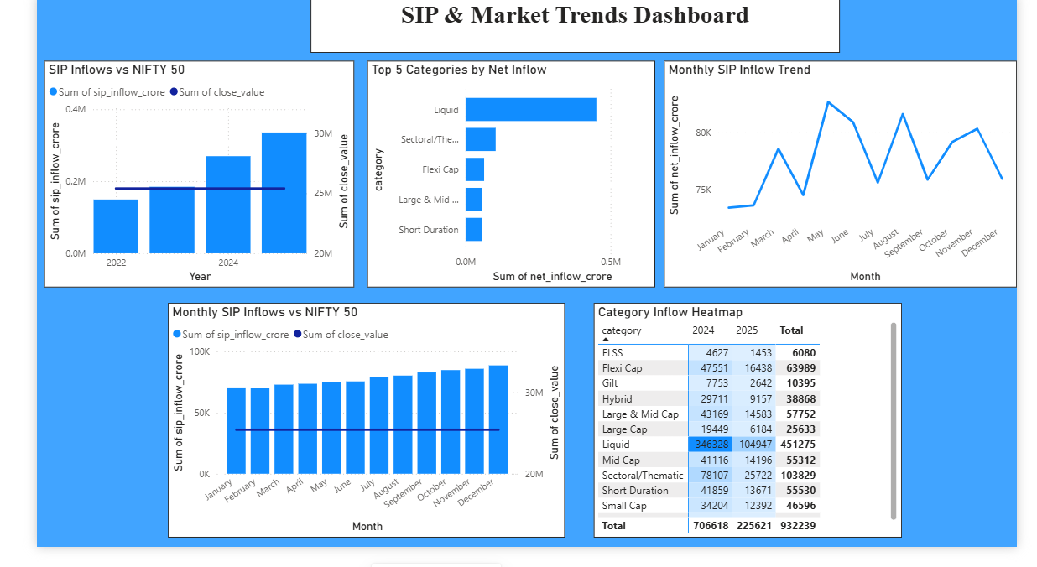
09 | BUSINESS INTELLIGENCE
10
Power BI Dashboard — Investor Analytics + SIP & Market Trends
Actual Power BI screenshots supplied by the project team

Slide 11
10 | DECISION INSIGHTS
11
Key Findings & Business Recommendations
WHAT THE ANALYSIS SHOWS
RECOMMENDATIONS
01
Data is analysis-ready
Use risk-adjusted metrics together rather than relying on headline return.
46K NAV rows across 40 funds; core validation executed successfully.
Use
02
Risk differs by fund
Track VaR/CVaR, drawdown and rolling Sharpe for risk surveillance.
Standard deviation, Sharpe, Sortino, drawdown and VaR provide complementary views.
Monitor
03
Benchmark context matters
Use cohort and SIP continuity analytics for investor engagement.
Fund returns are analysed against NIFTY indices using normalised paths and tracking error.
Segment
04
SIP participation is growing
Use sector HHI to identify concentrated equity exposures.
Monthly SIP inflows reach ₹31,002 Cr in Dec-2025 in the project data.
Diversify
05
Continuity is a useful signal
Schedule ETL and refresh the dashboard for recurring reporting.
1,362 investors qualify for continuity analysis; 97.80% are flagged under the project rule.
Automate
DISCLAIMER
Source: Bluestock capstone brief + project datasets / executed analysis
Educational analytics project; not investment advice.

Slide 12
THANK YOU
Mutual Fund Analytics Platform
40 SCHEMES
RISK ENGINE
BI LAYER
46K NAV rows
VaR • CVaR • Sharpe
4 dashboard pages
Multi-year fund universe
Performance + downside analytics
Interactive Power BI views
Prepared by: Nisarga P
Bluestock Fintech Capstone
Thank you | Bluestock Fintech Mutual Fund Analytics Capstone

