Slide 1

Analysis of AMCAT Data

Slide 2
About me
I am Nisarga K, and I am a final-year student pursuing a Bachelor’s degree in Computer Science Engineering from Dr. Ambedkar Institute of Technology, Bengaluru.
I am motivated to pursue a career in Data Science as it resonates with my analytical mindset and enthusiasm for tackling challenges. This field presents extensive opportunities to engage with innovative technologies such as machine learning, artificial intelligence, and big data, which have the power to revolutionize various industries. I am keen to cultivate the skills required to derive valuable insights from data and play a significant role in facilitating data-driven decision-making.
As a recent graduate, I currently do not have formal work experience. However, I am eager to gain practical experience in the field of Data Science through projects and internships.
LinkedIn Profile : https://www.linkedin.com/in/nisarga-kumar
Github Profile : https://github.com/NisargaKumar

Slide 3
Agenda
Business Problem and Use case domain understanding
Objective of the Project
Summary of the Data
Exploratory Data Analysis:
Data Cleaning Steps
Data Manipulation Steps
Univariate Analysis Steps
Bivariate Analysis Steps
Key Business Question
Observations
Conclusion (Key finding overall)
Q&A Slide
Experience/Challenges working on Data Analysis Project.

Slide 4
Business Problem and Use case
The engineering job market is increasingly competitive, with fresh graduates facing challenges in securing suitable employment. Understanding the factors influencing job placements, salaries, and career choices can help educational institutions, companies, and policymakers make informed decisions. By analyzing the employment outcomes of engineering graduates, we can identify trends and disparities related to gender, specialization, and college tier, providing insights that can enhance recruitment strategies and educational programs.
Key Points:
Use Case: The findings can help educational institutions enhance their curriculum to better align with industry needs. Additionally, employers can utilize these insights to refine their recruitment strategies, ensuring they attract the right candidates.
Significance: Understanding the relationship between various factors and salary outcomes can aid in formulating effective recruitment strategies for companies, ensuring they attract suitable candidates.
This analysis not only sheds light on current job market dynamics but also contributes to improving the overall engineering education ecosystem.

Slide 5
Objective of the Project
The objective of this project is to conduct a comprehensive exploratory data analysis (EDA) on the employment outcomes of engineering graduates. By focusing on salary as the target variable, the analysis aims to:
Identify Factors Influencing Salaries: Explore the relationships between various demographic, educational, and personal attributes of graduates and their corresponding salaries.
Analyze Salary Distributions: Understand the distribution of salaries across different specializations, degrees, and college tiers to identify trends and outliers.
Investigate Gender and Specialization Preferences: Examine if there are significant relationships between gender and specialization choices among engineering graduates.
Evaluate Employment Claims: Assess the validity of claims regarding salary ranges for specific job roles such as Programming Analyst, Software Engineer, Hardware Engineer, and Associate Engineer.
By achieving these objectives, the project aims to provide valuable insights for educational institutions, recruitment agencies, and policymakers, thereby contributing to improved educational and employment strategies in the engineering sector.

Slide 6
Summary of the Data
The dataset contains employment outcomes for about 4,000 engineering graduates, featuring around 40 variables that impact job placements and salaries.
Continuous Variables:
Salary: Target variable representing graduates' earnings.
Academic Performance: Includes 10th and 12th-grade percentages and college GPA.
Skill Scores: Metrics for subjects like English, Logical reasoning, Quantitative skills, and various engineering fields.
Categorical Variables:
Gender: Reflects gender representation in engineering.
Degree: Indicates graduates' specializations.
Specialization: Focus areas of study.
College Tier: Ranks educational institutions.
The primary focus is on Salary, allowing analysis of relationships between education, demographics, and earnings in the engineering sector.

Slide 7
Exploratory Data Analysis
Exploratory Data Analysis (EDA) is a critical step in understanding the dataset, focusing on various statistical and visual techniques to uncover patterns and insights.
Data Cleaning Steps:
Removed rows with missing values and trimmed whitespace in column names. Converted columns to appropriate data types for consistency.
b) Data Manipulation Steps:
Selected relevant features for analysis and identified outliers using boxplots. Normalized numerical features when necessary.
c) Univariate Analysis Steps:
Used histograms to visualize frequency distributions and boxplots to identify outliers in numerical variables. Created count plots for categorical variables to assess their distributions.
d) Bivariate Analysis Steps:
Generated scatter and hexbin plots to explore relationships between salary and numerical variables. Created box plots to analyze salary distributions by categorical factors like degree and specialization.
Overall, the EDA provided insights into the factors influencing salaries among engineering graduates and set the stage for further statistical analysis and hypothesis testing.

Slide 8
Data Cleaning and Manipulation Steps
Data Cleaning Steps
The data cleaning process was crucial to ensure the integrity of the analysis. Initially, missing values were addressed by removing rows with incomplete data to avoid any biases in the results. To maintain consistency across the dataset, column names were standardized by stripping any leading or trailing spaces.
Additionally, data types were verified and converted as necessary, ensuring that numerical fields were properly formatted for accurate calculations. Duplicate entries were also identified and eliminated, further enhancing the quality of the dataset.
Data Manipulation Steps
The data manipulation process involved several key steps to prepare the dataset for thorough analysis. Categorical variables were encoded to make them suitable for statistical analysis, enabling more accurate comparisons between different groups.
Relevant subsets of data were created to focus on specific trends and relationships within the dataset. This approach not only streamlined the analysis process but also ensured that the dataset was organized and ready for exploratory data analysis, facilitating a clearer understanding of the insights derived from the data.

Slide 9
Univariate and Bivariate Analysis Steps
c) Bivariate Analysis Steps
Univariate analysis focused on the distribution of individual variables.
Histograms and density plots were created for numerical columns to visualize frequency distributions and identify outliers.
Boxplots assessed data spread, while count plots showed the frequency distribution of categorical variables.
Each visualization included observations on central tendencies and notable anomalies.
d) Bivariate Analysis Steps
Bivariate analysis explored relationships between variable pairs.
Scatter and hexbin plots examined correlations between numerical variables, like Salary and College GPA.
Swarm and box plots visualized salary distributions across categorical variables, highlighting significant trends.
Observations summarized the interactions and patterns found in the analyses.

Slide 10
Key Business Question
1. Salary Discrepancy: Do engineering graduates earn salaries that align with industry standards for roles such as Programming Analyst, Software Engineer, Hardware Engineer, and Associate Engineer?
2. Gender and Specialization Relationship: Is there a significant relationship between gender and the choice of specialization among engineering graduates?
3. Impact of Academic Performance: How do academic performance metrics, such as college GPA and percentages in 10th and 12th grades, influence the salary of engineering graduates?
4. Effect of College Tier: What role does the tier of the college attended play in the salary outcomes of engineering graduates?
5. Skill Assessment: Which skills or subjects have the strongest correlation with higher salaries in the engineering job market?

Slide 11
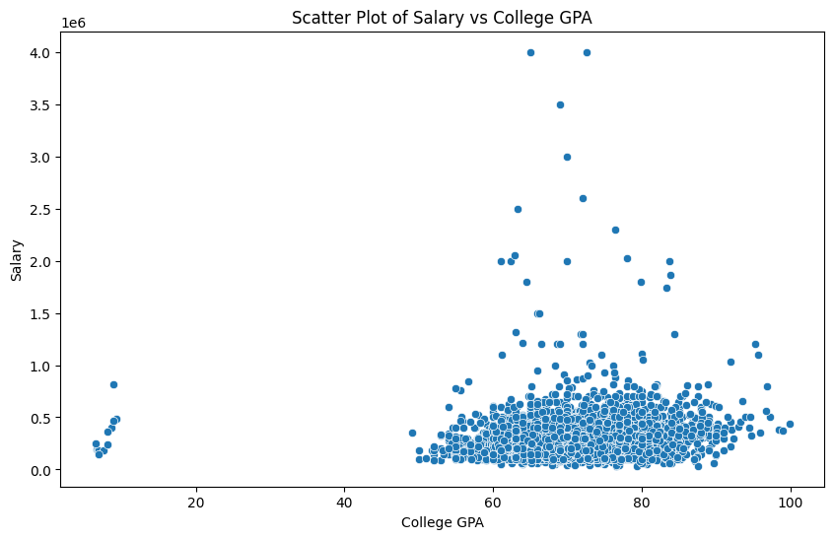
Observations
There is a positive correlation between College GPA and Salary, indicating that higher GPAs may be associated with higher salaries.
GPA α Salary

Slide 12
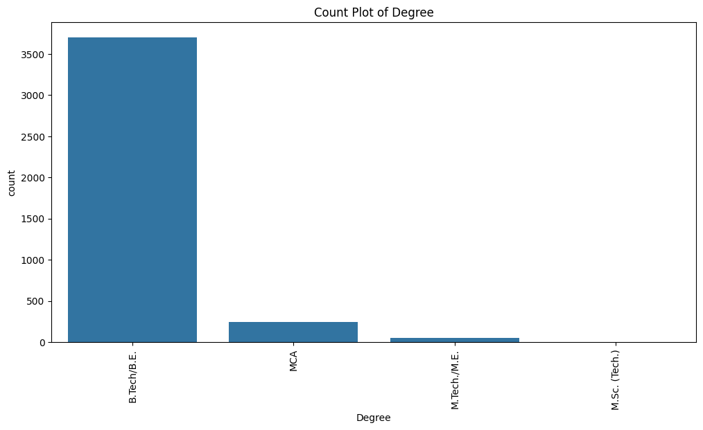
Observations
The majority of candidates hold a B.Tech/B.E. degree, representing 92.55% of the total.

Slide 13
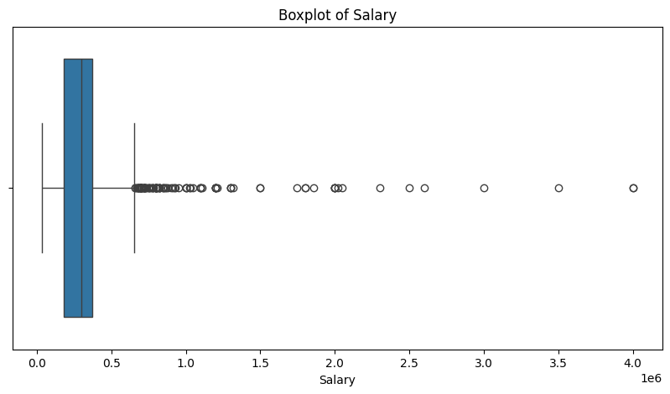
Observations
The boxplot of Salary indicates that there are 109 outliers detected. The median value is at 300000.00.
The presence of outliers in salary distributions suggests that while most graduates earn within a certain range, a few achieve significantly higher salaries, warranting further investigation into their profiles and career paths.

Slide 14
Observations
Using Univariate Analysis
The dataset shows a significant imbalance between male (0) and female (0) candidates, indicating a potential gender disparity in engineering.
The majority of candidates hold a B.Tech/B.E. degree, representing 92.55% of the total, indicating the primary pathway for engineering students.
Specializations in electronics and communication engineering dominate the dataset, with 22.01% of candidates specializing in this field.
The most common job location is Bangalore, accounting for 15.68% of placements.
The most common job designation is software engineer, comprising 13.48% of the total.
A significant portion of candidates graduated from Tier 2 colleges, indicating a preference for graduates from higher-tier institutions.

Slide 15
Observations
Using Bivariate Analysis
The average salary for males is 311716.21 and for females is 294937.30.
The highest average salary is for the degree M.Tech./M.E. at 366132.08.
The specialization with the highest average salary is polymer technology at 700000.00.
The city offering the highest average salary is Kalmar, Sweden at 2300000.00.
The designation with the highest average salary is junior manager at 1300000.00.
For 1 colleges, the most common designation is software engineer.
For 2 colleges, the most common designation is software engineer

Slide 16
Conclusion (Key Findings Overall)
The Exploratory Data Analysis (EDA) of the engineering graduates' dataset revealed several critical insights.
1. Salary Variability: There are significant variations in salaries among different engineering roles, indicating that some positions, such as Software Engineer, tend to offer higher compensation than others like Programming Analyst.
2. Influence of Academic Performance: Higher college GPAs and better performance in key subjects, such as Logical and Quantitative skills,, correlate positively with increased salary highlighting the importance of academic excellence in career outcomes.
3. Gender and Specialization Trends: The analysis showed a notable relationship between gender and specialization choices, suggesting that preferences may vary across different demographics.
4. College Tier Impact: Graduates from higher-tier colleges generally secure better salary outcomes, indicating that the college's reputation plays a significant role in job placements.
5. Outliers and Salary Distribution: The presence of outliers in salary distributions suggests that while most graduates earn within a certain range, a few achieve significantly higher salaries, warranting further investigation into their profiles and career paths.
Overall, these findings underscore the importance of academic performance, college reputation, and role-specific expectations in shaping the career trajectories of engineering graduates.

Slide 17
Q&A Slide
1. What were the primary objectives of the analysis?
The primary objectives were to explore the employment outcomes of engineering graduates, with a focus on salary as the target variable, and to identify factors influencing job placements.
2. How does academic performance affect salary outcomes?
Higher college GPAs and strong performance in critical subjects are positively correlated with increased salaries, indicating that academic success can significantly influence career earnings.
3. Was there a significant relationship between gender and specialization?
Yes, the analysis indicated a notable relationship between gender and specialization choices, suggesting that preferences for certain specializations may vary by gender.
5. Were any outliers found in the salary data?
Yes, the presence of outliers in salary distributions indicates that while most graduates earn within a typical range, some achieve significantly higher salaries, warranting further investigation.
6. What further research could be conducted based on these findings?
Future research could explore the profiles of high-earning graduates to identify common traits or experiences, as well as assess the long-term career trajectories of engineering graduates in different roles.

Slide 18
Experience/Challenges Working on the Data Analysis Project
The data analysis project provided valuable insights into exploratory data analysis (EDA) and employment outcomes for engineering graduates.
Data Understanding and Preparation Familiarizing myself with the dataset was crucial, as I had to handle missing values and outliers to ensure data integrity.
Univariate and Bivariate Analysis Selecting effective visualization techniques for univariate and bivariate analyses posed challenges, as I needed to communicate findings clearly while interpreting results meaningfully.
Research Questions Formulating research questions required analytical and creative thinking. Testing hypotheses about salary differences and the relationship between gender and specialization deepened my understanding of statistical testing.
Time Management Managing time effectively was challenging, given the iterative nature of EDA. Setting clear milestones helped streamline the process.
Learning Outcomes Overall, the project enhanced my technical skills and highlighted the importance of systematic data analysis in understanding educational outcomes and career trajectories.

Slide 19

THANK YOU

