Slide 1


DESIGN AND ANALYSIS OF ALGORITHMS LABORATORY WITH MINI PROJECT [19IS4DLADA ] Presentation on “Coin Exchanger”
Presented By
Nisarga K(1DS20IS065)
Nithya M(1DS20IS067)
Saijyoti Meti(1DS20IS085)
Sanjana H Goud(1DS20IS092)
LAB IN-CHARGE
Mrs. Radhika T V
Mrs. Shilpa Shree S
Mrs. Sreevidya B S

Slide 2
CONTENTS
Introduction
System Requirements
Hardware requirements
Software requirements
Algorithm
Greedy Approach
Tracing
Implementation
Pseudocode
Snapshots of Results
Time Complexity

Slide 3
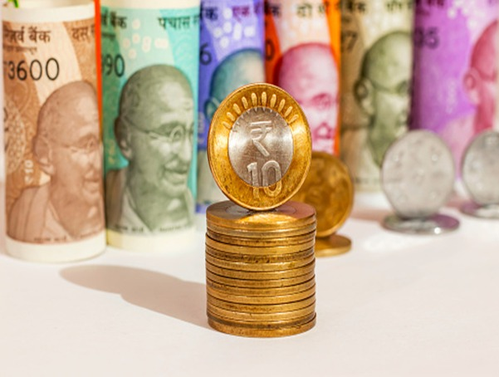
Introduction
COIN EXCHANGER
using Greedy technique
(special case of dynamic programming)

Slide 4
Coin Exchanger
WHAT IS COIN EXCHANGER?
Coin exchange problem is finding the minimum number of coins (of certain denominations) that add up to a given amount of money. We have an infinite supply of denominations of different country currencies (coins/notes). So this shows the minimum number of coins and/or notes needed to make the change.
The change-making problem faced by millions of cashiers all over the world (at least subconsciously): give change for a specific amount n with the least number of coins of the denominations d 1 > d2 > ... > dm used in that locale.

Slide 5
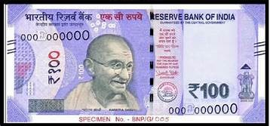
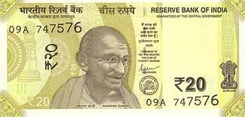
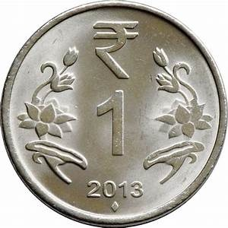
Example
Let us consider Indian Currency Denominations:
1, 2, 5, 10, 20, 50, 100, 200, 500, 2000
How would you give change with coins of these denominations of, say, 121 Rs?
If you came up with the answer 100Rs note, 20 Rs note, 1 rupee coin followed- consciously or not-a logical strategy of making a sequence of best choices among
the currently available alternatives.
+
+

Slide 6
System Requirements
Hardware requirements:
Min RAM Size : 4MB
Min Hard Drive Space : 25MB
Min processor Type : Intel 386 or higher
Software requirements:
OS Required : Microsoft DOS,Microsoft Windows 3.1 or later,PC DOS
OS Family : Windows
Language : C++
Platform Used: Visual Studio code

Slide 7
Algorithm
Greedy Approach
The approach applied in the change-making problem is called Greedy approach .A common intuition would be to take coins with greater value first. This can reduce the total number of coins needed. Start from the largest possible denomination and keep adding denominations while the remaining value is greater than 0.
Feasible, i.e., it has to satisfy the problem's constraints.
Locally optimal, i.e., it has to be the best local choice among all feasible choices available on that step.
Irrevocable, i.e., once made, it cannot be changed on subsequent steps of the algorithm.
Is this solution to the instance of the change-making problem optimal? Yes, it is. In fact, it is possible to prove that the greedy algorithm yields an optimal solution for every positive integer amount with these coin denominations. At the same time, it is easy to

Slide 8
give an example of "weird" coin denominations-e.g., d1 = 9, d2 = 6, d3= 5, d4=1 that may not yield an optimal solution for some amounts. Because when we take input amount=11, By greedy it selects 9,1,1. That is total of 3 coins. But we can select 6 and 5, So the number of coins reduces to 2. It is the reason to develop a dynamic programming algorithm for this problem that algorithm works for any set of coin denominations by either returning an optimal solution or reporting that no solution exists. In this project we have used Greedy and proper denominations of different countries which doesn’t lead to any drawback. So, it is a special case of Dynamic programming.

Slide 9
Algorithm
1. Sort the array of coins in decreasing order
2. Initialize result as empty
3. Find the largest denomination that is smaller than entered amount.
4. Add found denomination to result. Subtract value of found denomination from amount.
5. If amount becomes 0, then print result.
6. Else repeat steps 3 and 4 for new value of amount.

Slide 10
Tracing
Result set: empty
Check denominations:2000,500,200,100,50,20,10,5,2,1
100 <=121
So push 100 in result set.
New Value= 121-100=21
Input : Value=121
Value=21
Result set: {100}
Check denominations:50,20,10,5,2,1
20<=21
So push 20 in result set.
New Value=21-20=1

Slide 11
Result set: {100,20}
Check denominations: 1
We found 1 is equal to the Value. So push 1 in to result set.
New value 1-1=0
Value=1
Value=0
Result set: {100,20,1}
Since Value is 0 now, we”ll print the result.

Slide 12
Implementation
Pseudocode
Void countCurrency_INR(int amount)
{
int INR[10] = { 2000, 500, 200, 100,
50, 20, 10, 5, 2,1 };
int noteCounter[10] = { 0 };
// count notes using Greedy approach
for (int i = 0; i < 10; i++) {
if (amount >= INR[i]) {
noteCounter[i] = amount / INR[i];
amount = amount - noteCounter[i] * INR[i];
}
}

Slide 13
// Print notes
cout << "Currency Count in INR" << endl;
for (int i = 0; i < 10; i++) {
if (noteCounter[i] != 0) {
cout<<"Rs " << INR[i] << " : "
<< noteCounter[i] << endl;
}
}
}

Slide 14
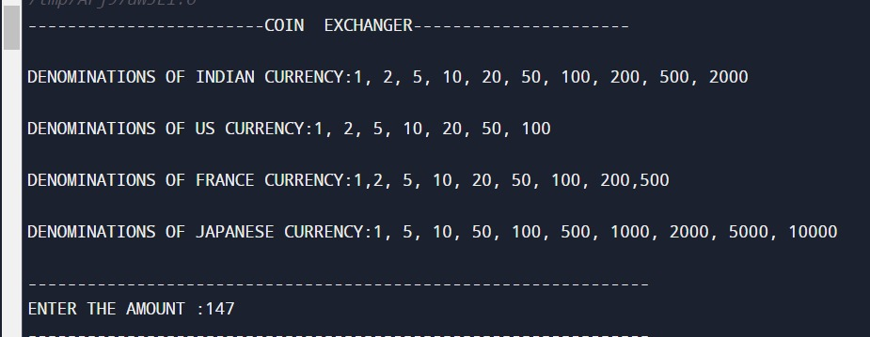
Snapshots of Result

Slide 15
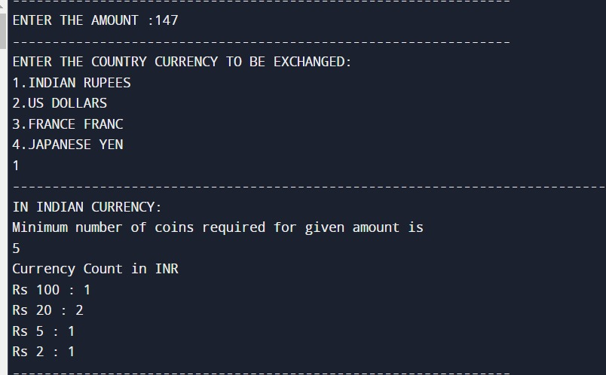

Slide 16
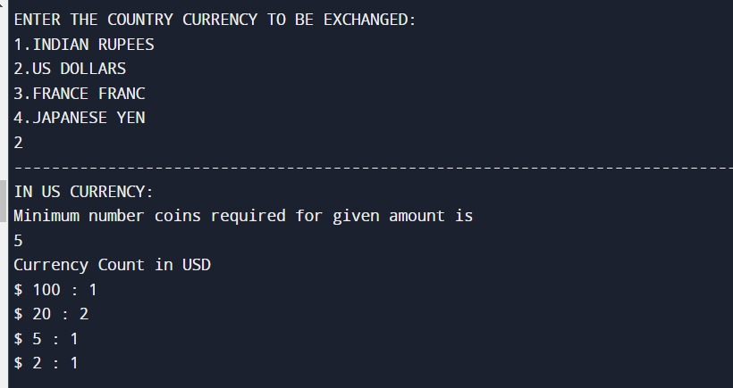

Slide 17
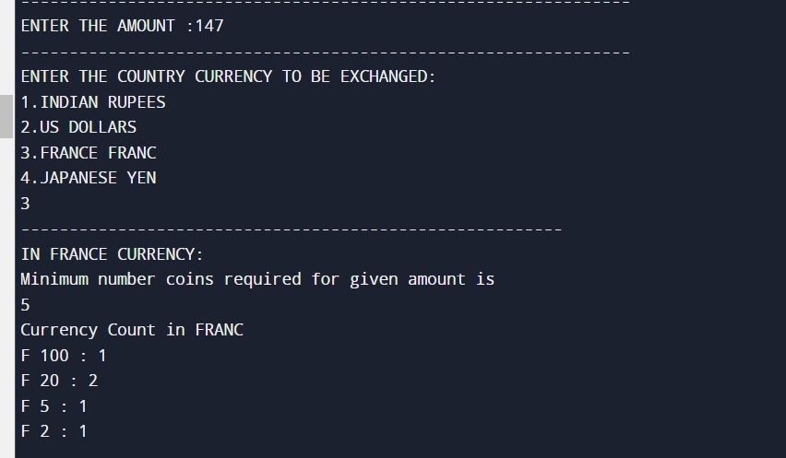

Slide 18


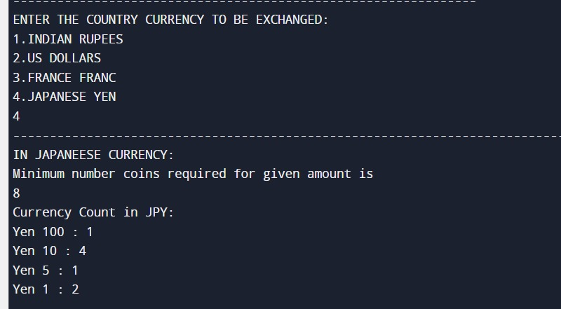

Slide 19
Time complexity
Time Complexity: O(m)
At the worst case, D include only 1 element (when m=1)
If m>>n (m is a lot bigger than n, so D has a lot of element which is bigger than n) then you will loop on all m element till you get smaller one than n (most work will be on the for-loop part) -> then it is O(m),
where m=number of denominations and n=amount
Space complexity: O(m)

