Slide 1

PRODUCT RECOMMENDATION SYSTEM
Team : ALPHA ELITE
PRIYANSHI SHAH : AU1841009
NISARG PATEL : AU1841048
VISMAY PATEL : AU1841071
SHIVAM LAKHTARIYA: AU1841084
Guided by :
Prof. Mehul Raval
T.A. Arpit Patel
T.A. Jay Patel

Slide 2

Introduction
We have designed a product recommendation system which can provide appropriate suggestions to the customers while buying another products. We are designing the system such that it suggests the item based on the ratings of all the other items and also according to their purchase history.It helps the users to make a right choice and also it makes the content more personalised.
We used jaccard similarity and cosine similarity as similarity measures to recommend the product to other users.
We used k-means clustering to recommend the product based on the rating given by the other users and the product ID.
We implemented K-means algorithm from scratch. Also we have carried forward the text based clustering algorithm in order to check the function build by us.

Slide 3
Problem Statement
Nowadays there are many similar products but off different quality and it is hard for a user to choose which product to buy. So it will be helpful to recommend which product to use based on the ratings and experience of other users.
The accuracy of each type of similarity is different so we have to know which type of similarity gives us the best result.
For a new user it is hard to choose which product to buy so it is necessary to recommend the product to the user based on the search keyword that the user has entered to find the product. It has to show the products which are all relevant based on the search.
The recommendation of the products should also be done based on the best ratings given by the other users so we have to find a way to do that.
We have to figure out a way to find the best number of clusters to get accurate results.

Slide 4


GANTT Progress Chart
January | February | March | April
Milestones
Week 4 | Week 1 | Week 2 | Week 3 | Week 4 | Week 1 | Week 2 | Week 3 | Week 4 | Week 1
Dataset exploration
Data Wrangling
Text-Based Clustering
Cosine-Similarity
K-means [User build function]
Jaccard Similarity
K-means [On productId-Ratings]
Final similarity[Comb.Of jaccard+cosine]

Slide 5
Existing Work
We are recommending the products based on the ratings of the products given by the other customers or users in past using cosine similarity as well as jaccard similarity.
When a new user comes to buy a product and enters a keyword to search, we are recommending the products using k-mean text clustering based on the keyword .
We are performing clustering based on the product ID and ratings given to that particular product.
We have performed k-means clustering from scratch without the use of inbuilt functions.

Slide 6
Approach
Approach
Jaccard Similarity
Data
Jaccard similarity
Output
At first we had imported relevant libraries such as pandas, sklearn, sklearn metrics pairwise
Made a matrix with index equal to user ID and columns with productID.
After having data in proper format we found pairwise distance between two products by userID.
Then we found dissimilarity from given similarity matrix.
Now we have a reason behind finding the dissimilarity i.e once we have large data set at that if we have dissimilarity then to remove that highly dissimilar products works easy for algorithm.

Slide 7
Approach
Clustering based on the product id and ratings.
Data Analysis
Feature Extraction
K-means
User-Built Function
At first we had imported relevant libraries such as pandas, sklearn, k-means and minmaxscaler.
We had read the csv file containing dataset and stored top 100(Out of 16,000) rows in a series variable type.
From that we had fetched features i.e Product Id and Ratings.
After that we had plotted a scatter plot graph of ratings vs product Id which depicts that which product id has which ratings.
We had applied k means clustering on the ratings columns. Here we had took number of clusters as 5 because the ratings value ranges from 1 to 5.
After that based on the ratings values cluster are assigned and thus plotted with different color notation
At last we had built a function named show_recommendation.
This function will take product Id as a input, fetches it’s ratings and as result displays the product Id with the same ratings as that of imputed product Id.

Slide 8
Approach
Approach
K means from scratch.
Helping function
Changing Cluster
K-means
Threshold
Initialize centroids of cluster by uniform distribution and choose them as they have wide distance between them.
Define a distance function and assign a initial cluster based on their closest distance from initial centroids.
At this stage we have initial clusters with its centroids.
We find new means of that initial clusters and check is that equal to centroids that they clusters have?
If No then assign our mean as a new centre of that clusters. Now clusters have new mean and all process will run again - Find distance from centre, assign to closest one,then find mean.
It's repeat until it arrives to its threshold condition.
Stopping this loop,threshold condition will check the distance b/w old and new centroids if its less than k 0.01(For our case) we stops.
K changes by data.

Slide 9
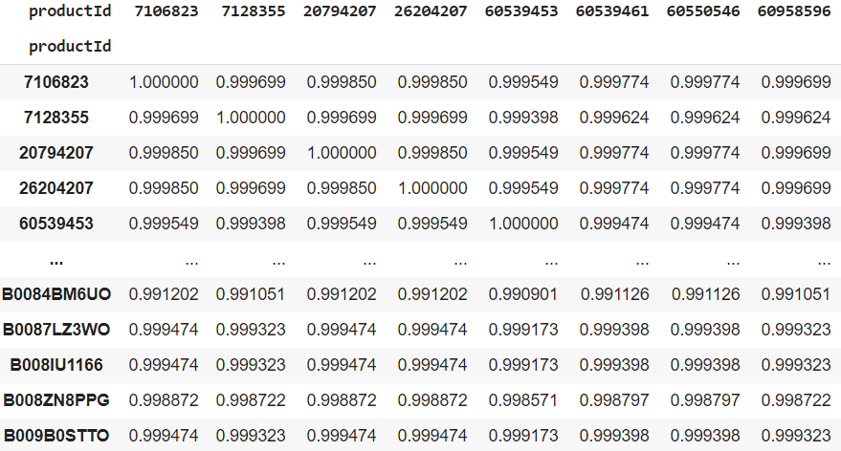
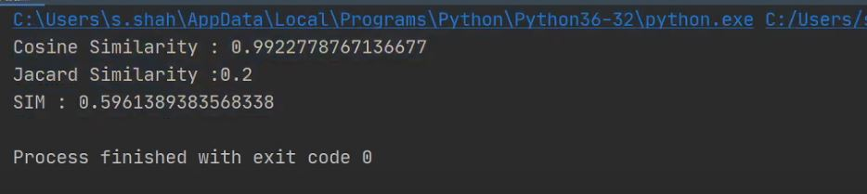
Final Results
Jaccard similarity
Final similarity (Combination of Cosine + Jaccard similarity)

Slide 10
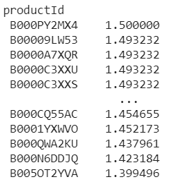
Final Results
These are the recommendations obtained after performing jaccard similarity.
The values beside the product ID column shows the similarity measure between the products.

Slide 11
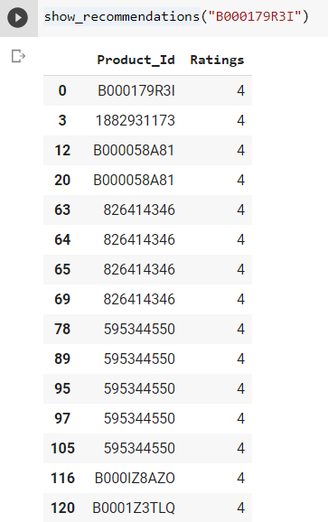
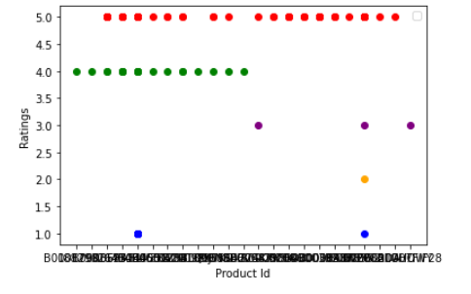
Final Results
Clustering based on the product id and ratings.
User build function which shows product similar to the user input product based on rating.

Slide 12
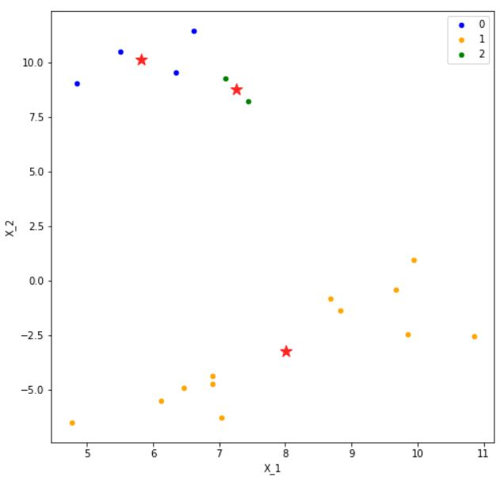
Final Results
K means

Slide 13
Conclusion
We were successfully able to build a recommendation system based on two types of similarities i.e cosine similarity and jaccard similarity.
We were able to recommend the products based on the searched keyword using k-means clustering.
We were able to recommend the products based on the clustering of product ratings and product ID.
We made the k-means algorithm from scratch without using any inbuilt functions.

Slide 14
ROLE OF EACH GROUP MEMBER
 | DATA PREPROCESSING | CODING | REPORT WRITING | PRESENTATION
SHIVAM LAKHTARIYA | YES | YES | YES | YES
NISARG PATEL | YES | YES | YES | YES
VISMAY PATEL | YES | YES | YES | YES
PRIYANSHI SHAH | YES | YES | YES | YES

Slide 15
References
●P. Resnick, H.R. Varian, Recommender systems, Communications of the ACM 40 (3) (1997) 56–58.
●S. Kangas, Collaborative filtering and recommendation systems, in: VTT Information Technology, 2002.
●https://scikit-learn.org/stable/modules/generated/sklearn.feature_extraction.text.TfidfVectorizer.html
DATA SET
●http://snap.stanford.edu/data/web-Amazon-links.html

Slide 16
THANK YOU

