Slide 1
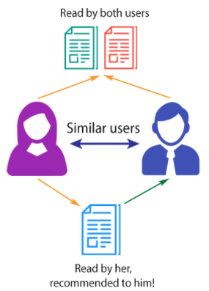
PRODUCT RECOMMENDATION SYSTEM
PRIYANSHI SHAH : AU1841009
NISARG PATEL : AU1841048
VISMAY PATEL : AU1841071
SHIVAM LAKHTARIYA: AU1841084

Slide 2
INTRODUCTION
We are designing a product recommendation system which can provide appropriate suggestions to the customers while buying another products. We are designing the system such that it suggests the item based on the ratings of all the other items and also according to their purchase history.It helps the users to make a right choice and also it makes the content more personalised.
We are using collaborative filtering for our recommendation system. It is used as it suggests the product to the user based on interests of other people.Nowadays it is highly used by some major companies to recommend the products to their users.

Slide 3
PROBLEM STATEMENT
Nowadays there are many similar products but off different quality and it is hard for a user to choose which product to buy. So it will be helpful to recommend which product to use based on the ratings and experience of other users.
Secondly the accuracy of different types of filtering is different so we have to choose which filter to use.
For a new user it is hard to choose which product to buy so it is necessary to recommend the product to the user based on the search keyword that the user has entered to find the product. It has to show the products which are all relevant based on the search.

Slide 4
EXISTING WORK
We have performed collaborative filtering based on the ratings of the products given by the other customers or users in past using cosine similarity.
When a new user comes to buy a product and enters a keyword to search, we are recommending the products using k-mean text clustering based on the keyword .
The algorithms for k-mean clustering and cosine similarity are already available.

Slide 5
APPROACH
For our project, e-commerce data-set was the main requirement. So we had sort-listed somewhat around 3 datasets of different shopping websites like amazon, flipkart and myntra.
So we selected the amazon dataset in which we had modified and cleaned the data in the following ways : -
We changed the format of data to the required format i.e. we had converted the text file having rows as feature to the .csv file having columns as features.
Also we had added a product description column to it, which was our main feature for performing clustering.
We had analysed how clustering can be performed based on the search of the user by considering product description as a medium of recommendation.
So further we did operations with the rows containing text of product description in the following ways :
First we converted the rows to the vector form. After that we used stopword function to neglect the english words such as is ,an, or etc..
Further we took the transpose of that in order to consider words with more frequency as a single feature only.

Slide 6
APPROACH
Further we need to analyze how a particular word in a row of product description is important to us. Thus for doing that we used a method having two steps i.e. Term Frequency(TF) and Inverse Document Frequency(IDF).
Then by using k means we had formed clusters and had plotted the group of clusters.
Finally we build a function named show recommendation which will take user input as keyword.
As a result it will show the most similar cluster which will be recommended to the user.

Slide 7
APPROACH
To perform collaborative filtering we first needed data in an appropriate format so we converted text format to an excel format so it is properly readable.
Then we read the excel file to print our data.
As we had to show the recommendations based on the ratings of the products given to the user, we printed our data in a matrix format where the null values of the ratings were filled with zeros so it is computable.
Then we transposed the matrix as we had to perform item-item collaborative filtering.
Then we calculated the cosine similarity between the products which is basically similar as the correlation between the products.
After that we found the cosine similarity between all the products and formed a matrix.
Then based on the purchase of the user and the rating given to the product we will recommend other products based on the similarity with all the other products..

Slide 8
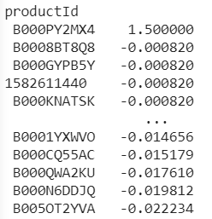
INITIAL RESULTS
Recommendations generated based on the product ID and the ratings entered by the user.

Slide 9
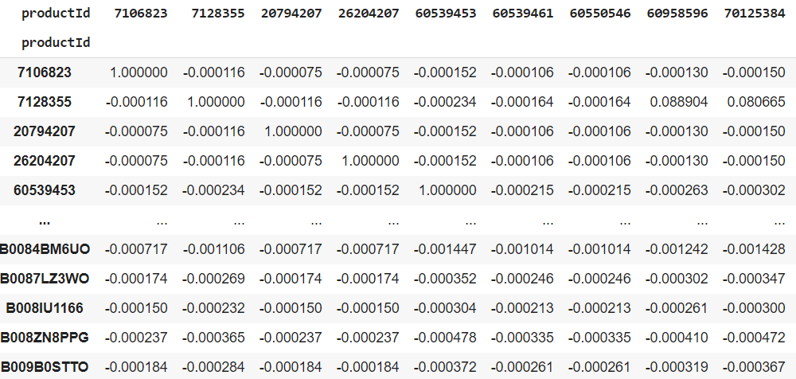
Similarity matrix

Slide 10
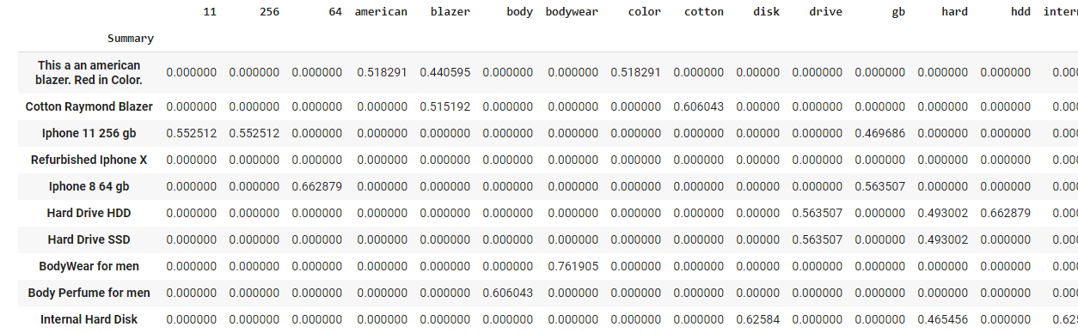
Mapping of words to the rows
In the given photo we mapped the word to the product description row and constructed a matrix.
After that we used stopwords function from natural language toolkit (nltk). What this does is that words such as (the,is,not etc) which are there in product description get removed or are not taken into consideration.

Slide 11
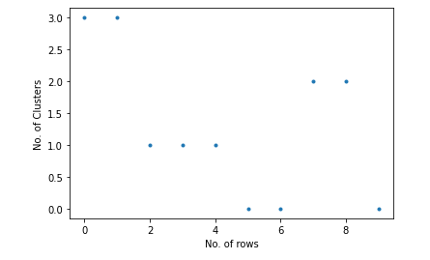
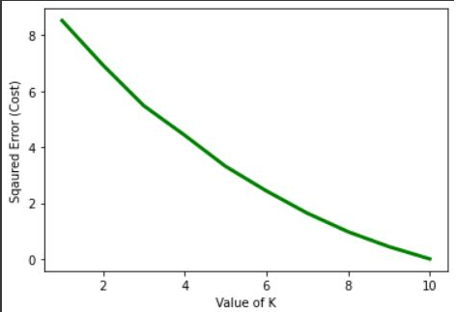
K means cluster plot
Using the k means method of clustering the result plotted is shown in the fig. given below : -

Slide 12
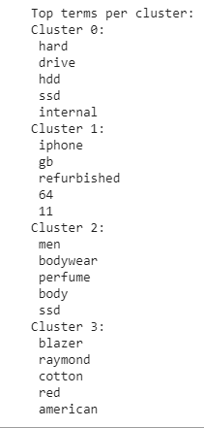
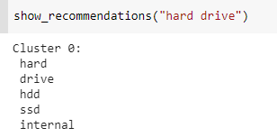
Output
The total clusters obtained are displayed on the left side.
The image given below shows the function of show recommendation based on the user input and it will display the best similar cluster to them.

Slide 13
ROLE OF EACH GROUP MEMBER
 | Coding | Report Writing | Presentation
Vismay Patel | YES | YES | YES
Nisarg Patel | YES | YES | YES
Shivam lakhtariya | YES | YES | YES
Priyanshi shah | YES | YES | YES

Slide 14
Future work
Right now we have performed collaborative filtering.
We will implement a clustering based on product rating and product ID which will form a cluster of similar product based on the product ID with the help of the user’s .
So next we will try to implement hybrid filtering which includes both content-based filtering as well as collaborative filtering.

Slide 15
References
P. Resnick, H.R. Varian, Recommender systems, Communications of the ACM 40 (3) (1997) 56–58.
S. Kangas, Collaborative filtering and recommendation systems, in: VTT Information Technology, 2002.
https://scikit-learn.org/stable/modules/generated/sklearn.feature_extraction.text.TfidfVectorizer.html
DATA SET
http://snap.stanford.edu/data/web-Amazon-links.html

Slide 16
Thank you

