Slide 1
SINGLE SHOT MULTIBOX DETECTOR:
The SSD model detects objects in a single pass, which means it saves a lot of time. But at the same time, the SSD model also seems to have amazing accuracy in its detection.
In order to achieve high detection accuracy, the SSD model produces predictions at different scales from the feature maps of different scales and explicitly separates predictions by aspect ratio.
->The SSD model is made up of 2 parts namely
The backbone model
The SSD head.
The Backbone model is a typical pre-trained image classification network that works as the feature map extractor. Here, the image final image classification layers of the model are removed to give us only the extracted feature maps.
SSD head is made up of a couple of convolutional layers stacked together and it is added to the top of the backbone model. This gives us the output as the bounding boxes over the objects. These convolutional layers detect the various objects in the image.

Slide 2
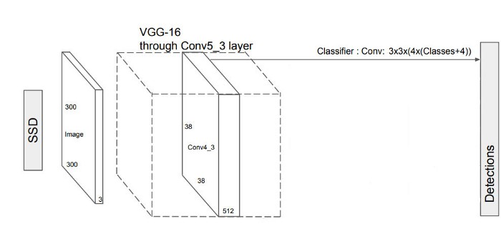
SSD ARCHITECTURE:
The SSD object detection composes of 2 parts:
Extract feature maps, and
Apply convolution filters to detect objects.
The SSD model works as follows, each input image is divided into grids of various sizes and at each grid, the detection is performed for different classes and different aspect ratios. And a score is assigned to each of these grids that says how well an object matches in that particular grid. And non maximum suppression is applied to get the final detection from the set of overlapping detections. This is the basic idea behind the SSD model.

Slide 3
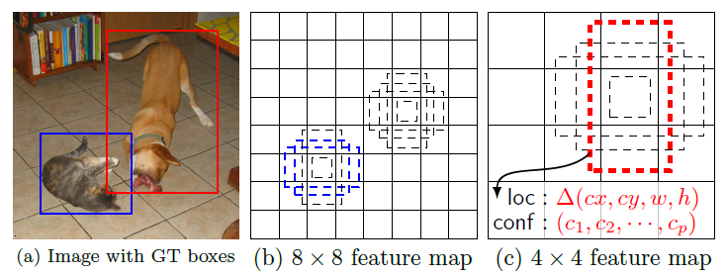
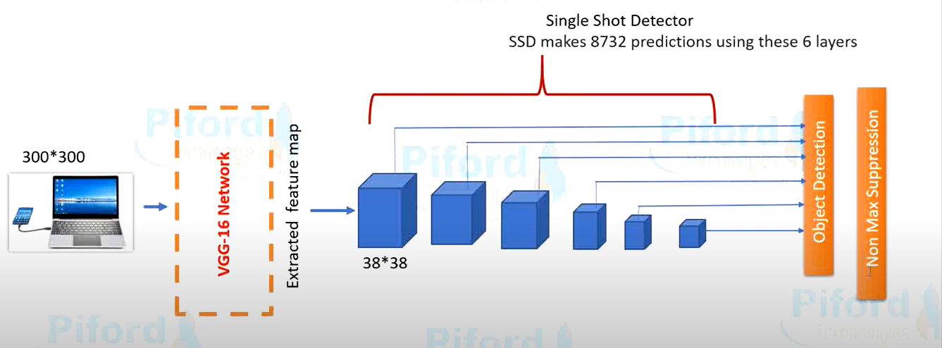

Slide 4
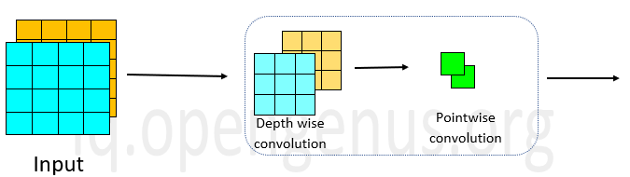
MobileNet:
MobileNet is an architecture model of the convolution neural network (CNN) that explicitly focuses on Image Classification for mobile applications. Rather than using the standard convolution layers, it uses Depth wise separable convolution layers. What makes this model stand out is that its architecture lessens the computational cost and very low computational power is needed to run or apply transfer learning.
The above image depicts the depth wise separable convolution. In mobileNet V1, the convolution box in the given image that consists of depth wise and point wise convolutions is repeated 13 times after the initial convolution layer .The table below gives its detailed architecture.

Slide 5
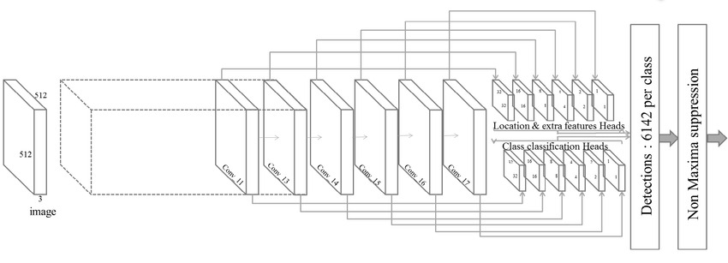
SSD MobileNet V1 architecture:
SSD is independent of its base network, MobileNet was used as the base network of SSD to tackle this problem.
This is known as MobileNet SSD.
When MobileNet V1 is used along with SSD, the last few layers such as the FC, Maxpool and Softmax are omitted. So, the outputs from the final convolution layer in the MobileNet is used, along with convoluting it a few more times to obtain a stack of feature maps. These are then used as inputs for its detection heads. Its architecture can be modified as per required.

