Slide 1

CS336 · AIML · B.Tech VI Sem CSE-C
AI Agent for Disease Risk
Awareness and Prevention
Chandrav Rajbangshi - BTECH/10521/23
Nischal Singh - BTECH/10529/23
Abhishek Sahu - BTECH/10535/23
Aman Kumar Sah - BTECH/10565/23
Assignment 3:- https://github.com/Nischal07bot/disease_awarness_ai_agent

Slide 2


Problem Statement & Target Audience
Problem Statement
Clinical Decision Support
Rural/Remote Health Screening
Early detection of Diabetes (PIMA dataset) and Heart Disease (UCI dataset) is critical to prevent severe health complications.
Personal Health Monitoring
Traditional diagnosis:
Requires multiple clinical tests
Can be time-consuming and expensive
Target Audience
👨‍⚕️ Healthcare Professionals
Doctors for preliminary screening support
🏥 Hospitals & Clinics
Assist patients
🧑‍💻 Researchers & Data Scientists
For experimentation on medical datasets
🧑‍🤝‍🧑 General Public (Future Scope)
Awareness tools for early risk detection
There is a need for a data-driven predictive system that:
Uses patient health parameters
Provides fast, reliable risk prediction
This project aims to build ML models that can:
Predict likelihood of Diabetes and Heart Disease
Assist in early screening and decision support
2

Slide 3

Dataset Description
PIMA Indians Diabetes
UCI Heart Disease
Samples
768 (8 features + target)
Samples
303 (13 features + target)
Target
Diabetic (1) / Non-Diabetic (0)
Target
Disease Present (1) / Absent (0)
Class Ratio
1.87 : 1
Class Ratio
1.17 : 1 (near-balanced)
Preprocessing
436 outliers (IQR): There are many outliers, therefore, they are not removed and Robust scaler is applied on the columns; 80/20 split → Train 614 / Test 154
Preprocessing
85 Outliers:There are many outliers, therefore, Robust Scaling applied; 80/20 split → Train 237 / Test 60
Features: Pregnancies · Glucose · BloodPressure · SkinThickness · Insulin · BMI · DiabetesPedigreeFunction · Age
Features: Age · Sex · Chest Pain · Resting BP · Cholesterol · Fasting BS · ECG · Max HR · Exang · Oldpeak · Slope · CA · Thal
3

Slide 4




Model Architecture — AI Disease Risk Agent
Preprocessing
(NB1)
▶
Feature Engg.
(NB2)
▶
Model Training
(NB3)
▶
Explainability
(NB4)
▶
AI Agent
(NB5)
Machine Learning Pipeline & Model Overview
Preprocessing: Imputes missing health values (Insulin, SkinThickness); applies RobustScaler for fair model training
Preprocessing: Imputes missing health values (Insulin, SkinThickness); applies RobustScaler for fair model training
Preprocessing: Imputes missing health values (Insulin, SkinThickness); applies RobustScaler for fair model training
Model Evaluation:
Accuracy, Precision, Recall, F1-score
ROC-AUC Curve
Feature Engg.: Creates domain-specific risk indicators (Glucose_Insulin_Ratio, chol_bp_ratio); MI scoring selects most disease-relevant features
Prediction System:
Input patient data → Output risk prediction
Model Training: Trains LR, RF, GB with GridSearchCV; outputs risk probability (0–1) per patient;
4

Slide 5
Results & Interpretation
0.8889
0.8214
0.7338
0.8214
Best PIMA Recall
(Logistic Regression)
Best Heart Recall
(Logistic Regression)
PIMA Accuracy
Heart Accuracy
Model Performance on Test Set
Key Observations
Model | PIMA Acc | PIMA F1 | PIMA AUC | Heart Acc | Heart F1 | Heart AUC
Logistic Regression | 0.7338 | 0.7007 | 0.8276 | 0.8500 | 0.8364 | 0.9420
Random Forest | 0.7143 | 0.6765 | 0.8191 | 0.8333 | 0.8077 | 0.9342
Gradient Boosting | 0.7338 | 0.6963 | 0.8157 | 0.8167 | 0.7843 | 0.9275
Linear Regression best on both datasets
Top PIMA features (MI): Glucose 0.136, BMI 0.0911
Top Heart features (MI): thal 0.143, cp 0.115
5

Slide 6
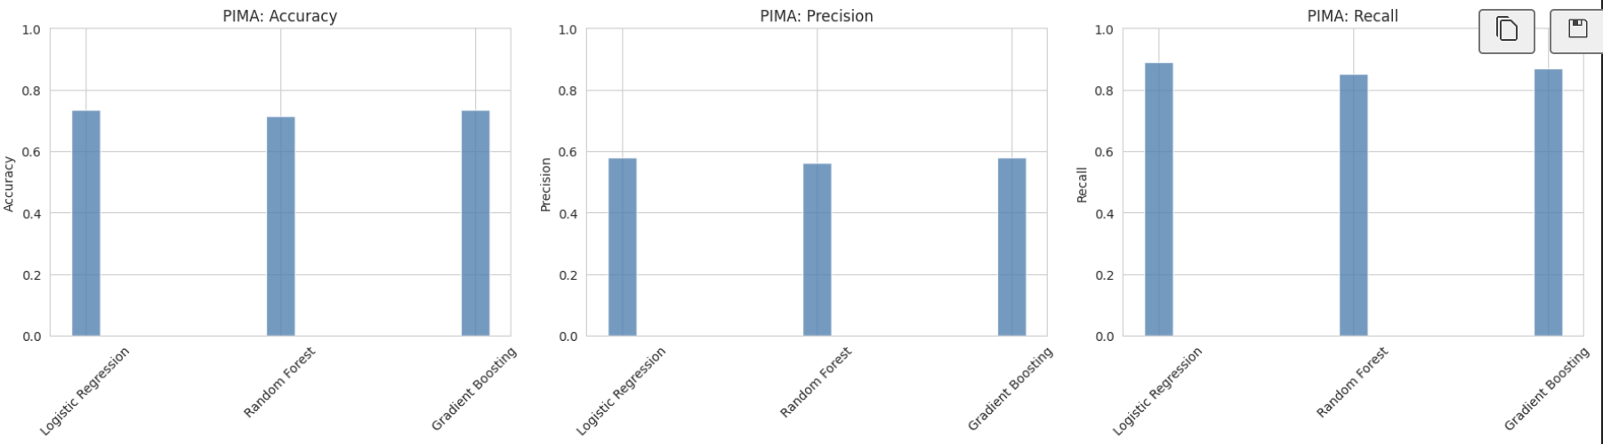
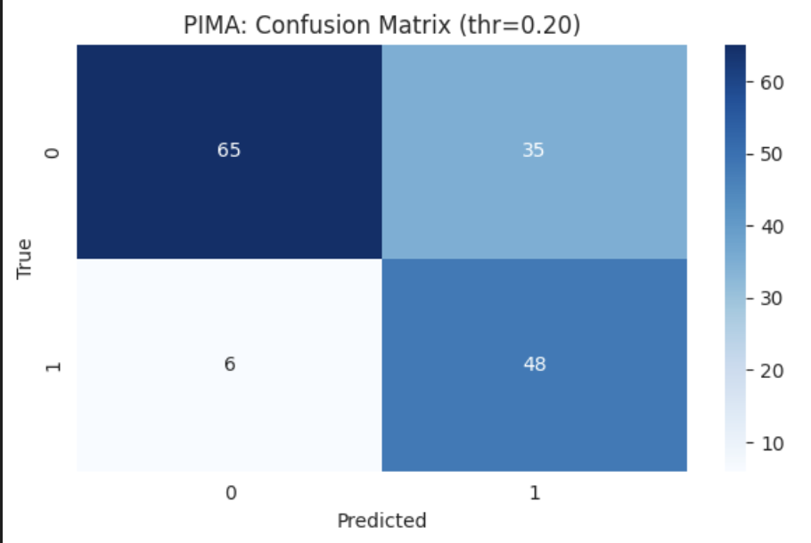
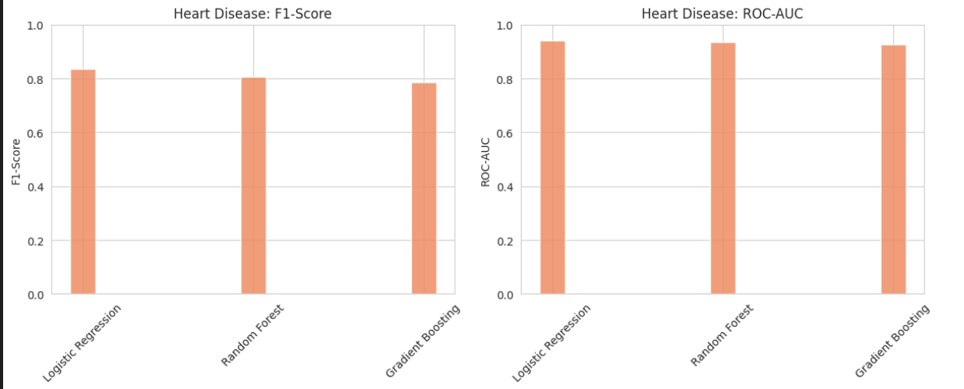
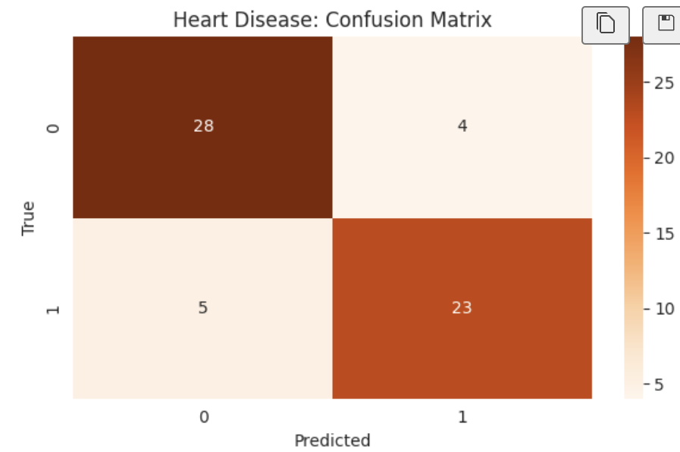
Graphs & Visualization

Slide 7
AI Agent in Action & Conclusion
DiseaseRiskAgent Logic
Conclusion
Low Risk (prob < 0.3)
✅ Successfully built a 5-notebook end-to-end AI agent for disease risk prediction
"Maintain lifestyle, annual checkup"
✅ Real fairness metrics computed — age-group bias identified and documented
Medium Risk (0.3 – 0.7)
"200 min/week exercise, reduce sugar, quarterly checkups"
✅ System is explainable (SHAP + LIME) and ethically analysed
High Risk (prob > 0.7)
"Urgent consultation with healthcare provider"
⚠️ Moderate accuracy due to synthetic dataset — real data would improve performance significantly
Sample Agent Outputs (NB5):
✅ Deployment-ready with documented limitations, encryption, and user rights
Prob 0.218 → Low Risk → Lifestyle maintenance
Prob 0.374 → Medium Risk → Dietary + monitoring
Prob 0.401 → Medium Risk → Lifestyle changes (Heart)
7

