Slide 1

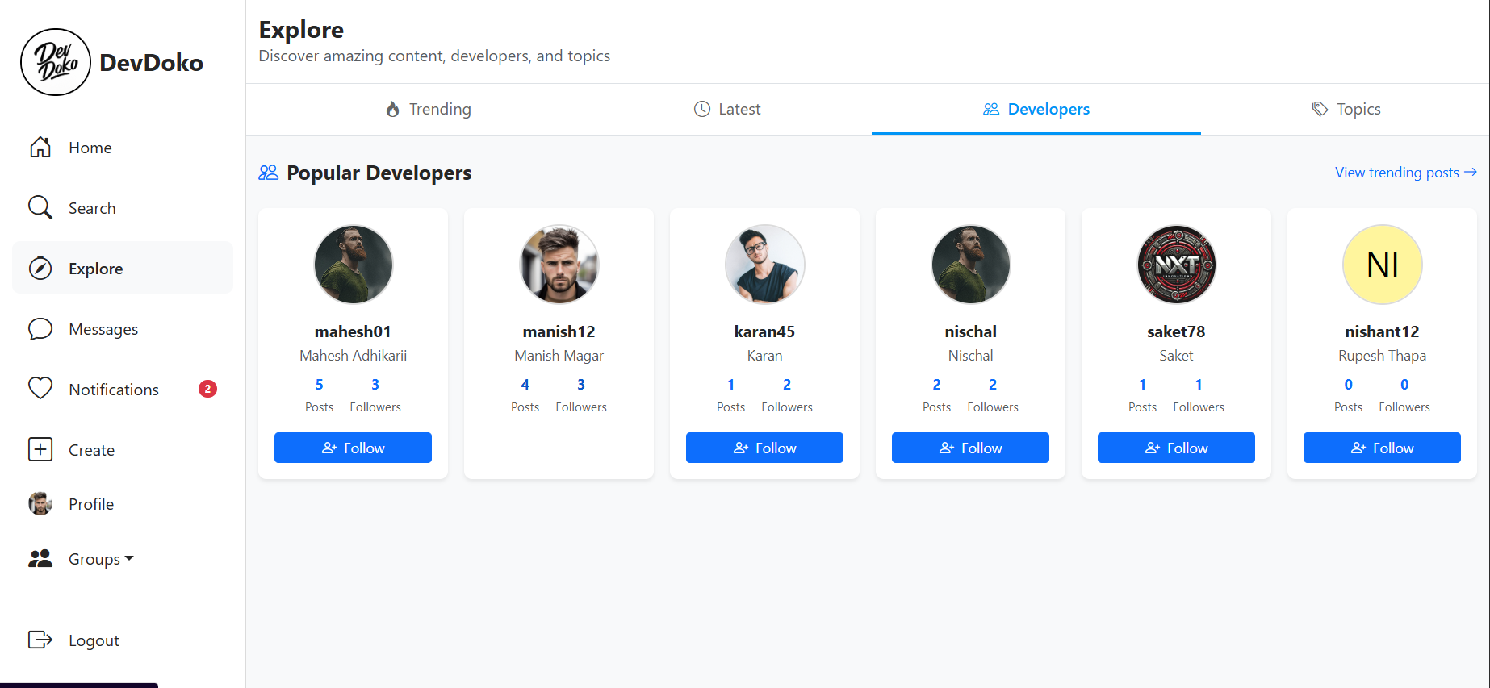
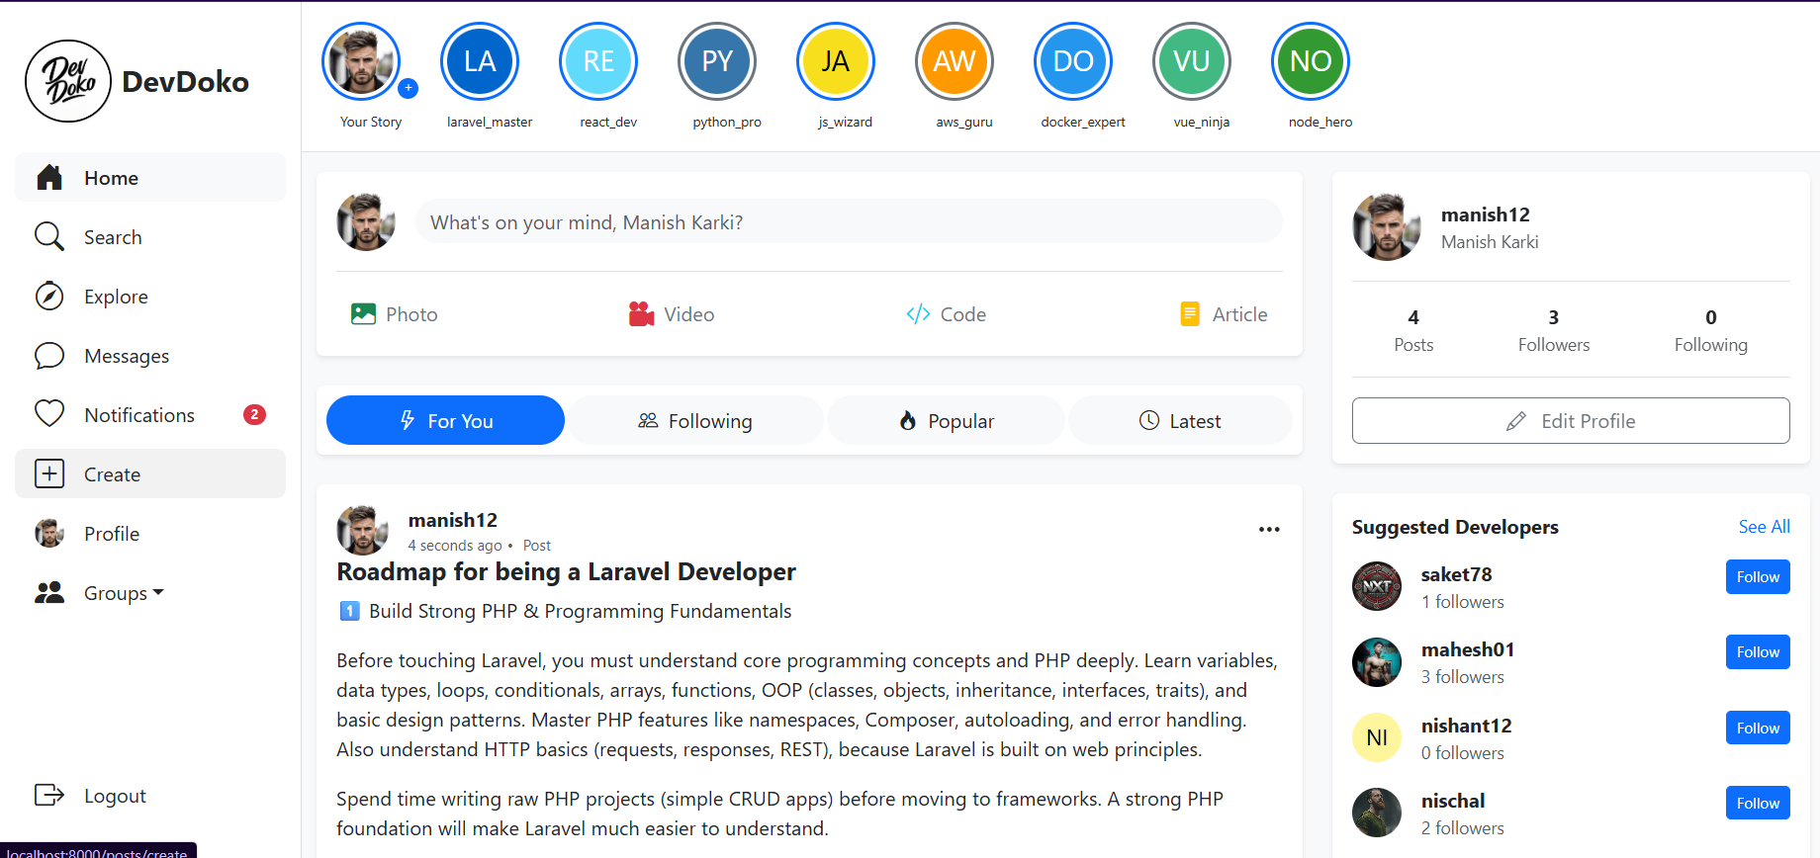
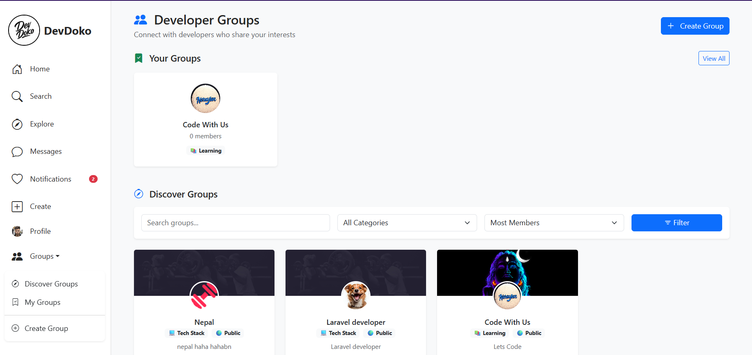
DevDoko
Final Year Project · 2026
Social Media Platform
(DevDoko)
A social network built for developers.
Code Posts
Groups
Messaging
Jobs
Marketplace
Stories
Laravel 12
PHP 8.2
MySQL
Bootstrap 5
Blade
Submitted By
4 members
Narayan Shrestha
780627
Priyanka Karki
780637
Simran Baral
780646
Prekshya Rai
780635
Project Supervisor Er. Hemant Kumar Goit
DevDoko — Social Media Platform for Developers
1 / 7

Slide 2
01 · Overview
Introduction & Objectives
Why a developer-first social network, and what the system sets out to solve.
Problem Statement
Proposed Solution
General social platforms are not built for developers. Code loses its formatting, technical discussion gets buried, and hiring, learning and buying dev gear all live on separate sites.
DevDoko puts posting, code sharing, groups, messaging, jobs, projects and a hardware marketplace into one Laravel application, so a developer never leaves the platform to go from learning to earning.
Objectives
01
02
03
04
Share technical content
Build a developer network
Collaborate in groups
Create opportunity
Rich posts with syntax-highlighted code snippets, images and tags.
Follow, message, react and grow reputation through activity.
Communities with roles, shared resources and events.
Job board with applications plus a peer-to-peer marketplace.
DevDoko — Social Media Platform for Developers
2 / 7

Slide 3
02 · Technology
Tools We Used
Four tools build the whole website. Each one has a simple job.
Laravel
MySQL
Blade
Bootstrap + JS
The Brain
The Storage
The Pages
The Look
Handles all the work — login, posting, sending messages.
Saves everything — users, posts, jobs, chats.
Builds every screen the user sees in the browser.
Makes it look good and work without reloading the page.
How It Works
1
User clicks
2
Laravel works
3
MySQL answers
4
Page shows
→
→
→
Opens a page or presses a button.
Checks who you are, then does the task.
Gives back or saves the data.
The result appears on the screen.
DevDoko — Social Media Platform for Developers
3 / 7

Slide 4
03 · Feature Set
Core Social Features
The feed layer: how developers post, discover and react to content.
01 Posts & Code Snippets
02 Stories
03 Follow & Reputation
• Text, image and code posts
• Language-tagged snippets
• Drafts, edit, pin & share
• Tag and #technology indexing
• 24-hour ephemeral updates
• Viewer list per story
• Auto-expiry on read model
• Image or text based
• Follow / unfollow developers
• Followers & following lists
• Reputation log from activity
• Block list for safety
04 Engagement
05 Discovery
06 Messaging & Alerts
• Like toggle on posts
• Threaded comments & replies
• Comment likes
• Save posts for later
• Report inappropriate posts
• Explore & trending tech
• Global search across entities
• Developer directory
• Feeds: following, popular, latest
• 1-to-1 direct messages
• Emoji reactions & starring
• Read receipts, message search
• Notification centre + counters
DevDoko — Social Media Platform for Developers
4 / 7

Slide 5
04 · Collaboration
Groups, Projects & Collaboration
Where communities form and work actually gets built together.
Groups — the largest module (GroupController, 40 KB)
Projects
Membership & Roles — Join or request to join, approve/reject queues, promote members to admin or moderator, remove members, invite by token link.
A portfolio and collaboration space attached to every developer profile.
Group Posts — Post inside a group, like and comment, pin announcements, and flag posts as important so they surface first.
Publish projects
Title, description, tech tags, repo and live links.
Shared Resources — Upload files and links to a group library with download tracking and likes on each resource.
Fork a project
Clone a project into your own workspace.
Events — Create group events, list upcoming ones and mark attendance.
Collaboration requests
Ask to join, owner accepts or declines.
Activity Log & Discovery — Every group action is logged for transparency; discover, recommended and trending listings help new members find groups.
Project likes
Signal support and feed reputation.
DevDoko — Social Media Platform for Developers
5 / 7

Slide 6
05 · Opportunity
Jobs & Marketplace
The economic layer — hiring pipeline and peer-to-peer trading.
Job Board
Marketplace
1
Post a job — Employers publish roles with stack, type and location.
Listings with galleries — Multiple images per listing, one marked primary.
2
Browse publicly — Job list and detail pages are open to guests, no login wall.
Categories — Browse by category; slug-based listing URLs.
3
Save jobs — Bookmark roles to a personal saved list.
Interest, not checkout — Buyers send interest; sellers accept, decline or counter.
4
Apply — Submit an application with cover note from the job page.
Interest inbox — Separate received and sent views, with a message thread per interest.
5
Track applicants — Job owner reviews applicants in one screen.
Saved listings & searches — Bookmark items and store search filters for reuse.
6
Status updates — Owner moves an application through its status; the applicant sees it under My Applications.
Reviews — Rate the other party after a deal to build trust.
DevDoko — Social Media Platform for Developers
6 / 7

Slide 7
06 · Conclusion
Conclusion & Future Scope
What the system delivers today, and where it goes next.
What We Built
Future Scope
✓ Six integrated modules in one Laravel 12 application.
✓ Full authentication with registration, login and password reset.
✓ Complete social graph: follow, block, message, notify.
✓ Group system with roles, resources, events and audit logging.
✓ Job pipeline from posting through to application status.
✓ Marketplace with images, interests, saved searches and reviews.
→ Real-time messaging and notifications over WebSockets.
→ Public REST API plus a mobile client.
→ Payment gateway so marketplace deals close on-platform.
→ AI-assisted code review and tag suggestions on posts.
→ Full-text search engine for posts, jobs and listings.
→ Analytics dashboard for group and job owners.
Thank You
Narayan Shrestha (780627) · Priyanka Karki (780637) · Simran Baral (780646) · Prekshya Rai (780635) Supervisor: Er. Hemant Kumar Goit
DevDoko — Social Media Platform for Developers
7 / 7

