Slide 1
HamroByapar
Presented By: Bipul Dhungana

Slide 2
Table of contents
01
02
03
Introduction
Objective
Scope
04
05
06
Limitations
Existing System
Development Methodology

Slide 3
Table of contents
07
08
09
Functional Requirements
Non-Functional Requirements
Feasibility Analysis
10
Conclusion

Slide 4
01
Introduction

Slide 5
Introduction
With the rapid growth of ecommerce platforms, government faces significant challenges in tracking, monitoring and collecting taxes from these digital transactions.
Sellers often struggle to navigate tax regulations, leading to errors, inefficiencies or tax evasion.
Similarly, buyers lack visibility and transparency into tax components of their purchase which can result in reduced trust in the system.
These challenges can cause government loss in revenue from tax, an increase in burden for the sellers and lack of transparency.

Slide 6
Introduction
HamroByapar is a multi-vendor e-commerce platform where merchants can sell their products and buyers can buy the products under the regulation of government.
HamroByapar incorporates sellers, buyers and the government in a single platform.
HamroByapar addresses the issues mentioned by providing a transparent platform which calculates the taxes based on the transactions. It provides a government monitoring system that tracks transaction, ensuring effective tax.

Slide 7
02
Objective

Slide 8
Objective
The main objective of this system is:
To provide a platform for sellers to list their products and track sales.
To integrate automated tax calculation during transactions.
To provide a user-friendly platform for users to browse products and complete purchases.

Slide 9
03
Scope

Slide 10
User Scope
Buyer: Users can register and log in to their account, browse available products, view product details, add items to their cart and complete purchase.
Seller: Sellers can register, list their products with details. They can manage their product listings and view tax details.
Government (Administrator): Government authorities can monitor all transactions on the platform and calculate taxes. They can track sales data and ensure the appropriate taxes are being applied.

Slide 11
System Scope
Product and Inventory Management: The system allows sellers to list and manage products.
Automated Tax Calculation: The system automatically calculates taxes on each purchase based on predefined rules.
Transaction Monitoring and Reporting: The system provides the government with access to transactions data. The government can monitor sales and track tax amount collected.

Slide 12
04
Limitations

Slide 13
Limitations
Limited Tax Rules Integration: The system will only use basic tax rules for demonstration purposes.
Manual Data Input: Sellers will manually enter product details and tax categories, which could lead to inaccuracies if not carefully managed.
Prototype: This system is only a prototype with limited functionalities like product listing, tax calculation and transaction monitoring.

Slide 14
05
Existing System

Slide 15
Existing System
Some government monitored e-commerce platforms are:
The Open Network for Digital Commerce (ONDC): It is an initiative by the Indian government to make online shopping fairer and more accessible. Launched on December 31, 2021, it aims to break the dominance of big e-commerce platforms. ONDC helps small businesses join the digital world by creating a shared system that is open to everyone, simplifies processes, and makes online trade easier and more inclusive.
The Commercial Platforms Program: It is run by the U.S. General Services Administration (GSA), makes it easier for federal employees to buy goods online using approved platforms like Amazon Business and Staples. It ensures purchases follow federal rules while offering a simple and user-friendly shopping experience.

Slide 16
06
Development Methodology

Slide 17
Development Methodology
For the development of this project, iterative waterfall model is being used. The iterative waterfall model combines the sequential steps of the traditional Waterfall Model with the flexibility of iterative design.
The stages of iterative waterfall model are:
Requirement Analysis
Design
Implementation
Testing
Maintenance

Slide 18
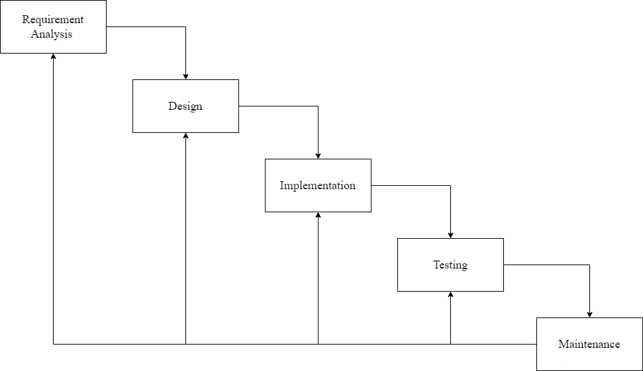
Iterative Waterfall Model
Figure 1: Iterative Waterfall Model

Slide 19
07
Functional Requirements

Slide 20
Functional Requirements
User Registration and Login
Product Management
Product Browsing and Searching
Tax Calculation
Shopping Cart
Transaction Monitoring

Slide 21
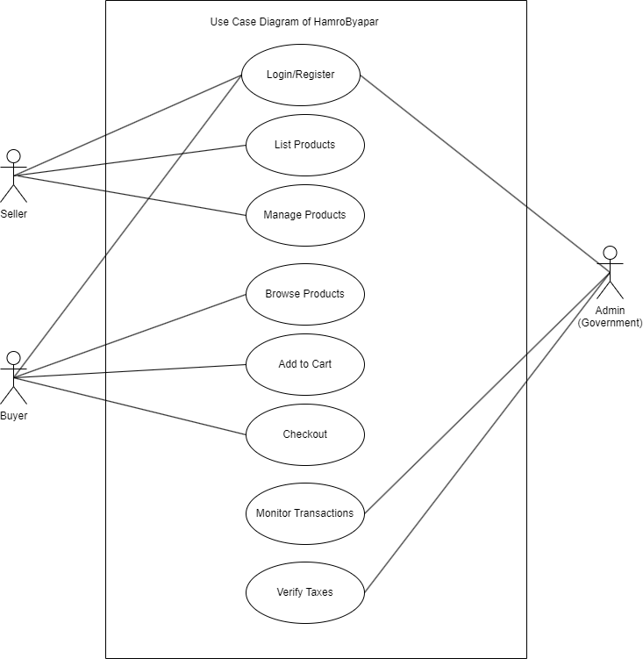
Use Case Diagram
Figure 2: Use Case Diagram of HamroByapar

Slide 22
08
Non-Functional Requirements

Slide 23
Non-Functional Requirements
User friendly Interface
Responsive User Interface
Reliability
Security
Error Handling

Slide 24
09
Feasibility Analysis

Slide 25
Feasibility Analysis
Technical Feasibility
Operational Feasibility
Economic Feasibility
Schedule Feasibility

Slide 26
Months (In Week) | January |  |  |  | February |  |  |  | March
Tasks | 1 | 2 | 3 | 4 | 1 | 2 | 3 | 4 | 1 | 2 | 3 | 4
Planning
Design
Implementation
Testing
Maintenance
Documentation
Table 1: Gantt Chart

Slide 27
10
Conclusion

Slide 28
Conclusion
HamroByapar is designed to provide a simple and trustworthy platform where sellers can reach more buyers, and buyers can easily make purchases. With the government's role in ensuring proper tax collection, the platform helps reduce tax evasion while contributing to government revenue. By promoting transparency and following legal regulations, it builds trust among users.

