Slide 1
Team Name: CanWeGetBackToYouLater
Team Members:
Nischay Ram Mamidi
Kumar Prasun
Kushal Agarwal
Arnav Dhamija

Slide 2

Whiskquilibrium
An Uncanny Tale

Slide 3
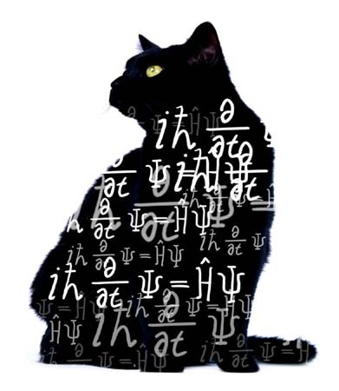
It’s time for an experiment.

Slide 4
Meet Minto

Slide 5
She is a little… special.

Slide 6
Her world is a little… weird.

Slide 7

She’s had enough of it though. Can you help her escape before the wave function collapses?

