Slide 1

CAPSTONE PROJECT
Mutual Fund Analytics
& Business Intelligence Platform
Comprehensive Data Engineering, Analytics & Dashboard Development
Prepared by
Organization
Year
Nischay Aggarwal
Bluestock Fintech
2025–26
Python
Pandas
SQLite
Tableu
NumPy
Financial Analytics
Notes:
1

Slide 2
Executive Summary
Project Overview at a Glance
10
4
8+
360°
Datasets
Integrated
Power BI
Dashboards
Performance
Metrics
Analytics
Coverage
Business Problem
Key Outcomes
Fragmented mutual fund data lacking integrated risk-performance-investor insights
✓ Centralized SQLite star-schema database across 10 datasets
✓ Performance analytics: CAGR, Sharpe, Sortino, Alpha, Beta
✓ Risk models: VaR, CVaR, Rolling Sharpe, HHI concentration
✓ Investor segmentation by demographics, geography & cohort
✓ 4 interactive Power BI dashboards for business decisions
Solution
End-to-end analytics pipeline: raw CSV → SQLite → EDA → Advanced Analytics → Power BI
Technologies
Python · Pandas · NumPy · SQLite · Tableu · Financial Metrics Engine
Notes:
2

Slide 3
Problem Statement & Objectives
Challenges in the Indian Mutual Fund Ecosystem
Key Challenges
Project Objectives
⚡ Fragmented data across multiple disconnected sources
1. Design scalable analytics pipeline
2. Clean & preprocess 10 financial datasets
⚡ Difficulty comparing funds across categories fairly
3. Build centralized relational database
⚡ Limited visibility into risk-adjusted performance
4. Perform exploratory data analysis
⚡ Inadequate understanding of investor behavior
5. Evaluate fund performance with advanced metrics
⚡ No integrated dashboard for strategic decisions
6. Analyze investor demographics & behavior
⚡ Identifying top schemes under varying conditions
7. Develop risk analytics models
8. Create 4 interactive dashboards
Notes:
3

Slide 4
Project Architecture
End-to-End Analytics Pipeline
📂
🔧
🗄
🔍
📈
📊
Raw Data
▶
Data Cleaning
▶
SQLite DB
▶
EDA
▶
Analytics
▶
Tableu
10 CSV Datasets
Preprocessing & Validation
Star Schema
Trends & Patterns
Performance & Risk
Dashboards
Insights
Data Layer Raw CSVs: Fund Master, NAV, AUM, SIP, Benchmark, Transactions, Portfolio, Performance
Engineering Layer Missing value treatment, date standardization, duplicate removal, feature engineering
Database Layer SQLite star-schema: dim_fund, dim_date, fact_nav, fact_aum, fact_transactions, fact_performance
Analytics Layer Performance metrics, risk models, investor segmentation, cohort analysis
Visualization Layer 4 Tableu dashboards covering Industry, Performance, Investors, SIP & Market Trends
Notes:
4

Slide 5
Dataset Overview
10 Financial Datasets | 2022–2026 Coverage
10
4 yrs
8
Star
Datasets
Time Range
Dim/Fact Tables
Schema
Dataset | Description | Key Columns
Fund Master | Scheme info, categories, fund houses | AMFI Code, Fund House, Category, Plan
NAV History | Daily NAV for all schemes 2022–2026 | Scheme ID, Date, NAV Value
AUM Data | Assets under management by fund house | Fund House, Month, AUM (₹ Crore)
SIP Dataset | Monthly SIP contributions & inflows | Month, SIP Amount, Folios, Net Flows
Benchmark | Nifty 50 & Nifty 100 index history | Date, Index, Close Value, Returns
Transactions | Investor-level transaction records | Investor ID, Scheme, Amount, Type
Portfolio | Sector allocation & holdings | Scheme, Sector, Allocation %, Holdings
Performance | Returns, Sharpe, volatility metrics | Scheme ID, CAGR, Sharpe, Alpha, Beta
Notes:
5

Slide 6
Data Cleaning & Database Design
Preprocessing Pipeline & Star Schema Architecture
Preprocessing Steps
SQLite Star Schema
Missing Values
dim_fund
dim_date
Forward-fill for NAV; median for numerical fields
Fund master, category,
fund house, plan type
Date hierarchy:
Year, Quarter, Month
Date Standardization
All date fields → datetime64 unified format
FACT TABLES
Duplicate Removal
fact_nav
fact_aum
fact_transactions
fact_performance
Identified & removed duplicate NAV & transactions
Validation Checks
dim_investor
dim_benchmark
NAV > 0 · Amount > 0 · Valid AMFI codes
Demographics,
city tier, age group
Nifty 50 / 100
index values
Feature Engineering
Daily Returns, CAGR, Fund Scores, Age Groups, Cohorts
Benefits: Faster aggregation · Simplified dashboard integration · Improved scalability
Notes:
6

Slide 7
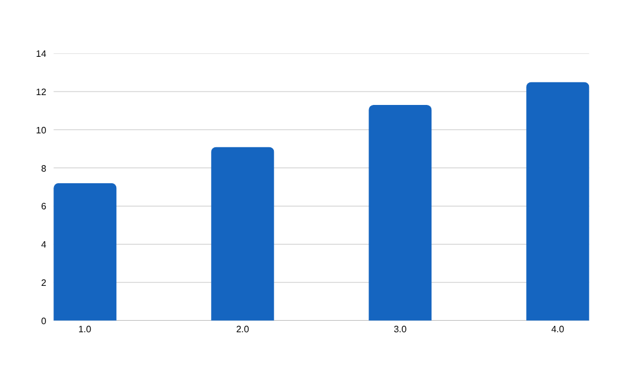
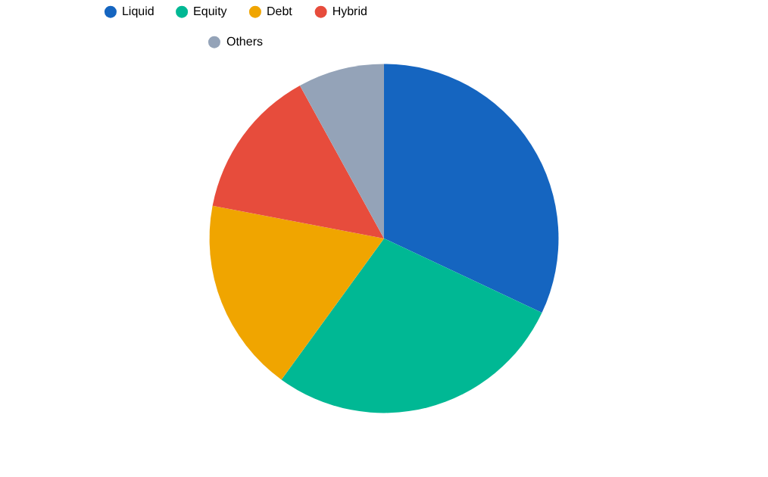
Exploratory Data Analysis
Patterns, Trends & Business Insights from the Data
AUM Growth 2022–2025 (₹ Lakh Crore)
Category Inflows Distribution
Key Observations
► SBI Mutual Fund emerged as industry leader with ~₹12.5 lakh crore AUM by 2025
► Liquid funds received largest category inflows — reflecting preference for liquidity
► Age group 26–35 constitutes the largest investor segment (young professionals)
► T30 metropolitan cities contribute the majority of total investment volumes
Notes:
7

Slide 8
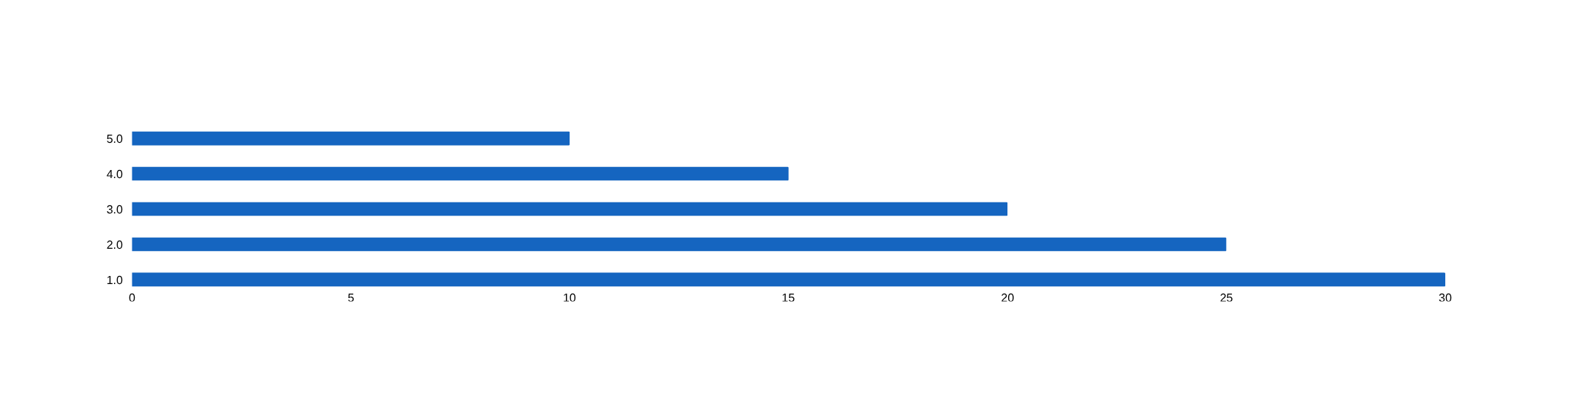
Performance Analytics
Risk-Adjusted Return Metrics & Fund Scoring
CAGR
Sharpe Ratio
Sortino Ratio
Alpha
12.4%
1.42
1.86
+2.3%
3-Year Average
Risk-Adj. Return
Downside Focus
Excess Return
Beta
Max Drawdown
Tracking Error
Fund Score
0.87
-18.5%
3.2%
78/100
Market Sensitivity
Peak-to-Trough
Benchmark Dev.
Composite Score
Composite Fund Score Weights
Notes:
8

Slide 9
Risk Analytics
Portfolio Risk Assessment & Investor Behavior Analysis
Value at Risk
(VaR)
CVaR
(Expected Shortfall)
Rolling Sharpe
(90-day)
HHI Concentration
Index
95% confidence: Max daily loss at -2.3%
Expected loss beyond VaR threshold: -3.7%
Dynamic risk-adjusted performance monitoring
Portfolio concentration risk via Herfindahl-Hirschman
Correlation Matrix — Diversification Opportunities
Investor Analytics
Equity
Debt
Liquid
Hybrid
ELSS
Metric | Finding
Largest Segment | Age 26–35 (Young Professionals)
Gender Split | Male ~67% · Female ~33%
Top Cities | Mumbai, Delhi, Bangalore (T30)
SIP Continuity | Strong — majority maintain > 12 months
Txn Type | Lump-sum leads total volume
B30 Cities | Growing but lag T30 significantly
Equity
1.0
-0.3
-0.4
0.6
0.8
Debt
-0.3
1.0
0.5
0.2
-0.2
Liquid
-0.4
0.5
1.0
0.1
-0.3
Hybrid
0.6
0.2
0.1
1.0
0.5
ELSS
0.8
-0.2
-0.3
0.5
1.0
Notes:
9

Slide 10
Power BI Dashboard Suite
4 Interactive Business Intelligence Dashboards
Dashboard 01
Dashboard 02
Industry Overview
Fund Performance
KPIs:
Total AUM · SIP Inflows · Folios · Schemes
KPIs:
CAGR · Sharpe Ratio · Fund Scorecard
Visuals:
AUM growth trend · Category inflows · Fund house comparison
Visuals:
Risk vs Return scatter · Benchmark comparison · Top performers
→ Interactive · Filterable · Cross-visual Drill-down
→ Interactive · Filterable · Cross-visual Drill-down
Dashboard 03
Dashboard 04
Investor Analytics
SIP & Market Trends
KPIs:
Investor Count · Avg Ticket · Retention Rate
KPIs:
Monthly SIP · Net Flows · Market Correlation
Visuals:
State-wise map · Demographic charts · Transaction trends
Visuals:
SIP vs Nifty line chart · Category momentum · Seasonal patterns
→ Interactive · Filterable · Cross-visual Drill-down
→ Interactive · Filterable · Cross-visual Drill-down
Notes:
10

Slide 11
Key Findings
Data-Driven Insights Across Fund Performance, Investor Behavior & Risk
🏦 Industry
👥 Investor Behavior
● SBI Mutual Fund leads industry AUM at ~₹12.5 lakh crore
● Age 26–35 is the largest investor segment
● Liquid funds receive maximum inflows across categories
● T30 cities dominate; B30 cities are an emerging opportunity
📈 Fund Performance
⚠️ Risk Observations
● Mid-cap & flexi-cap schemes consistently outperform benchmarks
● Portfolio diversification is the key determinant of risk outcomes
● Risk-adjusted performance varies significantly across categories
● Correlation analysis reveals clear sector concentration risks
Notes:
11

Slide 12
Recommendations
Investment, Business & Data Strategy Recommendations
💼 Investment Recommendations
🏢 Business Recommendations
→ Increase allocation to consistently high composite-score schemes
→ Expand investor acquisition campaigns in B30 cities
→ Prefer mid-cap & flexi-cap for alpha generation vs. benchmarks
→ Strengthen SIP programs targeting the 26–35 age demographic
→ Use correlation analysis for optimal diversification strategies
→ Develop tier-specific product offerings for metro vs. non-metro
🛡 Risk Management
🔬 Analytics Strategy
→ Monitor rolling Sharpe Ratios for early risk deterioration signals
→ Incorporate predictive analytics for forward-looking fund scores
→ Implement VaR/CVaR alerts for high-volatility scheme exposure
→ Build automated anomaly detection in transaction data
→ Reduce HHI concentration through systematic rebalancing
→ Integrate real-time NAV APIs for live monitoring dashboards
Notes:
12

Slide 13
Limitations & Future Scope
Current Boundaries & Roadmap for Enhancement
⚠ Current Limitations
🚀 Future Scope
✗ Limited number of schemes in dataset
→ ML Recommendation Engine Personalized fund suggestions using collaborative filtering
✗ Historical analysis may not guarantee future performance
→ Real-Time NAV API Live data integration with AMFI / BSE NAV feeds
✗ Synthetic assumptions used for certain investor demographics
→ Portfolio Optimization Markowitz mean-variance optimization models
✗ No real-time NAV or live market data integration
→ Investor Segmentation ML Clustering for targeted engagement campaigns
✗ Missing comprehensive sector allocation data
→ Sentiment Analysis NLP on fund manager commentaries & news
✗ Market condition changes may affect metric validity
→ Predictive Risk Modeling AI-driven drawdown & volatility forecasting
Notes:
13

Slide 14
Project Impact & Skills Demonstrated
Technical Competencies & Business Value Delivered
Technical Stack
Business Value Delivered
Python
🎯
90%
Evidence-Based Investing
Multi-metric framework enables objective, data-driven fund selection
Pandas / NumPy
88%
SQLite
📊
360° Analytics Coverage
82%
Performance + Risk + Investor + Market in a unified platform
Tableu
85%
🔍
Investor Transparency
Financial Analytics
88%
Clear visibility into fund behaviors and risk profiles
Data Visualization
84%
⚡
Scalable Foundation
Architecture supports future ML, real-time APIs, and AI advisors
Notes:
14

Slide 15
Thank You
Name: Nischay Aggarwal
Institution: Delhi Technological University (DTU) · Class of 2027
Organization: Bluestock Fintech · Capstone Project
Python
Pandas
NumPy
SQLite
Tableu
Financial Analytics
Notes:
15

