Slide 1

Customer Behavior & Retail Sales Analytics
A structured analysis of ~3,900 customer records and transaction-level purchase data — uncovering how demographics, subscriptions, discounts and shipping choices shape revenue across a retail product catalog.
PREPARED BY NISCHAY
PYTHON · SQL · BI DASHBOARD

Slide 2

Headline Numbers
3.9K
$233K
Customers Analyzed
Total Revenue Covered
4
3.75
Product Categories
Avg. Review Rating
Core takeaway: Revenue is driven far more by customer volume than by any single high-value segment — non-subscribers, standard-shipping and "loyal" customers dominate simply because they are the largest groups, while average spend per person is remarkably flat across almost every slice.

Slide 3
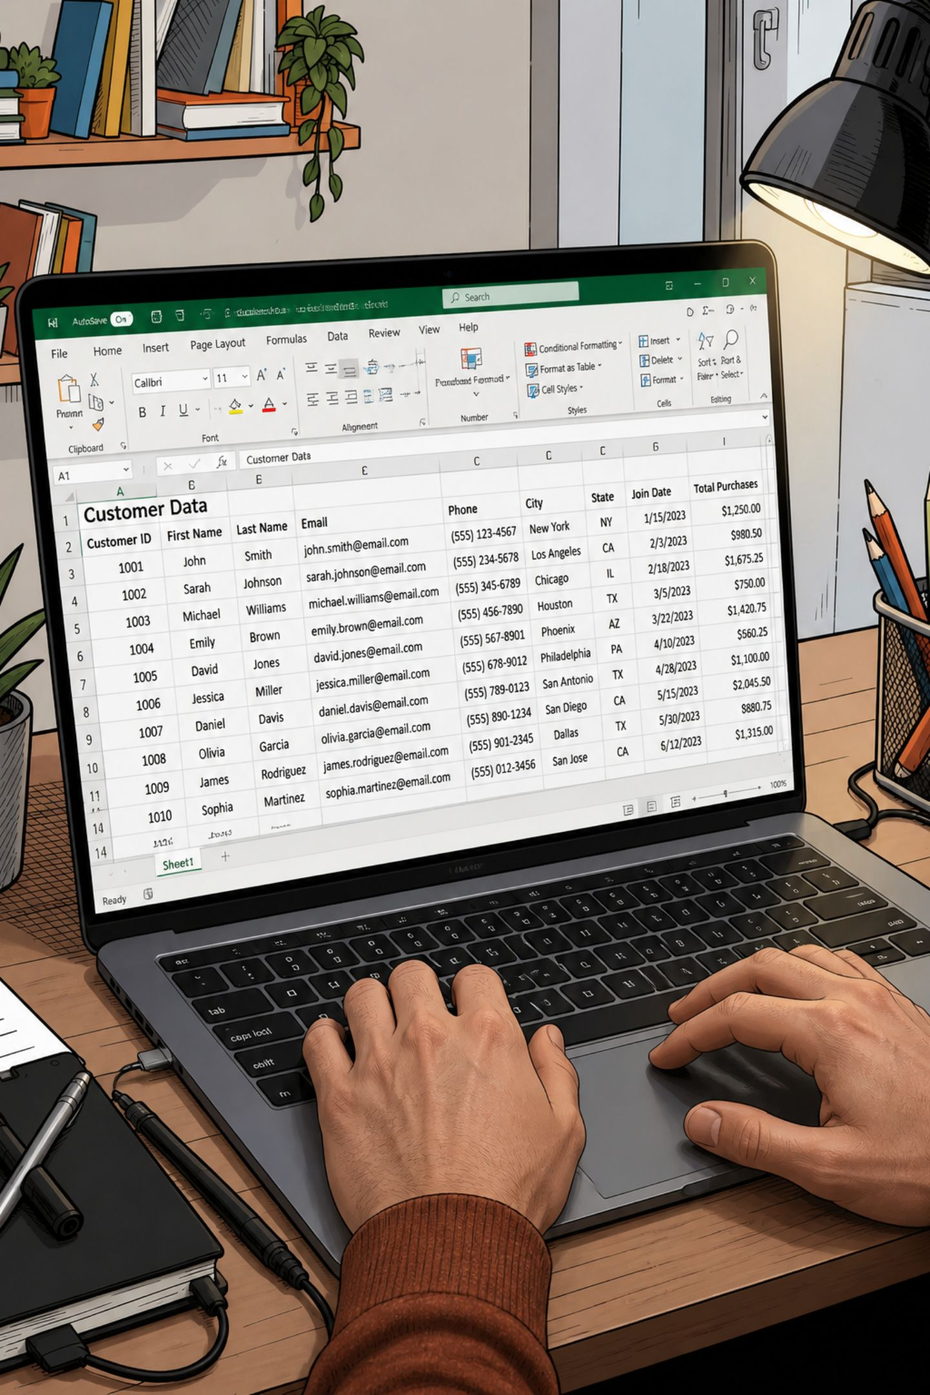
Approach & Methodology
01
Data Cleaning & Feature Engineering
Python (pandas) to profile, clean and enrich 3,900 rows — imputing missing ratings, mapping purchase frequency to numeric days, deriving age groups, dropping redundant columns.
02
Data Querying & Aggregation
SQL queries across customer and purchase tables (839 transaction rows) to compute revenue, averages and rankings by gender, age, subscription, category and shipping.
03
Segmentation & Ranking Logic
Window-function rankings (top items per category, top-rated and most-discounted products) to surface relative winners inside each group.
04
Dashboard Consolidation
One filterable BI dashboard (subscription, gender, category, shipping) with KPI cards, donut, bar and horizontal-bar charts for live slicing.

Slide 4
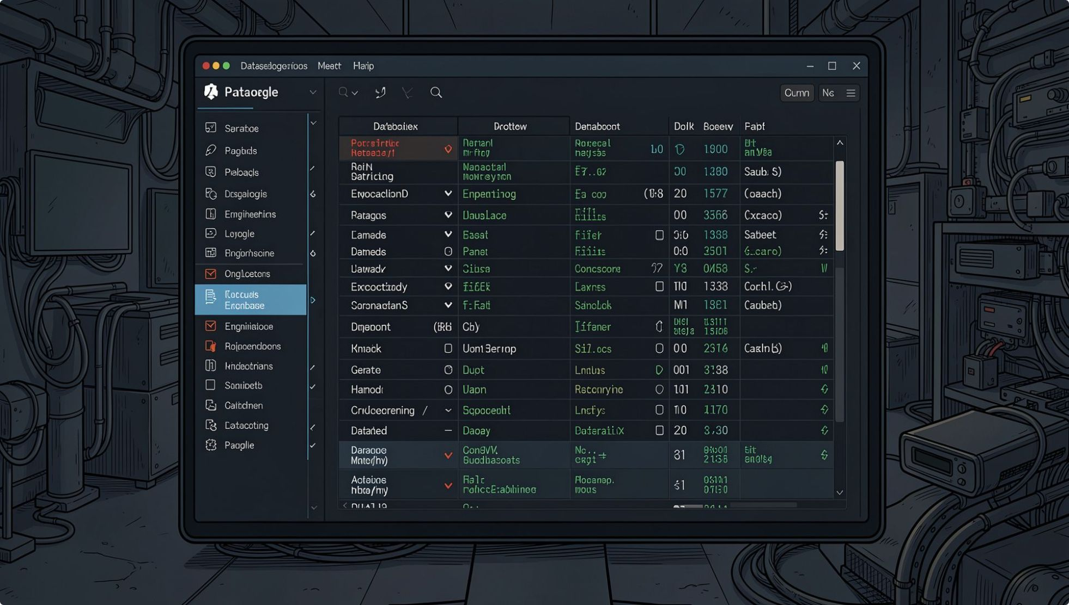
From Raw CSV to Warehouse-Ready Data
Missing ratings: 37 nulls imputed per category median via groupby
frequency_of_purchases: mapped to numeric days (Weekly → 7, Annually → 365)
age_group: quartiles via pd.qcut — Young Adult, Adult, Middle-aged, Senior
promo_code_used dropped: perfect duplicate of discount_applied across all 3,900 rows
Cleaned DataFrame loaded into PostgreSQL customer table via SQLAlchemy + psycopg2.
3,900 × 18
37 → 0
18 → 15
Raw rows × columns
Nulls in Review Rating
Columns after cleanup

Slide 5
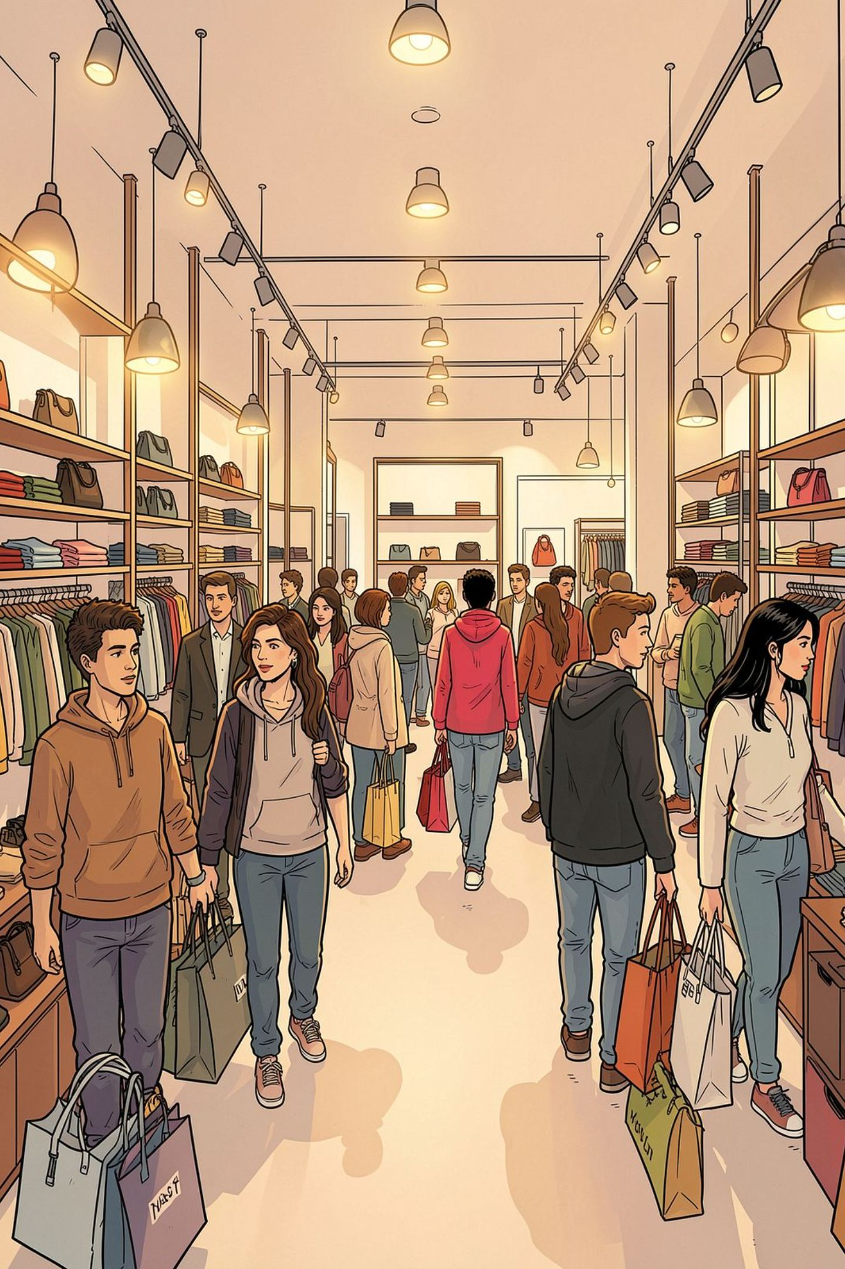
Who the Customers Are
Customer Segments
Revenue by Gender
Loyal: 79.9% (3,116)
Returning: 18.0% (701)
New: 2.1% (83)
Overwhelmingly retention-heavy base — new customers are a thin 2% sliver.
Male: $157,890 (67.7%)
Female: $75,191 (32.3%)
Male customers generate 2.1× the revenue of female customers — the largest single skew in the dataset.
Subscription vs. Spending
No: $59.87 avg · $170,436 total
Yes: $59.49 avg · $62,645 total
Spend is virtually identical. Subscription is a segmentation tag, not a spending multiplier.

Slide 6
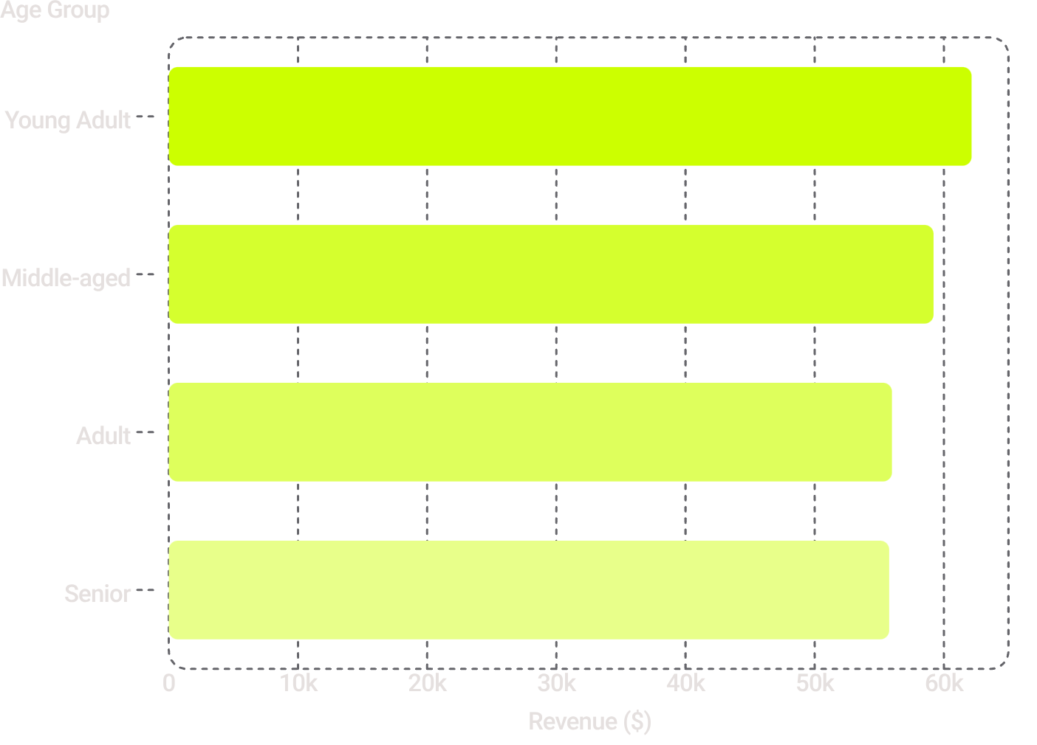
Loyalty & Fulfillment Patterns
Repeat Buyers by Subscription
Revenue by Age Group
Subscribers: 91.0% repeat rate (958 of 1,053)
Non-subscribers: 88.4% (2,518 of 2,847)
The gap is small. Subscription's main value is marginally higher retention — not bigger baskets.
Avg. Spend by Shipping Type
Express: $60.48 · Standard: $58.46
Express spenders pay ~3.5% more per order — a small but consistent signal that faster fulfillment correlates with slightly higher basket value.
Notably flat: gap between highest (Young Adult, $62.1K) and lowest (Senior, $55.8K) is under 11% — age is not a strong differentiator.

Slide 7

What Sells, What Rates Well
Top-Rated Products
Most Heavily Discounted
Item | Avg. Rating
Gloves | 3.86
Sandals | 3.84
Boots | 3.82
Hat | 3.80
Skirt | 3.78
Item | Discount
Hat | 50%
Sneakers | 49%
Coat | 49%
Sweater | 48%
Pants | 47%
Hat appears on both lists — deepest discount (50%) yet top-5 rated (3.80). Ratings across the catalog are tightly banded (3.78–3.86), so heavy discounting looks like a pricing/promo strategy, not a reaction to poor quality.
Order counts for category leaders sit in a tight 145–171 band — no single product dominates its category. Demand is broad-based across the catalog.

Slide 8
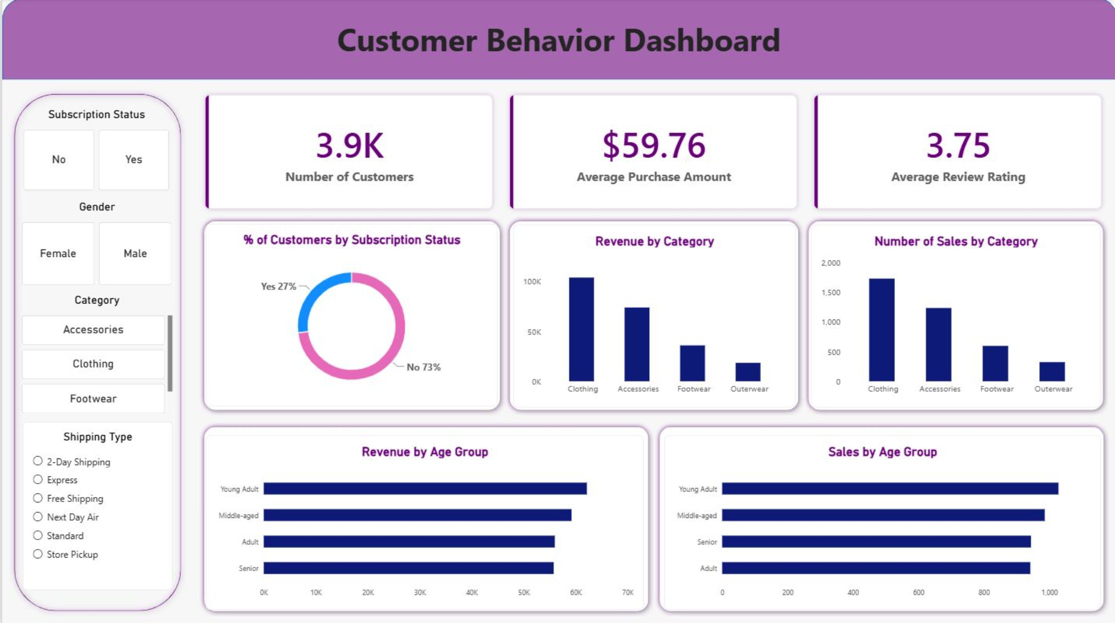
Interactive BI Dashboard
All findings consolidated into a single filterable dashboard — sliced live by subscription status, gender, category and shipping type.
KPI Cards
Subscription Split
Revenue by Category
Sales by Age Group
3.9K Customers · $59.76 Avg. Purchase · 3.75 Avg. Rating
Yes: 27% · No: 73%
Clothing ~$90K · Accessories ~$70K · Footwear ~$40K · Outerwear ~$20K
Young Adult ~950 · Middle-aged ~900 · Senior ~850 · Adult ~800

Slide 9
Insights & Next Actions
1. Investigate the gender revenue gap
2. Redesign the subscription program
3. Use Express shipping as a soft upsell
Male customers drive 67.7% of revenue — check whether it's driven by basket size, order frequency, or category mix.
Subscribers spend the same and churn only slightly less. Add spend-linked benefits (tiered rewards, free Express shipping).
The $2 gap between Express and Standard spenders is small but consistent — test free Express above a spend threshold.
4. Re-evaluate deep discounting
5. Treat age and category demand as stable
Hat, Sneakers and Coat carry ~48–50% discounts while rating comparably to full-priced items — likely over-discounted.
Both are evenly distributed — optimize operations (inventory, fulfillment) around this evenness rather than chasing a "winner."

Slide 10
Tools & Method
Python (pandas)
SQL · PostgreSQL
Data profiling, cleaning, imputation and feature engineering on the raw 3,900-row dataset.
Aggregation, ranking, joins and window functions across customer and purchase tables.
BI Dashboard
Customer Segmentation
Filterable, stakeholder-facing visualization with KPIs, donut, bar and horizontal-bar charts.
Loyal / Returning / New segments, age quartiles, gender and subscription-based groupings.
SQLALCHEMY
PSYCOPG2
DATA VIZ

