Slide 1


Department Of Mechanical Engineering
Project Review-3
“Design and development of light weight ornithopter”
1. NIKHIL S N 1NT15ME097
2. NISCHAY R 1NT15ME100
3. PRAJWAL C 1NT15ME110
4. BASAVARAJ 1NT15ME024
PROJECT GUIDE: Dr.SANTOSH KUMAR
(Asst.professor)
PROJECT CO-GUIDE: Mr.Kotgi Kotresh
(Asst.professor)
BB26

Slide 2
Abstract
The artificial design of the bird was started out with the inspiration of bird flight and breaking that complex motion into a mechanism that is easily replicable.
The bird designed is completely mechanical for steady flight and it will also serves video surveillance features with live feed send to a controlled device on ground through Wi-Fi.
Thus the design has taken a smart turn to building an UAV that flies like a bird, making it blend in and undetectable to the naked eye and provide surveillance capability over an area to any number of people on ground thus providing a new version to the concept eyes in sky.

Slide 3
Objectives
Develop concept sketches into a physical model through a design process.
To investigate the characteristics of ornithopter UAVs.
To introduce it in military applications such as aerial reconnaissance without alerting the enemies that they are under surveillance.

Slide 4
LITERATURE SURVEY
S.NO | RESEARCH PAPER TITLE | AUTHOR NAMES | YEAR OF PUBLICATION | MAJOR FINDINGS
1. | Design and Construction of an Autonomous Ornithopter | Zachary John Jackowski | May 7, 2009 | : The ornithopter was designed to be as lightweight and high performance as possible so as to maximize payload capacity and are intended to fail in predicable and ﬁeld repairable ways.
2. | Bio-Inspired Design of Micro Ornithopters with Emphasis on Locust Hindwings | Rajeev Kumar | July 3rd 2012 | Two sets of locust hindwings are extracted, tested and compared with artificial wings. Tests are performed at zero free stream velocity on two different transmissions, one strictly flapping and the other a combination of active flapping and pitching
3. | Ornithopter with Articulated Wings | Sushobhan Guha | April 2017 | ornithopter which is a highly efficient machine with low frequency is developed and numerical analysis of flapping wing was done

Slide 5
LITERATURE SURVEY
S.NO | RESEARCH PAPER TITLE | AUTHOR NAMES | YEAR OF PUBLICATION | MAJOR FINDINGS
4. | Design, Fabrication and Testing of a Passively Morphing Ornithopter Wing for Increased Lift and Agility | Dr. David Stargel | 12/13/2012 | Passive morphing was achieved through an optimally designed compliant spine that mimics the function of a bird’s wrist. compliant mechanisms proved to be not only feasible, but also beneficial for application to general air vehicle design.
5. | Designing a Biomimetic Ornithopter Capable of Sustained and Controlled Flight | Joon Hyuk park | 2008 | ornithopter under unsteady state flight regime was developed and believed that an ornithopter smaller than 10 cm should follow the features of much smaller insects based on their wings and flight mechanisms.
6. | . Development of next generation ornithopter prototypes | John Wood, Daniel Jensen, Peter Leetsma | 2009 | The two primary concepts researched and prototyped in the completion of this effort were the disk-rocker mechanism and the Modified Four-Bar Mechanism. testing of the prototypes against the specified requirements are shown.

Slide 6
LITERATURE SURVEY
S.NO | RESEARCH PAPER TITLE | AUTHOR NAMES | YEAR OF PUBLICATION | MAJOR FINDINGS
7. | Design , Fabrication and Testing of flapping wing micro air vehicle | K. P. Preethi Manohari Sai, K. Bharadwaj, K. Ravi Teja | 2013 | The chosen mechanism for turning rotation of the DCmotors into a flapping movement of the wings is accurate and leads to error free functioning. Through more than 300 tests the wings were optimized in angle and chord length that yield to enough lift generation for hover flight
8. | Evolving buildable flapping ornithopters | Floris van Breugel, Hod Lipson | 2010 | In order to create more realistic flapping patterns that can be achieved with off-the-shelf servo motors more work will need to be done to minimize the frequency and velocities.
9. | Innovative flapping umbrella | Yanming wei | 2007 | Instead of propeller driven helicopters a flapping umbrella driven ornithopter that is powered by pulse power supply.
10. | Development of tabletop test rig for aerodynamic characterization of ornithopter. | Divakar anand,Chandrasekhar | 2011 | This proposes a simple and cost efficient model for real time assessment of lift and thrust forces and also flapping frequencies.

Slide 7
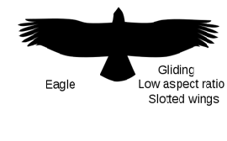
BODY DESCRIPTION
Body length : 12 inches
Wing span : 24 inches
Body weight : 650 - 750 g
Material used
Body : Carbon fibre
Wings : Polyfoam

Slide 8
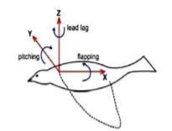
METHODOLOGY
1) KINEMATIC OF WINGS :
The flapping wing motion ornithopters can have three basic motion with respect to axis based on the kinematics motion of wing and mechanism of force generation .
Flapping , which is up and down plunging motion of the wing . Flapping produces the majority of the bird's power and has the largest degree of freedom.
Feathering is the pitching motion of wing and can vary along the span.
Lead-Lag, which is in-plane lateral movement of wing.
Fig: Moments on Wing

Slide 9
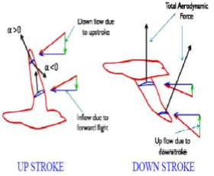
2) Flapping Wing Forces :
UP STROKE :
Up stoke provide the necessary thrust and the wing is slightly folded inwards to reduce the energetic cost of flapping with flight.
Birds change the angle between the up stroke and the down stroke of their wing.
DOWN STROKE :
During the down stroke the angle of attack is increased and is decreased during the up stroke.
During the down stroke the total aerodynamic force is tilted forward and has two components, lift and thrust.

Slide 10
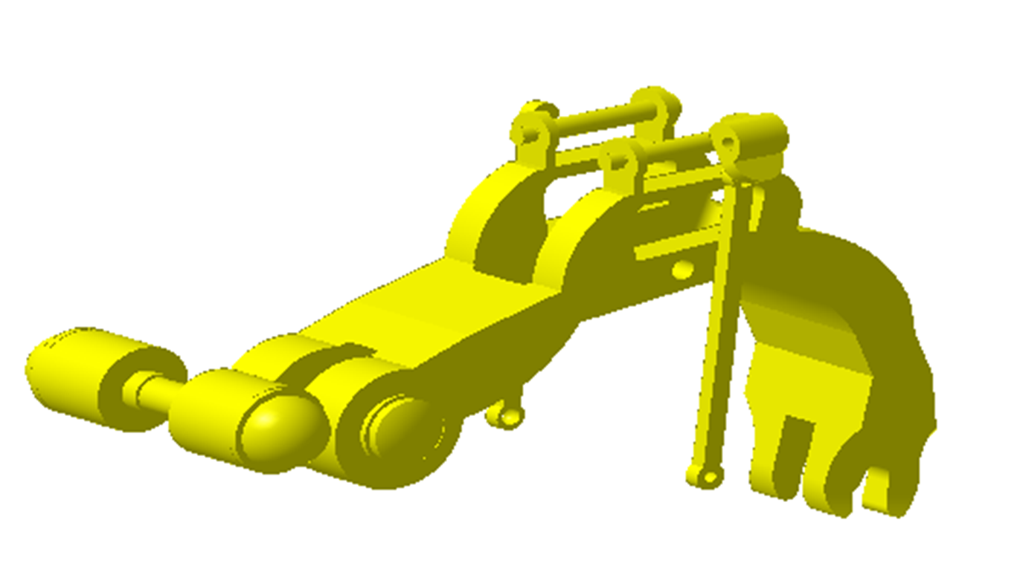
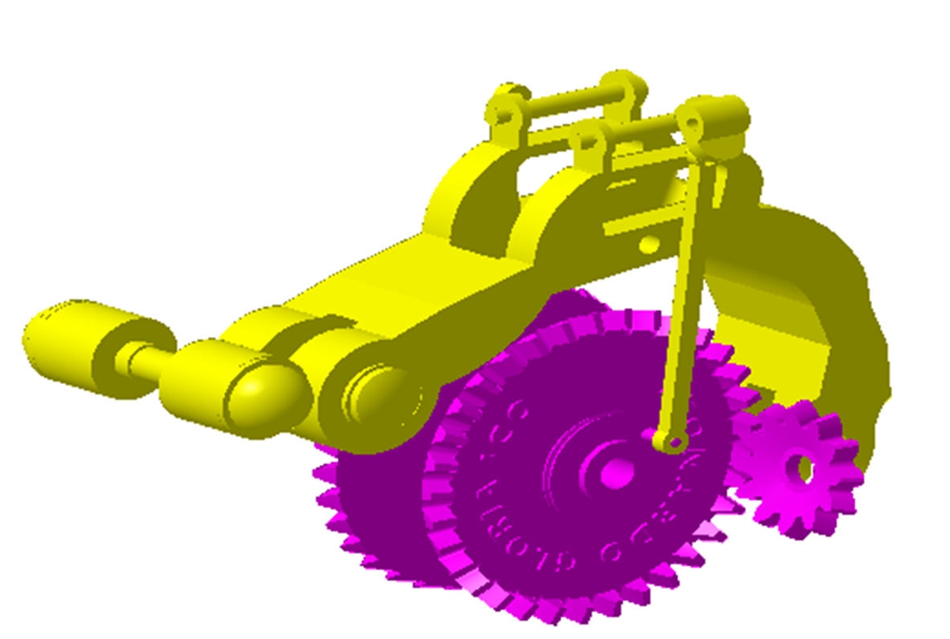
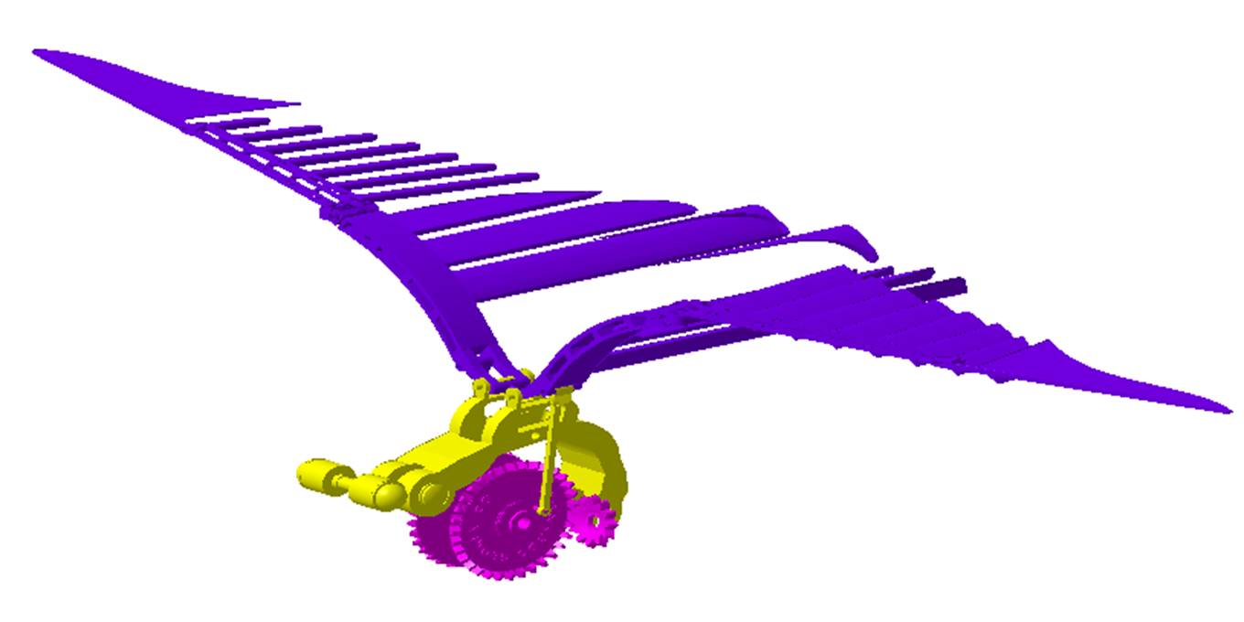
DESIGN MECHANISM
Fig: structure
Fig: Mounting of gears
Fig: Wings

Slide 11
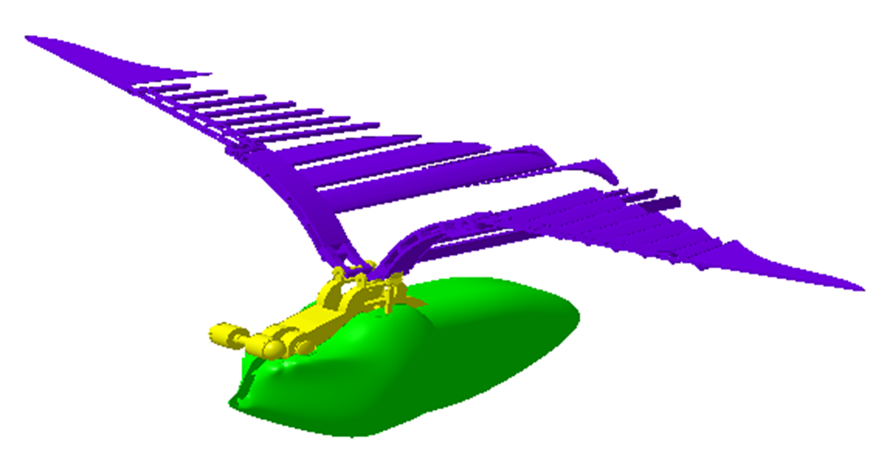
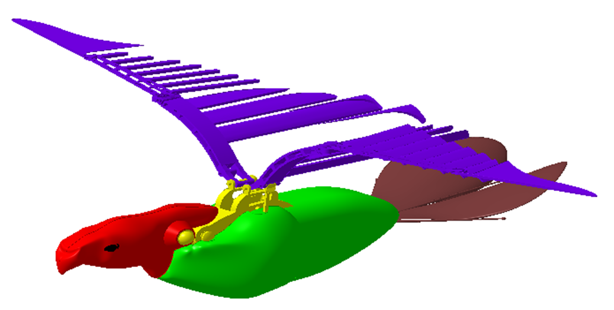
Fig: Body
Fig: Neck and tail part

Slide 12
Components used
Brushless DC motors:- 4 in no.s /2000 rpm each, out of which two are for wings and two are for head/tail.
Bevel gears:- Used as a reduction gear for reducing the speed.
Transmitter and receiver :- 2.4 GHz zigbee technology.
Motor positioning sensor:- HALL sensor( 3XTLE 4906).
Battery: Lithium battery(12V, 2200mA).
Micro-controller:-Arduino @M328.

Slide 13
Weight calculations
Conclusive weight estimation:-
1. 2* main rib joint: 16.865*2 = 33.72 g
2. Main rib support: 16.865/2 = 8.432 g
3. 3* gear= 24 g
4. 10* main stiffeners= 4*10 = 40 g
5. 8* secondary stiffeners= 3*8 = 24 g
6. Carbon fiber rods = 40 g
7. Battery pack = 99 g
8. 4* micro servo= 2*9 + 2*22= 62 g
9. 1* motor= 60 g
10. Clamps and hinges = 50 g
11. Receiver = 8 g
12. Camera = 32 g

Slide 14
Expected Outcome
Through the use of light-weight materials in the market we are able to create an UAV that exactly mimics the flight pattern of a bird and fly undetected. The structure of the bird and its behavior makes it blend in and not easily noticeable to the eye.
The flight pattern helps in slow flying of the UAV and the onboard camera module helps in high quality live video capture which is streamed to any device on ground, even to the mobile phone.

Slide 15
Ghantt Chart
2018
Aug
Sep
Oct
Nov
Dec
Jan-2019
Feb
Mar
2019
Literature Survey
Experimentation
Aug
Sep
Oct
Nov
Dec
Jan-2019
Feb
Mar
Report Writing
184 days
123 days
90 days

Slide 16
THANK YOU

