Slide 1
Explainable Claim: Claim check worthiness using rationality labels
G25
Ritvik Shekhar (2023440)
Hitesh Bhat (2023244)
Nischay Soni (2023353)

Slide 2
Introduction
@user1:US tax dollars allowed to fund a coronavirus project in Wuhan
Social media has transformed information sharing making it instant, global, and widely accessible
However, this rapid spread has also led to a rise in misinformation and false claims
Such misinformation can have serious real-world consequences, including:
Misleading public opinion
Threats to public health (e.g., COVID misinformation)
Social and political instability
Due to the massive volume of online content, manual verification is not feasible
Therefore, there is a critical need for automated systems to identify claims that require fact-checking
@user2:If you have ever eaten raw cookie dough you are immune to the coronavirus
These are some of the example of tweets which can lead to misinformation in the people of country. The first tweet can even lead to protest against government .

Slide 3
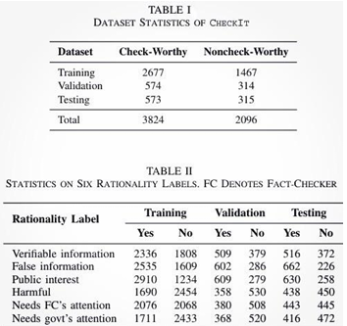
DataSet
We use the CheckIt dataset (Sundriyal et al., 2025), a large-scale, manually annotated Twitter corpus, for explainable claim check-worthiness detection. The dataset comprises 5,920 claims sourced from COVID-19 and political discourse on Twitter.
The DataSet Contained 6 rationality labels For verifying Claim Cheek Worthiness. The Labels are shown in the Table II.
The Distribution of Data is shown in Table I.
The dataset is split into training (70%), validation (15%), and test (15%) sets.

Slide 4
Baselines
SVM + TF-IDF: A classical baseline inspired by early claim check-worthiness systems such as ClaimBuster. Claims are represented using TF-IDF features and classified with a LinearSVC. This provides a strong non-neural reference point.
BERT (Fine-tuned): A pretrained BERT-base-uncased model fine-tuned on the CheckIt training set for binary check-worthiness classification. Extended with multi-head outputs for rationality label prediction.
RoBERTa (Fine-tuned): A robustly optimised BERT variant fine-tuned for the downstream task. RoBERTa's improved pretraining methodology yields stronger contextual representations than BERT.
XLNet(Fine-tuned): An autoregressive transformer fine-tuned for check-worthiness classification. XLNet captures bidirectional context through permutation-based language modelling, offering complementary strengths to BERT-style models.
CheckMate: The current state-of-the-art, which combines a contextual network (CoNet) and a linguistic network (LiNet) with attention heads specialised per rationality label. CheckMate is our primary point of comparison.

Slide 5
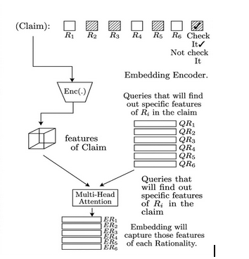
Methodology
We propose Claim-Aware Contrastive Learning (CACL), a multi-label contrastive learning framework built on the principle that check-worthiness is a consequence of specific rationality factors. The architecture consists of four main components:
(1) a BERT-based token encoder
(2) a Claim-Level Embedding Network (CLEN)
(3) a Rationality Aggregator
(4) a Prediction Head
Stage 1: The architecture of the claim-level embedding network. We have a query matrix that queries for the signal of that rationality label in the claim. We have used multihead attention to do so.

Slide 6
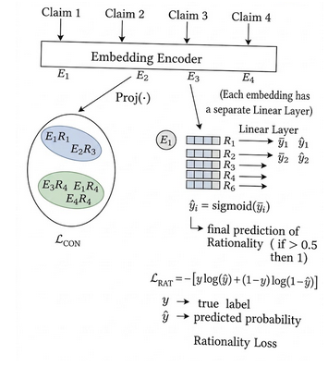
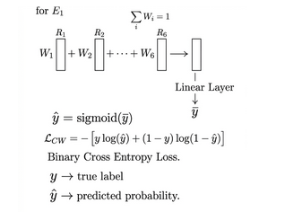

How Did The Training Happen?
Initially, the model is trained to predict: Check-worthiness (CW) and Rationality labels.This helps the model to learn meaningful initial embeddings that capture: Semantic information and Rationality-related features
Once the embeddings become sufficiently informative, we introduce contrastive learning .In this stage: Embeddings of claims with similar rationality labels are pulled closer.
Stage 2: It represents how the prediction is made for each rationality head. The L_rat is a loss function used for rationality prediction. L_con is a loss to bring the same rationality together. Clustering is performed on a batch of inputs.
Stage 3: This denotes how claim check worthiness is predicted. The vectors of R1… R6 are taken as a weighted average, and the resulting vector output is passed through the linear layer for making the prediction.

Slide 7
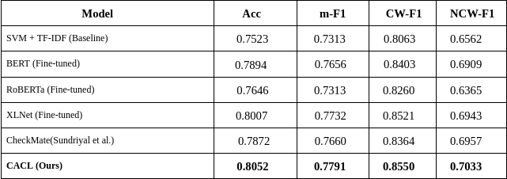
Results and Observations

Slide 8
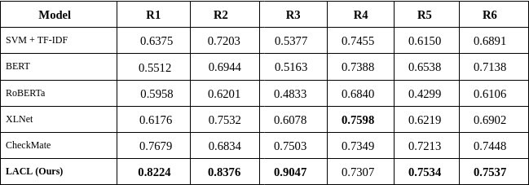
F1 score for rationality Labels

Slide 9
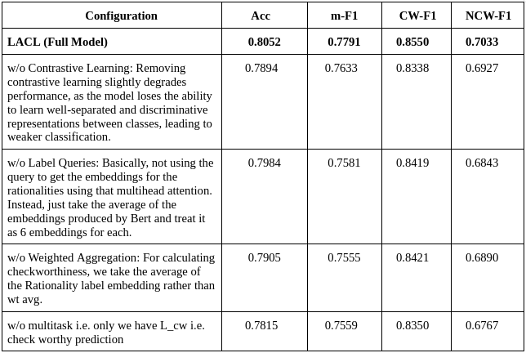
Ablation

Slide 10
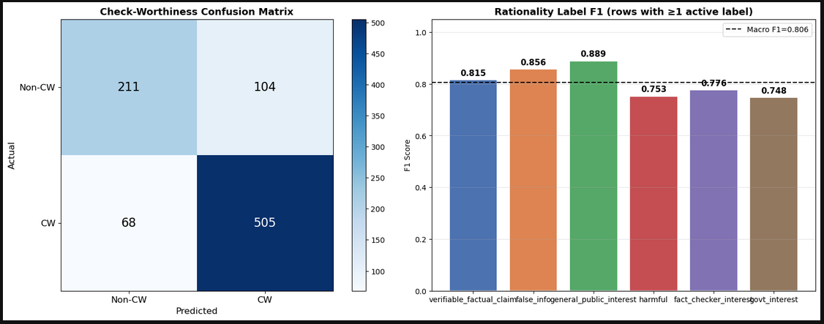
Ablation and Analysis
Ablation:
Label queries are crucial as they extract rationality-specific information.This is one of the most important component of our architecture.
Contrastive learning also helps to learn better class representation.
Weighted aggregation helps the model focus on more relevant rationality factors
Analysis:
The model performs better on check-worthy claims, but struggles with non-check-worthy cases, often misclassifying them as check-worthy.

Slide 11
Error Analysis
We qualitatively examine misclassified examples to identify persistent failure modes:
●​ Sarcasm/joke: Claims such as 'If we all stop breathing, the spread would stop' are misclassified because the model is not able to understand that whether it is a joke or sarcasm.
●​ Subtle public-interest claims: Short claims without explicit harm-related keywords but with broad public relevance (e.g., claims like “updates has beem made in government policy”) remain challenging for the model, suggesting that additional factual knowledge injection could be beneficial.

Slide 12
Future Work And conclusion
We introduced CACL (Claim-Aware Contrastive Learning), a framework for explainable claim check-worthiness detection that models check-worthiness through underlying rationality factors. By combining a Claim-Level Embedding Network, rationality-specific cross-attention, a weighted aggregation module, and supervised contrastive learning, CACL achieves state-of-the-art performance on the CheckIt dataset with consistent gains across all rationality labels. Ablation studies confirm the effectiveness of each component.
Future work includes extending CACL to multilingual settings, especially for low-resource languages, and incorporating external knowledge to better handle nuanced claims as seen in the error analysis. Expanding to multimodal data (images and memes) are also promising directions.

Slide 13
Prompts Used
How can we use contrastive learning for multi-label rationality prediction in claim check-worthiness detection?
How is the rationality loss and contrastive loss calculated in a joint learning framework?
How should the CW head be connected to the rationality embeddings to make predictions explainable?
How do we design a fair ablation study when the full model uses two-phase training?
How should BERT parameters be handled differently from task-specific heads during two-phase training to prevent representation degradation?

Slide 14
Contributions
Report: Hitesh Bhat
Implementation Of Baseline: Nischay Soni
CACL Architecture Design : Ritvik Shekhar

