Slide 1
VGP-AYUSH – Vaidya Granth Parakh
Expert Review of AYUSH Medical Textbooks.
CSE7101- Capstone Project
Final Review
Batch Number: PSCS_46
Roll Number | Student Name
20221CSE0637 | NISCHAY N RAJ
20221CSE0661 | CHARANYA SRI S
20221CSE0655 | ANUSHA D R
Under the Supervision of,
Ms.Rohini A
Assistant Professor
School of Computer Science and Engineering
Presidency University
Name of the Program: CSE7101- Capstone Project
Name of the HoD: Dr. Blessed Prince
Name of the Program Project Coordinator: Mr. Muthuraju V
Name of the School Project Coordinators: Dr. Sampath A K
Examiners: Anu Joseph , Riya Sanjeesh

Slide 2
Content
Problem Statement
Objectives
Approach
Existing Methods & Drawbacks
Proposed Method’s & Feasible Study
Architecture Diagram’s
System Module’s
Timeline of the Project
Github Link
References

Slide 3
Problem Statement Number: PSCS_46
Organization: Ministry of AYUSH
Category (Hardware / Software / Both) :Software Project.
Problem Description: Medical education depends on high-quality textbooks to ensure accurate learning.
In ASU systems (Ayurveda, Unani, Siddha), many books claim to follow CCIM/NCISM guidelines, but the quality is inconsistent.
Some books are well-researched and align with the curriculum.
Others are substandard, poorly structured, and written with vested interests.
Low-quality resources misguide students, causing knowledge gaps and lowering competency levels.
NCISM developed an official assessment scale to evaluate and recommend textbooks.
Current evaluation process is manual, time-consuming, and not easily accessible to all stakeholders.

Slide 4
Objectives:
Develop a web-based application to assess the quality of textbooks, reference books, and e-books using NCISM’s assessment scale.
Enable distributed reviewers across the country to evaluate books online.
Automate review collation and summarization for faster decision-making.
Provide transparent, publicly accessible results to guide students, teachers, and regulatory bodies.

Slide 5
Approach:
First platform aligned with NCISM’s official assessment scale – Digitizes and standardizes the evaluation of AYUSH textbooks, reference books, and e-books.
Distributed multi-reviewer evaluation – Assigns three reviewers per book, ensures balanced scoring, and reduces bias through automated collation.
Role-based dashboards for all stakeholders – Authors submit books, reviewers evaluate, and administrators oversee & publish results.
Transparent public repository – Students, teachers, and regulators can easily access approved/recommended textbook lists.
Roadmap from web application to nationwide deployment – Initial web platform (Node.js + MongoDB), followed by cloud hosting (AWS/Heroku) for scalability and accessibility.

Slide 6
Existing Methods & Drawbacks
Existing Methods:
Manual review committees formed under NCISM.
Rubric-based evaluation frameworks (e.g., Sharma et al., 2022).
Peer-review models used in medical curriculum evaluation.
Drawbacks:
Manual & slow – difficult to scale nationwide.
Geographically constrained – experts are dispersed across India.
Bias & inconsistency – lack of uniform digital process.
Limited accessibility – students and institutions cannot easily view results.
Example:
NCISM’s official review panels (2023)
  Strength: Authoritative framework for ASU textbook assessment.
  Weakness: Entirely manual, non-transparent to public, delays in publication of approved book lists.

Slide 7
Proposed Method & Feasibility Study
Proposed Method:
Web-based evaluation platform (Frontend: HTML/CSS/JS, Backend: Node.js + Express.js, Database: MongoDB).
Multi-reviewer model → 3 reviewers per book, automated score collation.
Role-based dashboards → Authors, Reviewers, Administrators.
Central repository → Students and teachers can access approved/rejected book lists.
Feasibility:
Technology: Open-source MERN stack, scalable, cloud-hosted.
Cost: Low – only basic hosting and cloud services needed.
Resources: Student team + NCISM assessment scale.
Impact: Faster, transparent, bias-free book evaluations nationwide.

Slide 8
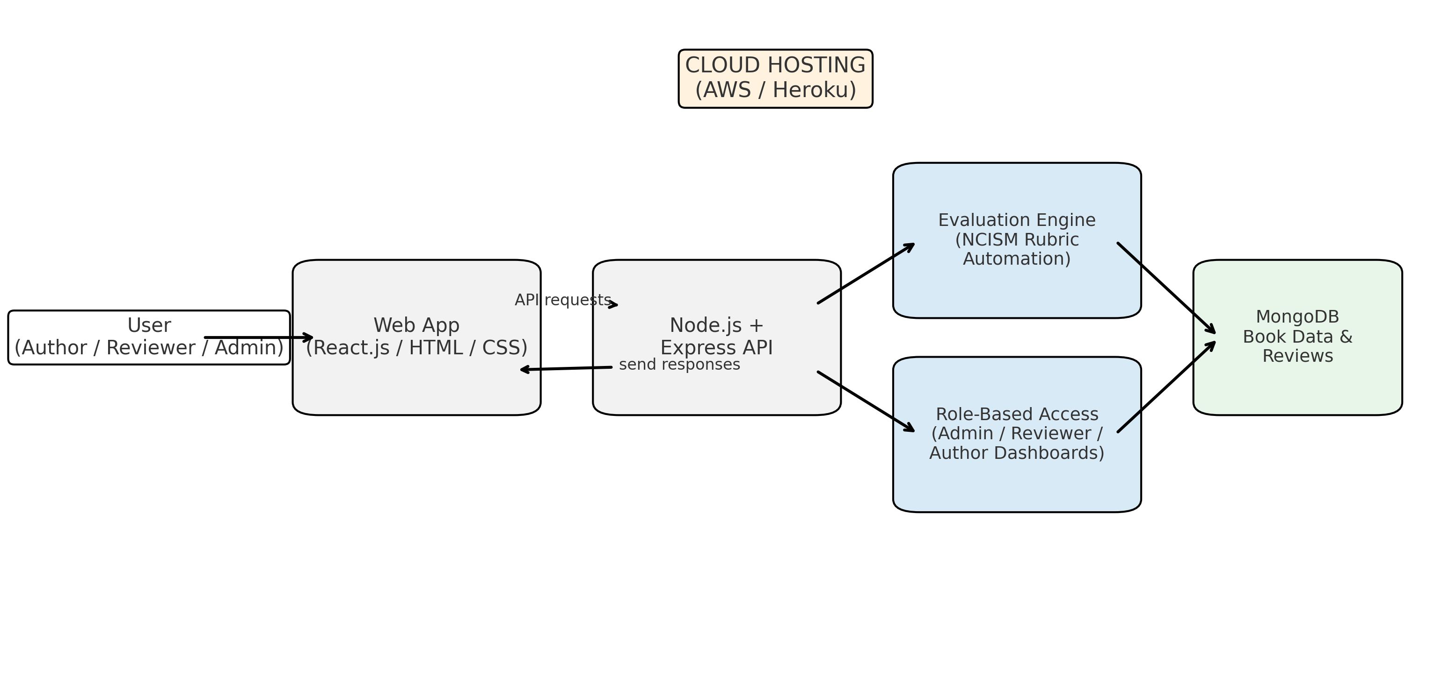
Architecture Diagram:

Slide 9
System Modules:
Modules:
Author Module:
Upload textbooks,
View review status.
Reviewer Module:
Evaluate using NCISM rubric
Submit scores.
Admin Module:
Assign reviewers
Manage system
Publish results.
Evaluation Engine:
Automates collation of reviewer scores & generates summaries.
Repository Module: Public access to evaluated results.

Slide 10
Timeline of the Project (Gantt Chart)
Week 1–2: Requirement gathering, template design, and backend architecture planning.
Week 3–4: Backend API development with user authentication and role management.
Week 5–6: Frontend integration with backend APIs.
Week 7: End-to-end testing and bug fixes.
Week 8: Final deployment, review, and presentation preparation.

Slide 11
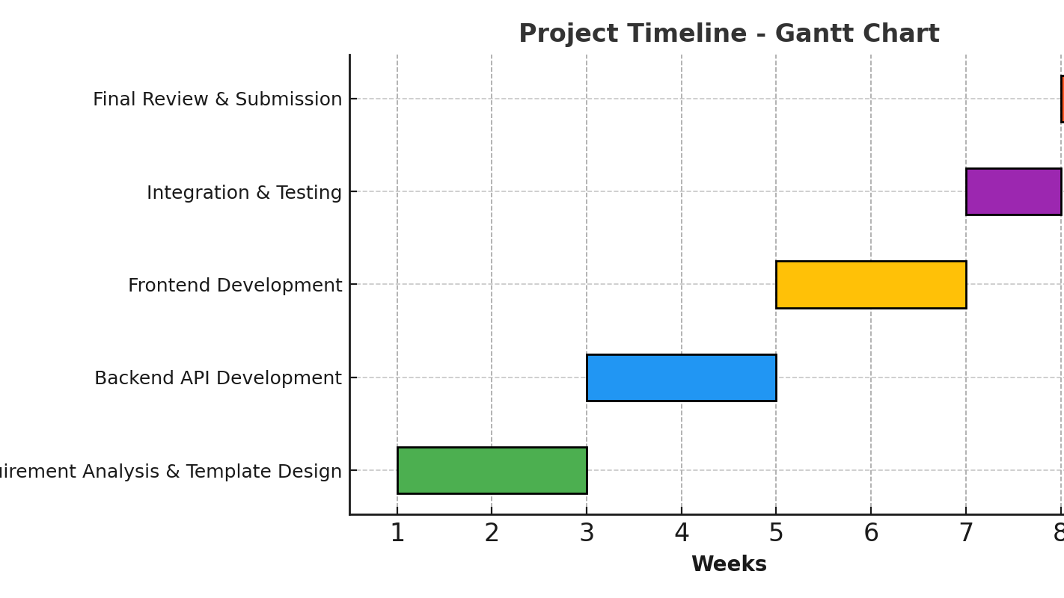
Gantt Chart
The below Picture Refers to the Gantt chart of out Project Timeline.

Slide 12
Github Link
The Github link provided should have public access permission.
Github Link
Link: https://github.com/Nischaynraj1810/VGP_Vaidya_Granth_Parak-AYUSH.git

Slide 13
References (IEEE Paper format)
[1] NCISM, “Assessment Scale for ASU Textbooks,” Ministry of AYUSH, 2023. [Online].
Available: https://ncismindia.org/
[2] R. Sharma, A. Singh, and P. Mehta, “Rubric-based Evaluation for Ayurveda Medical Literature,” Journal of Ayurveda & Integrative Medicine, vol. 13, no. 2, pp. 101–109, 2022. [Online].
Available: https://doi.org/10.1016/j.jaim.2022.04.003
[3] A. Garg, R. Kumar, and S. Bansal, “Peer-Review Model for Medical Curriculum Materials,” Education and Information Technologies, vol. 25, pp. 2761–2775, 2020. [Online].
Available: https://doi.org/10.1007/s10639-019-10066-0
[4] X. Li, Y. Zhang, and L. Chen, “Web-Based Evaluation System for Traditional Chinese Medicine Textbooks,” Evaluation and Program Planning, vol. 85, pp. 101–114, 2021. [Online]. Available: https://doi.org/10.1016/j.evalprogplan.2020.101914

Slide 14
Reference’s-Cont’d
[5] M. Tavakoli, M. Elias, G. Kismihók, and S. Auer, “Quality Prediction of Open Educational Resources: A Metadata-Based Approach,” in Proc. IEEE Int. Conf. on Advanced Learning Technologies (ICALT), pp. 298–302, 2020. [Online].
Available: https://doi.org/10.1109/ICALT49669.2020.00097
[6] C. Galindo-Durán and C. Medina-Ramírez, “Integration of Open Educational Resources Using Semantic Platform,” IEEE Access, vol. 9, pp. 148721–148733, 2021. [Online]. Available: https://doi.org/10.1109/ACCESS.2021.3124419
[7] K. A. Kroeze, S. M. van den Berg, B. P. Veldkamp, and T. de Jong, “Automated Assessment of and Feedback on Concept Maps during Inquiry Learning,” IEEE Transactions on Learning Technologies, vol. 14, no. 3, pp. 285–298, 2021. [Online]. Available: https://doi.org/10.1109/TLT.2021.3059643
[8] R. Conejo, J. Guzmán, and E. Millán, “Automated Assessment of Complex Programming Tasks Using SIETTE,” IEEE Transactions on Learning Technologies, vol. 12, no. 4, pp. 481–493, 2019. [Online]. Available: https://doi.org/10.1109/TLT.2018.2873727

Slide 15


