Slide 1

Git & GitHub

Slide 2
Agenda
CVCS & DVCS
Git installation
Local & Remote repository
Connect to remote repository
Git branching strategy
Pull and Fetch
Stash
Merging Techniques
Squash
Cherry Pick
Rebase

Slide 3
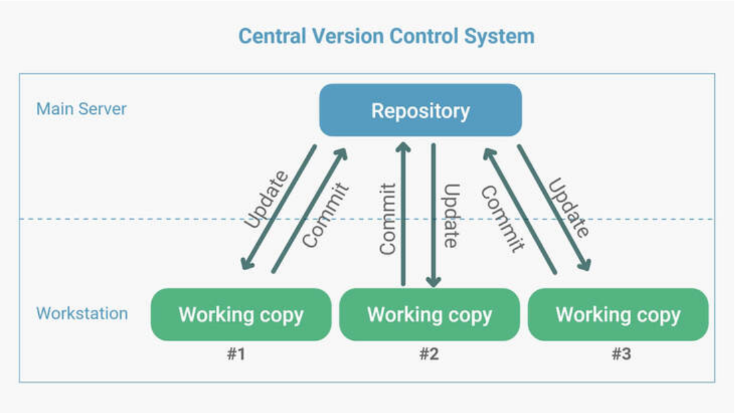
CVCS & DVCS
Centralized Version Control System (CVCS) - the central server stores all the data.
CVCS advantages :
Easy to learn and manage
More control over users and their access
CVCS disadvantages :
we must connect to the network to perform operations.
if the central server gets crashed, there is a high chance of losing the data.

Slide 4
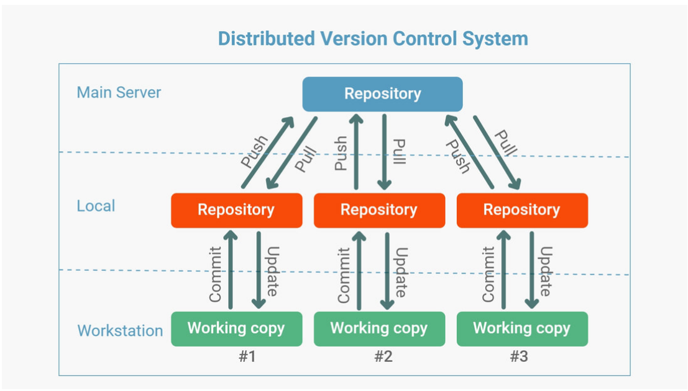
CVCS & DVCS
Distributed Version Control System (DVCS) - has a clone of the remote repository to the local.
DVCS advantages :
User can work offline in DVCS
Merging and branching the changes in DVCS is very easy
Even if the main server crashes, code will be stored in the local systems

Slide 5
Git Installation
Git website: http://git-scm.com/
– Free on-line book: http://git-scm.com/book
– Reference page for Git: http://gitref.org/index.html
– Git tutorial: http://schacon.github.com/git/gittutorial.html
– Git for Computer Scientists:
• http://eagain.net/articles/git-for-computer-scientists/

Slide 6
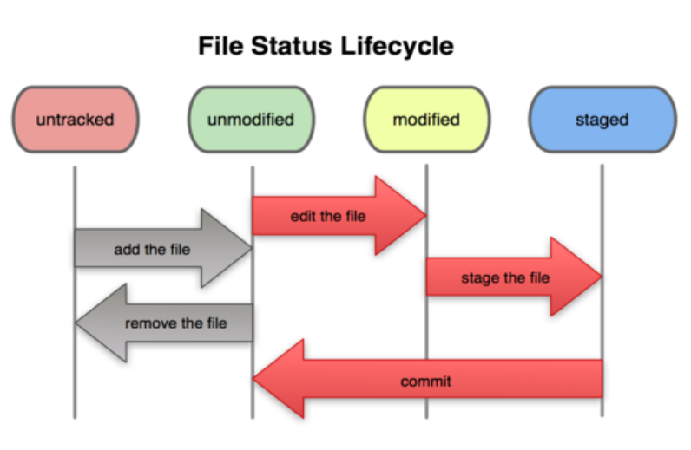
Basic git workflow
Modify files in your working directory.
Stage files, adding snapshots of them to your staging area.
Commit, which takes the files in the staging area and stores that snapshot permanently to your Git directory.

Slide 7
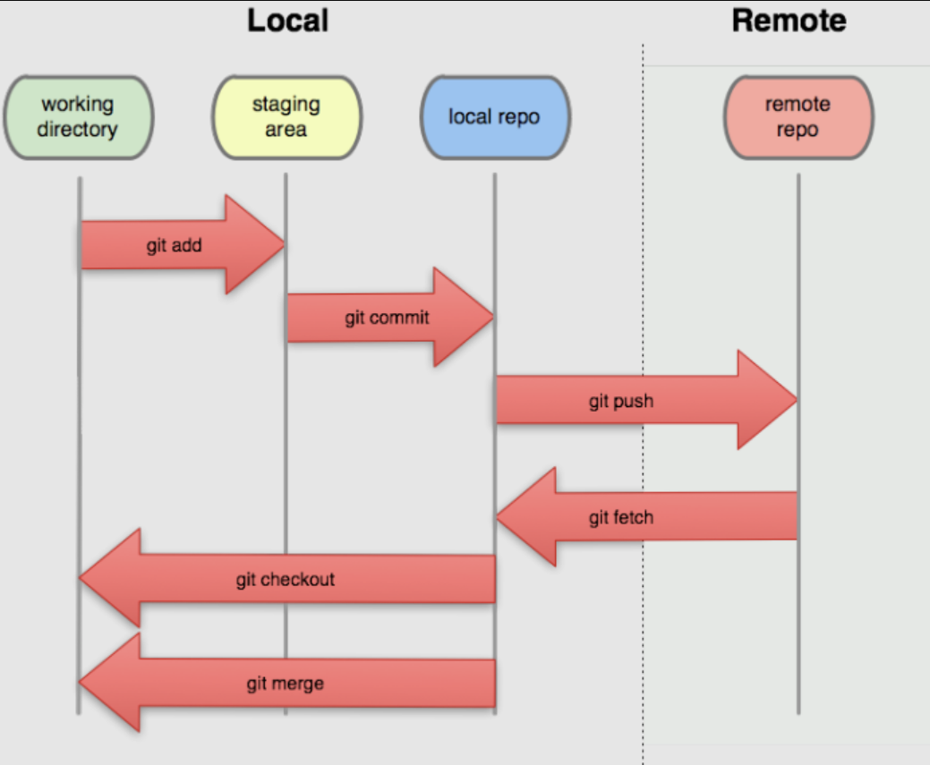
Local & Remote repository

Slide 8
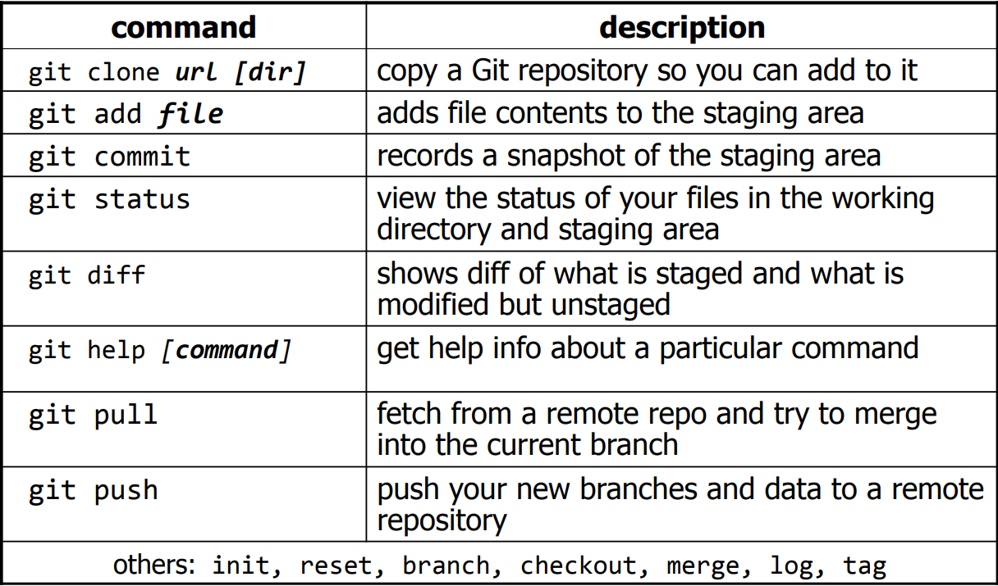
Git Commands

Slide 9
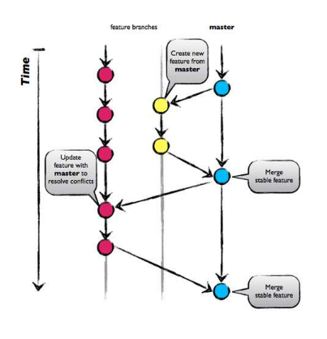
Git Branching Strategy

Slide 10
Git pull and fetch
Git fetch
downloads the latest changes into the local repository.
downloads only the fresh changes pushed to the remote repository since the last fetch
allows to review and merge manually at a later time
Git pull
downloads latest changes into the local repository
automatically merges change in the working directory.
more chances of merge conflicts to occur
git pull = git fetch + git merge

Slide 11
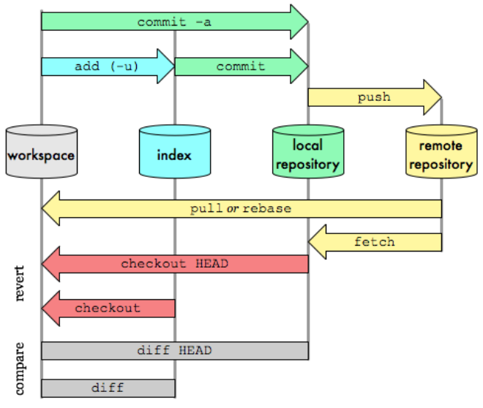
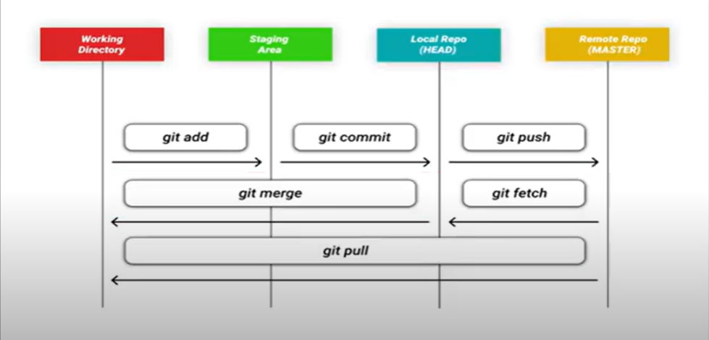
Git pull and fetch

Slide 12
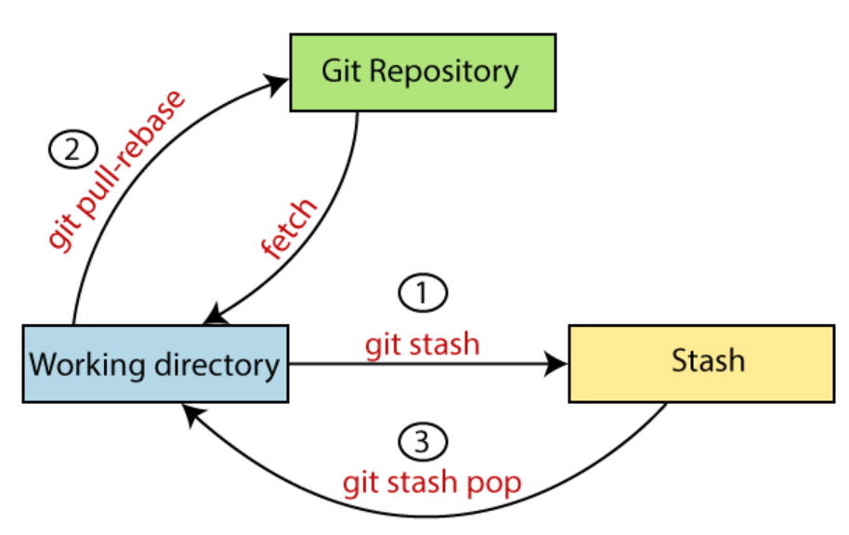
Stash
A temporary storage of code/changes without committing them to the repository

Slide 13
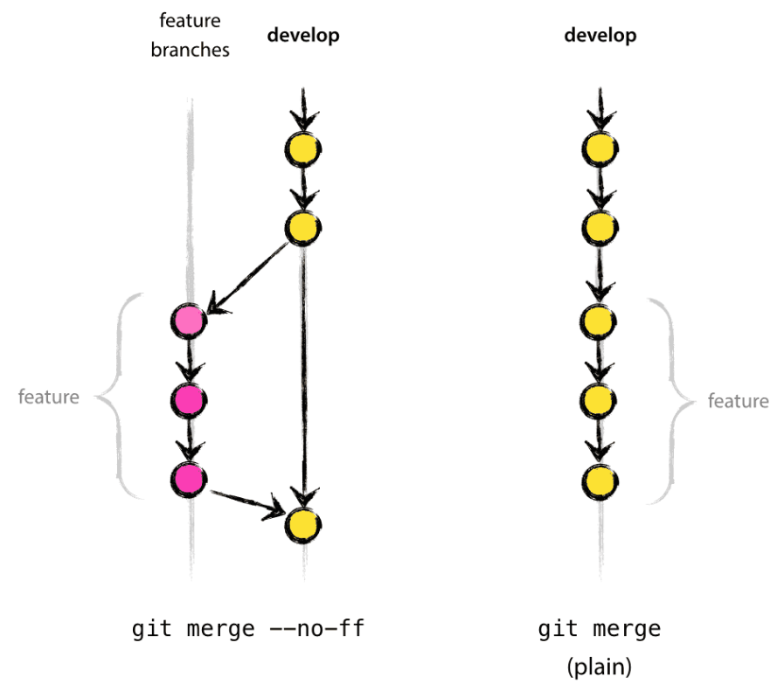
Merging Techniques
Fast forward merge
Fast-forward merges literally move your main branch's tip forward to the end of your feature branch

Slide 14
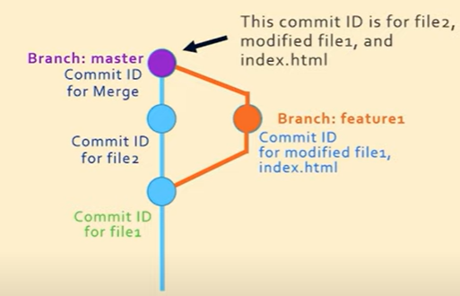
Merging Techniques
Recursive merge or 3-way merge
after you branch and make some commits, there are some new original commits on the ‘master‘, when it’s time to merge, git recurses over the branch and creates a new merge commit.

Slide 15
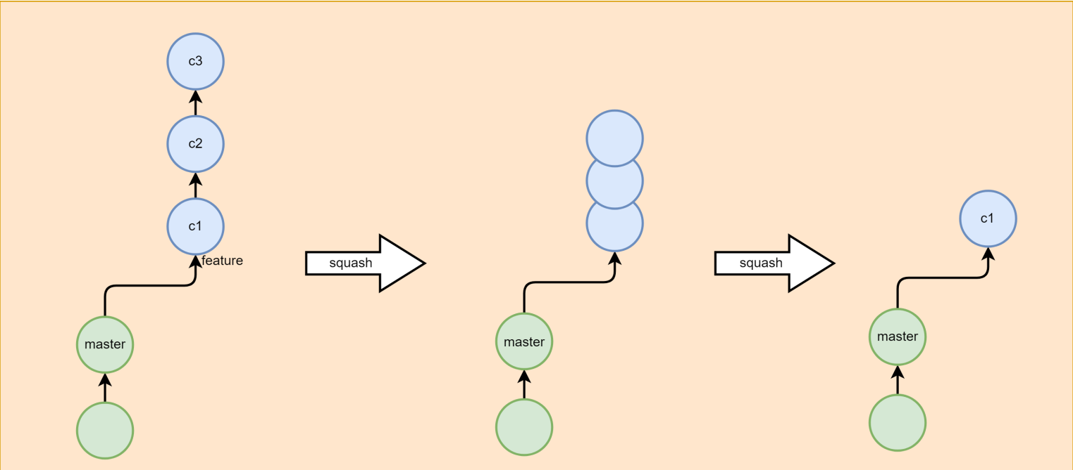
Git Squash
combining several commits into one
git rebase -i HEAD ~n

Slide 16
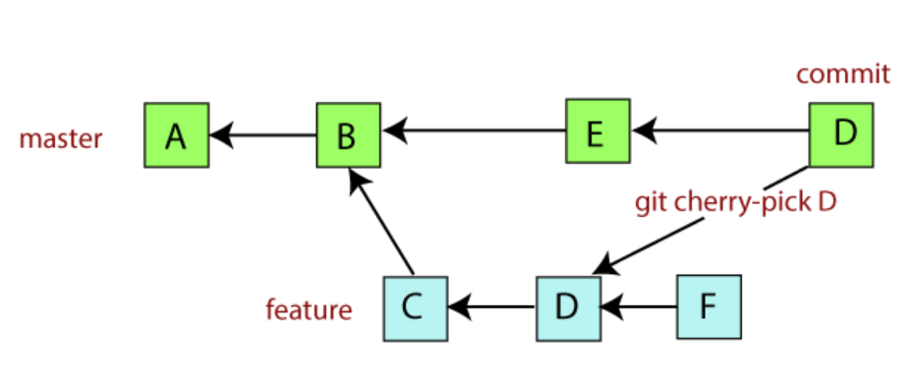
Git Cherry Pick
Cherry picking in Git means to choose a commit from one branch and apply it onto another.

Slide 17
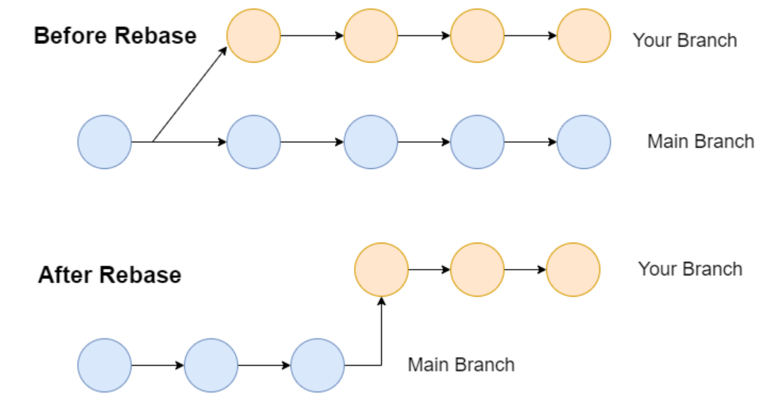
Git Rebase
the process of moving or combining a sequence of commits to a new base commit.

