Slide 2
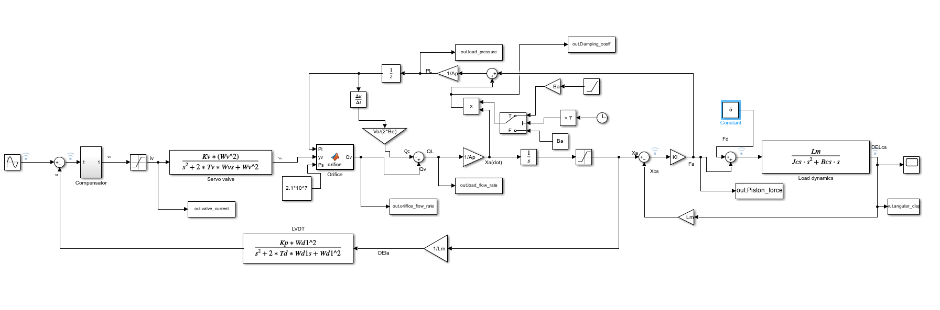
Simulink Model Explanation
Servo valve dynamics:
Gives the physical displacement of the spool with the help of a second order transfer function, here:
Wv: Natural frequency of servo valve
Tv: Damping factor of the servo valve
Kv: Displacement sensitivity of servo valve

Slide 3

Simulink Model Explanation
Orifice Flow: Flow from Servo valve to the backward chamber of the Piston, based on the following equation:
$$Qv = K_{fn}x_{v}\sqrt{\left|Ps−\operatorname{sgn}{(Pl})\right|}\left(\left|Ps−\operatorname{sgn}{(Pl})\right|\right)$$
Where xv is the effective displacement given by
$$x_{v}=y_{v}−δ\left\langle 1−ⅇ^{−\frac{σy_{v}}{C_{γ}δ}}\right\rangle \operatorname{sgn}\left(y_{v}\right)$$
Here:
Kfn: Servo valve flow gain factor
$$δ$$: Servo valve overlap
$$σ$$: Overlap parameter
Cv: Radial Clearence

Slide 4
Simulink Model Explanation
Next is the Flow from orifice will result in:
Movement of the piston(Load flow (Ql))
Compression of fluid in the forward chamber on the fluid(Qc)

Slide 5

Simulink Model Explanation
This loop calculates the flow due to compressibility of the fluid on the basis of based on the following equation:
$$Q_{c}=\frac{v_{0}}{2β_{e}}\frac{ⅆP_{L}}{ⅆt}$$
Vo: Forward chamber volume
𝛽𝑒: Bulk modulus of the chamber
PL: Load Pressure
$$\frac{F_{a}+B_{a}{\dot{x}}_{a}}{Ap}$$
Where
Ba: Actuator damping factor

Slide 6

Simulink Model Explanation
Moving forward calculating the the Actuator force(Fa)
$$F_{a}=k_{I}{(x}_{a}−x_{cs})$$
Where:
Ki: Actuator mounting stiffness
Xcs: forward moment of the control surface
Xa: displacement of the Piston, with the maximum allowed movement from -0.5m - 0.5m (assumed) calculated from the below equation:
$$x_{a}={\frac{Q_{L}}{Ap}}$$
Where Ap is the area of the piston

Slide 7

Simulink Model Explanation
Load Dynamics of the system:
Considering a control surface hinged on one end experiences the output force in its centre of mass the deflection $$(δ$$cs) is calculated from the below equation
$$F_{D}+F_{A}=\frac{J_{Cs}\ddot{δ}}{lm}+\frac{B_{Cs}\dot{δ}}{lm}$$
Where
Fd: Disturbance force
Jcs: Moment of inertia of the control surface
Bcs: Damping constant of the control surface
Lm: Actuator lever arm length

Slide 8

Assumptions Considered
Considered Command Signal as a Sine wave with amplitude of 7 V.
Range limit of Valve Current as -10 to 10 Amp.
Neglecting the friction experienced by the piston in the piston chamber.
Range Limit for the movement of the piston is from -0.5m to 0.5m.
The volume of forward and backward chambers of the piston is considered as equal.
Assuming pressure in each chamber to be uniformly distributed.
Effect of Temperature on any system is neglected.
Parameter that are considered as constant:
Cross-Area of the piston(Ap)
Control surface viscous damping(Bcs)
Moment of inertia of the control surface(Jcs)
PI compensator gain(Kf, Ki)
Roll off frequency factor(wff)
Servo valve gain parameter(Kfn)
Position sensor scale factor(Kl)
Actuator lever arm length(Lm)
Half volume of the actuator(Vo)
Effective bulk modulus of the hydraulic oil($$β_{e}$$)
Servo valve overlap($$δ$$)
Overlap parameter($$σ$$)
Denominator damping frequency factor of the notch(Td)
Numerator damping frequency factor of the notch(Tn)

Slide 9
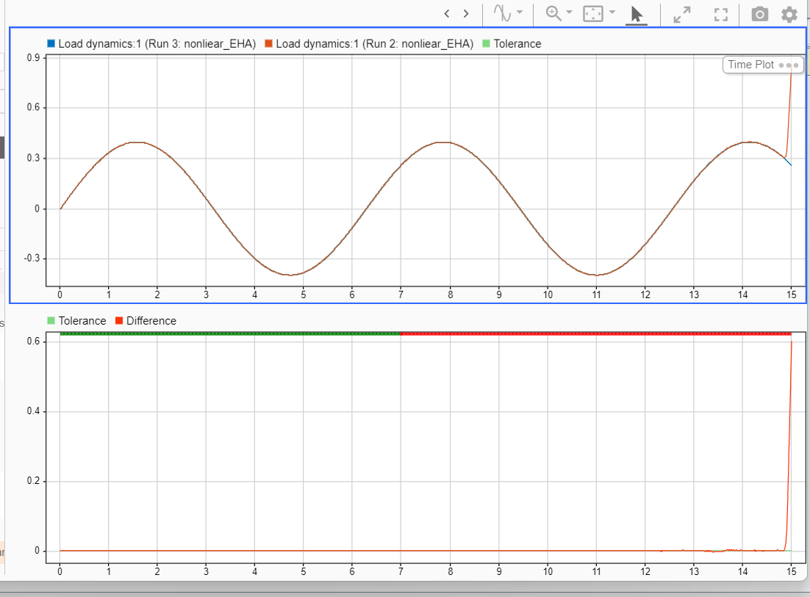
Fault Identification and Injection
Since the scope of this project is to predict whether there is fault in our model or not we have considered we injected only one gradual type fault in our model.
We have considered that due to the leakage of hydraulic oil present in the actuator chamber can result in the gradual decrease of the Viscous damping constant of actuator(Ba), in our model we have considered the Ba will decrease by a -0.75 slope.

Slide 10
Design of Experiment creation
We have used Full Factorial experimentation for DoE generation, considering 2 levels i.e. faulty or not faulty and 6 parameter that are:
Supply Pressure of flow from tank to servo valve(Ps) varies from 2.1*10^8N/m^2 - 2.2*10^8N/m^2.
Disturbance Force(Fd) varies from 3 – 8 N
Natural frequency of the servo valve(Wv) 940 – 945 rad/sec
Notch frequency(Wn) 224 – 227 rad/sec
Demodulator frequency(Wd1) 627 – 629 rad/sec
Damping factor of servo valve spool(Tv) 0.5 - 1.5

Slide 11
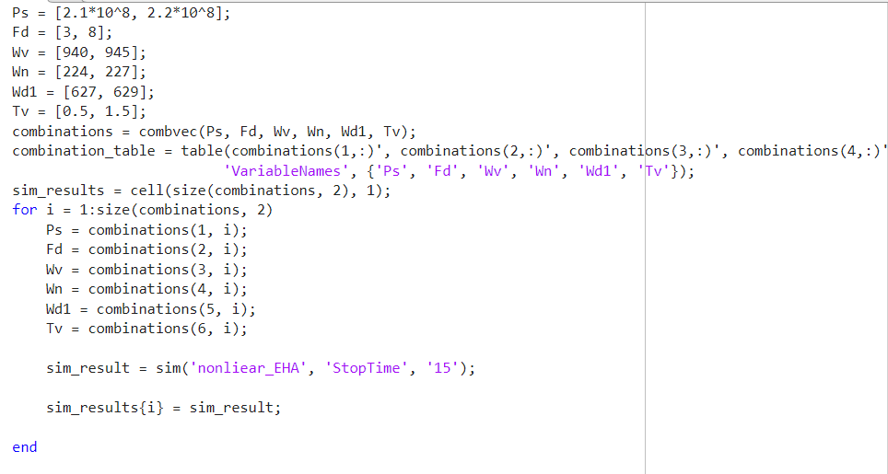
Data Generation
For each DoE combination(64 combinations) we have run our model for 15 sec and have collected our data at 0.15 time interval(100 pts)each of the following signals with the help of to workspace block:
Orifice Flow
Load Flow
Valve Current
Load Pressure
Actuator Damping
Actuator Force
Physical Displacement of the spool
Deflection of the Control Surface

Slide 12

Machine Learning Model for Fault Diagnosis in Electrohydraulic Actuator Systems

Slide 13
DATA GENERATION
DATA PREPROCESSING
Fault Diagnostics Model Development Pipeline
Feature Engineering
MODEL TRAINING
Model Evaluation
Model Deployment

Slide 14
Data Preprocessing
Data preprocessing is a crucial step in the data analysis and machine learning pipeline. It involves cleaning, transforming, and organizing raw data to make it suitable for further analysis. This process includes handling missing values, removing duplicates, and dealing with outliers to ensure data integrity. Additionally, data preprocessing involves feature scaling and normalization to bring all variables to a similar scale, preventing dominance by certain features.

Slide 15
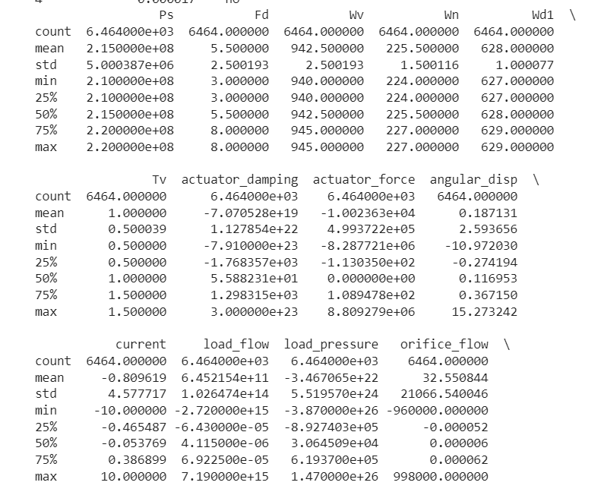
The first step here was to analyze different numerical as well as categorical features.
Here we calculate the maximum , minimum , standard deviation and different percentiles of all the numerical columns------ Made a certain conclusion from it.
The standard deviation is a statistical measure that quantifies the amount of variability or dispersion in a dataset. A high standard deviation indicates that the data points are spread out from the mean, while a small standard deviation indicates that the data points are clustered closely around the mean.

Slide 16
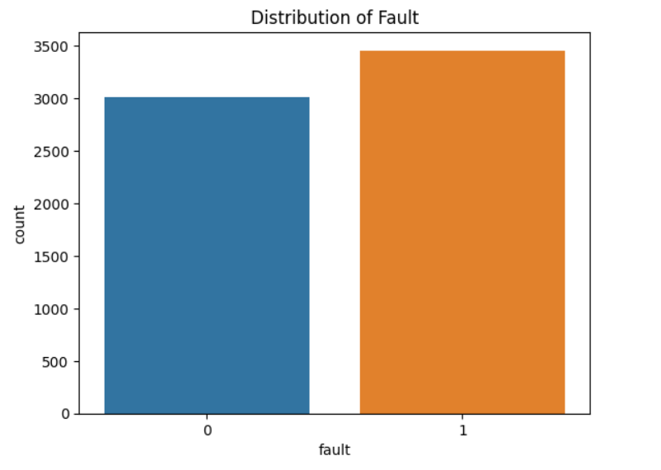
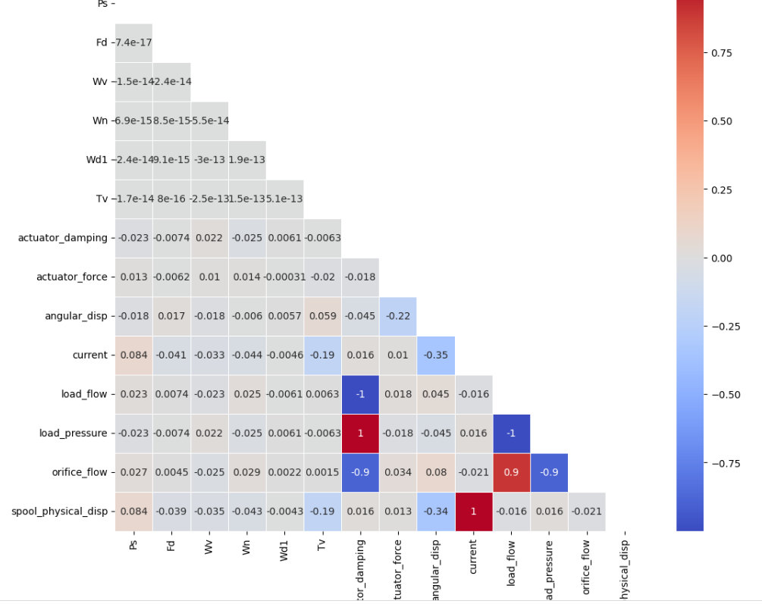
Beside is the count of faulty data and the number of unfaulty data in our dataset.
0 represents a non-faulty data and 1 as faulty one.
Here we observe that the feature load_flow,load_pressure and orifice_flow are either highly positively correlated or highly negatively correlated with actuator_damping.
Hence keeping all of the above variables for model prediction will not be feasible. So we remove
Heatmap is frequently used to display correlation matrices, showing the strength and direction of relationships between pairs of variables. Positive correlations are often represented by warmer colors (e.g., red), while negative correlations are represented by cooler colors (e.g., blue).

Slide 17
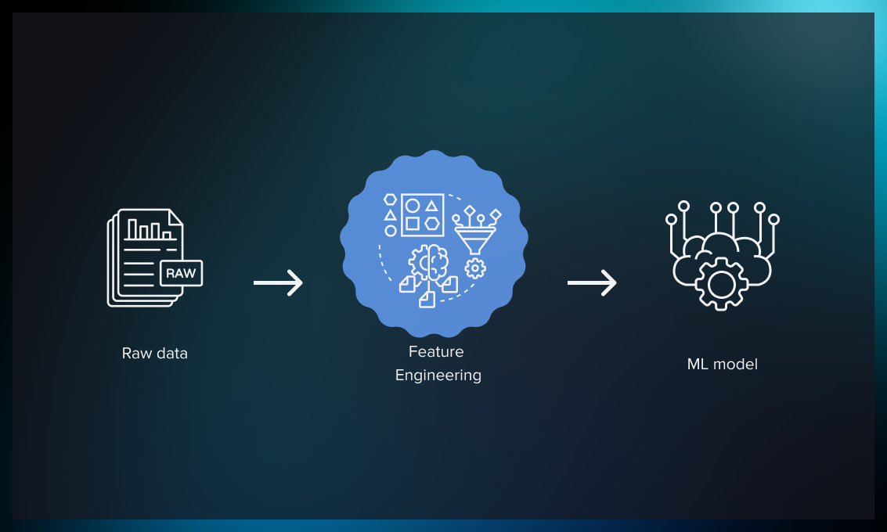
Feature Engineering and Feature Selection
FEATURE ENGINEERING
Feature engineering is the process of transforming, creating, or selecting relevant features from raw data to enhance the performance of machine learning models. It involves extracting meaningful information, reducing noise, and crafting new representations that improve the model's ability to understand patterns and relationships within the data. Feature engineering can include operations such as scaling, normalization, binning, one-hot encoding, and deriving new features from existing ones.
By eliminating irrelevant or redundant features, feature selection can mitigate overfitting, enhance model generalization, and improve model interpretability.

Slide 18
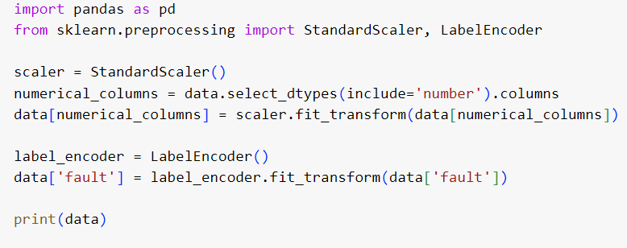
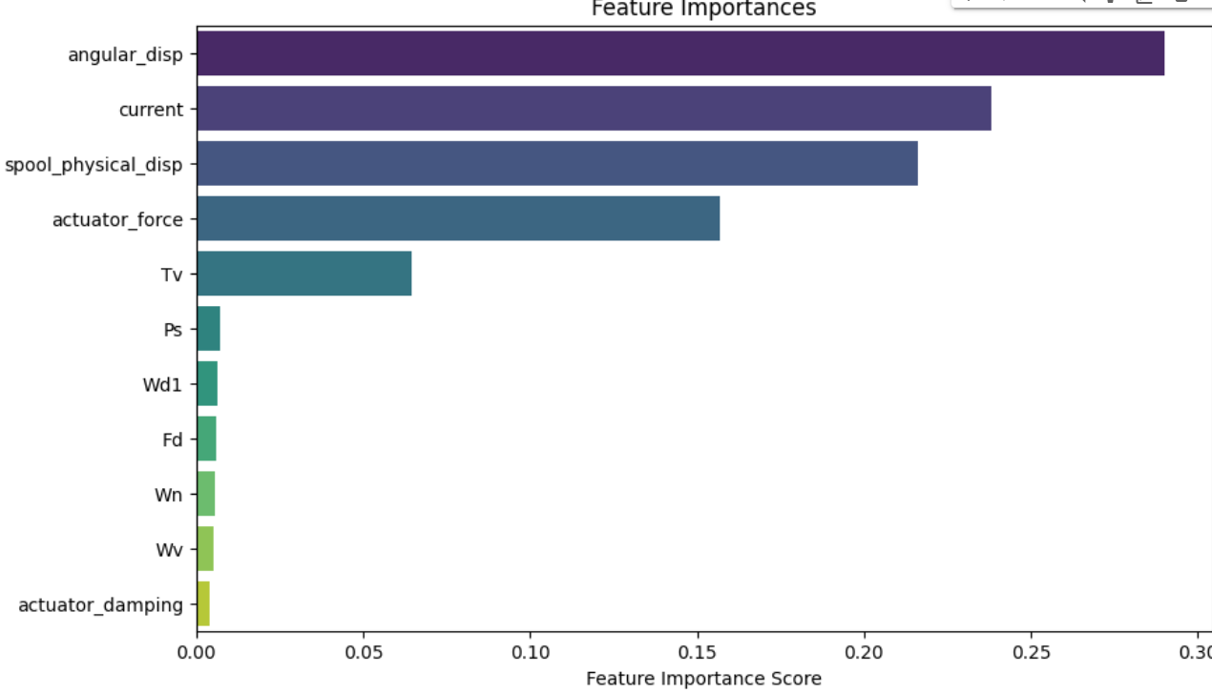
First we use the MinMaxSxalar to scale numerical features in a dataset. It transforms the features such that they have a mean of 0 and a standard deviation of 1.
Similarly by using the LabelEncoder we convert the categorical column,i.e fault to numerical column. It's particularly useful when dealing with categorical target variables or converting categorical features into a format that can be used by machine learning algorithms.
Next we use RandomForestClassifier to find the most important features out of all the features.
Random forests are generally robust to irrelevant features, but reducing the dimensionality of the feature space through feature selection can lead to faster training and potentially better model performance.

Slide 19
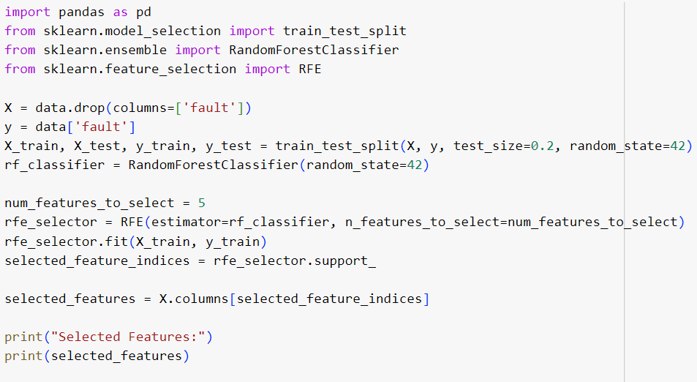
Now we use the Recursive Feature Elimination (RFE) which is a feature selection technique commonly used in machine learning to improve model performance and reduce the dimensionality of the feature space.
From the RFE technique we obtain 'Tv', 'actuator_force', 'angular_disp', 'current', 'spool_physical_disp‘ as the most important features.
Steps in RFE:-
Model Fitting: RFE starts by training a chosen machine learning model (such as a classifier or a regression model) on the entire set of features.
Feature Importance Ranking: After training, the importance or contribution of each feature is determined based on model-specific attributes (e.g., feature weights or feature importance scores).
Feature Elimination: The least important feature(s) are removed from the dataset. The number of features to eliminate at each iteration is a user-defined parameter.
Model Refitting: The model is retrained on the reduced feature set. This new model's performance is evaluated to assess its impact on predictive accuracy or other evaluation metrics.
Iteration: Steps 2-4 are repeated iteratively until a predefined number of features remains or until the model's performance stabilizes.

Slide 20
Diagnostic Model Development
Here we use a series of machine learning models to train them with the data we obtained after feature selection .
Here is the list of ML Models we used for our prediction:-
LogisticRegression
SupportVectorClassifier
DecisionTreeClassifier
RandomForestClassifier
GaussianNB
KNeighborsClassifier
XGBClassifier
We use train_test_split library of Sklearn for training and testing of the data.

Slide 21







MODEL EVALUATION
MODEL | ACCURACY(%) | CONFUSION MATRIX
LogisticRegression | 54.06
SupportVectorClassifier | 70.06
DecisionTreeClassifier | 99.9
RandomForestClassifier | 99.6
GaussianNB | 67.8
KNeighborsClassifier | 98
XGBClassifier | 100

Slide 22
Since XGBoost model shows best results with the test data, hence we select this as our primary ML model.
FINAL MODEL SELECTION

Slide 23
Thanks!
Diagnostic Model Development

