Slide 1
PRESENTATION ON HBASE
SUBMITTED TO : SUBMITTED BY :
MR. ANAND MOHAN PANDEY NISHANT AMAR

Slide 2
CONTENT
What is HBase?
HBase Features
Why Choose HBase?
HBase Vs Hive
HBase VS RDBMS

Slide 3
HBASE
HBase is an open-source, column-oriented distributed database system in a Hadoop environment. Initially, it was Google Big Table, afterward, it was re-named as HBase and is primarily written in Java. Apache HBase is needed for real-time Big Data applications.
HBase can store massive amounts of data from terabytes to petabytes. The tables present in HBase consists of billions of rows having millions of columns. HBase is built for low latency operations, which is having some specific features compared to traditional relational models.

Slide 4
HBase Features
HBase is built for low latency operations
HBase is used extensively for random read and write operations
HBase stores a large amount of data in terms of tables
Provides linear and modular scalability over cluster environment
Strictly consistent to read and write operations
Automatic and configurable sharding of tables
Automatic failover supports between Region Servers
Convenient base classes for backing Hadoop MapReduce jobs in HBase tables
Easy to use Java API for client access
Block cache and Bloom Filters for real-time queries
Query predicate pushes down via server-side filters.

Slide 5
Why Choose HBase?
A table for a popular web application may consist of billions of rows. If we want to search particular row from such a huge amount of data, HBase is the ideal choice as query fetch time in less. Most of the online analytics applications use HBase.
Traditional relational data models fail to meet performance requirements of very big databases. These performance and processing limitations can be overcome by Apache HBase.

Slide 6
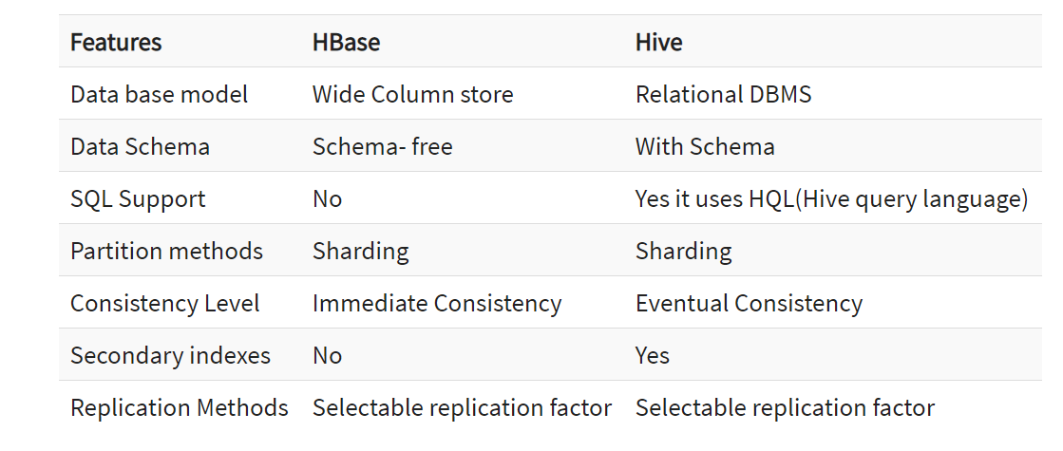
HBase Vs Hive

Slide 7
HBase VS RDBMS
HBASE | RDBMS
Schema-less in database | Having fixed schema in database
Column-oriented databases | Row oriented data store
Designed to store De-normalized data | Designed to store Normalized data
Wide and sparsely populated tables present in HBase | Contains thin tables in database
Supports automatic partitioning | Has no built in support for partitioning
Well suited for OLAP systems | Well suited for OLTP systems
Read only relevant data from database | Retrieve one row at a time and hence could read unnecessary data if only some of the data in a row is required
Structured and semi-structure data can be stored and processed using HBase | Structured data can be stored and processed using RDBMS
Enables aggregation over many rows and columns | Aggregation is an expensive operation

Slide 8
THANK YOU

