Slide 1
HoverSpace
Developed by: Nishant Sharma

Slide 2
What is HoverSpace ?
This web application is supposed to make a public forum on which user can post questions, answer them related to academics and daily life.

Slide 3
Tools and Languages Used:
Python Programming Language
Python Django Framework
MongoDB database
Cascading Style Sheet(for design)
HTML and JavaScript

Slide 4
Intended Features:
User will be able signUp, signIn and post the questions.
User will be able to answer any question.
Answers could be flagged up or down according to the authenticity of answer.
Inappropriate answer could be flag down.
Specific tags can be assigned which will make it easy to search for specific question.

Slide 5
CODE QUALITY:
Simplicity:
Layout and style:
Documentation of design by contract:
Extensible Design:
Error handling

Slide 6
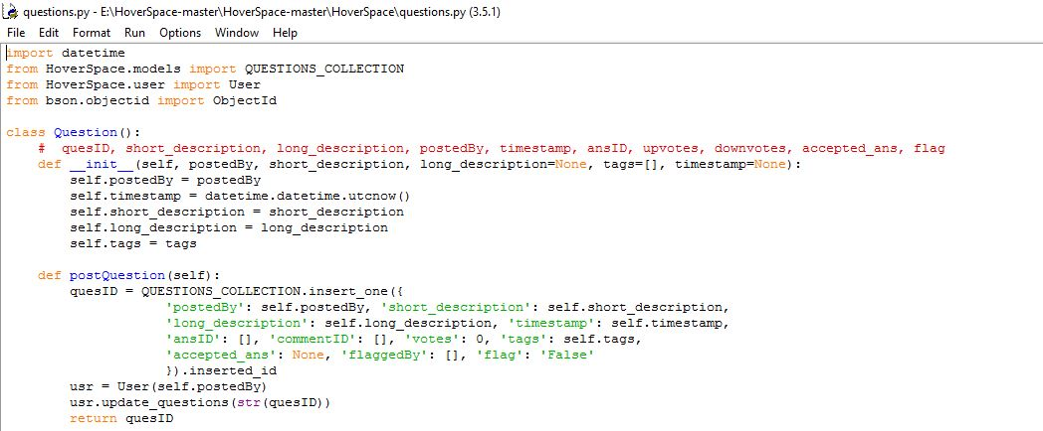
Simplicity: Code is made as simple as it can be, minimize complexity

Slide 7
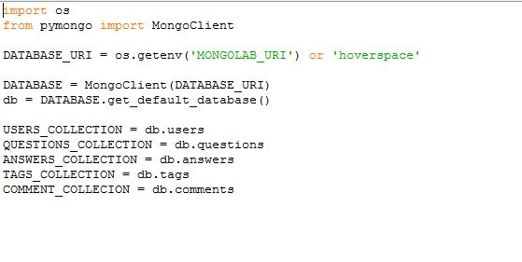
Naming Variables:

Slide 8
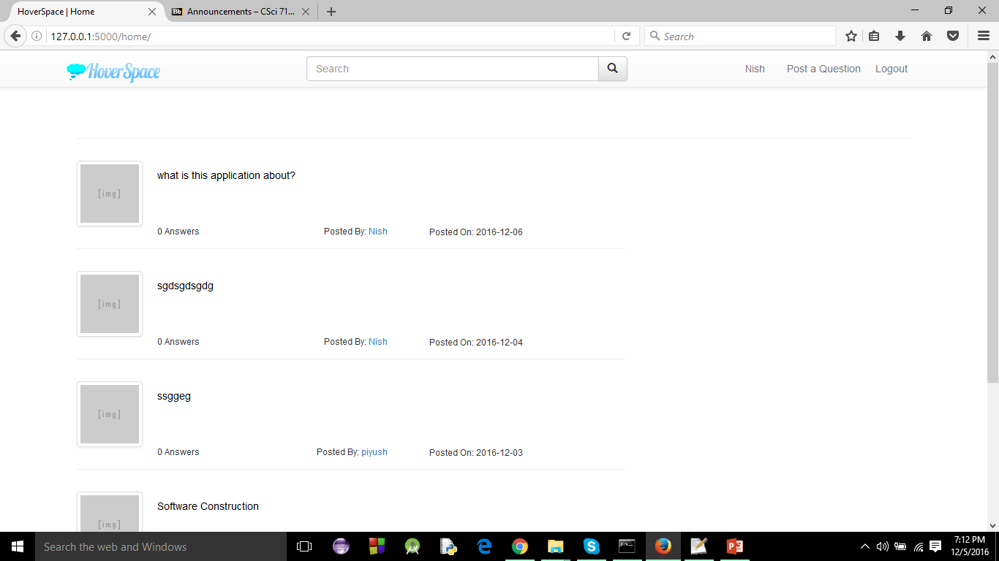
Layout and style:

Slide 9
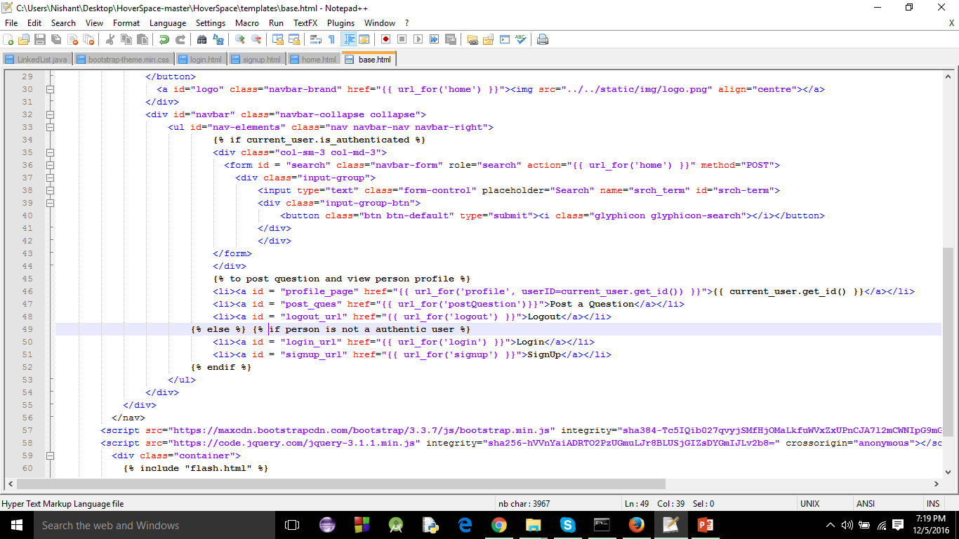
Layout and style continue:

Slide 10
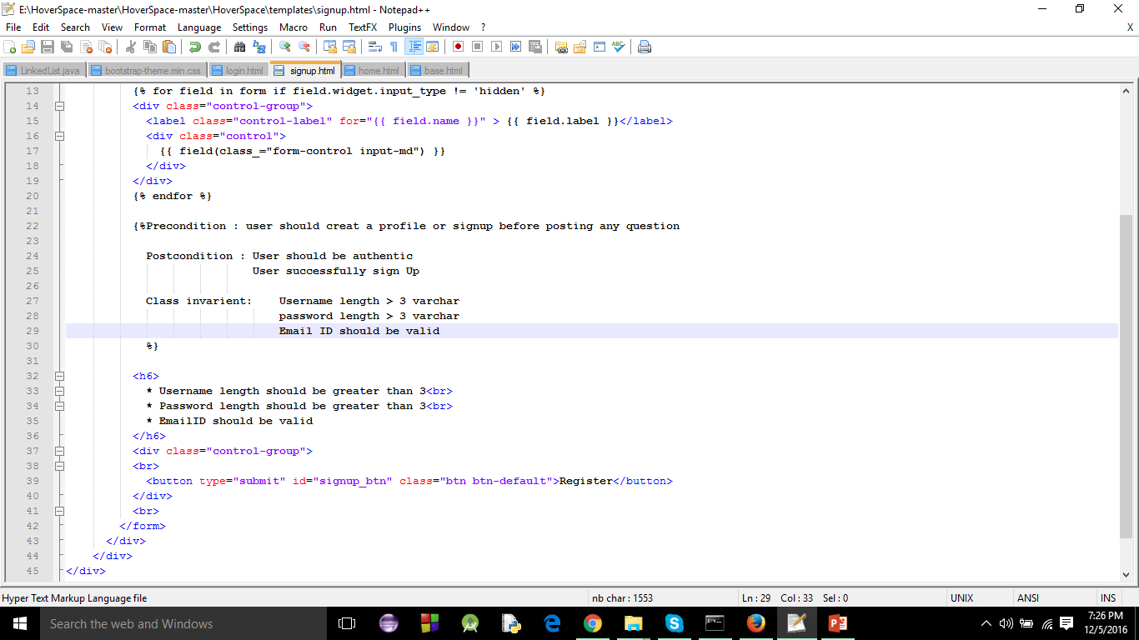
Design by contract:

Slide 11
WEB APPLICATION DEMO

