Slide 1


DATA STRUCTURES & ALGORITHMS
Queues (FIFO)
Understanding Queue from Scratch with Python
FRONT
REAR
People standing in a queue — first to arrive, first to be served
Presented by
Rohan Poddar
Notes:
Welcome the audience. Introduce the topic: Queues, a fundamental FIFO data structure, and set up that we'll build one from scratch in Python.

Slide 2


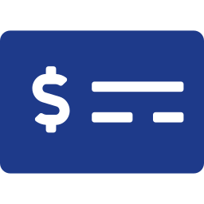
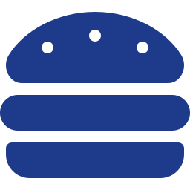


Why Do We Need a Queue?
Real-Life Examples
Ticket Counter
Who gets served first?
ATM Queue
Answer: The person who arrived first.
Food Delivery Orders
Printer Queue
FIFO in action
First arrived → first served
Toll Booth
This is exactly how a Queue works.
Notes:
Walk through everyday examples where order of arrival determines order of service. Ask the audience the highlight question before revealing the answer.

Slide 3



What is a Queue?
Definition: A Queue is a linear data structure that follows the FIFO (First In, First Out) principle.
FIFO — First In → First Out
The element inserted first is removed first.
FRONT
REAR
10
20
30
40
Remove
Insert
Insertion → Rear
Deletion → Front
Notes:
Introduce the formal definition and the FIFO acronym, then walk through the box diagram: new elements enter at the rear, elements leave from the front.

Slide 4

Queue Operations
Operation | Purpose
enqueue(x) | Insert an element
dequeue() | Remove front element
peek() | View front element
isEmpty() | Check if queue is empty
size() | Number of elements
enqueue(50)
10
20
30
10
20
30
50
dequeue()
10
20
30
20
30
Notes:
Go through each core operation and its purpose, then show visually what enqueue and dequeue do to the underlying sequence.

Slide 5
Queue Visualization
Step-by-step state changes (animate each step in PowerPoint)
Initially
enqueue(10)
enqueue(20)
EMPTY
10
10
20
enqueue(30)
dequeue()
enqueue(40)
10
20
30
20
30
20
30
40
Notes:
Walk through each queue state transition live, ideally with a PowerPoint animation revealing one card at a time.

Slide 6


Queue Implementation in Python
We'll build a Queue that supports:
enqueue()
dequeue()
class Queue:
def __init__(self):
self.items = []
peek()
isEmpty()
size()
Live Coding in VS Code
Notes:
Transition to the live-coding portion. In VS Code, build out the Queue class method by method: enqueue, dequeue, peek, isEmpty, size.

Slide 7
Time Complexity
Operation | Python List
enqueue() | O(1)
dequeue() | O(n)
peek() | O(1)
isEmpty() | O(1)
size() | O(1)
Python provides collections.deque
enqueue →
O(1)
dequeue →
O(1)
Interview Question
Why is list.pop(0) O(n)?
Notes:
Compare naive Python list performance vs collections.deque. Pose the interview question and let the audience think before explaining: list.pop(0) needs to shift all remaining elements.

Slide 8





Real-World Applications
Where are Queues Used?
Printer Scheduling
Web Server Requests
Message Queues
Breadth First Search (BFS)
CPU Scheduling
Multiplayer Game Matchmaking
Queues are used whenever “First Come, First Served” is required.
Notes:
Close by connecting queues to systems the audience already uses daily — printers, web servers, messaging systems — and algorithmic uses like BFS and CPU scheduling.

Slide 9
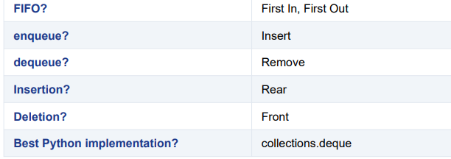
SUMMARY

