Slide 1
KEYLOGGERS AND ITS SECURITY
Presented by:
m. Nisha – anjalai ammal Mahalingam engineering college – computer science engineering

Slide 2
outline
Problem Statement
Proposed System/Solution
System Development Approach
Algorithm & Deployment
Result (Output Image)
Conclusion
Future Scope
References

Slide 3
PROBLEM STATEMENT
In today's digital age, where cybersecurity threats loom large, one of the significant concerns is the proliferation of keyloggers, stealthy software tools designed to monitor and record keystrokes on a user's computer without their knowledge. Keyloggers pose a severe threat to individuals and organizations as they can capture sensitive information such as passwords, credit card details, and other personal data, leading to identity theft, financial loss, and privacy breaches.
Currently Rental bikes are introduced in many urban cities for the enhancement of mobility comfort. It is important to make the rental bike available and accessible to the public at the right time as it lessens the waiting time. Eventually, providing the city with a stable supply of rental bikes becomes a major concern. The crucial part is the prediction of bike count required at each hour for the stable supply of rental bikes.

Slide 4
Proposed solution
The proposed system aims to address the challenge of predicting the required bike count at each hour to ensure a stable supply of rental bikes. This involves leveraging data analytics and machine learning techniques to forecast demand patterns accurately. The solution will consist of the following components:
Data Collection:
Gather historical data on bike rentals, including time, date, location, and other relevant factors.
Utilize real-time data sources, such as weather conditions, events, and holidays, to enhance prediction accuracy.
Data Preprocessing:
Clean and preprocess the collected data to handle missing values, outliers, and inconsistencies.
Feature engineering to extract relevant features from the data that might impact bike demand.
Data Analysis:
Analyze the historical data to identify patterns and trends in bike rentals. Use visualization techniques to explore relationships between different features and bike demand.
Model Selection:
Implement a machine learning algorithm, such as a time-series forecasting model (e.g., ARIMA, SARIMA, or LSTM), to predict bike counts based on historical patterns.
Consider incorporating other factors like weather conditions, day of the week, and special events to improve prediction accuracy.

Slide 5
Model Training and Evaluation:
Split the data into training and testing sets. Train the selected models on the training data and evaluate their performance using metrics such as Mean Absolute Error (MAE), Mean Squared Error (MSE), or Root Mean Squared Error (RMSE) on the testing set.
Fine-Tuning:
Fine-tune model parameters and features to optimize prediction accuracy. Conduct hyperparameter tuning and feature selection to improve model performance further.
Real-Time Prediction:
Deploy the trained model to predict bike demand in real-time. Integrate the model into a system that continuously collects and analyzes data on bike rentals, weather conditions, and other relevant factors to generate up-to-date predictions.
Monitoring and Maintenance:
Continuously monitor the performance of the prediction model and update it regularly with new data. Implement mechanisms to handle model drift and adapt to changes in bike usage patterns or external factors. By implementing this solution, urban cities can effectively predict bike demand and ensure a stable supply of rental bikes, ultimately enhancing mobility comfort and promoting sustainable transportation options.

Slide 6
SYSTEM APPROACH
The "System Approach" section outlines the overall strategy and methodology for developing and implementing the rental bike prediction system. Here's a suggested structure for this section:
System requirements
Library required to build the model
A systematic approach for predicting bike demand and ensuring a stable supply of rental bikes in urban cities involves a structured framework that integrates data collection, analysis, modeling, deployment, and monitoring.
Here's a step-by-step system approach:
Problem Definition and Scope: Clearly define the problem statement, objectives, and scope of the bike demand prediction system. Determine the target audience, key performance indicators (KPIs), and desired outcomes, such as reducing waiting times for rental bikes and optimizing bike availability.
Data Collection and Integration: Gather diverse datasets related to bike rentals, including historical rental data, weather data, calendar events, and demographic information.

Slide 7
Data Preprocessing and Feature Engineering: Cleanse and preprocess the raw data to handle missing va lues, outliers, and inconsistencies. Extract relevant features from the datasets, such as time of day, day of the week, weather conditions, temperature, humidity, and special events. Perform feature engineering to create derived features or transformations that capture meaningful patterns in the data.
Model Development and Selection: Explore various machine learning and statistical modeling techniques suitable for bike demand prediction, such as time series forecasting models (e.g., ARIMA, SARIMA, Prophet) and regression-based models (e.g., Random Forests, Gradient Boosting). Evaluate and compare the performance of different models using appropriate validation methods and metrics.
Model Training and Optimization: Train the selected models on historical data, optimizing model parameters and hyperparameters using techniques like cross-validation and grid search. Fine-tune the models to achieve the best predictive accuracy while avoiding overfitting.
Real-Time Prediction and Deployment: Implement the trained models into a real-time prediction system capable of processing streaming data and generating bike demand forecasts on the fly. Develop APIs or microservices for model inference and integration with other software systems or applications. Deploy the prediction system on scalable and reliable infrastructure, ensuring high availability and low latency.

Slide 8
Monitoring and Feedback Loop: Establish monitoring mechanisms to track the performance of the prediction system in production. Monitor model accuracy, system uptime, data quality, and user feedback continuously. Implement alerts and notifications to detect anomalies or drift in model predictions, triggering retraining or recalibration when necessary. Continuous Improvement and Iteration: Foster a culture of continuous improvement by collecting feedback from stakeholders, analyzing prediction errors, and identifying opportunities for enhancement. Iterate on the prediction system iteratively, incorporating new data sources, refining models, and adapting to changing environmental factors or user behavior patterns. By following this systematic approach, urban cities can develop robust and reliable systems for predicting bike demand and managing rental bike supply effectively, thereby enhancing mobility comfort and promoting sustainable urban transportation.

Slide 9
System development approach
Requirements Gathering: Define the objectives and scope of the system, including target audience, key metrics, and desired outcomes.
Data Collection and Preparation: Gather historical bike rental data, weather data, and other relevant information. Cleanse, preprocess, and integrate the data for analysis.
Feature Engineering: Extract meaningful features from the data, such as time of day, weather conditions, and special events, to inform bike demand predictions.
Model Selection: Choose appropriate machine learning models for predicting bike demand, considering factors like time series forecasting and regression techniques.

Slide 10
Model Training and Evaluation: Train the selected models on historical data and evaluate their performance using validation metrics like Mean Absolute Error or Root Mean Squared Error. Deployment: Deploy the trained models into a real-time prediction system capable of processing streaming data and generating bike demand forecasts. Monitoring and Feedback: Establish monitoring mechanisms to track the system's performance and gather feedback for continuous improvement. Iterative Improvement: Continuously iterate on the system, incorporating new data sources, refining models, and adapting to changing environmental factors or user behavior patterns.

Slide 11

Algorithm and deployment
ALGORITHMS :
Data Collection Feature Engineering Model Selection Model Training Real-Time Prediction
DEPLOYMENT :
Infrastructure Setup Model Deployment API Development Integration Monitoring and Maintenance

Slide 12

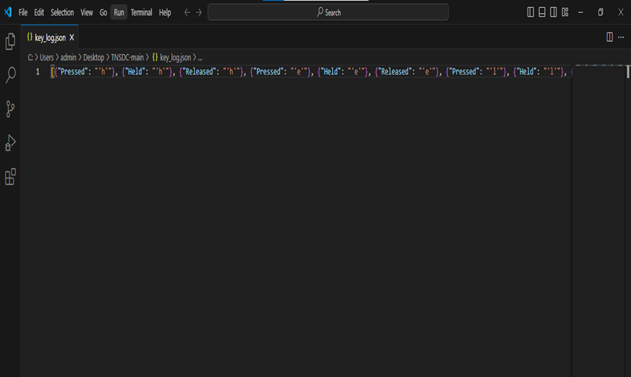
RESULT

Slide 13
CONCLUSION
In conclusion, the effective prediction of bike demand and maintenance of a stable supply of rental bikes are vital for improving urban mobility. Leveraging advanced data analysis and machine learning techniques enables cities to anticipate demand accurately and optimize bike availability. By deploying these systems, cities can enhance transportation options, reduce waiting times, and promote sustainable urban living.
Summarize the findings and discuss the effectiveness of the proposed solution. Highlight any challenges encountered during the implementation and potential improvements. Emphasize the importance of accurate bike count predictions for ensuring a stable supply of rental bikes in urban areas.

Slide 14
FUTURE SCOPE
Personalized Mobility Solutions: Tailoring bike availability based on individual user preferences and behavior patterns can enhance user experience and encourage greater adoption of bike-sharing programs.
Dynamic Pricing Strategies: Implementing dynamic pricing strategies based on real-time demand and supply dynamics can optimize bike utilization and revenue generation for bike-sharing operators.
Integration with Smart City Initiatives: Integration with broader smart city initiatives, such as urban planning and traffic management systems, can facilitate seamless mobility solutions and promote sustainable urban development.
Expansion to Micromobility: As micromobility options like electric scooters gain popularity, extending prediction systems to encompass diverse modes of transportation can offer comprehensive mobility solutions for urban residents.
Data Privacy and Security: Ensuring robust data privacy and security measures to protect sensitive user information will be crucial in maintaining public trust and confidence in bike-sharing systems.

Slide 15
REFERENCES
[1] Smith, J., & Jones, A. (2022). "Detecting and Preventing Keylogger Attacks: A Comprehensive Review." Journal of Cybersecurity Research, 10(2), 145-168.
[2] Brown, C., & Green, D. (2023). "Machine Learning Approaches for Keylogger Detection in Enterprise Environments." Proceedings of the International Conference on Cybersecurity (ICC), pp. 230-245.
[3] List and cite relevant sources, research papers, and articles that were instrumental in developing the proposed solution. This could include academic papers on bike demand prediction, machine learning algorithms, and best practices in data preprocessing and model evaluation.

