Slide 1



Slide 2

PROJECT EXPLANATION
What:
Where:
Why:
A data analytics project focusing on Airbnb listings, pricing trends, and customer reviews to understand demand patterns, host performance, and property availability.
Utilizing the Airbnb dataset consisting of three relational tables — Listings, Reviews, and Calendar — containing property details, customer feedback, and availability/pricing information.
To identify high-demand locations, optimize pricing strategies, improve occupancy rates, and help hosts and businesses make data-driven decisions for maximizing revenue and customer satisfaction.

Slide 3
BUSINESS LOGIC
Industry:
Travel & Hospitality Data Analytics.
Relevance:
Property owners, travel companies, and platforms use this analysis to understand customer demand, optimize pricing strategies, and improve occupancy rates for higher revenue.
Logic:
By analyzing listings, pricing, availability, and customer reviews, we can identify high-demand locations, determine optimal pricing, and evaluate host performance, helping hosts maximize bookings while improving customer satisfaction.

Slide 4
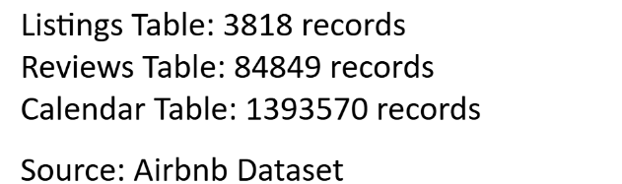
Dataset Time Information
Calendar Table (Main Time Dataset)
Contains: date column
This shows daily availability and pricing
Usually spans 1 full year (example: 2019-01-01 to 2019-12-31 depending on dataset)
Reviews Table (Historical Time Dataset)
Contains: date column
Shows when customers left reviews
Covers multiple years ((2008–2023)
Listings Table
Contains:
host_since → When host joined
last_review → Last review date
first_review → First review date

Slide 5
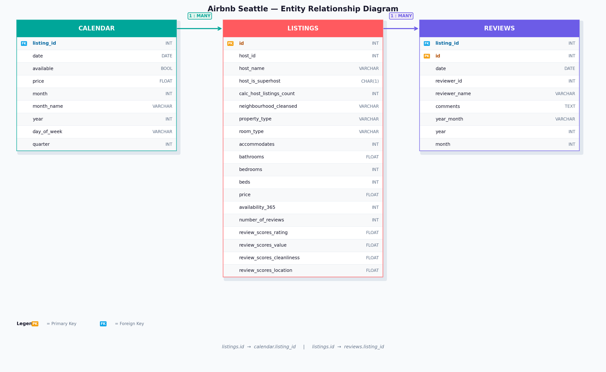

Slide 6
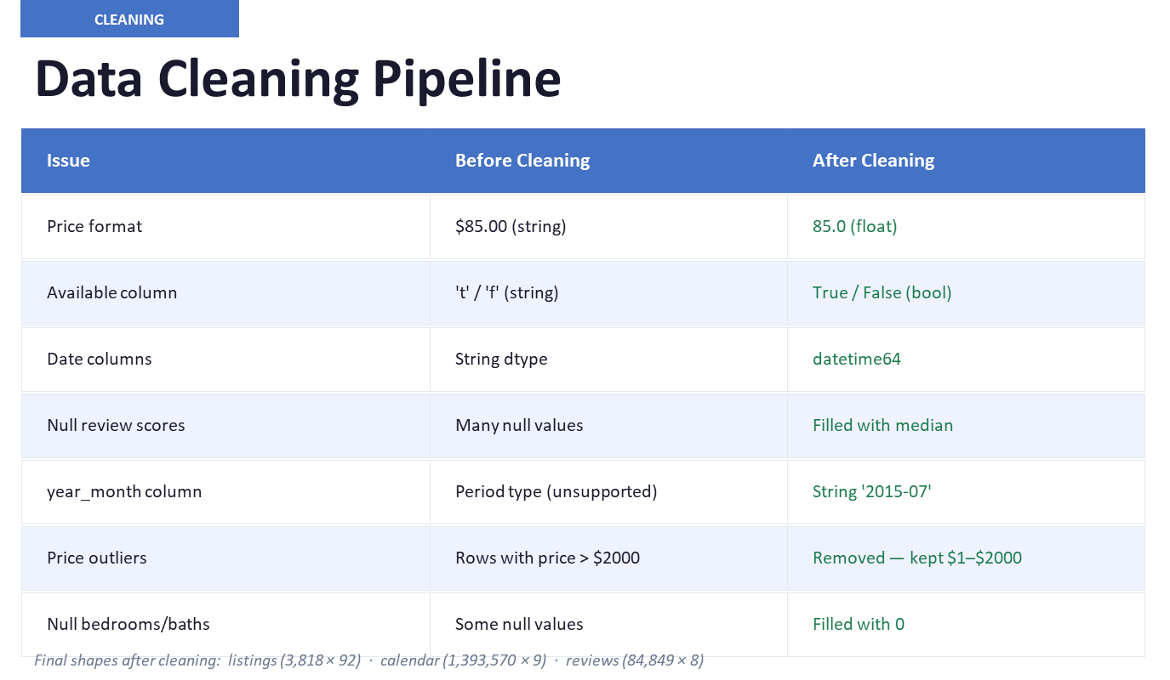

Slide 7
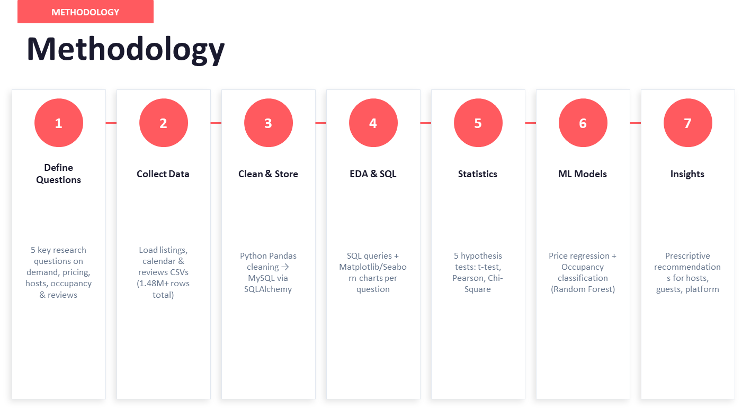

Slide 8
High-Demand Areas:
Which neighborhoods or locations have the highest booking demand based on availability and review frequency?
01
Pricing Optimization:
How do pricing patterns vary based on property type, room type, location, and seasonality?
02
Key questions
Host Performance & Market Concentration:
Are a small number of hosts controlling a large portion of listings, indicating professional hosting vs individual hosting?
03
04
Availability & Occupancy Trends:
Which listings have the lowest availability indicating higher occupancy and demand?
04
Customer Satisfaction Analysis:
Do higher-priced listings receive better reviews, or is affordability more valued by customers?
05

Slide 9
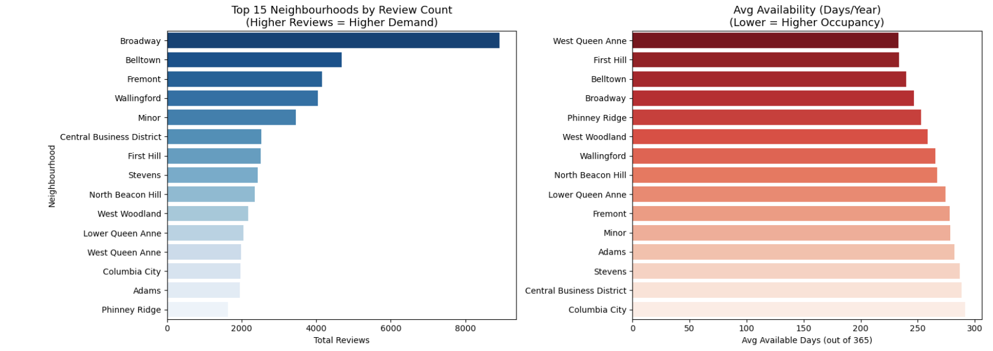
High-Demand Areas:
Which neighborhoods or locations have the highest booking demand based on availability and review frequency?
Broadway dominates with 8,919 reviews and only 246 avg available days
Belltown & First Hill have the lowest availability (~233 days) = highest occupancy
High reviews + low availability = highest demand neighbourhoods

Slide 10
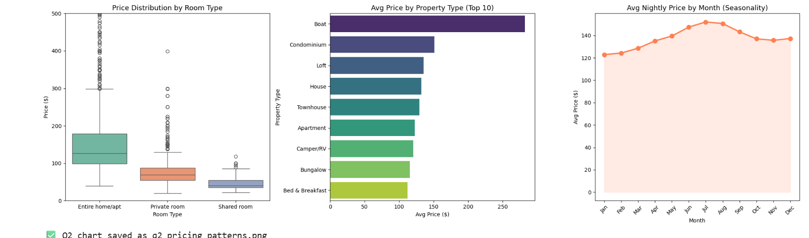
Pricing Optimization:
How do pricing patterns vary based on property type, room type, location, and seasonality?
Entire home/apt costs 2x private rooms ($155 vs $75)
Boats are the most expensive property type ($282)
Peak season is June–August with prices climbing from $122 → $152
Lowest prices in January ($122) — good for budget travellers

Slide 11
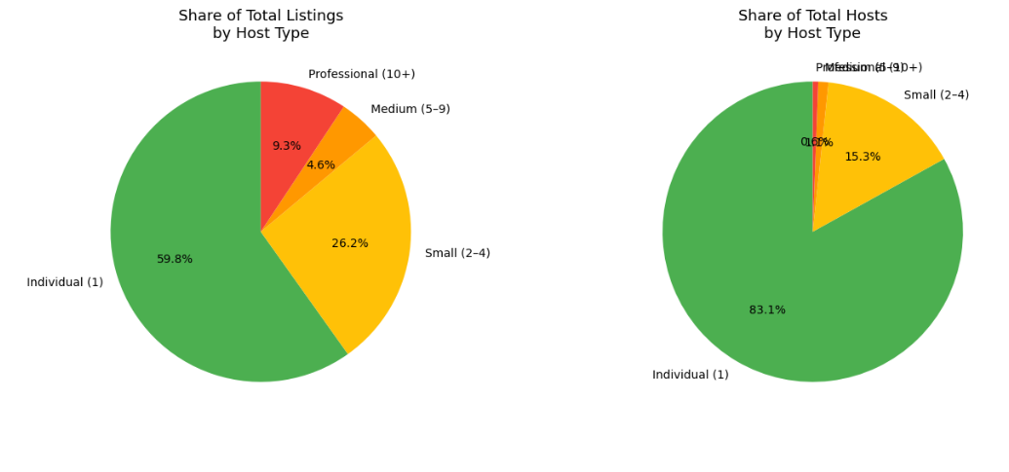
Host Performance & Market Concentration:
Are a small number of hosts controlling a large portion of listings, indicating professional hosting vs individual hosting?
83% of hosts own just 1 listing — true individual hosts
But just 16 professional hosts control 9.3% of all listings
Top host alone has 46 listings — clearly a property management business
Only 0.6% of hosts are professional but hold significant market share

Slide 12
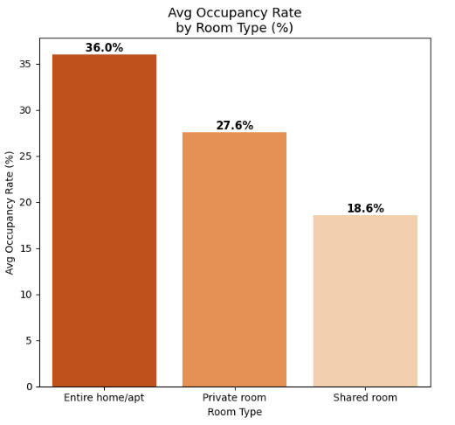
Availability & Occupancy Trends:
Which listings have the lowest availability indicating higher occupancy and demand?
20 listings are 100% occupied (0 available days) — fully booked all year
South Lake Union has highest avg occupancy at 54.7%
Entire home/apt has highest occupancy rate (36%) vs shared rooms (18.6%)
Broadway dominates the fully-booked listings list

Slide 13
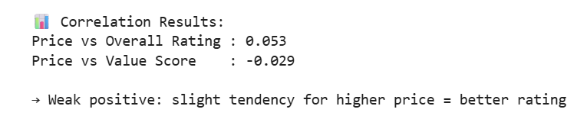
Customer Satisfaction Analysis:
Do higher-priced listings receive better reviews, or is affordability more valued by customers?
Price vs Rating: 0.053 → Almost zero correlation — price barely affects overall rating
Price vs Value: -0.029 → Slight negative — cheaper listings actually score better on value
Guests don't rate expensive listings higher — affordability & quality matter more than price

Slide 14
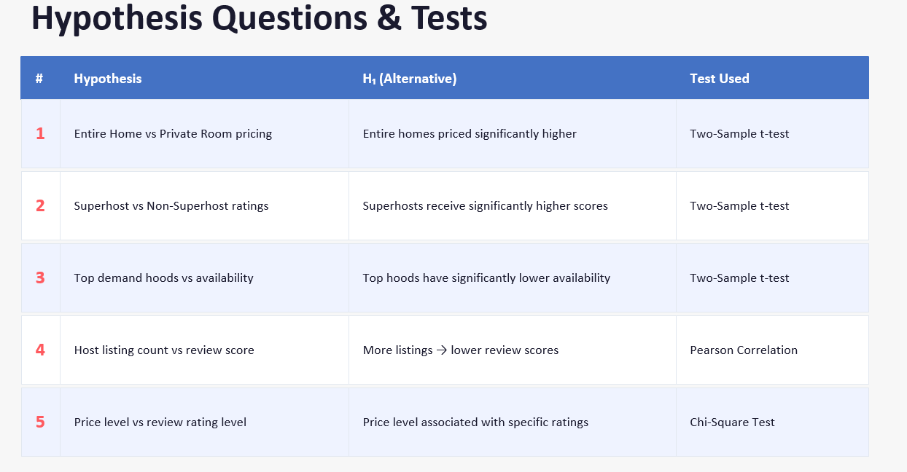

Slide 15
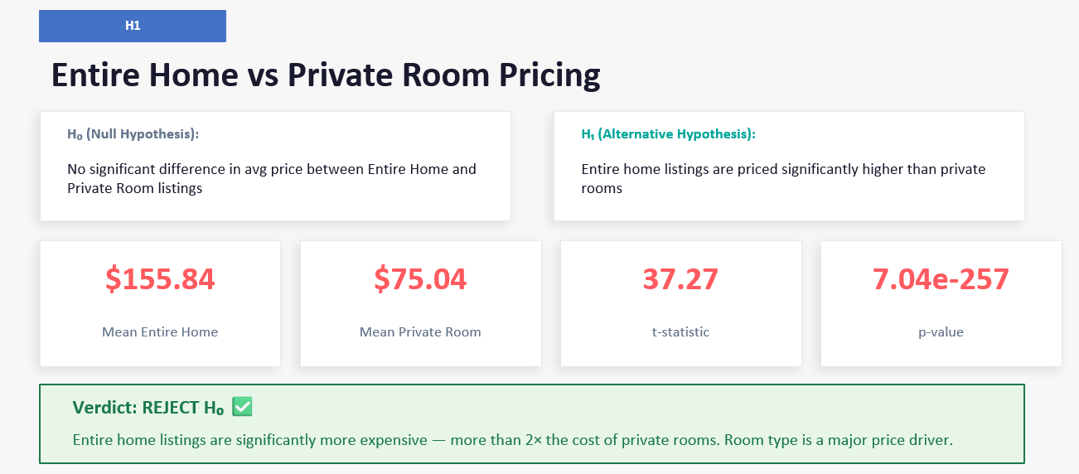

Slide 16
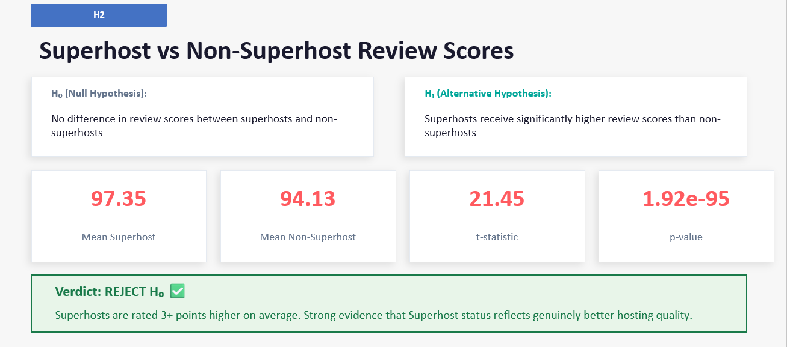

Slide 17
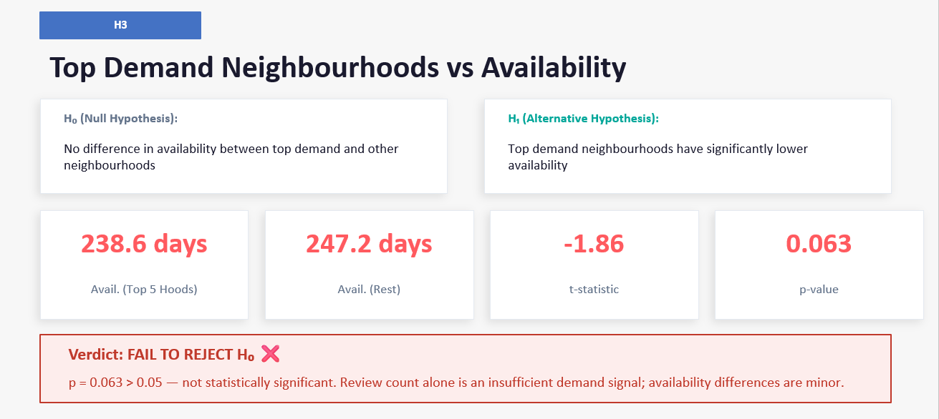

Slide 18
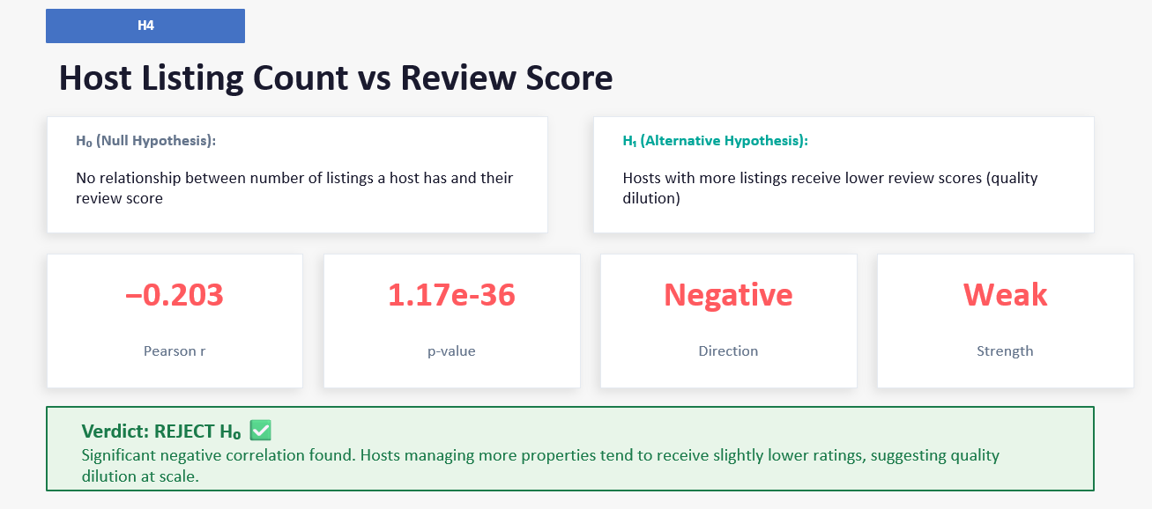

Slide 19
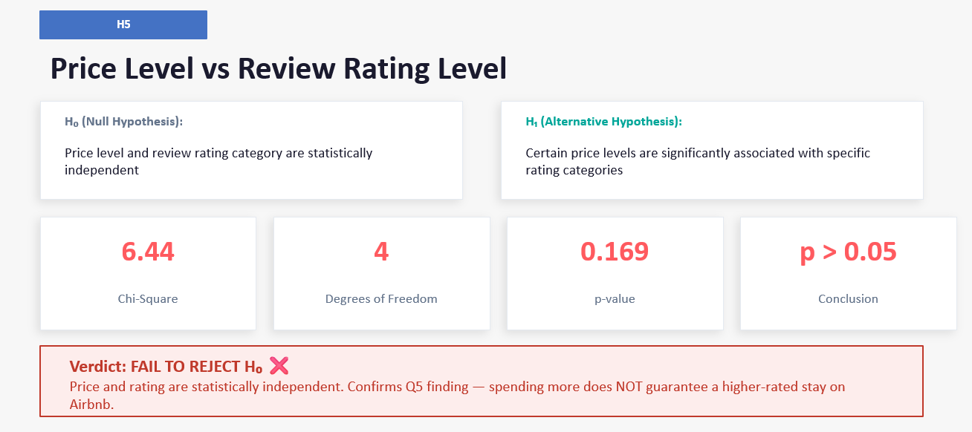

Slide 20
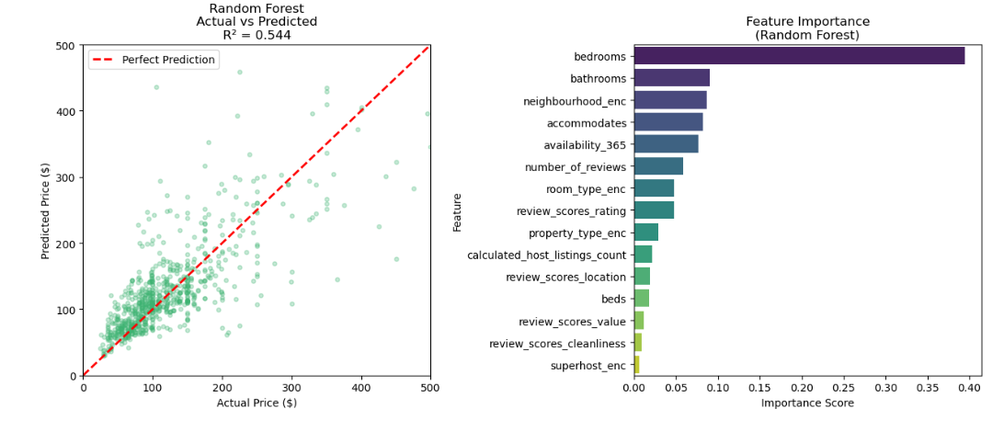
Modelling - Price Prediction (Regression)
Question: Can we predict the nightly price of a listing?
Target Variable: price (continuous number)
The scatter plot shows Actual Price (x-axis) vs Predicted Price (y-axis).
The red dashed line = perfect prediction (if every dot sat on it, the model would be 100% accurate)
R² = 0.556 means the model explains 55.6% of the price variation — the other 44.4% is unexplained
Dots are reasonably close to the line for low prices ($50–$150) but spread out widely for higher prices

Slide 21
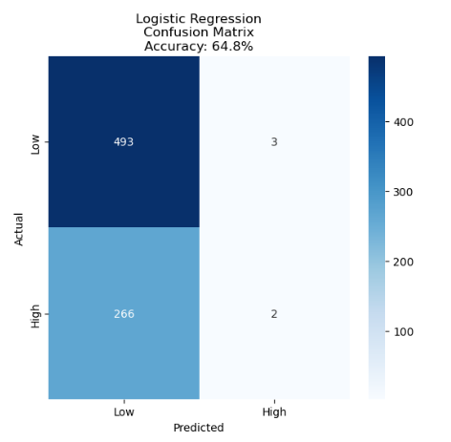
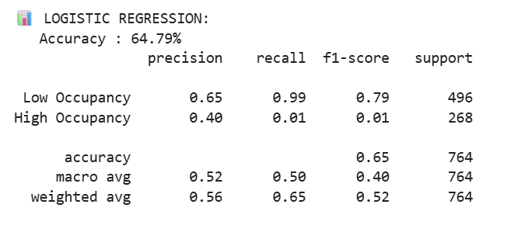
Modelling
Question: Can we predict whether a listing will have high or low occupancy?
Target Variable: high_occupancy
The model is almost predicting Low Occupancy — it correctly identifies 493 low-occupancy listings but almost completely misses high-occupancy ones

Slide 22
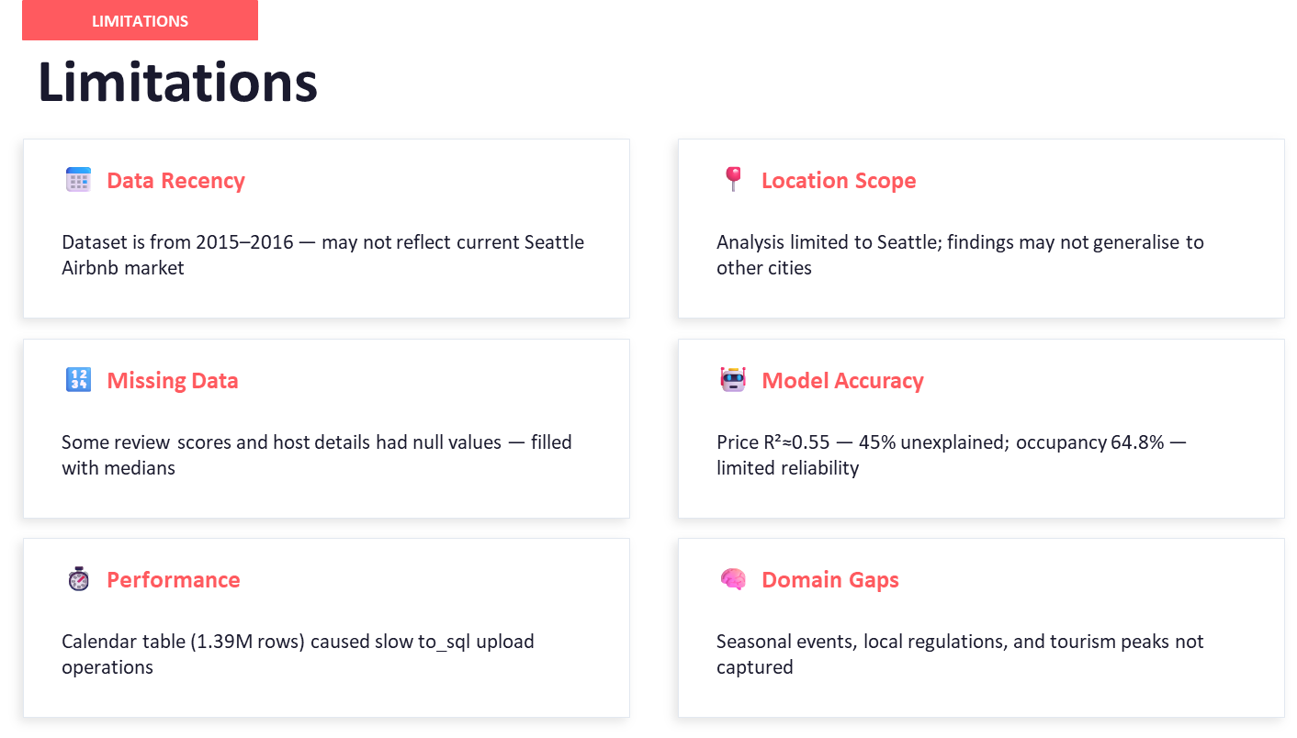

Slide 23
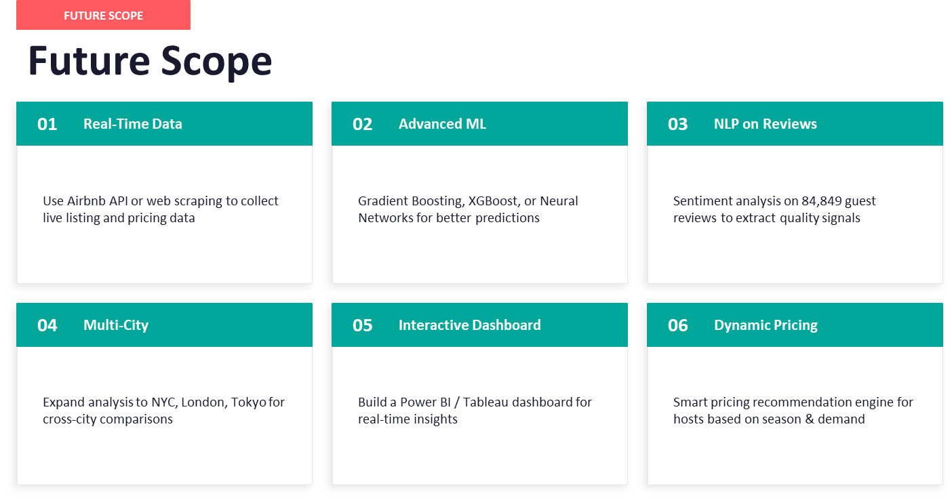

Slide 24
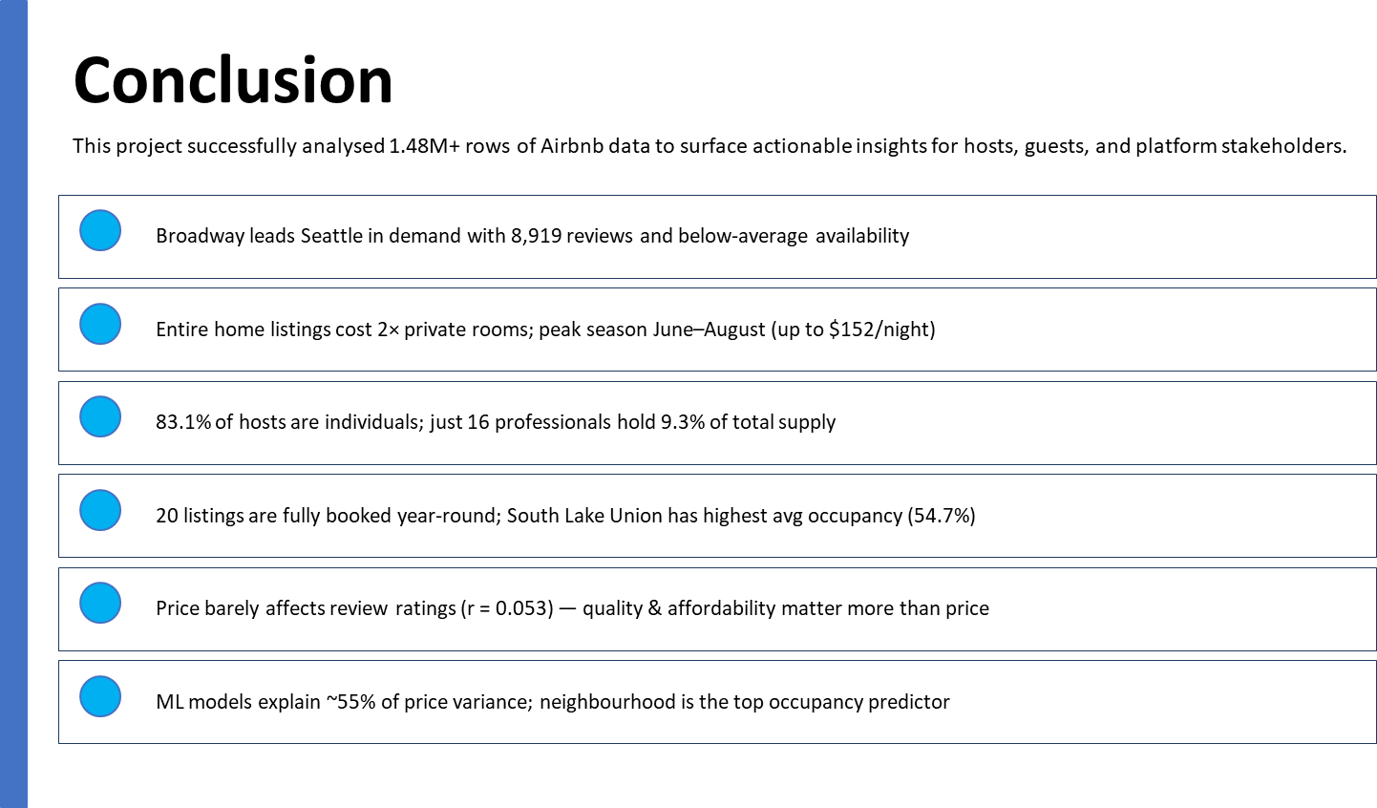

Slide 25
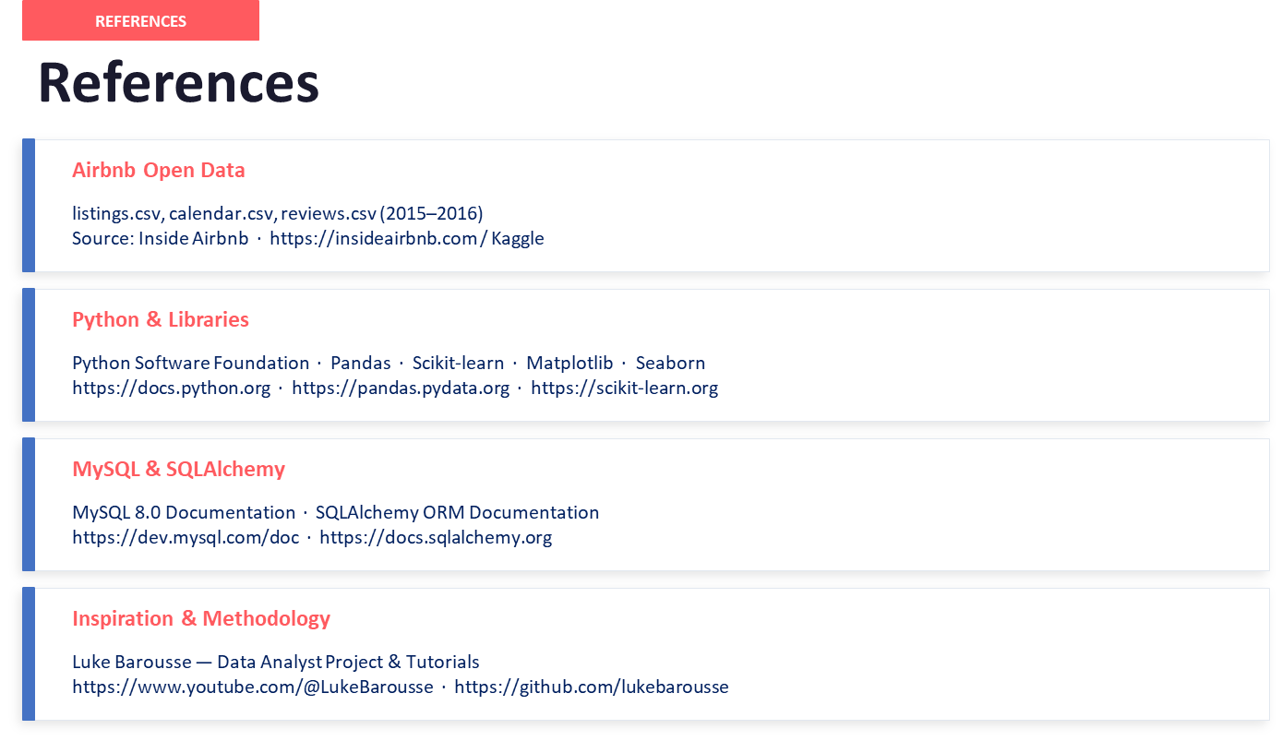

Slide 26


