Slide 1
RENEWAL HEALTH CHECK
Are renewals really healthy?
Paid members grew, but the headline renewal rate hides a sharp deterioration in first renewals.

Slide 2
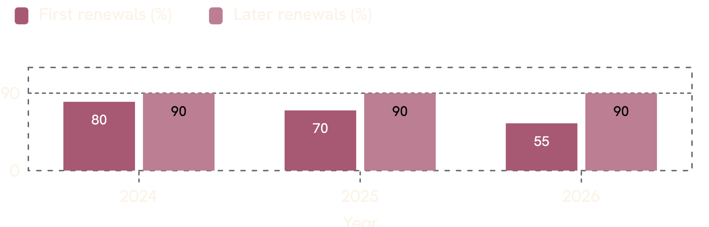
01 — HEADLINE RATE
How can the rate stay flat while the risk rises?
PAID MEMBERS
5,080 → 6,024
SEPTEMBER RENEWAL RATE
80.0%
in both 2025 and 2026
FIRST RENEWALS
The total rate is flat because later renewals are stable and increasingly dominate the mix.
80% → 70% → 55%
across 2024–2026
Are renewals really healthy?
2

Slide 3
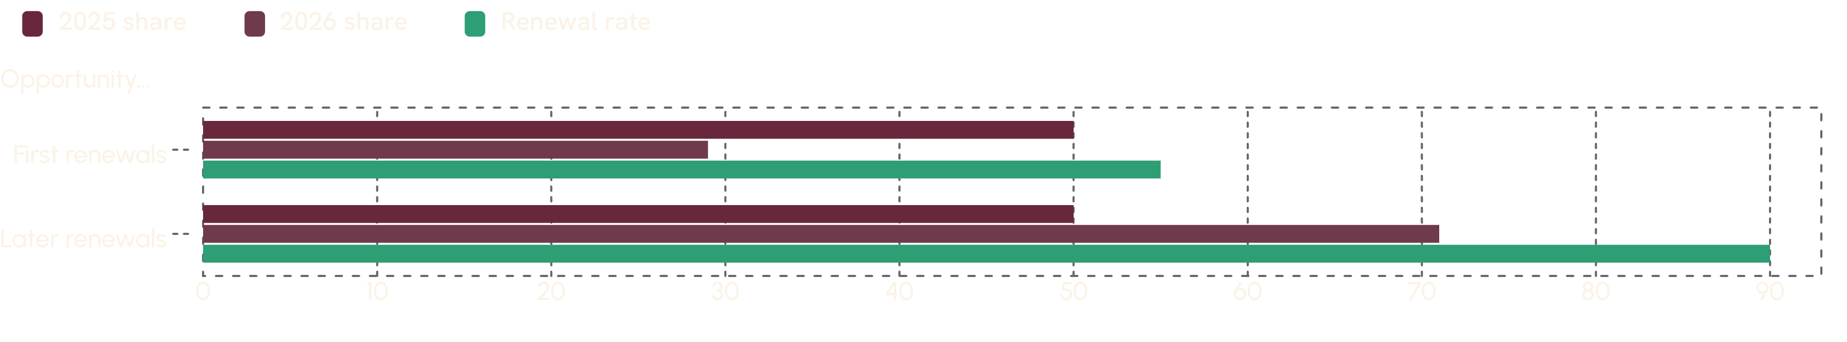
02 — MIX SHIFT
Is the mix masking the cohort that fell?
FIRST RENEWALS
LATER RENEWALS
AT 2025’S MIX
50% → 29%
90%
72.5%
of September opportunities in 2026
higher-renewing cohort grew as a share of opportunities
2026 renewal rate
Mix shift explains much of the stable headline rate, but not the underlying first-renewal decline.
Are renewals really healthy?
3

Slide 4
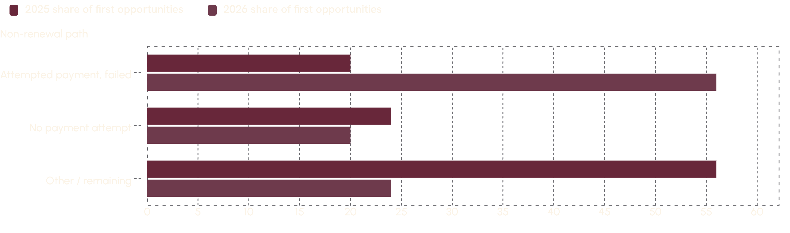
03 — FIRST-RENEWAL PATHS
What happened to first renewers?
The largest loss is not silent disengagement. It is members who tried to pay and failed.
Payment-failure losses expanded sharply.
No-attempt losses improved.
Are renewals really healthy?
4

Slide 5
04 — PAYMENT EVIDENCE
Did these members give up—or did checkout fail?
2026 FIRST-RENEWAL NON-RENEWERS
ATTEMPTS
320 of 576
3 each
failed after attempting payment
none recovered
BENEFIT USE
INACTIVE
SUPPORT
about 8.4
0%
about 80%
in the last 30 days
were inactive
contacted support
Every contact was FREE_DELIVERY_UNAVAILABLE.
Are renewals really healthy?
5

Slide 6
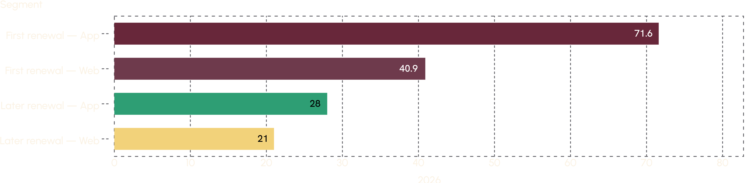
05 — CHANNEL CONCENTRATION
Where is the failure concentrated?
PSP_TIMEOUT
First renewals, App: 71.6% failure rate in 2026 vs 30.3% in 2024.
First renewals, Web: 40.9%.
Later renewals stayed stable: App 28%, Web 21%.
728
failures in 2026 vs 341 in 2025
Are renewals really healthy?
6

Slide 7
06 — RECOVERY UPSIDE
How much of the loss is recoverable?
2026 FIRST-RENEWAL RATE
AT 2025’S FAILURE SHARE
EXCESS LOSS
55%
about 74%
about 243
not 55%
first renewals
ANNUAL-FEE EXPOSURE
This is a recovery problem before it is a pricing problem.
roughly ₹4.5 lakh
Are renewals really healthy?
7

Slide 8
07 — DISENGAGEMENT CHECK
Is disengagement the real story?
NO-ATTEMPT NON-RENEWALS
ZERO USE
ACTIVE → INACTIVE
24% → 20%
45%
38–48%
of first opportunities in 2025 to 2026
of no-attempt members in the last 30 days
renewal rate
True disengagement exists, but it is smaller and more stable than the payment-failure loss.
Are renewals really healthy?
8

Slide 9
08 — PRICING RESPONSE
Should we use a blanket discount?
CAUSE MISMATCH
BREAK-EVEN
A discount cannot fix a timeout or authentication failure.
141 of 576 non-renewers would need to return.
COST
EVIDENCE GAP
₹300 off across 704 renewals gives up about ₹2.1 lakh.
All 1,060 discounted opportunities renewed; no non-renewed opportunity had a discount.
VERDICT: No blanket discount. The current data does not prove an offer changed behaviour.
Are renewals really healthy?
9

Slide 10
09 — DECISION
What should we do first?
01
02
03
04
Recover payment
Trace the signal
Re-engage selectively
Test discounts last
Investigate App checkout and PSP timeouts; add retry, fallback methods, and support pay links.
Check why FREE_DELIVERY_UNAVAILABLE appears in these failed-renewal contacts.
Randomised pilot for no-attempt, low-use first renewers only.
Target Active → Inactive members, whose renewal rate is 38–48%.
Decision ask: fund payment recovery first; reserve discounting for a measured test.
Are renewals really healthy?
10

