Slide 1
BATTERY THERMAL MANAGEMENT SYSTEM
SUBMITTED BY :
ARULMATHI. A - 71772213104
DHINESH KUMAR.V -71772213108
NISHA.P -71772213138
SIVARAM.K.N -71772213148

Slide 2
ABSTRACT :
Recent incidents of electric bike fires have been linked to poor battery design and inadequate thermal management, leading to Battery Management System (BMS) failures. Most EVs lack effective cooling mechanisms, increasing the risk of overheating and fire hazards.
This project introduces a Battery Thermal Management System (BTMS) with smoke detection, which monitors battery temperature and automatically activates a cooling fan when overheating or smoke is detected.
This proactive cooling mechanism helps in reducing battery temperature and preventing potential hazards, ensuring safe and efficient EV operation.

Slide 3
COMPONENTS :
ESP32 MICROCONTROLLER
TEMPERATURE SENSOR (DS18B20)
SMOKE SENSOR (MQ135)
LITHIUM ION BATTERY (12V)
I2C 16 X 2 LCD DISPLAY
RELAY MODULE
COOLING FAN
BUZZER
MOSFET
BLYNK APP
JUMPER WIRES

Slide 4
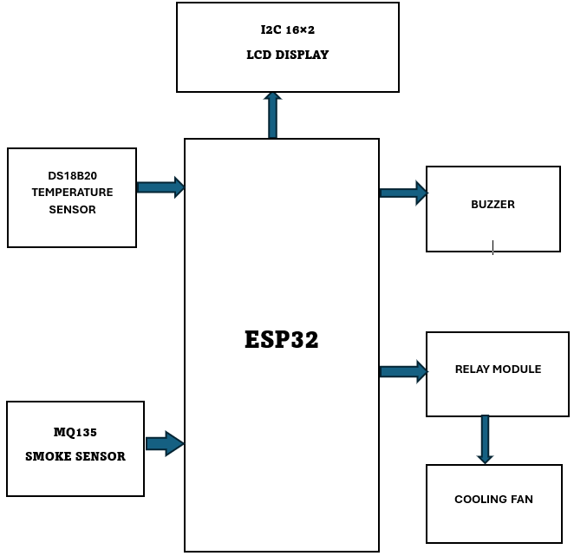
BLOCK DIAGRAM :

Slide 5
WORKING :
TEMPERATURE AND SMOKE SENSOR:
The temperature sensor constantly measures the battery temperature and sends data to the ESP32. It processes the data and checks if the temperature crosses a predefined threshold.
The smoke sensor detects any presence of smoke or gas (such as burning plastic or overheating components).
COOLING SYSTEM ACTIVATION :
The sensor detects high temperature or smoke and sends data to the ESP32.
If the reading exceeds the threshold, It sends a HIGH (5V) signal to the relay.
The relay coil energizes, closing the NO contact, allowing current to flow to the fan (turning it ON).

Slide 6
When temperature drops or no smoke is detected, EPS32 sends a LOW (0V) signal to the relay.
The relay deactivates, opening the NO contact, cutting power to the fan (turning it OFF).
LCD DISPLAY UPDATES :
The LCD module (likely a 16x2 LCD) displays real-time temperature and smoke status using ESP32 and I2C communication for easier interfacing.
ADAPTIVE FAN CONTROL USING PWM :
The ESP32 generates a PWM signal on a digital pin.
The PWM signal controls the MOSFET, adjusting the voltage supplied to the fan.
A higher PWM duty cycle increases fan speed, and a lower duty cycle reduces speed dynamically based on temperature sensor readings.

Slide 7
APPLICATIONS :
Electric Vehicles (EVs) – Prevents overheating, enhances battery life, and improves efficiency.
Renewable Energy Storage – Maintains stable temperature in solar and wind energy battery banks.
Aerospace & Drones – Ensures battery performance in extreme temperatures for satellites and aircraft.
Consumer Electronics – Protects smartphones, laptops, and wearables from overheating.
Industrial & Military Use – Ensures reliable battery performance in robots, forklifts, and defense vehicles.

Slide 8
ADVANTAGES :
Prevents overheating and fire risks
Enhances battery life and performance
Real-time monitoring with automatic cooling
Reduces maintenance costs and failures
Improves overall EV safety
INNOVATION :
ADAPTIVE FAN CONTROL USING PWM :
Instead of simply turning the fan ON/OFF, use Pulse Width Modulation (PWM) to adjust fan speed based on temperature levels.
PWM Signal Generation
ESP32 generates a PWM signal based on the temperature reading.
Higher temperature → Higher PWM duty cycle (Fan spins faster).
Lower temperature → Lower PWM duty cycle (Fan slows down).

Slide 9
STUDY - 1
STUDY OF SENSORS AND COMMUNICATION PROTOCOLS IN IoT
This project utilizes sensors and IoT communication protocols for EV battery thermal management. LM35 and MQ-2 sensors detect temperature and smoke, sending data to a microcontroller. Using Wi-Fi or Bluetooth, the system transmits real-time data to the Blynk app. The fan is automatically controlled based on sensor inputs to regulate cooling. This ensures efficient battery safety, remote monitoring, and proactive thermal management in EVs.
STUDY - 2
ELECTRIC VEHICLES AND MOBILITY - COURSERA
The "Electric Vehicles and Mobility" course provides knowledge on battery management systems, thermal management, and power electronics, which are crucial for this project. It helps in understanding EV battery safety, energy efficiency, and cooling mechanisms.

Slide 10
THANK YOU

