Slide 1

Sentiment Analysis of Tweets

Slide 2
Introduction
Brief overview of the project
Importance of sentiment analysis in social media
Objective: Analyzing sentiment in a Twitter dataset

Slide 3

Purpose of project
Understanding Public Opinion:
Improving Brand Interactions:
Monitoring Social and Political Trends

Slide 4
Project Overview
Description of the Twitter dataset
Source of the dataset
Fields/columns in the dataset

Slide 5

Data Cleaning
Importance of data cleaning
Methodology used for cleaning tweets
Data from twitter

Slide 6
Sentiment Analysis
Explanation of sentiment analysis
Use of TextBlob library for sentiment analysis
Polarity and subjectivity in sentiment analysis

Slide 7

Analyzing Tweets
User input for filtering tweets
Displaying filtered tweets
Example of a user query and filtered tweets
Use the sentiment analyzer on the filtered tweets

Slide 8
Results - Sentiment Distribution
Pie chart representation of sentiment distribution
Percentage of positive, neutral, and negative sentiments
Visualization of sentiment distribution

Slide 9
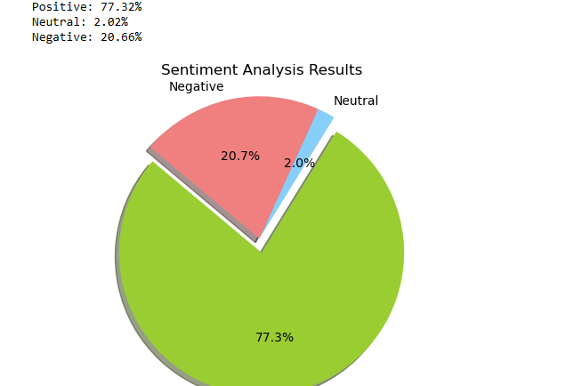
Results - Example
Displaying a sample tweet and its sentiment analysis
Visualization of sentiment score for the example tweet

Slide 10
Results for predictions
Use the results for predicting future sentiment distributions
Find the key factor for positive distribution
Similarity calculation of key factors for success predection

Slide 11
Conclusion
Summary of findings
Insights gained from the sentiment analysis
Potential applications of the results

Slide 12

Future Work
Possible improvements or extensions to the project
Using the result data in prediction as a feed back for brand improvement

Slide 13

References
List of sources, libraries, and tools used
Pandas
Textblob
Matplotlib
re
Acknowledgment of datasets and libraries
Twitter
Tweepy

Slide 14

Team Members
Nisha Tyagi –E22BCAU0128
Nikunj Goel –E22BCAU0113
Vansh Kohli –E22BCAU0022

Slide 15

Thank You

