Slide 1

DATA SCIENCE
InstaInsights
Nikunj E22BCAU0113
Harshvardhan E22BCAU0065
Nisha E22BCAU0128
Vansh E22BCAU0022

Slide 2
Introduction
In the era of social media dominance, Instagram has become a powerhouse platform for personal branding, business promotion, and community engagement. With over a billion monthly users and an ever-evolving ecosystem, it's no surprise that individuals and organizations are keen to maximize their reach and impact on this platform. "InstaInsight" is an ambitious data science project designed to delve deep into the wealth of Instagram data to uncover the strategies and insights that can catapult your presence to new heights.

Slide 3
Objective of the project
01.
02.
03.
04.
Revealing the Secrets of Visibility
Effective Content Strategies
We aim to understand what factors contribute to increased visibility and engagement on Instagram
We will explore the types of posts, content formats, and storytelling techniques that drive high levels of engagement.
Actionable Recommendations
Influencer Collaboration
The primary goal of this project is to provide you with actionable recommendations based on data-driven insights
Identifying potential influencers or collaborators who can help increase your reach. Analyzing the performance of influencer partnerships.

Slide 4
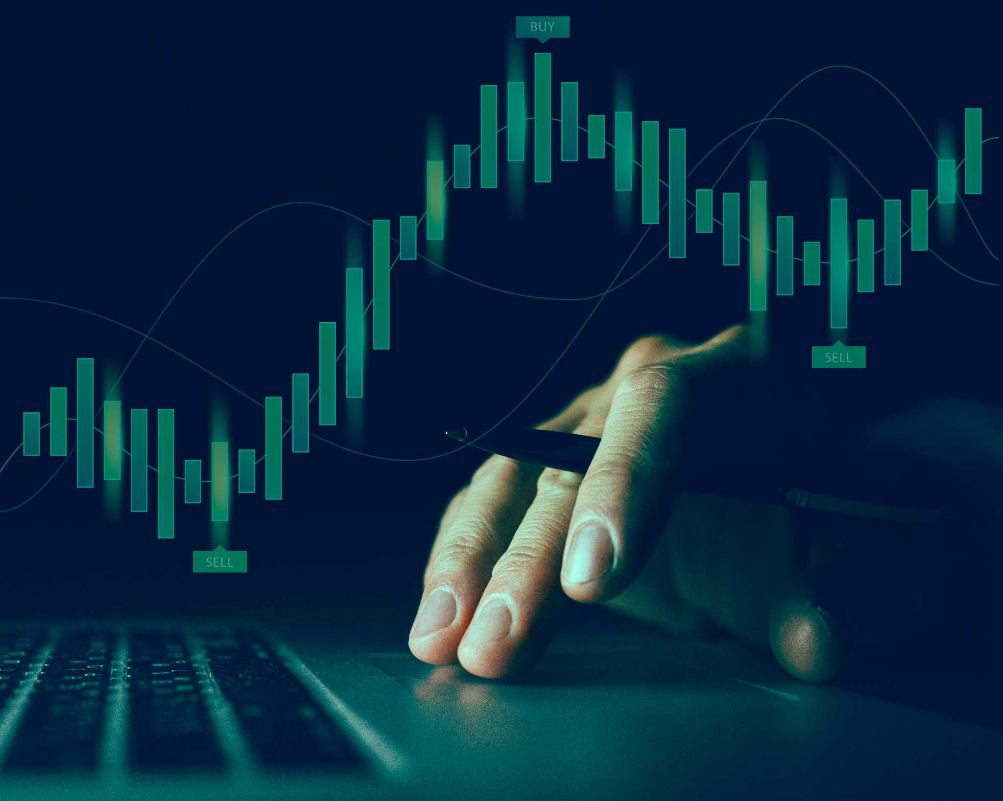
Data resources
Platform- PyCharm and Jupyter notebook
Data cleaning-
Pandas and NumPy
Visualization-
Matplotlib and Seaborn library and ploty express
Predictive models-
Scikit learn and ProgessiveAgressiveRegressive

Slide 5
Methodology
01
03
04
Visualization
Data Collection preprocessing and organization
Data cleaning
interpretation and Insights
02

Slide 6
Solution codes
# Import necessary libraries !pip install wordcloud Wordcloud import pandas as pd import numpy as np import matplotlib.pyplot as plt import seaborn as sns import plotly.express as px from sklearn.model_selection import train_test_split from sklearn.linear_model import PassiveAggressiveRegressor from wordcloud import WordCloud, STOPWORDS, ImageColorGenerator
#data set loading
# Plot pie chart for Impressions from different sources using Plotly home = data["From Home"].sum() hashtags = data["From Hashtags"].sum() explore = data["From Explore"].sum() other = data["From Other"].sum() labels = ['From Home', 'From Hashtags', 'From Explore', 'Other'] values = [home, hashtags, explore, other] fig = px.pie(data, values=values, names=labels, title="Impressions on Instagram Posts From Various Sources",hole=0.5) fig.show()
data = pd.read_csv('instagram_data.csv', encoding='ISO-8859-1') df = pd.DataFrame(data) df
# Plot distribution of Impressions from different sources plt.figure(figsize=(10, 8)) plt.style.use('fivethirtyeight') plt.title("Distribution of Impressions From Home") sns.distplot(data['From Home']) plt.show()

Slide 7
fig = px.scatter(data_frame=data, x="Impressions", y="Likes", size="Likes", trendline="ols", title="Relationship Between Likes and Total Impressions") fig.show()
conversion_rate = (data["Follows"].sum() / data["Profile Visits"].sum()) * 100 print(conversion_rate)
Calculate and print correlation values for different variables correlation = data.corr() print(correlation["Impressions"].sort_values(ascending=False))
# Train a PassiveAggressiveRegressor model x = np.array(data[['Likes', 'Saves', 'Comments', 'Shares', 'Profile Visits', 'Follows']]) y = np.array(data["Impressions"]) xtrain, xtest, ytrain, ytest = train_test_split(x, y, test_size=0.2, random_state=42) model = PassiveAggressiveRegressor() model.fit(xtrain, ytrain) score = model.score(xtest, ytest) print(score)
# Predict with the trained model features = np.array([[282.0, 233.0, 4.0, 9.0, 165.0, 54.0]]) prediction = model.predict(features) print(prediction)

Slide 8
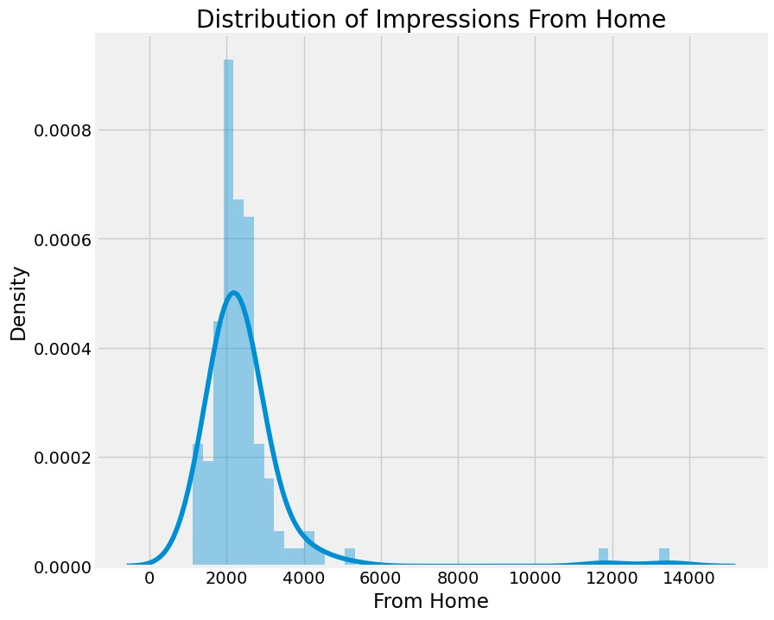
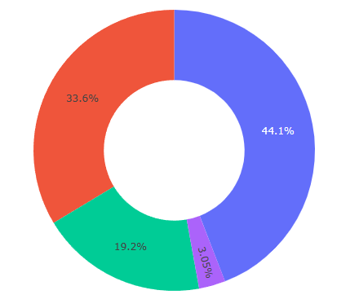
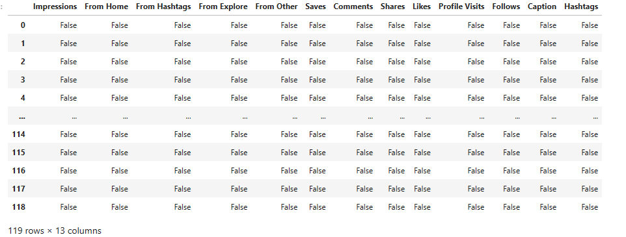
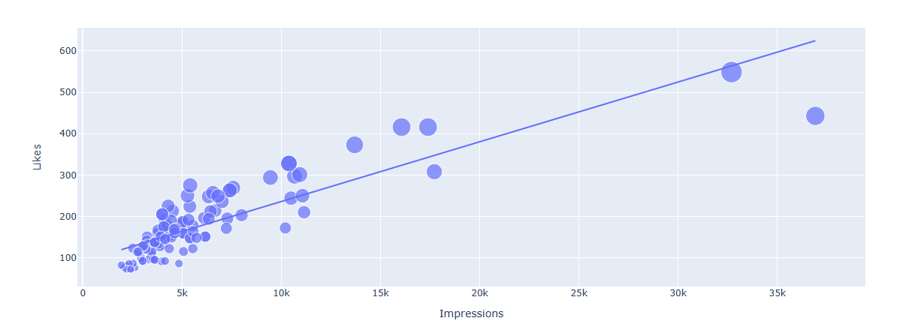
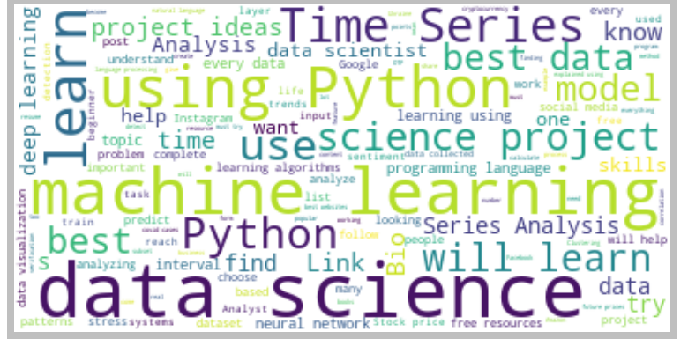
Outputs

Slide 9
CONCLUSION
04
05
ACCOUNT GROWTH
INCREASE REACH
INSIGHTS

Slide 10
Future enhancement
Analyzing Instagram datasets to improve user engagement is an exciting and dynamic project. Below are some potential future improvements and areas of focus for this project: Advanced Analytics: Sentiment analysis: Analyze the sentiment expressed in the comments and captions of Instagram posts to gain insight into user sentiment. Emotion recognition: Emotion recognition techniques can be used to measure the emotional impact on user engagement of images and content. User segmentation: Machine learning algorithms can be used to segment users based on their behavior, interests or demographics. Personalization: Personalized recommendations can be used to suggest content based on past engagement patterns. Content Analysis: Analyze the performance of various types of content (image, video, carousels, etc.) to determine which formats are most engaging. Content creation strategies can be optimized on the basis of these insights. Hashtag analysis: Hashtag analysis can be used to analyze trending hashtags and their impact on user engagement. Identify relevant and popular trending hashtags to improve discoverability. Time Series analysis: Time series analysis can help you identify patterns over time in user engagement over a period of time.

