Slide 1
DEMO WEB SHOP AUTOMATION TESTING FRAMEWORK
USING SELENIUM, CUCUMBER, TESTNG AND JAVA
CAPSTONE PROJECT PRESENTATION
SDET TRAINING PROGRAM
WIPRO LIMITED
2026
Guided By Anand B | Submitted By Group – G Team Members Nisha Mandiwal Pammi Yashwitha Reddy Pasagadugula Sree Keerthana Manikanta Potnuru Arthi Prasuna Reddy Musipatla Kandukuri Siddarth Goud

Slide 2
Project Overview
Introduction
The Demo Web Shop Automation Framework is an end-to-end automation testing project developed for validating major functionalities of an e-commerce website.
Purpose
Automate repetitive test scenarios
Reduce manual effort
Improve test coverage
Generate detailed execution reports
Follow industry-standard automation practices

Slide 3
Automate end-to-end business workflows
Improve testing efficiency
Reduce execution time
Increase test reliability
Implement reusable automation framework
Support data-driven testing
Generate professional reports
Project
Objectives

Slide 4
Technology Stack
Technology | Purpose
Java | Programming Language
Selenium | Browser Automation
Cucumber | BDD Testing
TestNG | Test Execution
Maven | Dependency Management
Apache POI | Excel Data Handling
Allure Report | Reporting
Extent Report | Reporting
GitHub | Version Control

Slide 5
Framework Architecture
Page Object Model Architecture
Benefits
Plain Text Feature Files ↓ Step Definitions ↓ Page Objects ↓ Web Elements ↓ Browser
Reusability
Scalability
Easy Maintenance
Better Readability

Slide 6
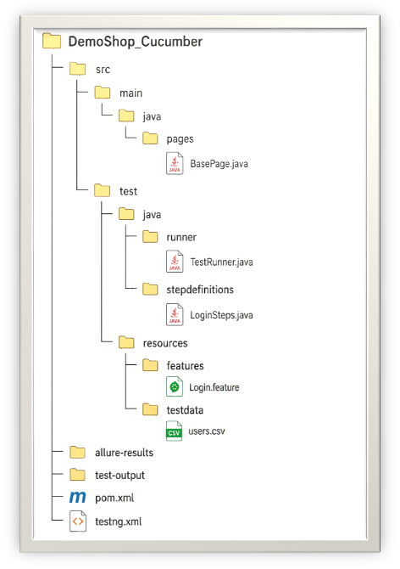
Project Structure
src/main/java └─ Pages
src/test/java ├─ Runner ├─ Step Definitions └─ Hooks
src/test/resources ├─ Features └─ Test Data

Slide 7
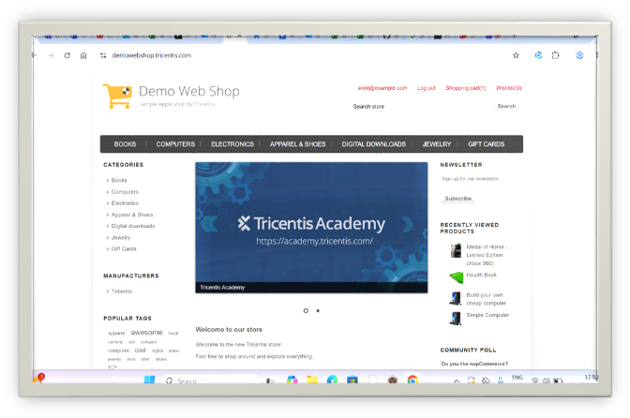
User Management
Registration
Login
Logout
Product Management
Search Product
Filter Product
Product Comparison
Shopping Features
Wishlist
Shopping Cart
Checkout
Guest Checkout
Registered Checkout
Customer Services
Return Request
Recently Viewed Products
Functionalities Covered​

Slide 8
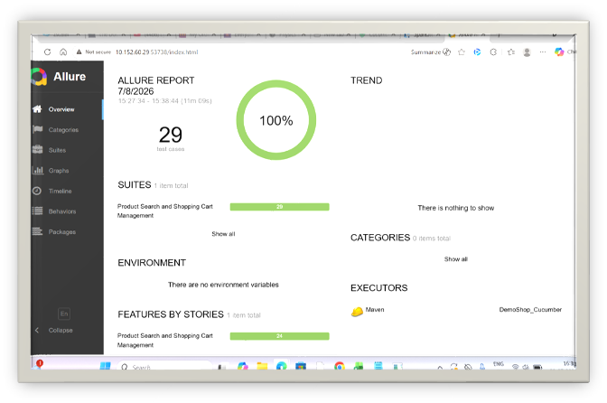
Reporting
Allure Reports
Features
Execution Summary
Pass/Fail Statistics
Timeline View
Detailed Logs

Slide 9
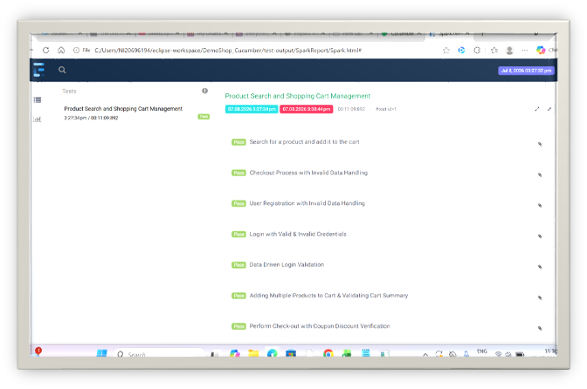
Extent Reports
Features
Interactive HTML Dashboard
Test Status
Logs
Execution Summary

Slide 10
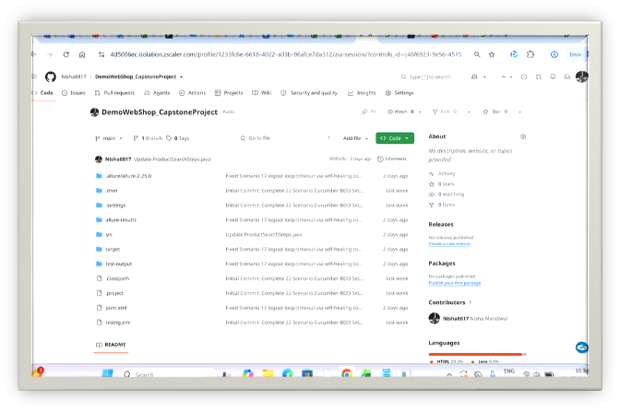
GitHub Integration
Activities Performed
Repository Creation
Code Commit
Push & Pull Operations
Branch Management
Collaboration
Benefits
Code Tracking
Team Collaboration
Backup & Recovery

Slide 11
Challenges & Solutions
Challenge | Solution
Dynamic Elements | Explicit Waits
Synchronization Issues | WebDriverWait
Test Data Management | Excel Utility
Reusability | Page Object Model
Reporting Setup | Allure & Extent Integration

Slide 12
Results & Achievements
Project Outcomes
Automated major e-commerce workflows
Increased test coverage
Reduced manual effort
Reusable automation framework
Data-driven execution
Professional reporting
Scalable project structure

Slide 13

THANK YOU

