Slide 1
Churn Analysis
By: Nisha Kadian

Slide 2

Purpose
To analyse data to gather mindful insights which will be helpful for client retention & frame short term as well as long term company policy.

Slide 3

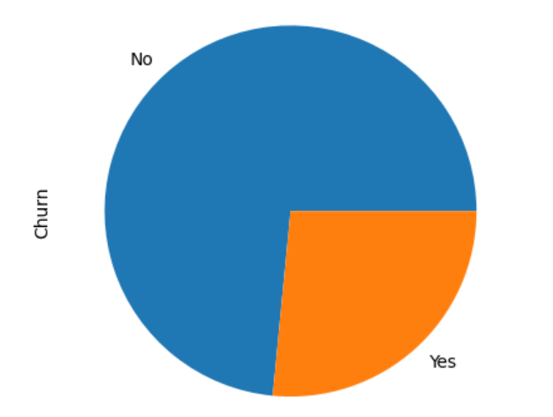
Target Data
Data is highly imbalance ,with a ratio of 73:27.
To understand target data, we will use univariate & bivariate analysis so that useful insight can be extracting & needful steps can be performed accordingly.

Slide 4
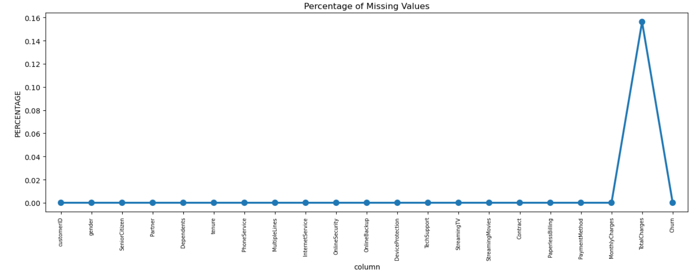
Missing Data:
The null values are very less in Total Charges column.
The total percentage of missing value is 0.15% considered as a low compared to the whole data.
As the percentage value is less, the impact on insight will be minimum. So dropped these values.

Slide 5
Data Cleaning
Few columns which were not relevant,removed from the sample data. Such as’CustomerId’.
New columns inserted to make impactful analysis, for example:’TenureGroup’.
To avoid duplication, ‘Tenure’ column removed as the data already covered under new tab ‘TenureGroup’.

Slide 6
Univariate Analysis

Slide 7
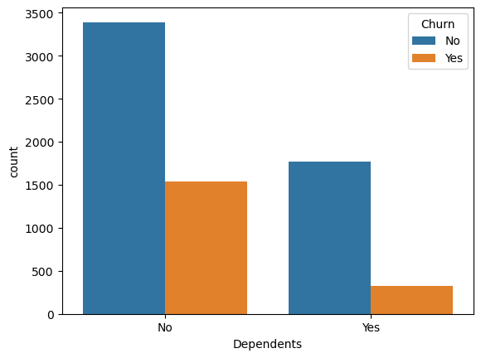
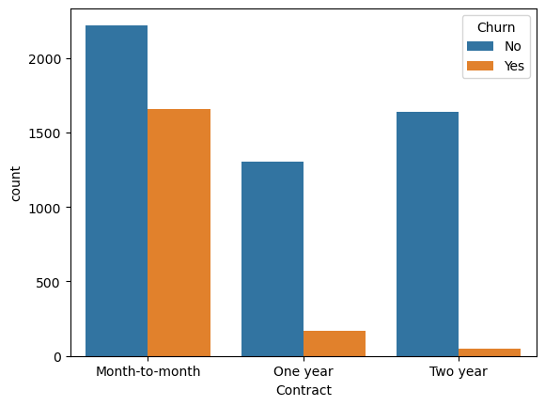
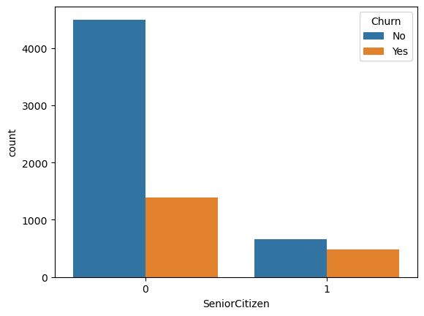
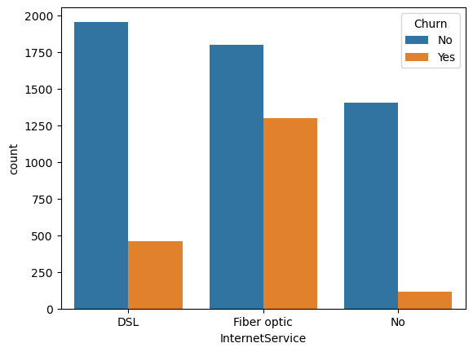
Insights
Customers with no dependents show high churn rate.
First year subscription show high rate of churning.
Customers using Fiber optic sare more likely to churn.
Senior citizen are more likely to churn.

Slide 8
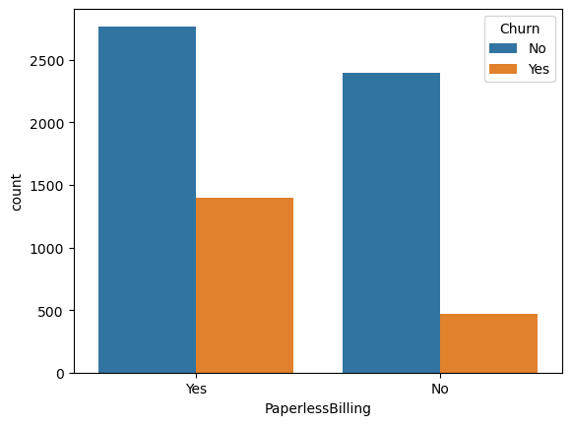
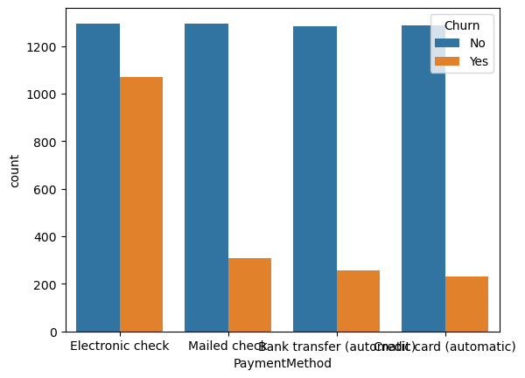
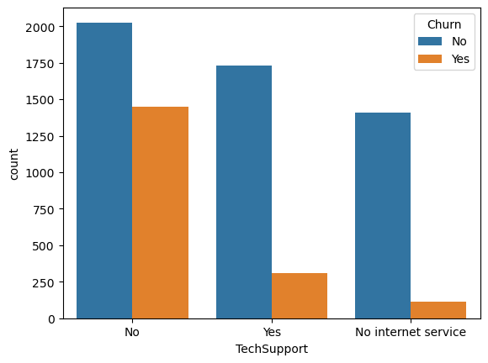
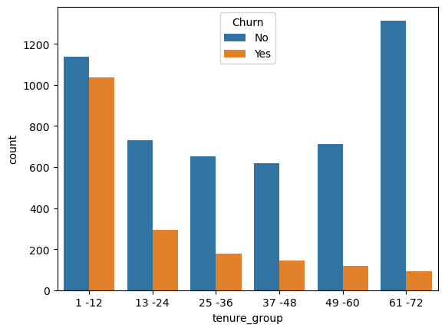
Insights
Customers using paperless billing are more likely to churn.
Customers using electronic check method are more likely to churn.
No tech support clients are more likely to churn.
Long tenure leads to less churning rate

Slide 9
Univariate insights
• Senior citizens are more likely to churn with churn rate of 26.45%
• Gender does not seem to have much impact on churn rate as both male & female are approximately equal in terms of churning with churn rate of 26.20% & 26.95% respectively.
• Customers without partner are more likely to churn with churn rate of 32.97% in comparison of Customers with partner at churn rate 19.71%.
• Customers without dependents are more like to churn (31.27%) instead of with dependents Customers (15.53%)
• Phone Service factor does not seem effective in churning as with or without Phone Service, the churn rate is 26.74% & 25% respectively.
• MultipleLines also has approximately equal impact: With MultipleLines (28.64%), no MultipleLines (25.08%) & No Phone service( 25%)
• Fiber optic internet service has the most churn rate(41.89%) instead of DSL (18.99%) & No internet service (7.43%)
• Customers with No online security are more likely to churn( 41.77%) comparatively with online security ( 14.64% ) & no internet service( 7.43%).
• Customers with Device protection are less likely to churn( 22.53%), however, in its absence, the churn rate is 39.14%.
• Tech support plays an important role with less churn rate( 15.19%) in comparison of no tech support churn rate( 41.64%)
• Customers with or without TV streaming have approximately same churn rate i.e. 30.11% & 33.53% respectively.
• The churning rate with movie streaming(29.41%) is less than without movie streaming( 33.72%)
• Month to month contract has the highest churn rate (42.70), on the other hand, 2 year contract has least churn rate( 2.84%) & 1 year(11.27%)
• Paper less bill leads to more churn rate( 33.58%) with paper bill( 16.37%)
• Customers with electronic check method are most likely to churn( 45.28%)
• Tenure group of (1-12) are most likely to churn with 47.68%

Slide 10
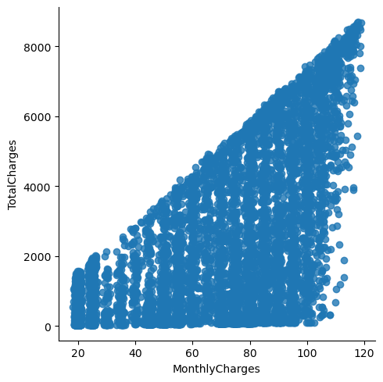
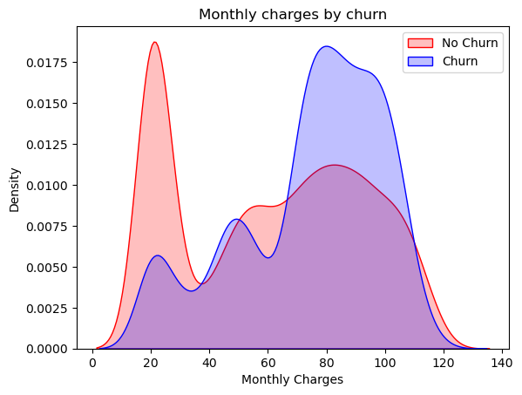
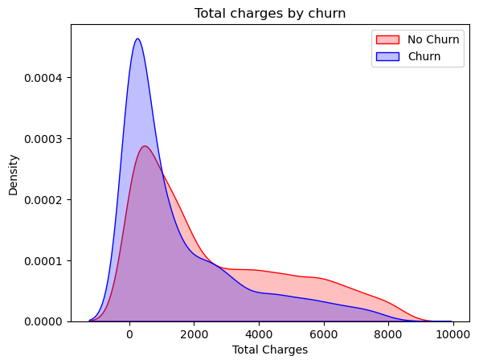
Relationship between Monthly & Total charges
Churn is high when monthly charges are high.
Churn is high when Toal charges are low.

Slide 11
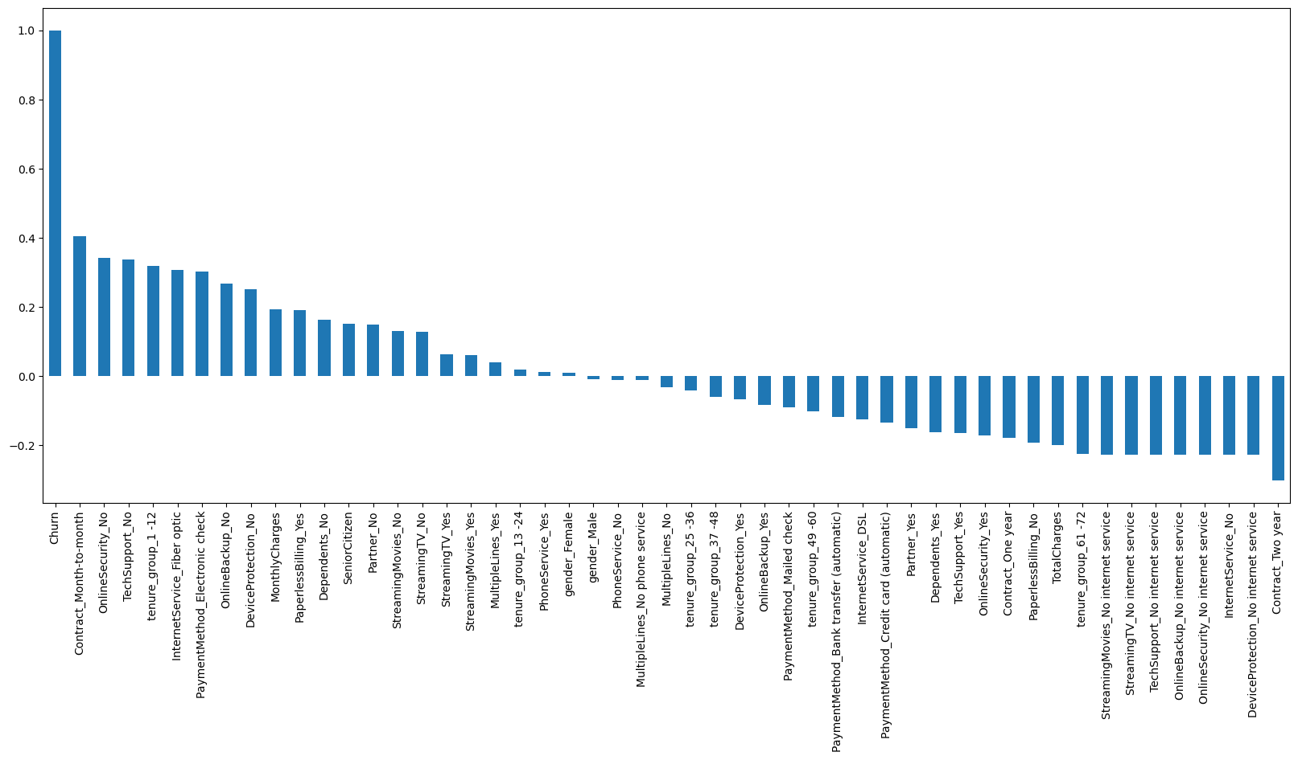
Co-relation of all predictors with 'Churn'

Slide 12
Insights
High churn rate in : Month to month contract, No online security,No tech support,first year of subscription, Fibre optic internet service, Electronic check payment method,No online backup, No device protection.
Low Churn rate in : Long term contract & subscriptions without internet services.
No impact: Gender & Phone service.

Slide 13
Bivariate Analysis

Slide 14
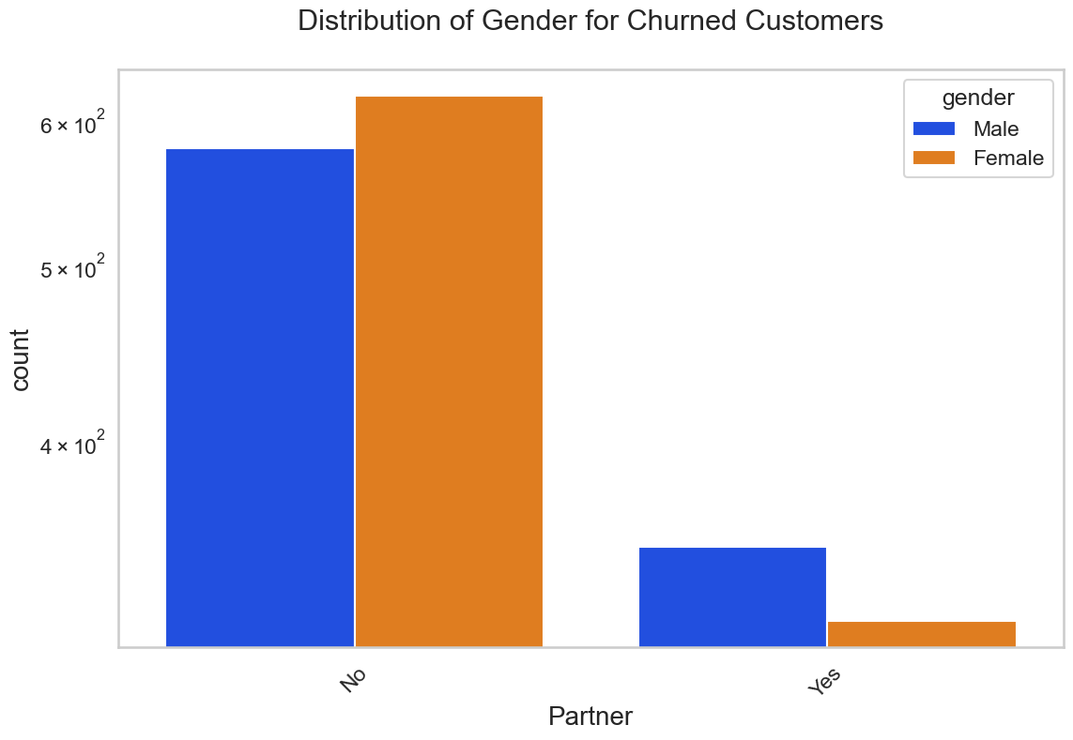
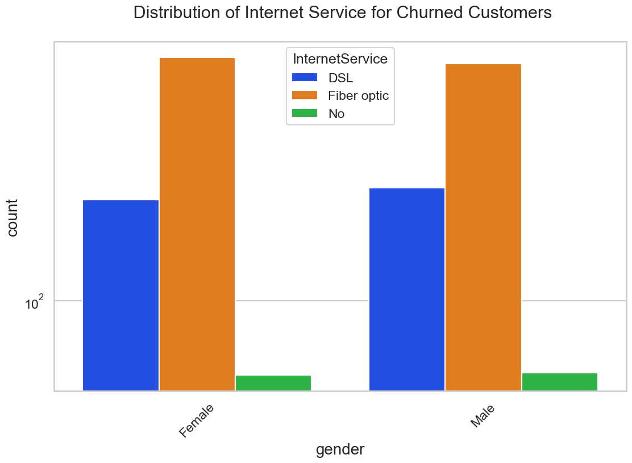
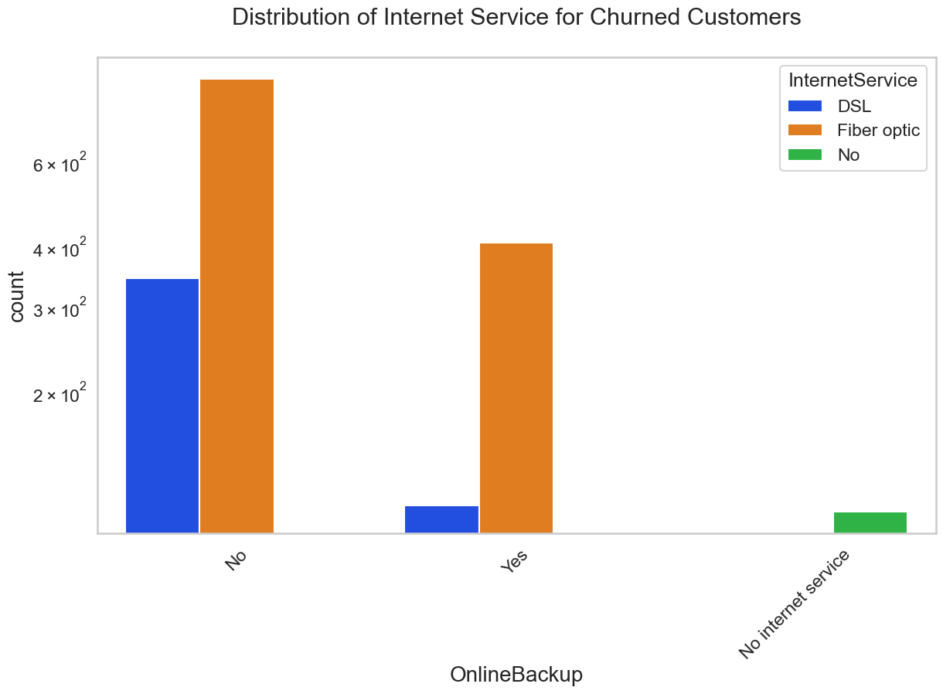
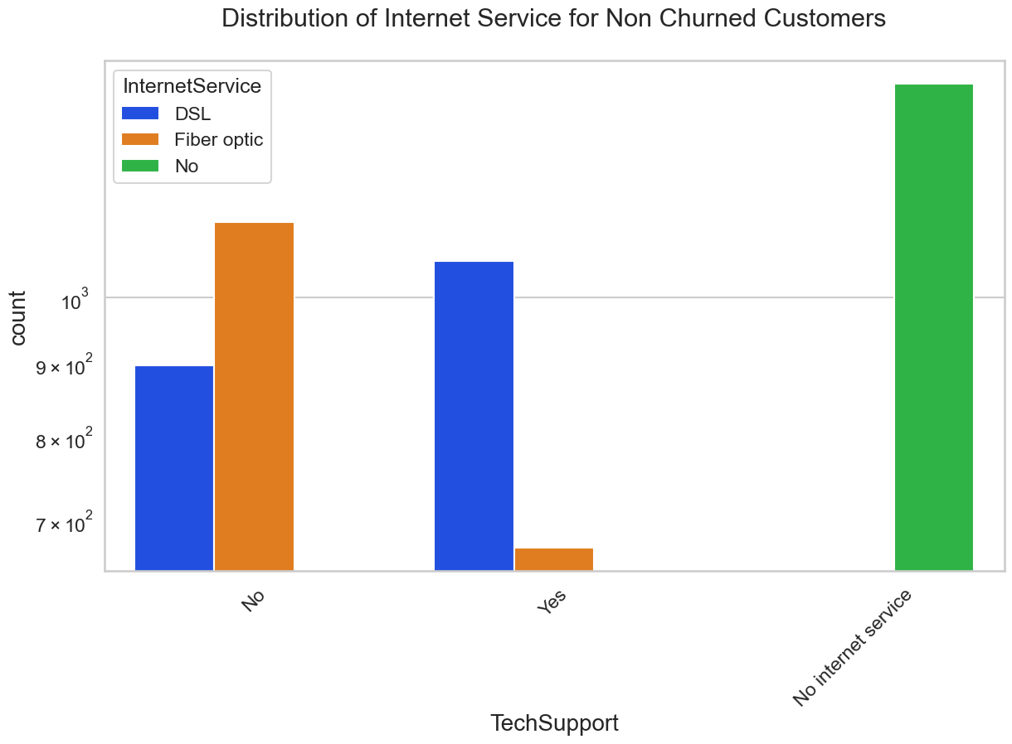
Bivariate Analysis

Slide 15

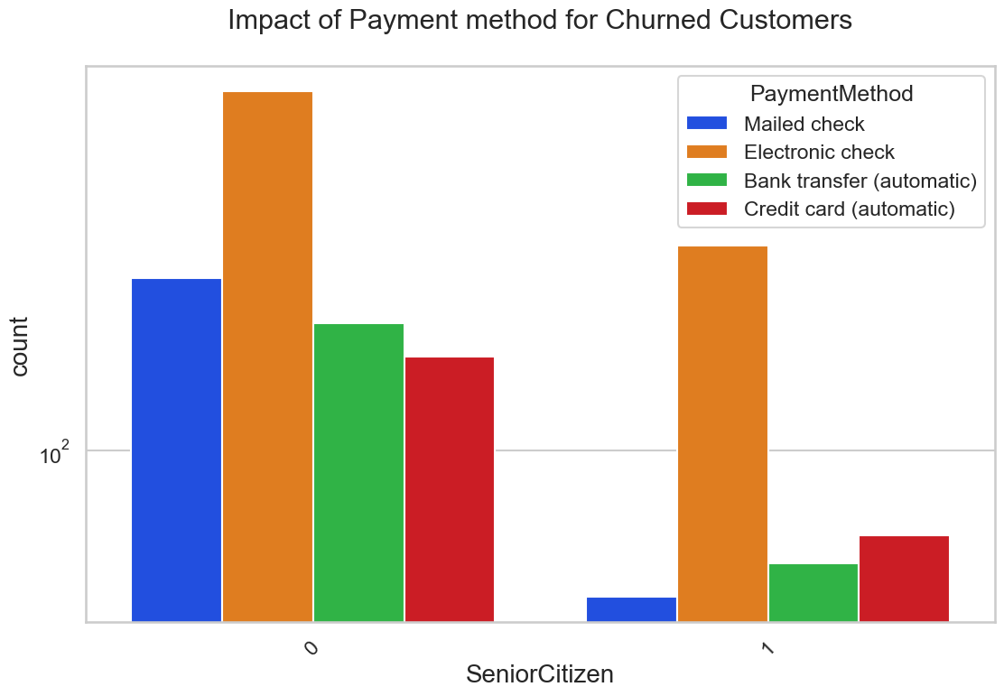
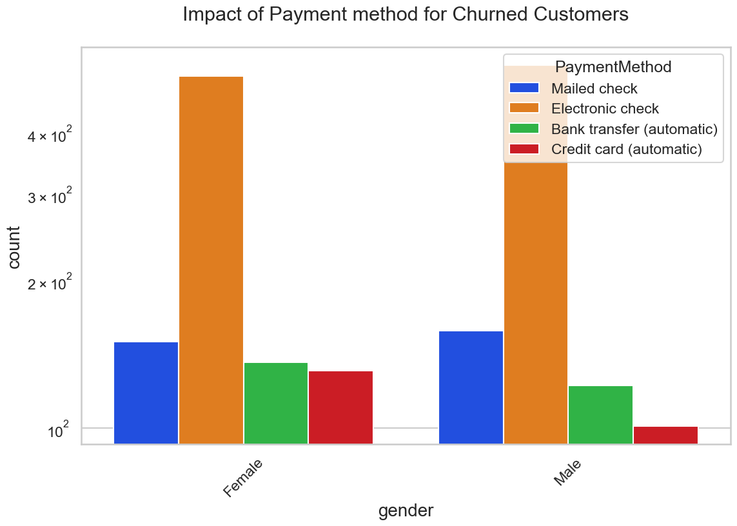
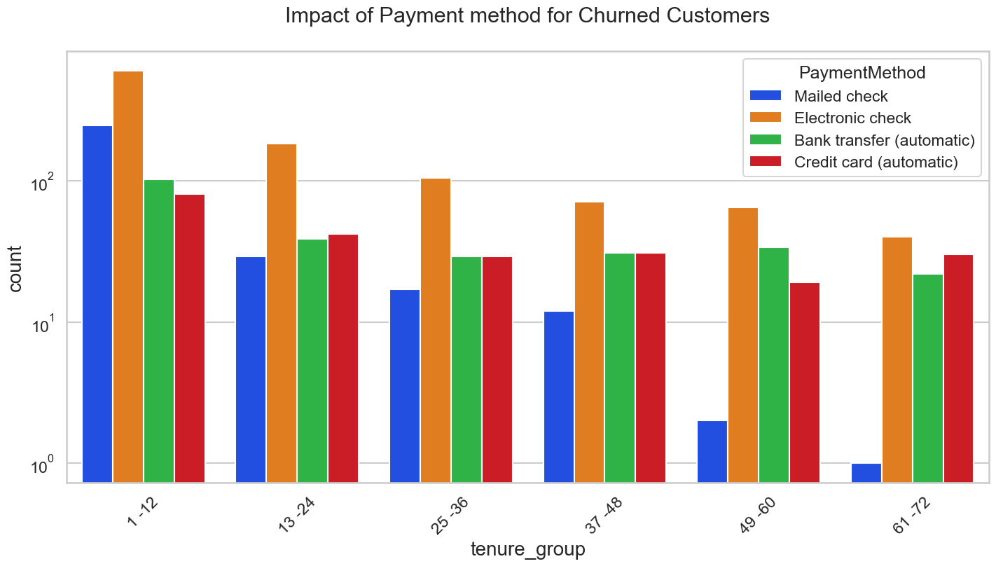
Bivariate Analysis

Slide 16
Bivariate Insights
Gender does not have any significant impact on tendency to churn.
Customers without Online security, No Tech support, No Online Backup and No Device protection show higher tendency to churn compared to those without any internet connection.
Customers using Fibre optic service are more likely to churn.
Churn rate is very low with No Internet subscription.
Consumers on month to month contract are more likely to churn regardless of their tenure length and usage of multiple lines.
Customers using Electronic check payment methods are more likely to churn regardless of age, gender or tenure length.

Slide 17
Conclusion
High Churn:
1. Customers who have no online security, Tech support, Online backup & device protection,are more likely to churn.
2. Customers using Fibre optic service are more likely to churn.
3. Consumers on month to month contract are more likely to churn irrespective of their tenure length and whether they use multiple lines.
4. High monthly charges, shorter tenure, and lower total charges are associated with a high churn rate.
5. Regardless of age, gender, or tenure length, customers using electronic check payment methods are more likely to churning.
6. Senior citizens have an elevated likelihood of churning..
7. Customers who just started subscription are more likely to churn.
Low Churn:
1. Customers with a long tenure demonstrate a lower likelihood of churning.
2. The churn rate is minimal among those who do not have an active internet subscription.
No Impact:
1. Factors like Gender, Availability of Phone Service and multiple lines have insignificant impact on churn.

Slide 18
Next Steps
The presented data is crucial in terms of client retention.
Clients should be provided online security, tech support, online backup & rotation in order to retain them.
Various discounts & offers can ensure long tenure of clients which may result in low churning rate.

Slide 19
Thank you

