Slide 1
HTML&CSS

Slide 2
HTML
HTML stands for Hyper Text Markup Language
Every webpage is written in a language called HTML
skeleton that gives every webpage structure
Latest Version is HTML5
Hypertext refers to the way in which Web pages (HTML documents) are linked together.
Markup Language means(markup is the code that structures and formats a webpage's content.), you use HTML to simply "mark up" a text document with tags that tell a Web browser how to structure it to display.

Slide 3
HTML
Sample HTML
<!DOCTYPE html>, <html>-open,</html>-close,shift+!
<html>
<head>
<title>This is document title</title>
</head>
<body>
<h1>This is a heading</h1>
<p>Document content</p>
</body>
</html>

Slide 4
HTML
mark-up language makes use of various tags to format the content.
Tags are enclosed within angle braces <Tag Name>.
Except few tags, most of the tags have their corresponding closing tags.
For example <html> has its closing tag </html> and <body> tag has its closing tag </body> tag etc.

Slide 5
Some Tag Explanation
Tag | Description
<!DOCTYPE> | is used by the web browser to understand the version of the HTML used in the document
<html> | This tag encloses the complete HTML document
<head> | This tag represents the document's header which can keep other HTML tags like <title>, <link> etc.
<title> | The <title> tag is used inside the <head> tag to mention the document title.
<body> | This tag represents the document's body which keeps other HTML tags like <h1>, <div>, <p> etc.
<h1> | This tag represents the heading.
<p> | This tag represents a paragraph.

Slide 6
Some other commonly used tags
Tag | Description
<div> | Division, Specifies a logical division within a document
<a> | Anchor The tag defines a hyperlink, which is used to link from one page to another.
<B> | Bold Text
<BUTTON> | Used for a standard clickable button within a form
<INPUT> | Input fields within form
<H> tags(h1..h6) | Headings
<IMG > | To show an image
<SCRIPT> | Inline script
<STYLE> | CSS style settings
<TABLE> | Table
<ul><ol><li> | Unordered List, ordered list, items in OL or UL respectively

Slide 7
Cmnt=ctrl+/
<br>-break
Placeholder “name”

Slide 8
HTML5
Latest version of HTML
new standard incorporates features like video playback ,drag-and-drop etc that have been previously dependent on third-party browser plug-ins such as Adobe Flash etc
Supporting browsers
Apple Safari
Google Chrome
Mozilla Firefox
Opera
Internet Explorer 9.0

Slide 9
Some New Features of HTML5
Semantic Elements
<header>, <footer>, <section>,<table>. Etc
New Attributes to form input tag
Placeholder, type email, required, autocomplete, pattern etc
WebSocket
bidirectional communication technology for web applications.
Canvas
This supports a two-dimensional and 3 dimensional drawing surface that you can program with JavaScript
Audio & Video
We can embed audio/ video on web page without resorting to third-party plugins.

Slide 10
Semantic HTML
Semantic -> Meaning
Semantic elements are elements with a meaning
clearly describes its meaning to both the browser and the developer
Some semantic tags
<article>
<aside>
<details>
<figure>
<footer>
<header>
<section>
<summary>
<time>

Slide 11
Some Examples using input tag
Placeholder
<input type="text" name="userName" id="userName" placeholder=“Enter Your User Name">
Autocomplete
<input type="text" name=“homeAddress" id=" homeAddress " autocomplete=“on">
Required
<input type="text" name=“userName " id=" userName " required>
Pattern
Country code: <input type="text" name="countryCode" pattern="[A-Za-z]{3}" placeholder ="Three letter country code“>

Slide 12
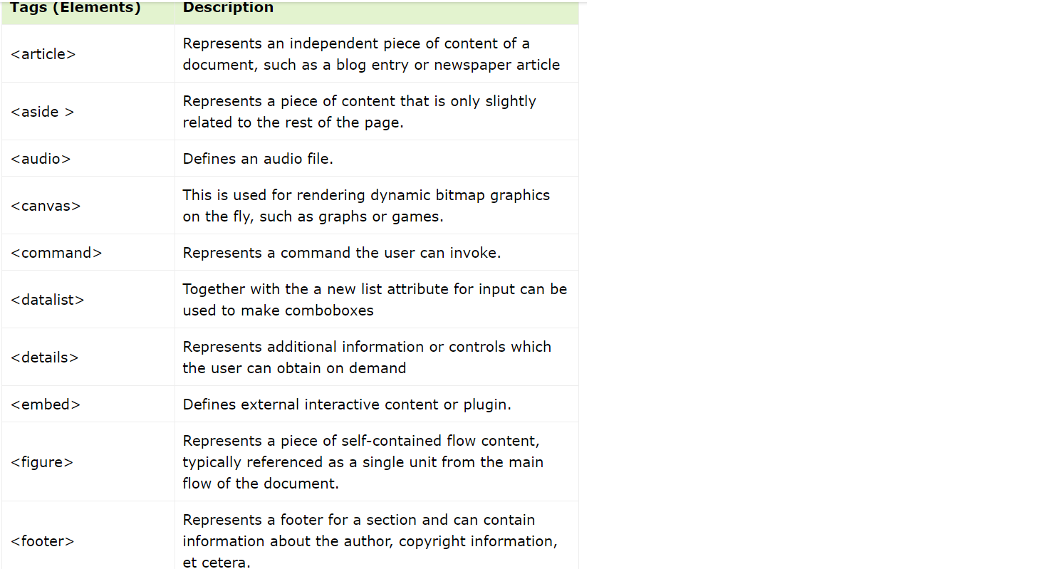
NEW ELEMENTS(tags)

Slide 13
The HTML <form> Elements
<input>
<label>
<select>
<textarea>
<button>
<datalist>
<option>

Slide 14
<div> Tag
A <div> section in a document that is styled with CSS:
<html> <head> <style> .myDiv { border: 5px outset red; background-color: lightblue; text-align: center; } </style> </head> <body> <div class="myDiv"> <h2>This is a heading in a div element</h2> <p>This is some text in a div element.</p> </div> </body> </html>

Slide 15
<input>
<label for="fname">First name:</label> <input type="text" id="fname" name="fname">
<label>
<label for="fname">First name:</label>
<select>
<label for=“vehicle">Choose a vehicle:</label> <select id=“vehicle" name=“vehicles"> <option value=“car">Volvo</option> <option value=“bike">Saab</option> <option value=“bus">Fiat</option> </select>

Slide 16
<textarea>
<textarea name="message" rows="10" cols="30"> </textarea>
Radio button
<form>
<input type=“radio” id=“male” value=“male”>
<lable for=“male”>Male</label><br>
<input type=“radio” id=“female” value=“female”>
<lable for=“male”>Female</label><br>
<input type=“radio” id=“Transgender” value=“male”>
<lable for=“male”>Transgender</label><br>
</form>
Submit
<input type="submit">

Slide 17
Data list
<form action="">
<input list="browsers" name="browser" id="browser">
<datalist id="browsers">
<option value="edge">
<option value="firefox">
<option value="chrome">
</datalist>
<input type="submit">
</form>

Slide 18
tables
HTML tables allow web developers to arrange data into rows and columns.
<table> <tr>--table row <th>School</th>-table heading <th>Student Name</th> <th>Class</th> </tr> <tr> <td>Vivekananda</td>-table data <td>Ram</td> <td>V</td> </tr> <tr> <td>KV</td> <td>Sam</td> <td>VI</td> </tr> </table>

Slide 19
video
Video
<video width=“512" height=“300" controls autoplay> <source src=“video1.mp4" type="video/mp4"> </video>
The controls attribute adds video controls, like play, pause, and volume
Autoplay attribute for starting the playback after load
Set width and height using width and height attributes.
Text between the <video> and </video> tags will only display in browsers that do not support the <video> element.
Multiple <source> elements can link to different video files. The browser will use the first recognized format.

Slide 20
Audio
<audio controls autoplay>
<source src="audio.mpeg">
</audio>
The controls attribute adds audio controls, like play, pause, and volume
Autoplay attribute for starting the playback after load
Text between the <audio> and </audio> tags will only display in browsers that do not support the <audio> element.
Multiple <source> elements can link to different audiofiles. The browser will use the first recognized format.

Slide 21
css
CSS stands for Cascading Style Sheets. It is a style sheet language which is used to describe the look and formatting of a document written in markup language. It provides an additional feature to HTML

Slide 22
How to add CSS
CSS is added to HTML pages to format the document according to information in the style sheet. There are three ways to insert CSS in HTML documents.
Inline CSS
Internal CSS
External CSS
1) Inline CSS
Inline CSS is used to apply CSS on a single line or element.
<p style="color:blue">Hello CSS</p>
2)Internal CSS
Internal CSS is used to apply CSS on a single document or page. It can affect all the elements of the page. It is written inside the style tag within head section of html.
<style>
p{color:blue}
</style>

Slide 23
3) External CSS
External CSS is used to apply CSS on multiple pages or all pages. Here, we write all the CSS code in a css file. Its extension must be .css for example style.css.
p{color:blue}
“<link rel="stylesheet" type="text/css" href="style.css"> -The link tag must be used inside head section of html.”
Class –”.”
Id-”#”

Slide 24
Table
table, th, td { border: 1px solid; }
1.background-color: lightblue;
2.color: white; 3.text-align: center;
4.font-family: verdana; 5.font-size: 20px;
6.

Slide 25
Css box model
In CSS, the term "box model" is used when talking about design and layout.
The CSS box model is essentially a box that wraps around every HTML element. It consists of: content, padding, borders and margins. The image below illustrates the box model:
Content - The content of the box, where text and images appear
Padding - Clears an area around the content. The padding is transparent
Border - A border that goes around the padding and content
Margin - Clears an area outside the border. The margin is transparent
div { width: 300px; border: 15px solid green; padding: 50px; margin: 20px; }

Slide 26
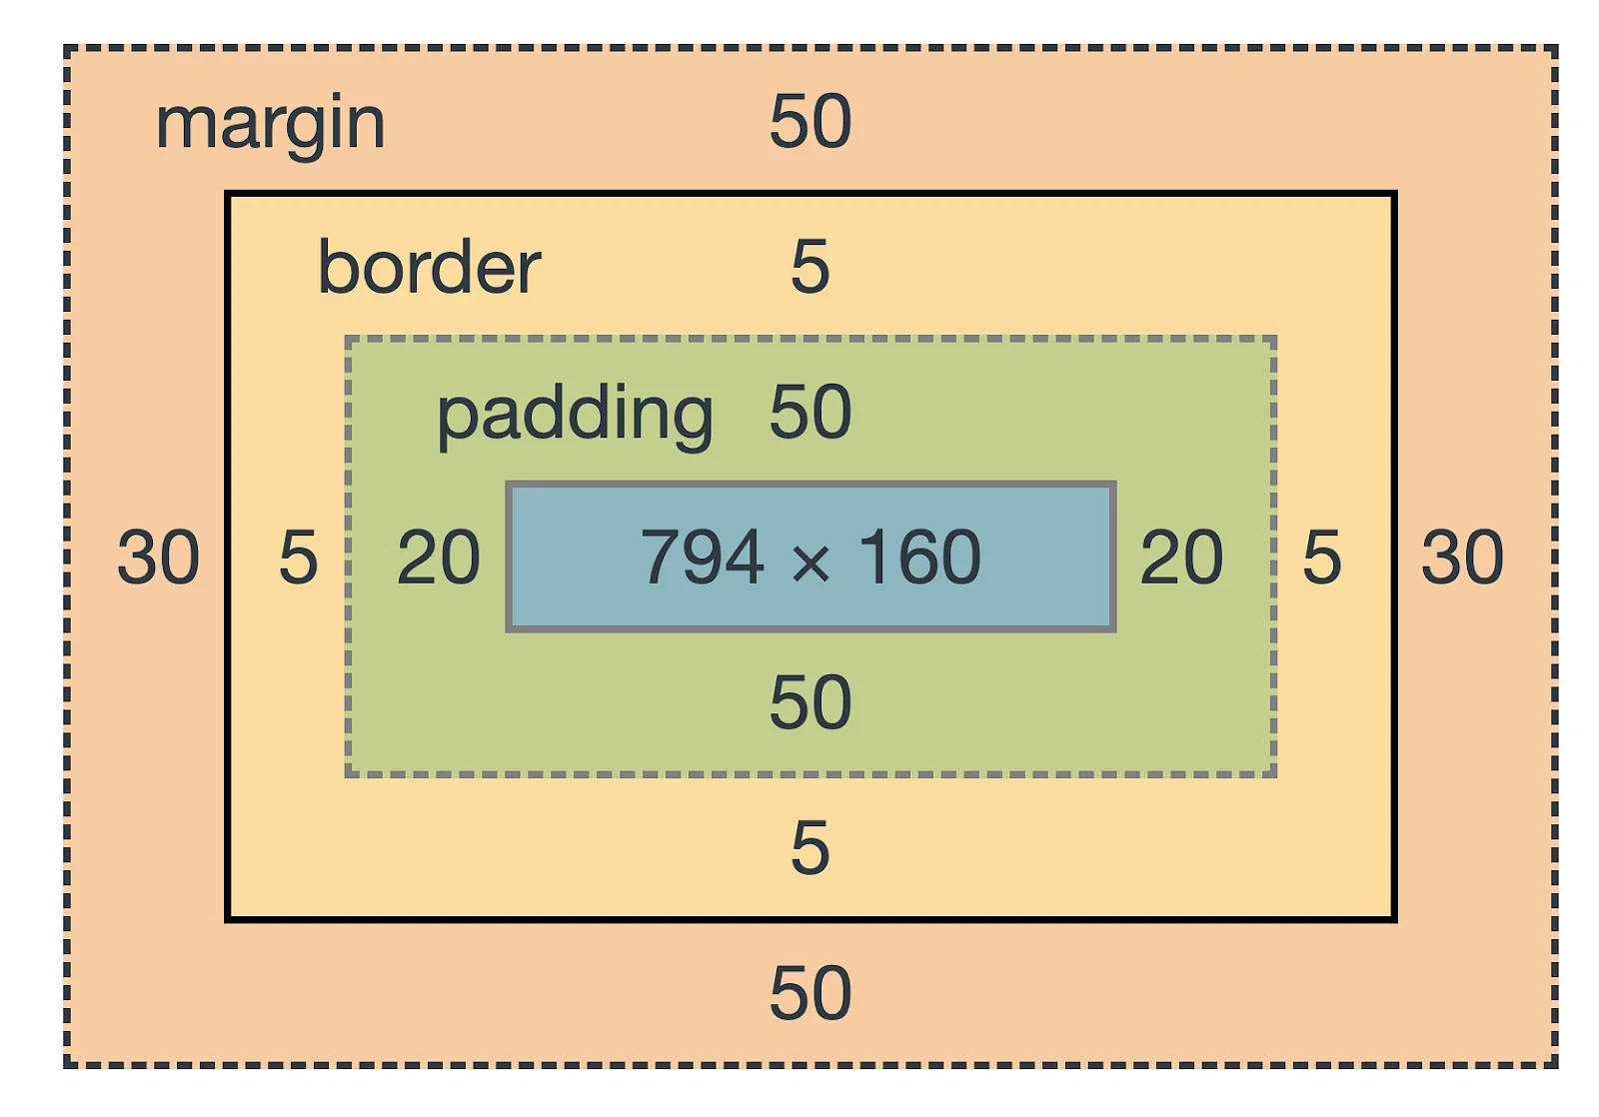
Box type
1. CSS Border
p { border: __px solid powderblue; }
2.Padding
p { padding:top,right,bottom,left.; }
3. Margin
p { margin:; }
Top
left
right
bottom

