Slide 1
Software Engineering
Topics
Introduction Software, Process Models, Software Engineering
Reguirement Engineering - Phases, SRS, Analysis
Design & Architecture , UML Diagrams
Agile SDLC & Introduction to JIRA Tool
SE MCQ Test & Submission(30 marks)

Slide 2
Hierarchy

Slide 3
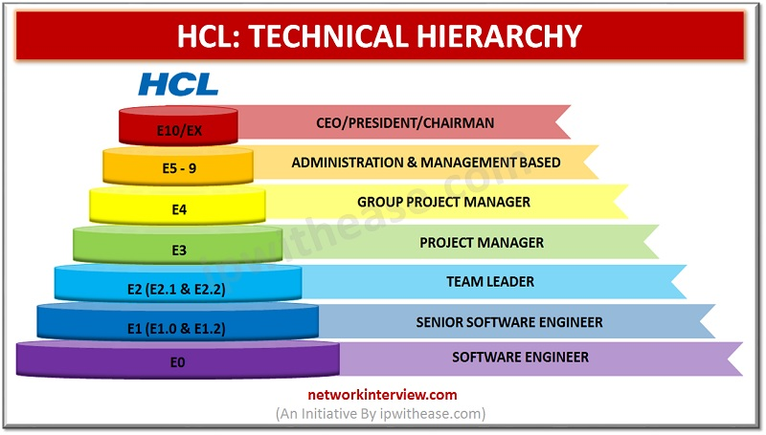
IT Industry Organisation structure

Slide 4
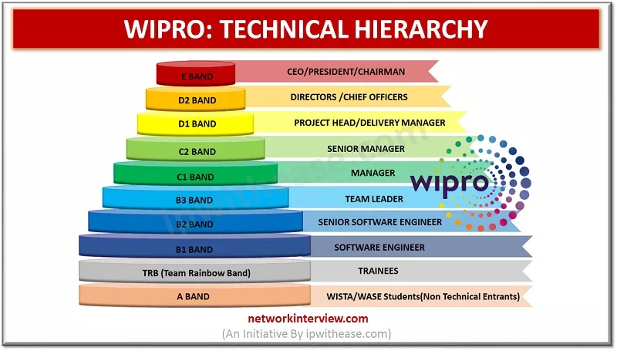

Slide 5
Where are you ?

Slide 6
Project Sponsor
Senior Management
Business Unit(HR, Sales, Finance)
Customer
External Stakeholders
IT
HR
Admin
Project Team
Business Analysts
Program / Project / Product Manager
Developers
Quality / Architecture / Analysts

Slide 7
What are you going to do

Slide 8
Ans: Create Develop Software

Slide 9
Chapter 1- Introduction

Slide 10
Day 1 - Points Covered
Software
Difference between Software and Hardware
Software Engineering, need , Importance
Types of Software Products, Costs
Software Engineering Principles/Ethics
Process /Product/Project
Software Process Framework
Software Process Model & Case Studies

Slide 11
What is Software?
Set of programs
Data Structures
Documentation :

Slide 12
What are the characteristics of Software?
Logical rather than Physical
Software is developed or engineered, it is not
manufactured
3. Software does not wear out
4. Moving towards component based
construction, however most of the software is
custom built

Slide 13
Hardware vs. Software
Hardware | Software
Manufactured Wears out Built using components Relatively simple | Developed/Engineered Deteriorates Custom built Complex
13

Slide 14
Manufacturing vs. Development
Once a hardware product has been manufactured, it is difficult or impossible to modify.
In contrast, software products are routinely modified and upgraded.
In hardware, hiring more people allows you to accomplish more work, but the same does not necessarily hold true in software engineering.
Unlike hardware, software costs are concentrated in design rather than production.
14

Slide 15
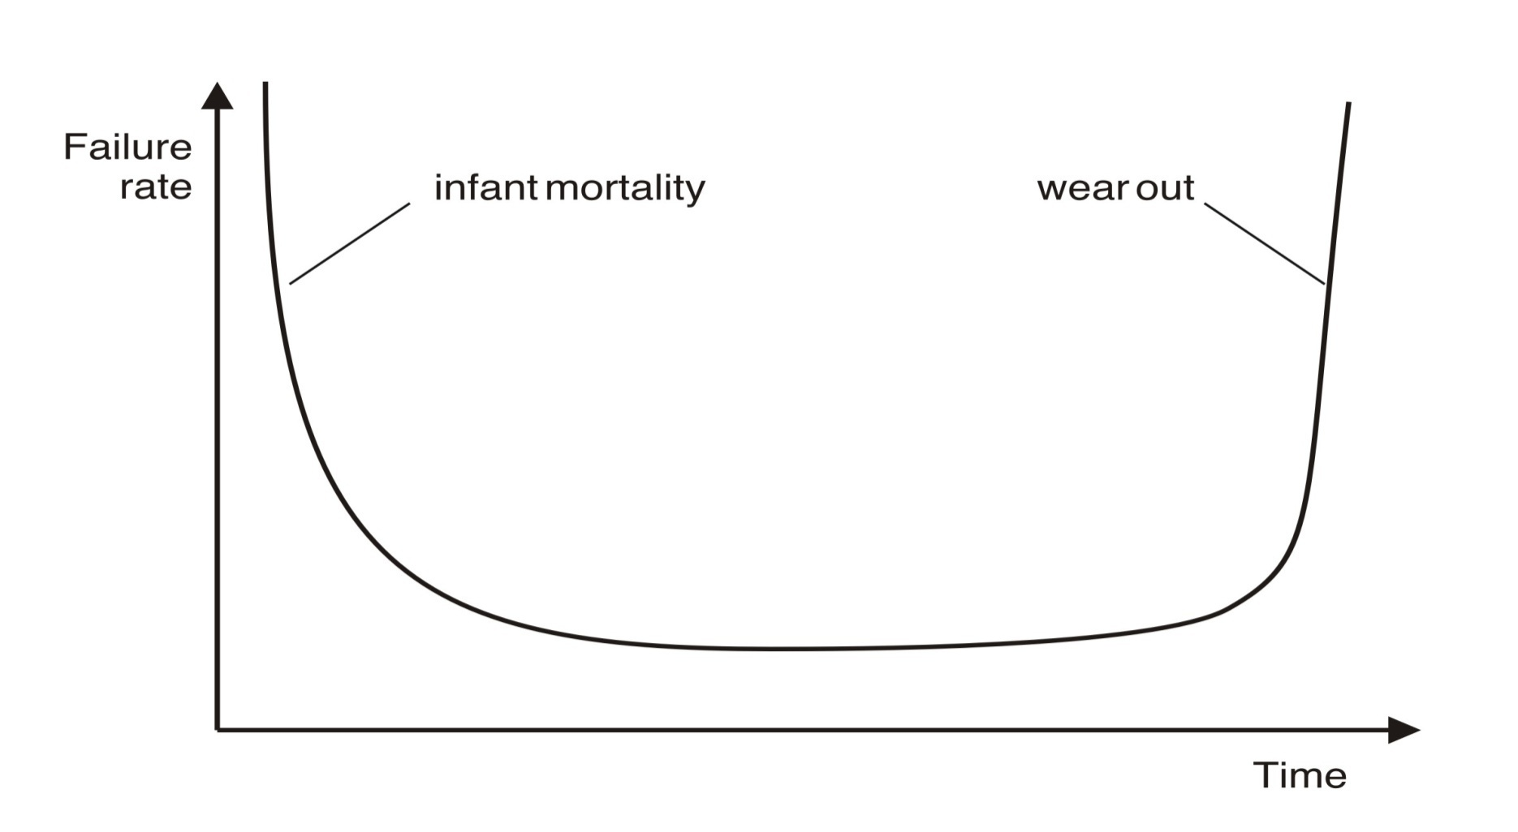
Wear vs. Deterioration
Hardware wears out over time
15

Slide 16
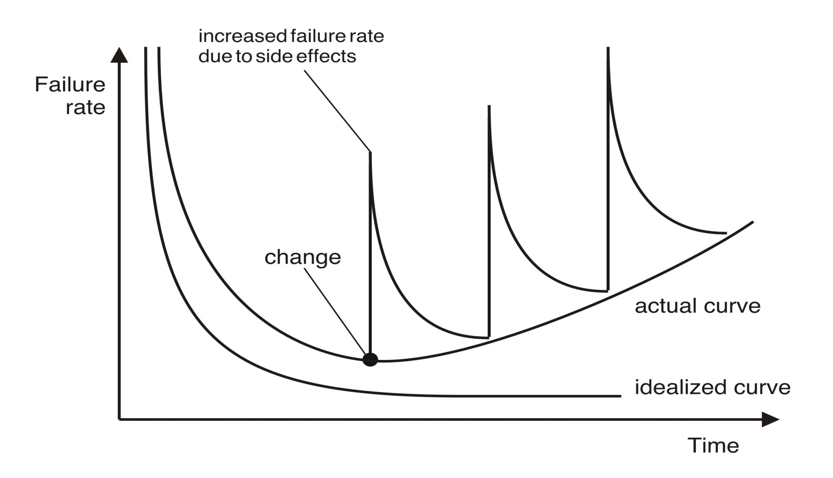
Wear vs. Deterioration
16
Software deteriorates over time

Slide 17
Hardware can replace parts but not with software
Software design can be reason for failure, which cannot be mended

Slide 18
Background Software engineering
The economies of ALL developed nations are dependent on software.
More and more systems are software controlled
Software engineering is concerned with theories, methods and tools for professional software development.
Expenditure on software represents a significant fraction of GNP in all developed countries.

Slide 19
Software Myths
Management Myths
Customer Myths
Practitioners Myth

Slide 20
Software Myths
Management Myth
We are already having a book that is full of
Standards & Procedures for building
software. It will provide my people everything
they need to know.
If we get behind schedule, we can add more
developers & catch up.
We can outsource the software project to a
third party. I can just relax & let that firm build
it.

Slide 21
Software Myths
Customer Myths
A general statement of objectives is
sufficient to begin writing programs.
We can fill in the details later
Project requirements continually
change, but the change can be easily
accommodated because software is
flexible

Slide 22
Software Myths
Practitioners Myth
Once we write the program and get it to work our job is
done
Until I get the program running, I have no way of
accessing its quality
The only deliverable work product for a successful
project is the working program
Software Engineering will make us create voluminous &
unnecessary documentation & invariably slow us down

Slide 23
Software project failure
Increasing system complexity – Changes , Demand, Time Constraint
New software engineering techniques help us to build larger, more complex systems, the demands change.
Systems have to be built and delivered more quickly;
larger, even more complex systems are required;
systems have to have new capabilities that were previously thought to be impossible.
Failure to use software engineering methods- later face issues,change ,cost
It is fairly easy to write computer programs without using software engineering methods and techniques.
Many companies have drifted into software development as their products and services have evolved.
They do not use software engineering methods in their everyday work. Consequently, their software is often more expensive and less reliable than it should be.

Slide 24
Software costs
Software costs often dominate computer system costs.
Costs of software on a PC are often greater than the hardware cost.
Software costs more to maintain than it does to develop.
For systems with a long life, maintenance costs may be several times development costs.
Software engineering is concerned with cost-effective software development.

Slide 25
Nature of Software
Systems Software
Applications Software
Engineering / Scientific software
Embedded Software
Product Line Software
Web Applications
Artificial Intelligence Software etc

Slide 26
Bio –Medical /Diagnosis
Mobile Apps- UTS Railway Travel Booking Reservation
Shipping Services
Government Services
Courier Delivery System
AI /Robotics
Natural Calamities – Weather Rain Forecast
Social Media App – Instagram , FB
Sports Software
Entertainment – Netflix/Hotstar/Amazon Prime
Aerospace, Satellite Monitoring

Slide 27

Think For Domain!

Slide 28
Each Breakout will be labelled and assigned
Health & Research Management
Education (e-Learning & exam)
E-commerce
Banking Finance /Insurance
Defence /Army/Military
Geological &Weather Forecast
Travel & Tourism
Sports & Entertainment
Government Services&License
Software Industry tools

Slide 29
Software products & Specification
Generic products – purchased by any customer
Stand-alone systems that are marketed and sold to any customer who wishes to buy them.
Examples – PC software such as graphics programs, project management tools; CAD software; software for specific markets such as appointments systems for dentists.
The specification of what the software should do is owned by the software developer and decisions on software change are made by the developer.
Customized products- made on customer demand
Software that is commissioned by a specific customer to meet their own needs.
Examples – embedded control systems, air traffic control software, traffic monitoring systems.
The specification of what the software should do is owned by the customer for the software and they make decisions on software changes that are required.

Slide 30
IT Industry can be seen 2 dimensions
Product Based / Service Based Industry

Slide 31
What is a Product Based Company?
A product based company mainly deals with selling a physical or digital product.
Product development and quality is the core objective of a product based company. Microsoft, Google, Adobe, Dell are some of the examples of a product based company.
Microsoft’s products are Windows OS, Microsoft Office Suite, Microsoft Outlook, Microsoft Edge, etc.
Qualcomm is another product based company that sell products like Snapdragon Processors, Snapdragon Modems, etc.
Apple, one of the product based company giant, sell products such as the iPhone, iMac, iPad, etc.

Slide 32
Service Based
A service-based company deals with non-physical products. The core business of a service-based company is providing services to clients. Service-based companies are clients of product-based companies. Examples of service-based companies are TCS, Wipro, LTI, Cognizant, Infosys, Capgemini, etc.
Infosys provides services like database management, network management, blockchain, applied AI, digital marketing, Internet of Things, cybersecurity, testing, etc.
Persistent is another service-based company that delivers services such as privacy management, identity access management, cloud, infrastructure, intelligent business automation, etc.

Slide 33
1. A product based company have high salaries and a high frequency of hikes. In contrast, a service based company provides less salary, and the hike frequency is shallow.
Example: The average salary in a product-based company like Google can range from ₹50,00,000 to ₹1,50,00,000 a year. In a service-based company like Accenture, salaries can range from 3 LPA to 16 LPA.

Slide 34
2. The learning curve in a product based company is extraordinary, and decent means are delivered. While in a service-based company, the learning curve is average.
Example: In product-based companies like Microsoft, you can learn new technologies in the computer science space. In a service-based company, you have to struggle for project allocation occasionally.
3. Product based companies have an adaptable working time, whereas a service-based company has a strict 8 to 9 working hours. You can even work from home in a product based company.
Example: Some product-based companies like Twitter and Facebook have permanently permitted their staff to work from home.

Slide 35
4. A product based company has a more creative, efficient, productive, and complicated job than a service-based company.
Example: Facebook and Google are working on futuristic technologies like holograms, augmented reality, virtual reality, etc.
5. The recruitment process in a product-based company is callous, whereas, in a service-based company, it is straightforward to crack an interview.
Example: There are at least six stages in the recruitment process of the product based companies such as online round, on-site round, technical round one, technical round two, technical round three, and technical-cum-HR round. In a service-based company, there are at the most three rounds.
6. A product based company hire a very fixed number of candidates, whereas a service-based company carries mass recruitments.
Example: Microsoft hires one or two candidates from a tier-one college on average. Infosys, which is a service-based company, hires 50 to 100 candidates in single on-campus recruitment.

Slide 36
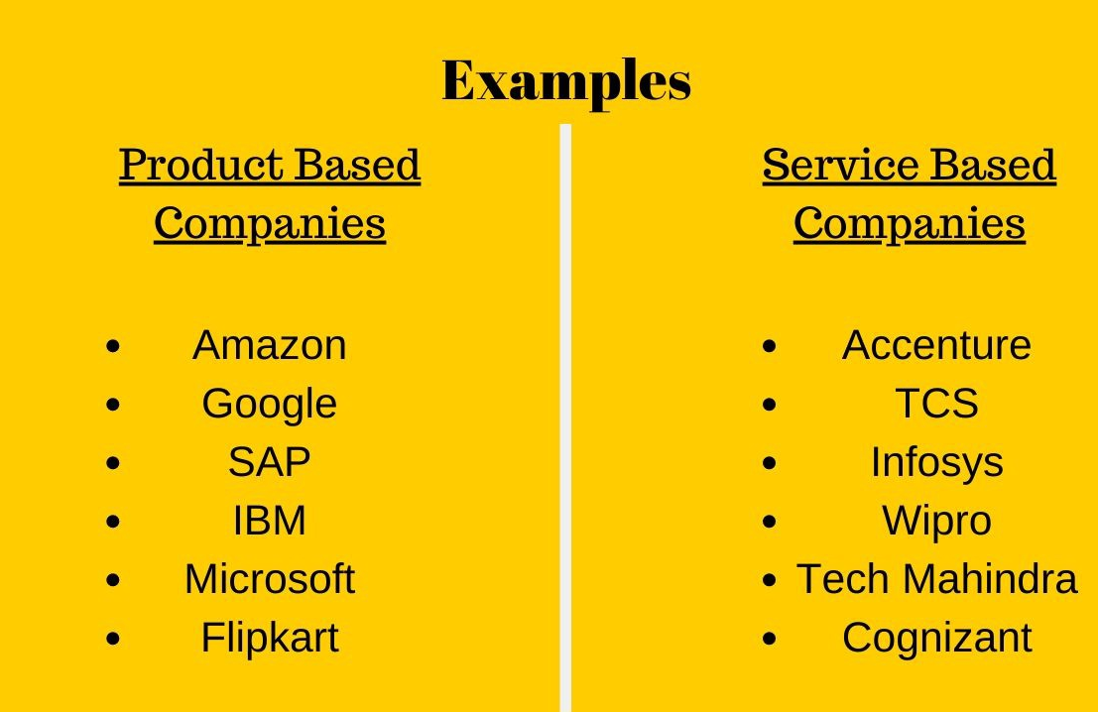

Slide 37
3P’s = Product /Process/Project

Slide 38
Software engineering diversity
Due to diversity in software there is no fix pattern /principle/policy or method to develop a software
Selection depends on many factors like user, stake holders, business needs, feasibility , budget, resources etc

Slide 39
Application Types
Stand-alone applications
Interactive transaction-based applications
Embedded control systems
Batch processing systems
Entertainment systems
Systems for modeling and simulation
Data collection systems
Systems of systems

Slide 40
Application brief
Stand-alone applications
Run on a local computer, such as a PC,not need to be connected to a network.
Interactive transaction-based applications
E-commerce
Applications that execute on a remote computer and are accessed by users from their own PCs or terminals.
Embedded control systems
Software that control and manage hardware devices.
Batch processing systems
Process large Business data
Entertainment systems
For Personal entertainment
Systems for modeling and simulation
Developed by Scientist , Engineers
Data collection systems
These are systems that collect data from their environment using a set of sensors and send that data to other systems for processing.

Slide 41
Professional software development

Slide 42
Software engineering
Software engineering is an engineering discipline that is concerned with all aspects of software production from the early stages of system specification through to maintaining the system after it has gone into use.
Engineering discipline
Using appropriate theories and methods to solve problems bearing in mind organizational and financial constraints.
All aspects of software production
Not just technical process of development. Also project management and the development of tools, methods etc. to support software production.

Slide 43
Frequently asked questions about software engineering
Question | Answer
What is software? | Computer programs and associated documentation. Software products may be developed for a particular customer or may be developed for a general market.
What are the attributes of good software? | Good software should deliver the required functionality and performance to the user and should be maintainable, dependable and usable.
What is software engineering? | Software engineering is an engineering discipline that is concerned with all aspects of software production.
What are the fundamental software engineering activities? | Software specification, software development, software validation and software evolution.
What is the difference between software engineering and computer science? | Computer science focuses on theory and fundamentals; software engineering is concerned with the practicalities of developing and delivering useful software.
What is the difference between software engineering and system engineering? | System engineering is concerned with all aspects of computer-based systems development including hardware, software and process engineering. Software engineering is part of this more general process.

Slide 44
Frequently asked questions about software engineering
Question | Answer
What are the key challenges facing software engineering? | Coping with increasing diversity, demands for reduced delivery times and developing trustworthy software.
What are the costs of software engineering? | Roughly 60% of software costs are development costs, 40% are testing costs. For custom software, evolution costs often exceed development costs.
What are the best software engineering techniques and methods? | While all software projects have to be professionally managed and developed, different techniques are appropriate for different types of system. For example, games should always be developed using a series of prototypes whereas safety critical control systems require a complete and analyzable specification to be developed. You can’t, therefore, say that one method is better than another.
What differences has the web made to software engineering? | The web has led to the availability of software services and the possibility of developing highly distributed service-based systems. Web-based systems development has led to important advances in programming languages and software reuse.

Slide 45
A Layered Technology
Software Engineering
tools
methods
process model
a “quality” focus
45

Slide 46
Software Engineering Layers
Quality Focus : Organizational commitment to
quality ( TQM, Six Sigma )
Process : Defines a framework (Foundation
for Software Engineering)
Methods : “How to”s for building software
(Tasks)
Tools : Automated or semi-automated
support (Rational Rose, CASE
tools)

Slide 47
Importance of software engineering
Reliable & Trustworthy Software
Economically cheap, can be used for Long run
Society advancing in use of software
Demanding Change in needs

Slide 48
Core Principles
The Reason it all Exists
Keep It Simple, Stupid (KISS!)
Maintain the Vision
What you Produce, others will Consume
Be Open to Future
Plan Ahead for Reuse
THINK

Slide 49
General issues that affect Software
Heterogeneity
Business & Social Change
Security & trust
Scale

Slide 50
General issues that affect software
Heterogeneity
Increasingly, systems are required to operate as distributed systems across networks that include different types of computer and mobile devices.
Business and social change
Business and society are changing incredibly quickly as emerging economies develop and new technologies become available. They need to be able to change their existing software and to rapidly develop new software.
Security and trust
As software is intertwined with all aspects of our lives, it is essential that we can trust that software.
Scale
Software has to be developed across a very wide range of scales, from very small embedded systems in portable or wearable devices through to Internet-scale, cloud-based systems that serve a global community.

Slide 51
Ethical principles
1. PUBLIC - Software engineers shall act consistently with the public interest.
2. CLIENT AND EMPLOYER - Software engineers shall act in a manner that is in the best interests of their client and employer consistent with the public interest.
3. PRODUCT - Software engineers shall ensure that their products and related modifications meet the highest professional standards possible.
4. JUDGMENT - Software engineers shall maintain integrity and independence in their professional judgment.
5. MANAGEMENT - Software engineering managers and leaders shall subscribe to and promote an ethical approach to the management of software development and maintenance.
6. PROFESSION - Software engineers shall advance the integrity and reputation of the profession consistent with the public interest.
7. COLLEAGUES - Software engineers shall be fair to and supportive of their colleagues.
8. SELF - Software engineers shall participate in lifelong learning regarding the practice of their profession and shall promote an ethical approach to the practice of the profession.

Slide 52
Essential attributes of good software
Product characteristic | Description
Maintainability | Software should be written in such a way so that it can evolve to meet the changing needs of customers. This is a critical attribute because software change is an inevitable requirement of a changing business environment.
Dependability and security | Software dependability includes a range of characteristics including reliability, security and safety. Dependable software should not cause physical or economic damage in the event of system failure. Malicious users should not be able to access or damage the system.
Efficiency | Software should not make wasteful use of system resources such as memory and processor cycles. Efficiency therefore includes responsiveness, processing time, memory utilisation, etc.
Acceptability | Software must be acceptable to the type of users for which it is designed. This means that it must be understandable, usable and compatible with other systems that they use.

Slide 53
Product/Process/Project
Product is Software (Outcome)
Process (Technique)
Project is (Workdone)

Slide 54
Software process activities
Software specification, where customers and engineers define the software that is to be produced and the constraints on its operation.
Software development, where the software is designed and programmed.
Software validation, where the software is checked to ensure that it is what the customer requires.
Software evolution, where the software is modified to reflect changing customer and market requirements.

Slide 55
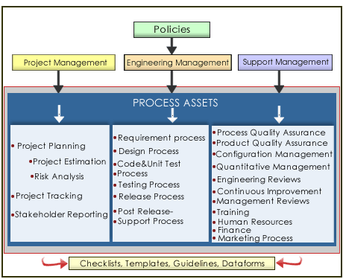

Slide 56
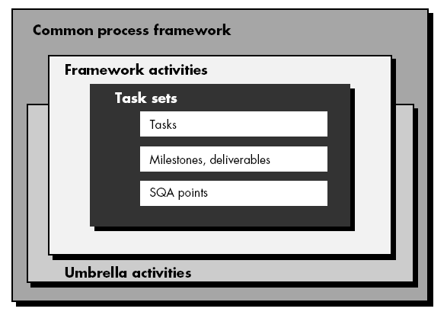
Process Framework

Slide 57
Common Framework activities
CPMCD
Communication – project initiation, requirement gathering
Planning- estimating , scheduling ,tracking
Modeling – Analysis, Design
Construction – Code , test
Deployment –Delivery , Support , Feedback

Slide 58
Umbrella Activity
Project Tracking & Control
Risk management
SQA
SCM
Technical Reviews

