Slide 1
Chapter 7: Deadlocks

Slide 2
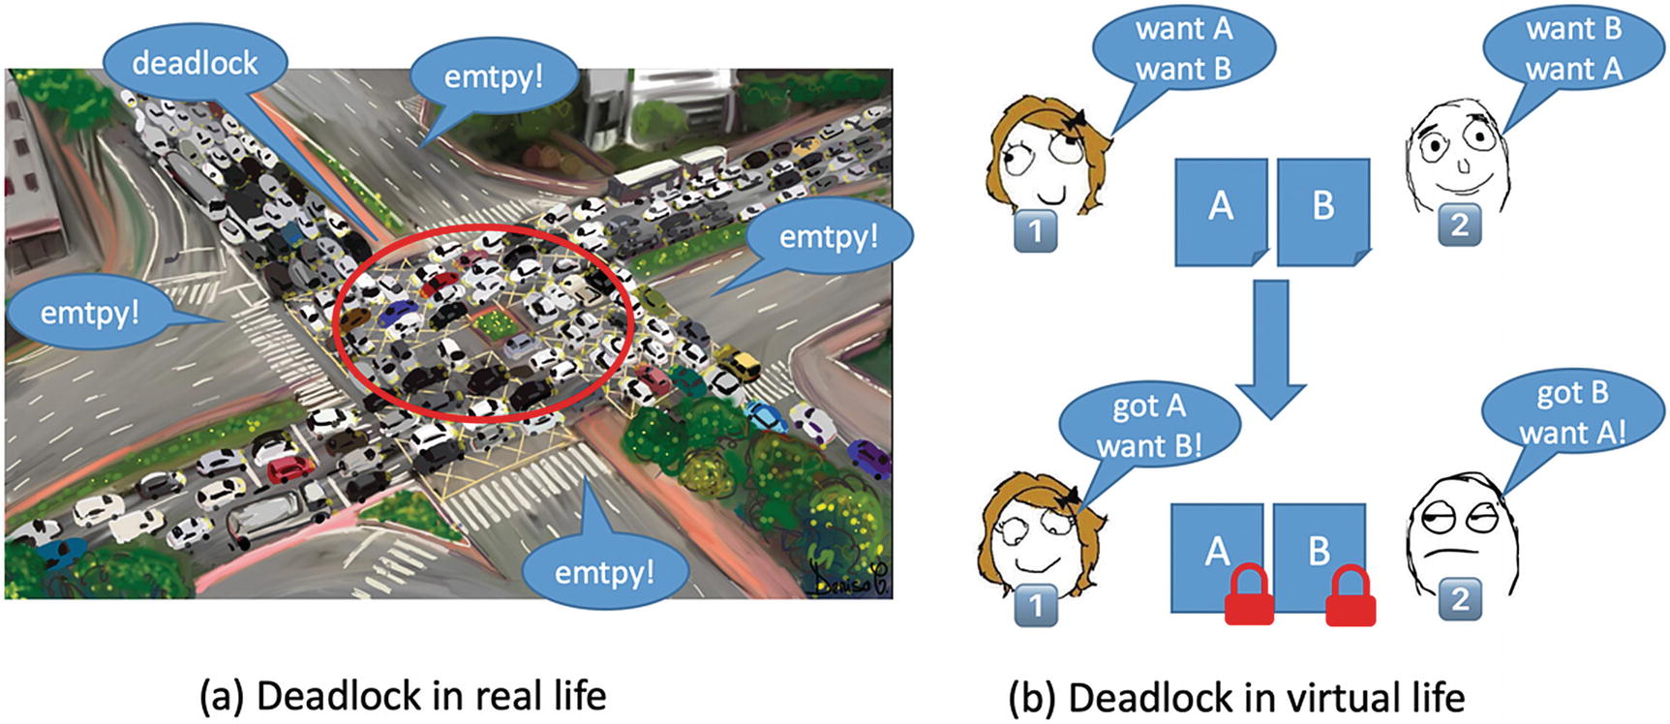
Deadlock

Slide 3
System Model
System consists of resources
Each process utilizes a resource as follows:
  request
  use
  release

Slide 4
Deadlock Characterization
Deadlock can arise if four conditions hold simultaneously.
Mutual exclusion: only one process at a time can use a resource
Hold and wait: a process holding at least one resource is waiting to acquire additional resources held by other processes
No preemption: a resource can be released only voluntarily by the process holding it, after that process has completed its task
Circular wait: there exists a set {P₀, P₁, …, P_{n}} of waiting processes such that P₀ is waiting for a resource that is held by P₁, P₁ is waiting for a resource that is held by
P₂, …, P_{n–1} is waiting for a resource that is held by P_{n}, and P_{n} is waiting for a resource that is held by P₀.

Slide 5
Resource-Allocation Graph
A set of vertices V and a set of edges E.
V is partitioned into two types:
  P = {P₁, P₂, …, P_{n}}, the set consisting of all the processes in the system
  R = {R₁, R₂, …, R_{m}}, the set consisting of all resource types in the system
request edge – directed edge P_{i} → R_{j}
assignment edge – directed edge R_{j} → P_{i}

Slide 6
Resource-Allocation Graph (Cont.)
Process
Resource Type with 4 instances
P_{i} requests instance of R_{j}
P_{i} is holding an instance of R_{j}
P_{i}
R_{j}
P_{i}
R_{j}

Slide 7

Example of a Resource Allocation Graph

Slide 8

Resource Allocation Graph With A Deadlock

Slide 9

Graph With A Cycle But No Deadlock

Slide 10
Basic Facts
If graph contains no cycles ⇒ no deadlock
If graph contains a cycle ⇒
  if only one instance per resource type, then deadlock
  if several instances per resource type, possibility of deadlock

Slide 11
Methods for Handling Deadlocks
Ensure that the system will never enter a deadlock state-Consistent efforts to never go to deadlock by violating any one of the 4 conditions.
Avoid the system to go the deadlock system- with limited efforts(maintains some data)
Allow the system to enter a deadlock state and then recover
Ignore the problem and pretend that deadlocks never occur in the system; used by most operating systems, including UNIX

Slide 12
Deadlock Prevention
Restrain the ways request can be made
Mutual Exclusion – not required for sharable resources; must hold for nonsharable resources
Hold and Wait – must guarantee that whenever a process requests a resource, it does not hold any other resources
  Require process to request and be allocated all its resources before it begins execution, or allow process to request resources only when the process has none
  Low resource utilization; starvation possible

Slide 13
Deadlock Prevention (Cont.)
No Preemption –
  If a process that is holding some resources requests another resource that cannot be immediately allocated to it, then all resources currently being held are released
  Preempted resources are added to the list of resources for which the process is waiting
  Process will be restarted only when it can regain its old resources, as well as the new ones that it is requesting
Circular Wait – impose a total ordering of all resource types, and require that each process requests resources in an increasing order of enumeration

Slide 14
Deadlock Avoidance
Requires that the system has some additional a priori information
available
Simplest and most useful model requires that each process declare the maximum number of resources of each type that it may need
The deadlock-avoidance algorithm dynamically examines the resource-allocation state to ensure that there can never be a circular-wait condition
Resource-allocation state is defined by the number of available and allocated resources, and the maximum demands of the processes

Slide 15
Deadlock Avoidance
Provide information about the resource requirement in advance
Safe state
Safe sequence
  Number of resources -12
Process | Maximum need | Currently Holding | May need
P0 | 10 | 5 | 5
P1 | 4 | 2 | 2
p2 | 9 | 2 | 7

Slide 16
Deadlock Detection
Allow system to enter deadlock state
Detection algorithm
Recovery scheme

Slide 17
Recovery from Deadlock:
Process Termination
Abort all deadlocked processes
Abort one process at a time until the deadlock cycle is eliminated
In which order should we choose to abort?
  Priority of the process
  How long process has computed, and how much longer to completion
  Resources the process has used
  Resources process needs to complete
  How many processes will need to be terminated
  Is process interactive or batch?

Slide 18
Assignment
A resource allocation graph is present in a file e.g.
  P1->R1
  R1->P2
  P2->R3
Read the resource allocation graph.
Report if deadlock possible (cycle exists).
Program can be written in C or C++

Slide 19
End of Chapter 7

