Slide 1
Chapter 9: Virtual Memory

Slide 2
Background
Code needs to be in memory to execute, but entire program rarely used
  Error code, unusual routines, large data structures
Entire program code not needed at same time
Consider ability to execute partially-loaded program
  Program no longer constrained by limits of physical memory
  Each program takes less memory while running -> more programs run at the same time
    Increased CPU utilization and throughput with no increase in response time or turnaround time
  Less I/O needed to load or swap programs into memory -> each user program runs faster

Slide 3
Background
Virtual memory – separation of user logical memory from physical memory
  Only part of the program needs to be in memory for execution
  Logical address space can therefore be much larger than physical address space
  Allows address spaces to be shared by several processes
  Allows for more efficient process creation
  More programs running concurrently
  Less I/O needed to load or swap processes
Virtual address space – logical view of how process is stored in memory
  Usually start at address 0, contiguous addresses until end of space
  Meanwhile, physical memory organized in page frames
  MMU must map logical to physical
Virtual memory can be implemented via:
  Demand paging
  Demand segmentation

Slide 4

Virtual Memory That is
Larger Than Physical Memory

Slide 5

Virtual-address Space
Usually design logical address space for stack to start at Max logical address and grow “down” while heap grows “up”
  Maximizes address space use
  Unused address space between the two is hole
    No physical memory needed until heap or stack grows to a given new page
Enables sparse address spaces with holes left for growth, dynamically linked libraries, etc
System libraries shared via mapping into virtual address space
Shared memory by mapping pages read-write into virtual address space
Pages can be shared during fork(), speeding process creation

Slide 6

Shared Library Using Virtual Memory

Slide 7

Demand Paging
Could bring entire process into memory at load time
Or bring a page into memory only when it is needed
  Less I/O needed, no unnecessary I/O
  Less memory needed
  Faster response
  More users
Similar to paging system with swapping (diagram on right)
Page is needed ⇒ reference to it
  invalid reference ⇒ abort
  not-in-memory ⇒ bring to memory
Lazy swapper – never swaps a page into memory unless page will be needed
  Swapper that deals with pages is a pager

Slide 8
Basic Concepts
With swapping, pager guesses which pages will be used before swapping out again
Instead, pager brings in only those pages into memory
How to determine that set of pages?
  Need new MMU functionality to implement demand paging
If pages needed are already memory resident
  No difference from non demand-paging
If page needed and not memory resident
  Need to detect and load the page into memory from storage
    Without changing program behavior
    Without programmer needing to change code

Slide 9
Valid-Invalid Bit
With each page table entry a valid–invalid bit is associated
(v ⇒ in-memory – memory resident, i ⇒ not-in-memory)
Initially valid–invalid bit is set to i on all entries
Example of a page table snapshot:
During MMU address translation, if valid–invalid bit in page table entry
is i ⇒ page fault
Frame #
valid-invalid bit
v
v
v
v
i
….
i
i
page table

Slide 10

Page Table When Some Pages Are Not in Main Memory

Slide 11
Page Fault
If there is a reference to a page, first reference to that page will trap to operating system:
page fault
Operating system looks at another table to decide:
  Invalid reference ⇒ abort
  Just not in memory
Find free frame
Swap page into frame via scheduled disk operation
Reset tables to indicate page now in memory
Set validation bit = v
Restart the instruction that caused the page fault

Slide 12

Steps in Handling a Page Fault

Slide 13
Aspects of Demand Paging
Extreme case – start process with no pages in memory
  OS sets instruction pointer to first instruction of process, non-memory-resident -> page fault
  And for every other process pages on first access
  Pure demand paging
Actually, a given instruction could access multiple pages -> multiple page faults
  Consider fetch and decode of instruction which adds 2 numbers from memory and stores result back to memory
  Pain decreased because of locality of reference
Hardware support needed for demand paging
  Page table with valid / invalid bit
  Secondary memory (swap device with swap space)
  Instruction restart

Slide 14
Instruction Restart
Consider an instruction that could access several different locations
  block move
  auto increment/decrement location
  Restart the whole operation?
    What if source and destination overlap?

Slide 15
Performance of Demand Paging
Stages in Demand Paging (worse case)
Trap to the operating system
Save the user registers and process state
Determine that the interrupt was a page fault
Check that the page reference was legal and determine the location of the page on the disk
Issue a read from the disk to a free frame:
  Wait in a queue for this device until the read request is serviced
  Wait for the device seek and/or latency time
  Begin the transfer of the page to a free frame
While waiting, allocate the CPU to some other user
Receive an interrupt from the disk I/O subsystem (I/O completed)
Save the registers and process state for the other user
Determine that the interrupt was from the disk
Correct the page table and other tables to show page is now in memory
Wait for the CPU to be allocated to this process again
Restore the user registers, process state, and new page table, and then resume the interrupted instruction

Slide 16
What Happens if There is no Free Frame?
Used up by process pages
Also in demand from the kernel, I/O buffers, etc
How much to allocate to each?
Page replacement – find some page in memory, but not really in use, page it out
  Algorithm – terminate? swap out? replace the page?
  Performance – want an algorithm which will result in minimum number of page faults
Same page may be brought into memory several times

Slide 17
Page Replacement
Prevent over-allocation of memory by modifying page-fault service routine to include page replacement
Use modify (dirty) bit to reduce overhead of page transfers – only modified pages are written to disk
Page replacement completes separation between logical memory and physical memory – large virtual memory can be provided on a smaller physical memory

Slide 18

Need For Page Replacement

Slide 19
Basic Page Replacement
Find the location of the desired page on disk
Find a free frame:
- If there is a free frame, use it
- If there is no free frame, use a page replacement algorithm to select a victim frame
- Write victim frame to disk if dirty
Bring the desired page into the (newly) free frame; update the page and frame tables
Continue the process by restarting the instruction that caused the trap
Note now potentially 2 page transfers for page fault – increasing EAT

Slide 20

Page Replacement

Slide 21
Page and Frame Replacement Algorithms
Frame-allocation algorithm determines
  How many frames to give each process
  Which frames to replace
Page-replacement algorithm
  Want lowest page-fault rate on both first access and re-access
Evaluate algorithm by running it on a particular string of memory references (reference string) and computing the number of page faults on that string
  String is just page numbers, not full addresses
  Repeated access to the same page does not cause a page fault
  Results depend on number of frames available
In all our examples, the reference string of referenced page numbers is
7,0,1,2,0,3,0,4,2,3,0,3,0,3,2,1,2,0,1,7,0,1

Slide 22

Graph of Page Faults Versus
The Number of Frames

Slide 23

First-In-First-Out (FIFO) Algorithm
Reference string: 7,0,1,2,0,3,0,4,2,3,0,3,0,3,2,1,2,0,1,7,0,1
3 frames (3 pages can be in memory at a time per process)
Can vary by reference string: consider 1,2,3,4,1,2,5,1,2,3,4,5
  Adding more frames can cause more page faults!
    Belady’s Anomaly
How to track ages of pages?
  Just use a FIFO queue
15 page faults

Slide 24

FIFO Illustrating Belady’s Anomaly

Slide 25

Optimal Algorithm
Replace page that will not be used for longest period of time
  9 is optimal for the example
How do you know this?
  Can’t read the future
Used for measuring how well your algorithm performs

Slide 26

Least Recently Used (LRU) Algorithm
Use past knowledge rather than future
Replace page that has not been used in the most amount of time
Associate time of last use with each page
12 faults – better than FIFO but worse than OPT
Generally good algorithm and frequently used
But how to implement?

Slide 27
LRU Algorithm (Cont.)
Counter implementation
  Every page entry has a counter; every time page is referenced through this entry, copy the clock into the counter
  When a page needs to be changed, look at the counters to find smallest value
    Search through table needed
Stack implementation
  Keep a stack of page numbers in a double link form:
  Page referenced:
    move it to the top
    requires 6 pointers to be changed
  But each update more expensive
  No search for replacement
LRU and OPT are cases of stack algorithms that don’t have Belady’s Anomaly

Slide 28
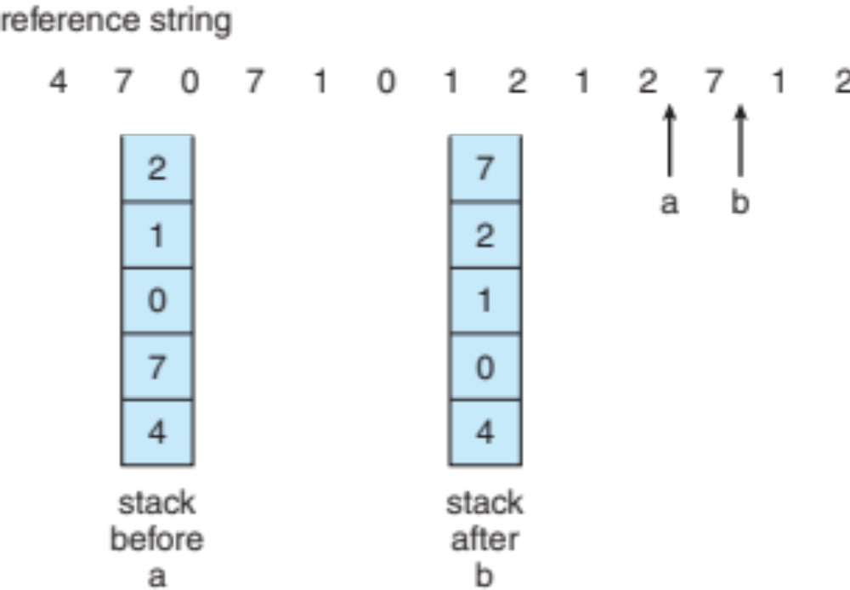
Use Of A Stack to Record Most Recent Page References

Slide 29
LRU Approximation Algorithms
LRU needs special hardware and still slow
Reference bit
  With each page associate a bit, initially = 0
  When page is referenced bit set to 1
  Replace any with reference bit = 0 (if one exists)
    We do not know the order, however
Second-chance algorithm
  Generally FIFO, plus hardware-provided reference bit
  Clock replacement
  If page to be replaced has
    Reference bit = 0 -> replace it
    reference bit = 1 then:
      set reference bit 0, leave page in memory
      replace next page, subject to same rules

Slide 30
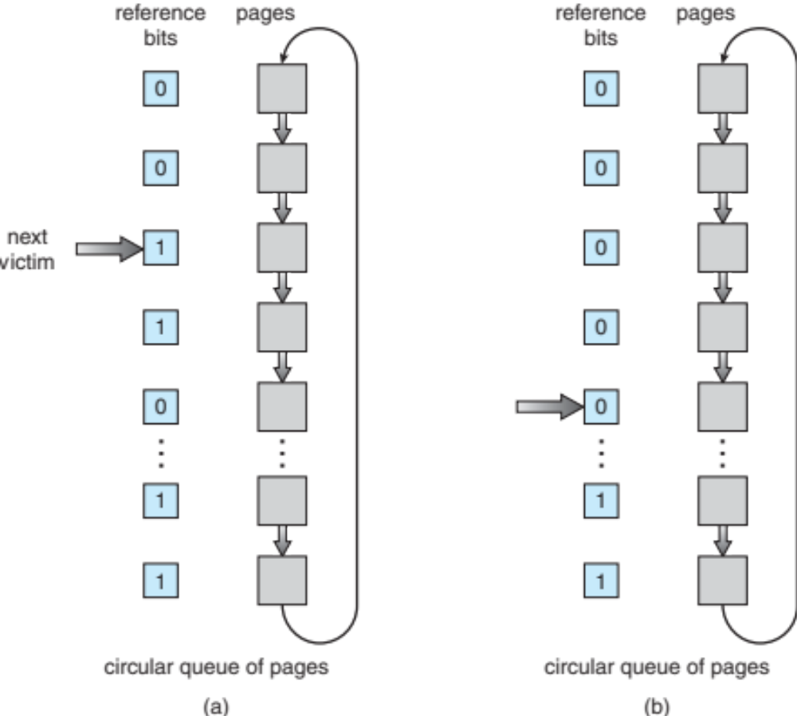
Second-Chance (clock) Page-Replacement Algorithm

Slide 31
Enhanced Second-Chance Algorithm
Improve algorithm by using reference bit and modify bit (if available) in concert
Take ordered pair (reference, modify)
(0, 0) neither recently used not modified – best page to replace
(0, 1) not recently used but modified – not quite as good, must write out before replacement
(1, 0) recently used but clean – probably will be used again soon
(1, 1) recently used and modified – probably will be used again soon and need to write out before replacement
When page replacement called for, use the clock scheme but use the four classes replace page in lowest non-empty class
  Might need to search circular queue several times

Slide 32
Page-Buffering Algorithms
Keep a pool of free frames, always
  Then frame available when needed, not found at fault time
  Read page into free frame and select victim to evict and add to free pool
  When convenient, evict victim
Possibly, keep list of modified pages
  When backing store otherwise idle, write pages there and set to non-dirty
Possibly, keep free frame contents intact and note what is in them
  If referenced again before reused, no need to load contents again from disk
  Generally useful to reduce penalty if wrong victim frame selected

Slide 33
Thrashing
If a process does not have “enough” pages, the page-fault rate is very high
  Page fault to get page
  Replace existing frame
  But quickly need replaced frame back
  This leads to:
    Low CPU utilization
    Operating system thinking that it needs to increase the degree of multiprogramming
    Another process added to the system
Thrashing ≡ a process is busy swapping pages in and out

Slide 34

Thrashing (Cont.)

Slide 35

Page-Fault Frequency
Establish “acceptable” page-fault frequency (PFF) rate and use local replacement policy
  If actual rate too low, process loses frame
  If actual rate too high, process gains frame

Slide 36
End of Chapter 9

