Slide 1


Hotel Booking DATA ANALYSIS
Presented By : Nisha Hanumante
Guided By : Abhishek Wavhal

Slide 2
Table Of Content
Project Summary
Dataset Overview
Analyzing Data
Expected Outcome
About Data
Problem Statement
Data Cleaning & Transformation
Data Visualization &Analysis
Business Recommendation
Conclusion

Slide 3
Project Summary
This project focuses on analyzing hotel booking data, from 2015-2017 for City and Resort Hotel.
Data includes booking IDs, ADR, cancellation status, lead time and guest details.
The process involved cleaning, wrangling, and visualizing the dataset to identify key business insights and improve operations.

Slide 4
Dataset Overview
Total Records: 119,390 bookings from City & Resort hotels
After cleaning the data got 87,220 record and 33 columns.
Key Fields: hotel, lead_time, is cancelled, country, adr, market segment.
Deposit type, is repeated guest, meals.
Timeframe: 2015–2017
Tools Used: Excel, Power Query, Power BI.

Slide 5
Expected Outcome
This project is expected provide clear insights into hotel booking patterns, customer preferences and revenue performance.
It helps hotels increase occupancy rates, reduce cancellation, make data driven business decision through interactive power BI dashboard.

Slide 6
Analyzing Data Steps
Data Cleaning = (remove duplicate, error, blank records)
Data Transformation = (add primary key ,remove unwanted column, replace null value, add new column just like total stays, total guest)
Data Visualization = (cleaned and transform data visualized in power BI, created charts, graphs, KPI ,slicers in dashboard)

Slide 7
About Data
Booking History
Room Information
Customer Information
Financial & Extras services
Booking Channel
Reservation Status
Date & Time Information

Slide 8
Problem Statement
The dataset consists of booking information for a city hotel and a resort hotel, including the booking date, number of adults, children, and babies, available parking spaces, booking agent, and other relevant information.
This project examines and analyzes the data to determine important factors affecting bookings.

Slide 9
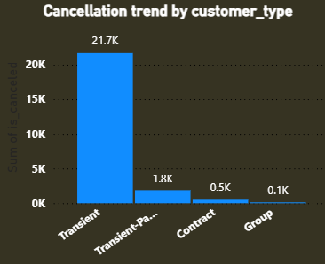
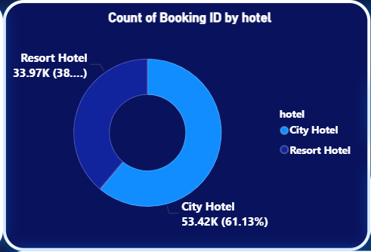
Data Visualization and Analysis
Highest cancellation from Transient customer type = major contributr to overall cancellation rate.
Low cancellation among Contract and Group customers = stable and reliable bookings.
City Hotel : 61% = More booking ,High demand
Resort Hotel : 39% = Few Booking,may focus on luxury and longer stays.

Slide 10
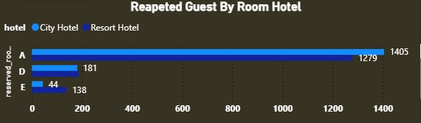
Room Type A : Most preferred by repeat guest (high loyalty)
City Hotels : Higher guest retention rate than Resort Hotels.
Room Types D & E : Need improvement or promotional focus.

Slide 11
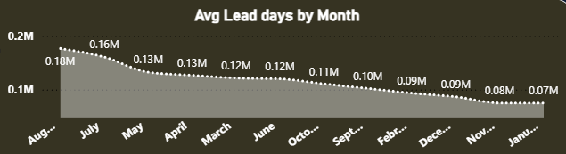
It shows that during July and August, customer tend to book earlier, indicating these are peak travel months. As the year progresses the average lead time gradually decline, reaching its lowest january , suggesting that guests make last minute booking during this period.

Slide 12
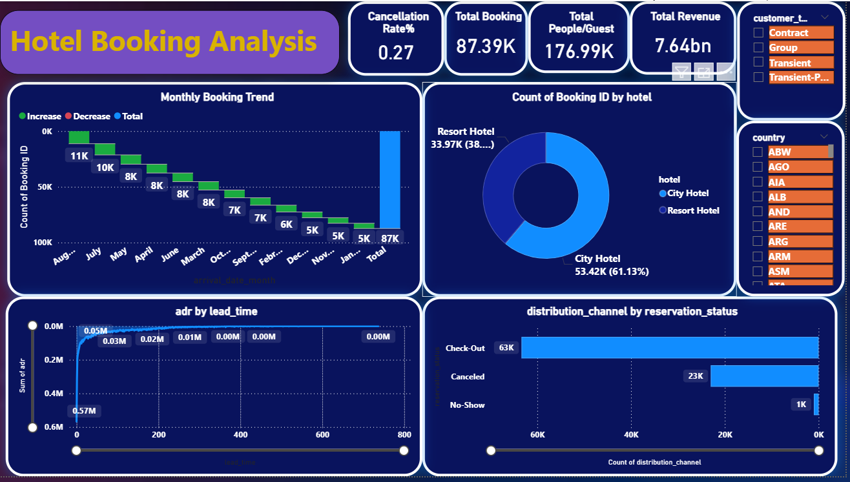
DASHBOARD OVERVIEW

Slide 13
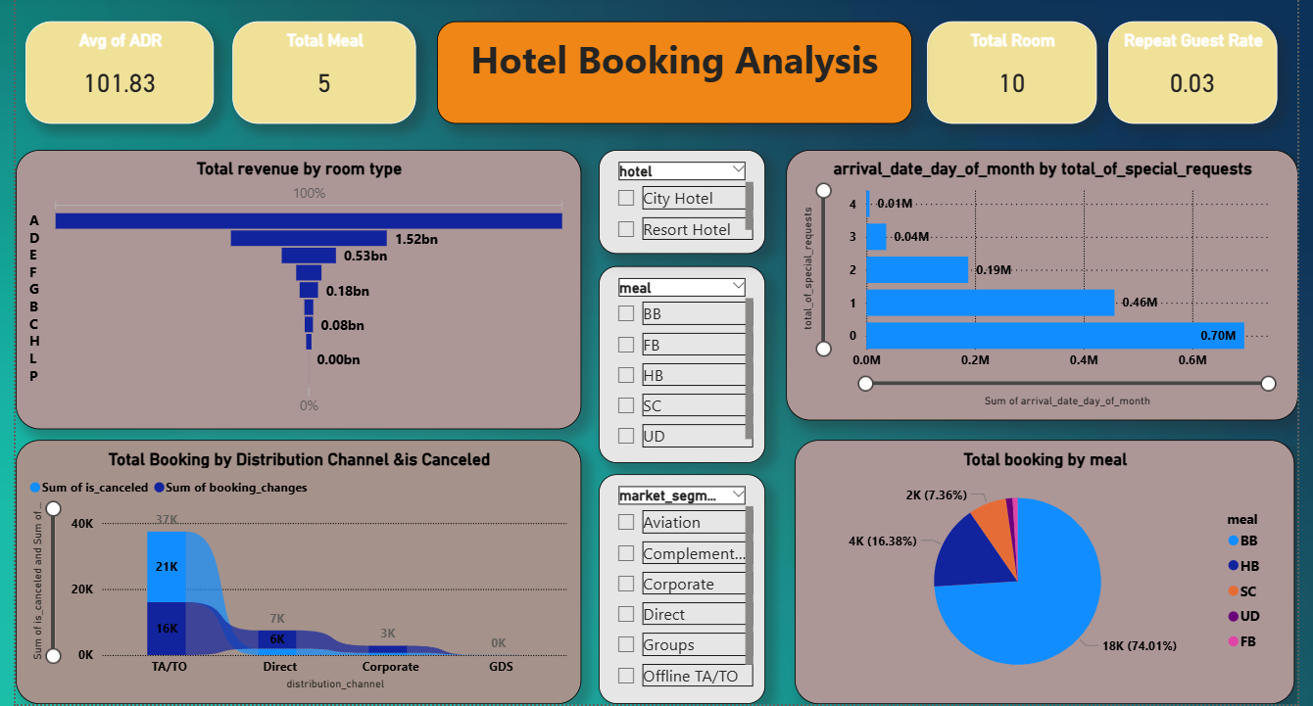
DASHBOARD OVERVIEW

Slide 14
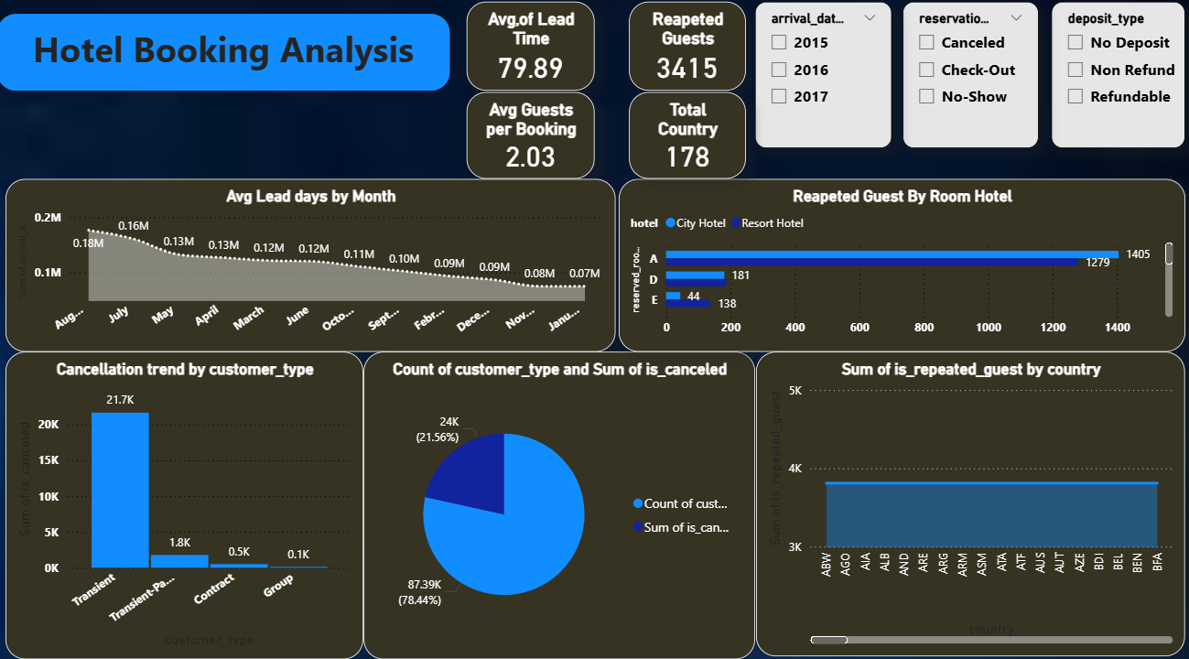
DASHBOARD OVERVIEW

Slide 15
Business Recommendation
In the hotel booking analysis the hotel should used flexible pricing based on season and demand to earn more revenue.
It should also reduce cancellation by sending reminders and offering easy change option.
The hotel can increase occupancy during low season by giving discount or special offers.

Slide 16
Conclusion
The hotel booking analysis helps us understand customer behaviour and booking trends.
From the data, we can see which months have the highest bookings, which room types are most preferred, and what factors lead to cancellations.
This analysis helps the hotel improve its services, manage rooms better, and plan special offers during low seasons. Overall, using data in hotel booking helps increase revenue, reduce cancellations, and improve customer satisfaction.

Slide 17


