Slide 1
CT3-PA2312044010017_Nisha_Dashboard1
File created on: 10-May-24 2:51:48 AM

Slide 2
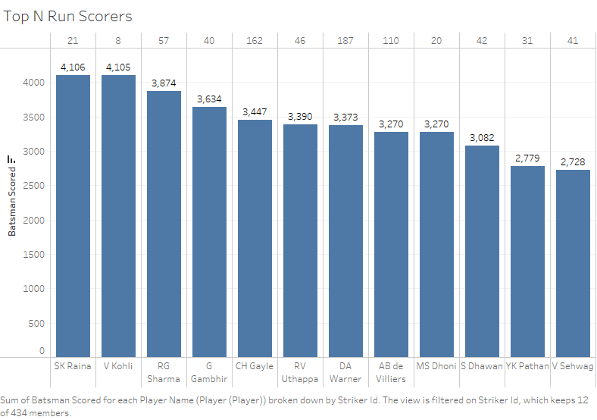

Slide 3
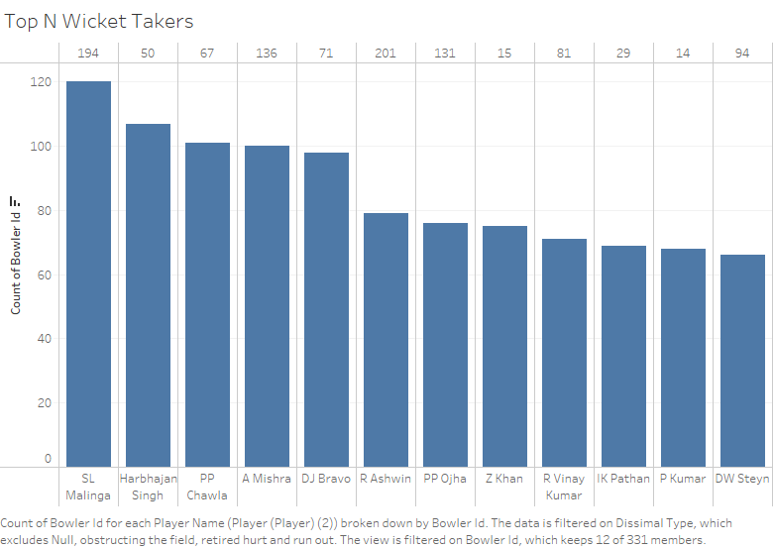

Slide 4
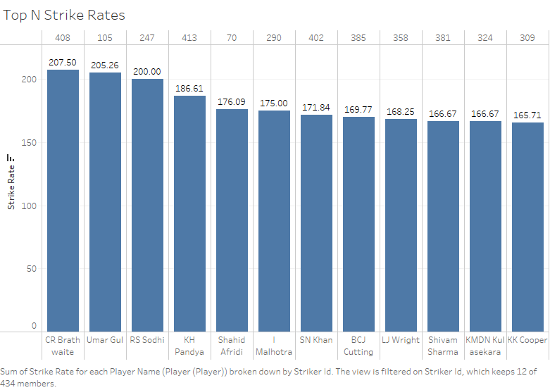

Slide 5
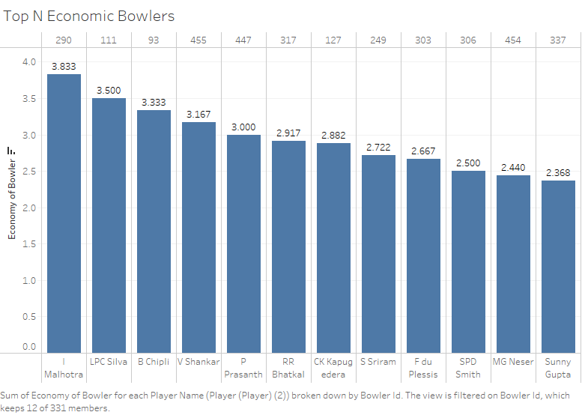

Slide 6
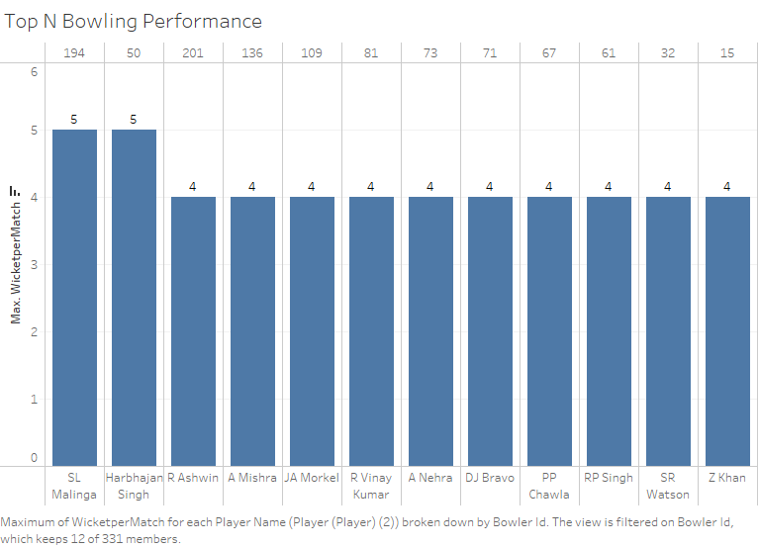

Slide 7
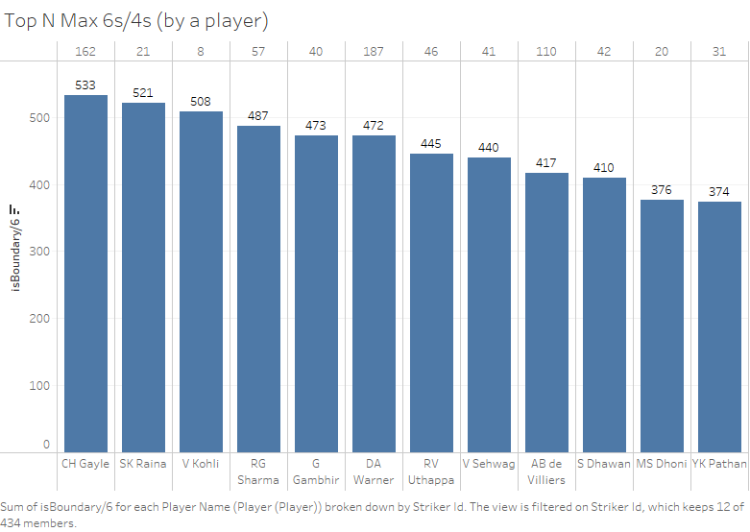

Slide 8
