Slide 1
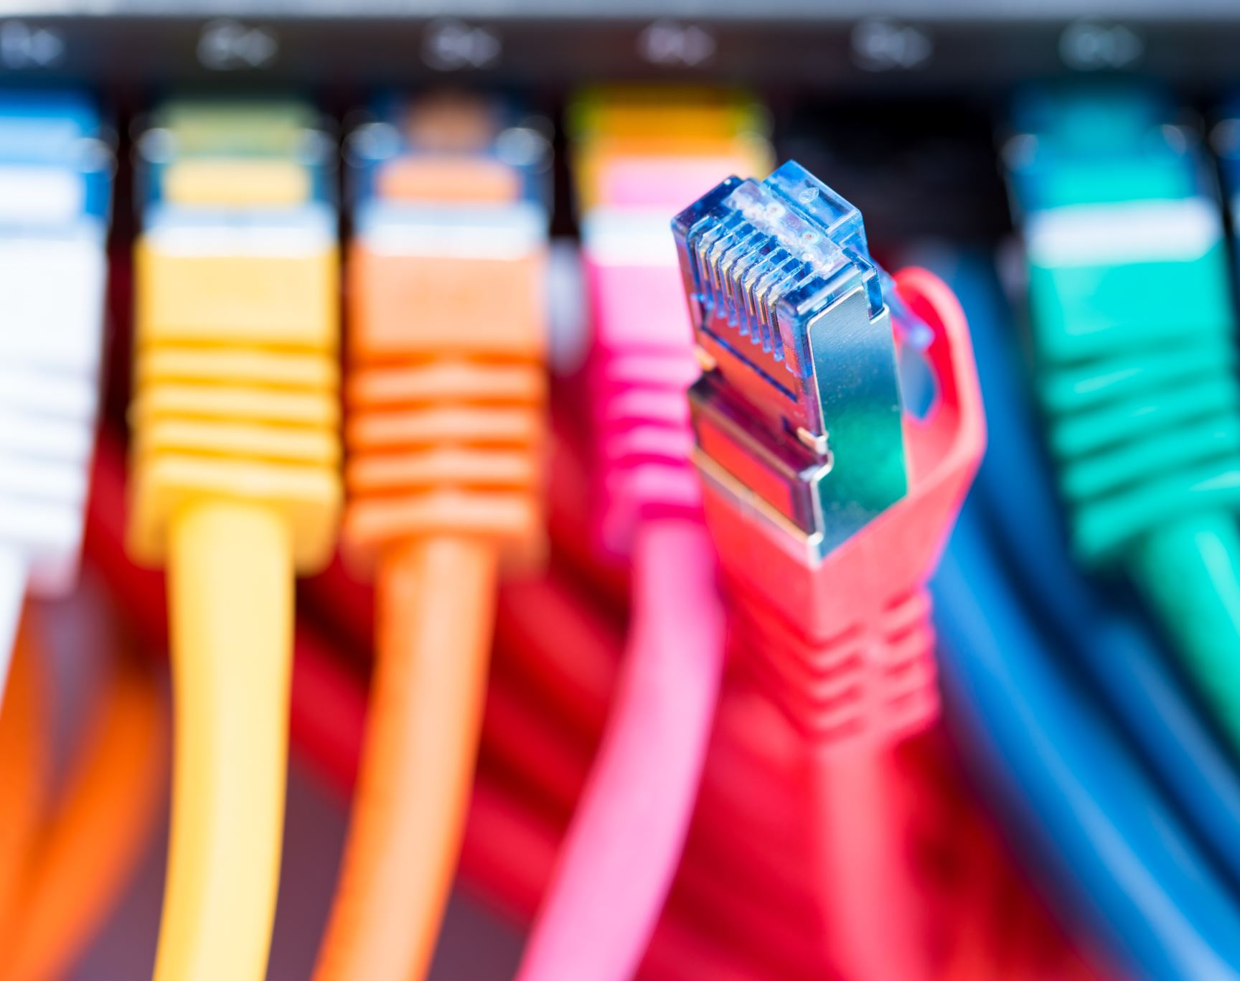
NANOG-87 CU Boulder Importing Existing Network into Netbox
Fan Shen
Kanishka Singh
Mayuri Mohan
Nisha Murarka

Slide 2

Agenda
High-Level Diagram
Configuration Files
Future Enhancements

Slide 3
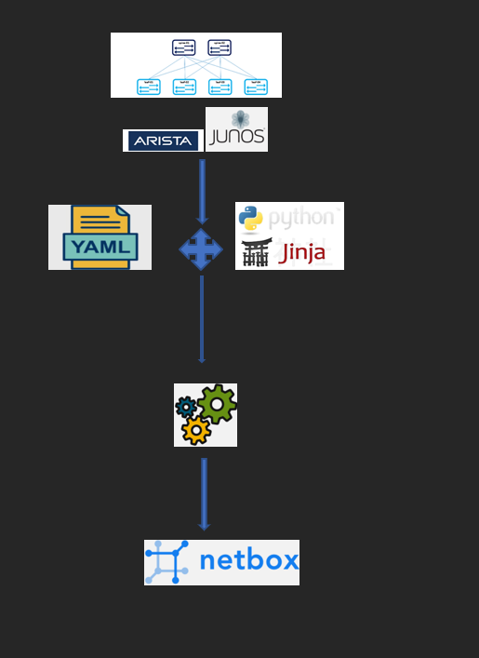
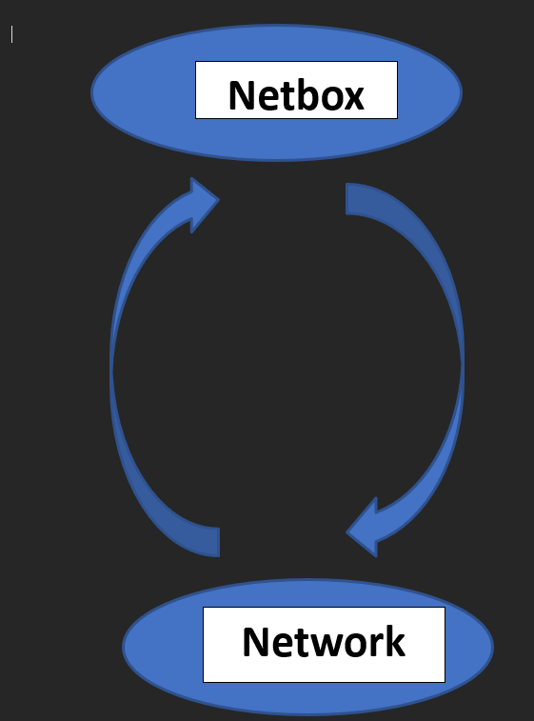
High Level Diagram
Automated scripts that read from yaml and create new “Sites”, and “Devices” in Netbox present in existing/new network.
Automated scripts that pull the configuration from the device and import them into the “config-context” of the device in Netbox.

Slide 4
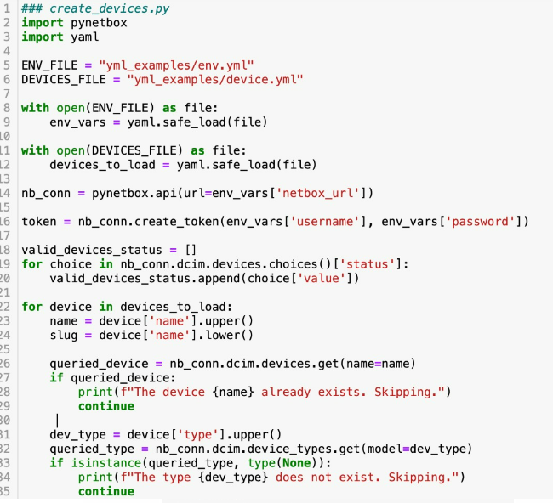
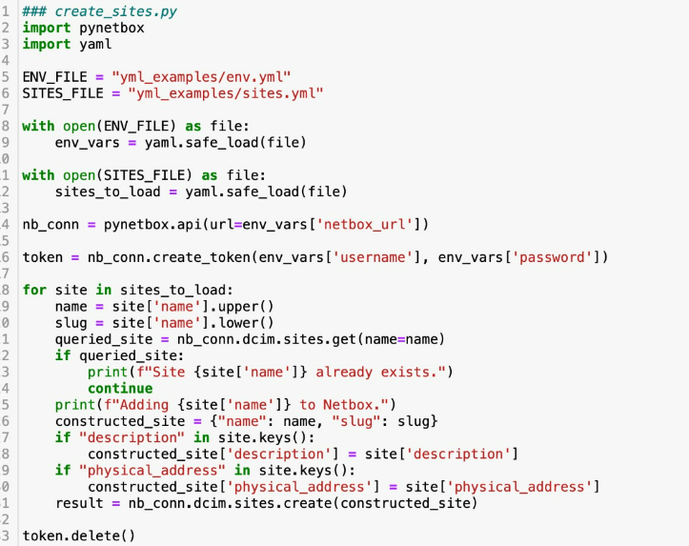
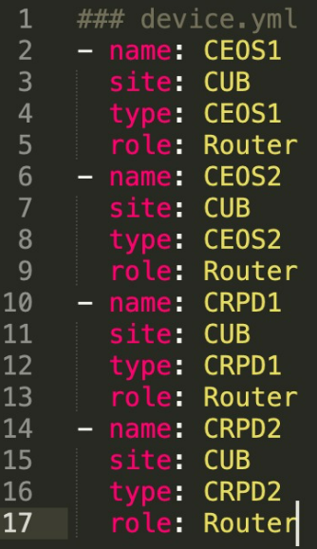
Creating Sites and Devices (Python)

Slide 5

Push config to Netbox
Generated separate YAML files for: “Sites”, “Devices”, and“ Device-Types”
Pushing them via code to Netbox

Slide 6
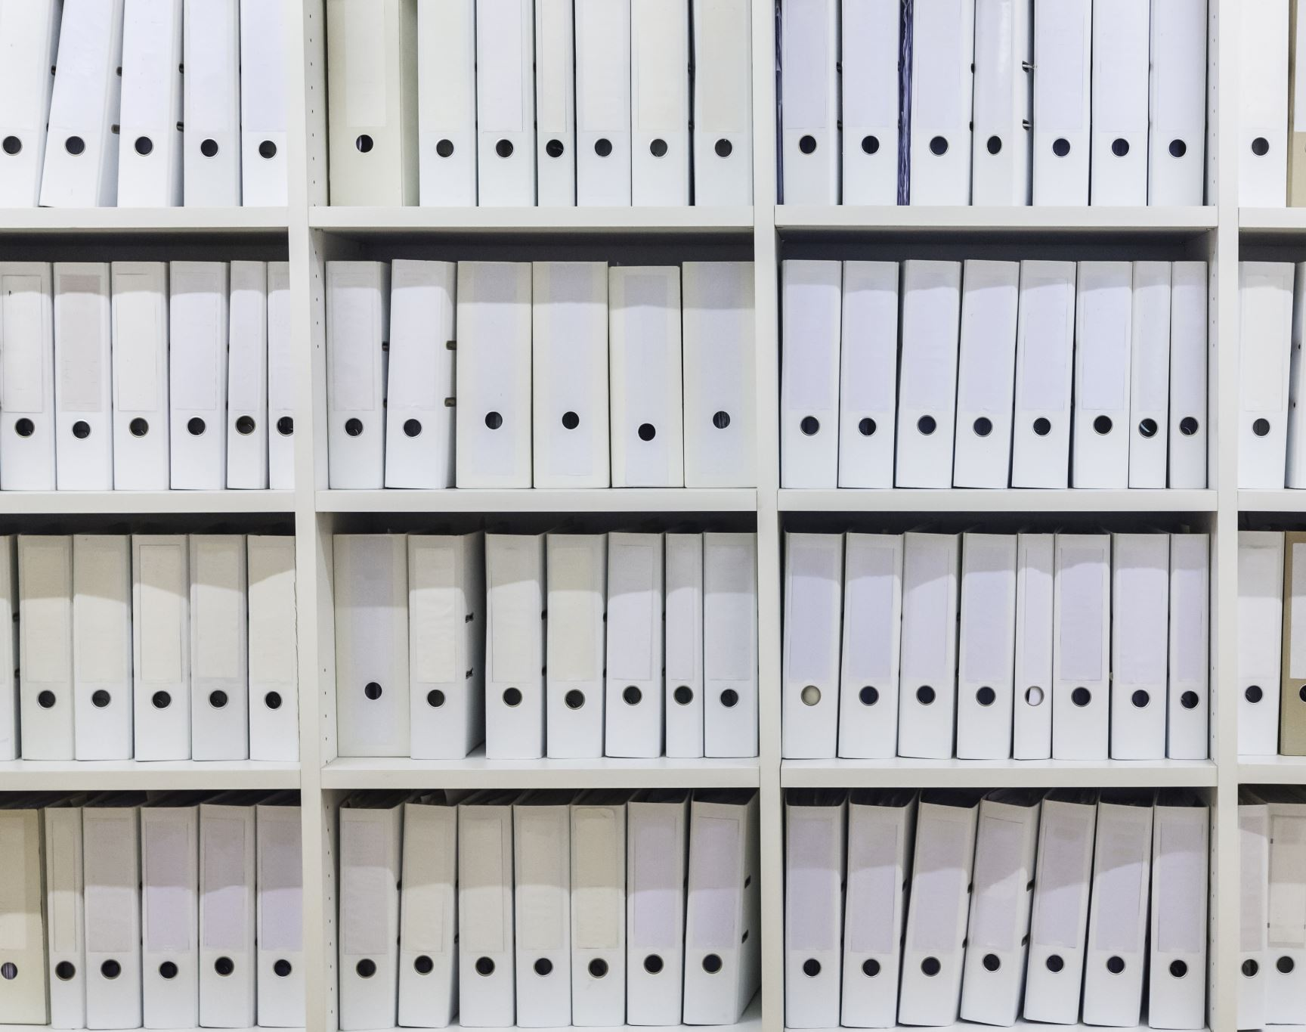
Tools for: Generating Config Files
Python
Yaml file
Jinja2 Templates
pynetbox library

Slide 7
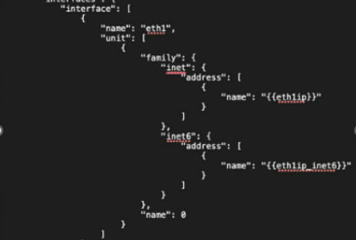
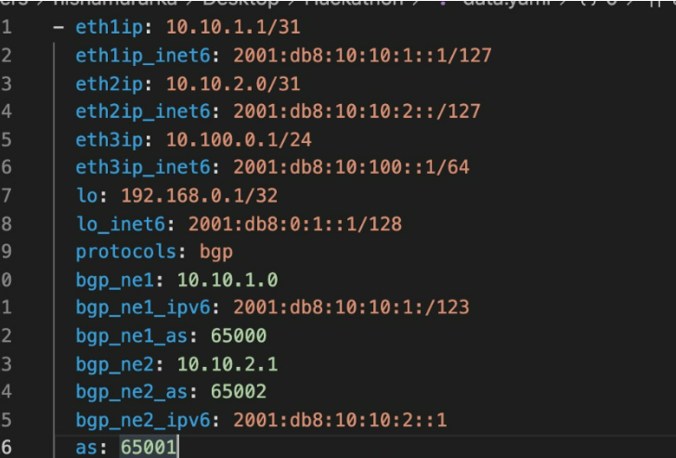
YAML file
Jinja2 template

Slide 8
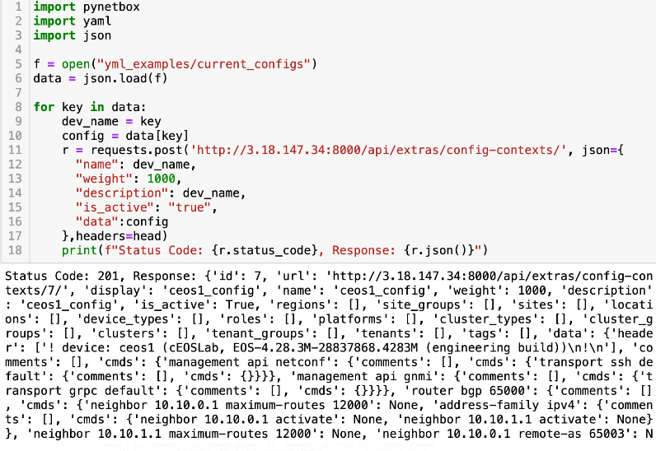
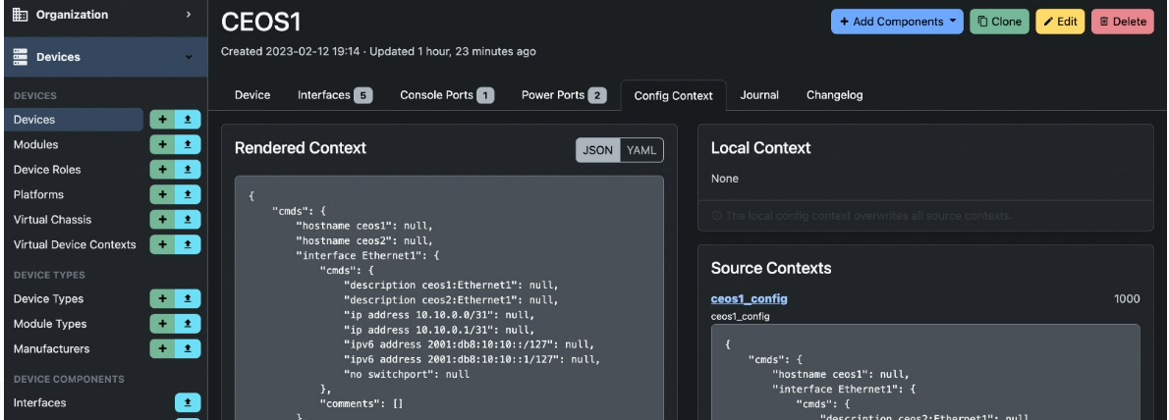
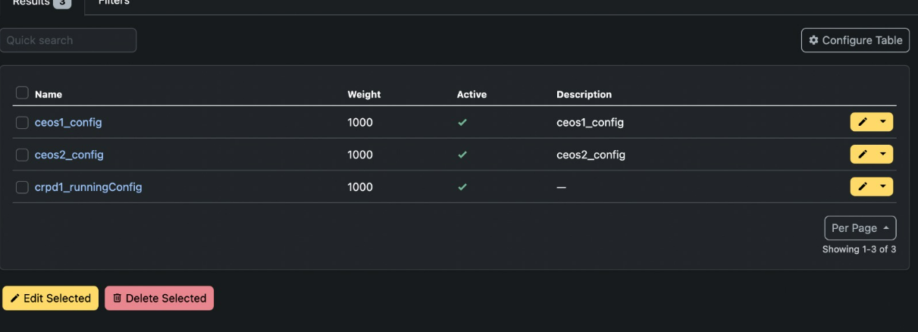
Configuration pushed into Netbox

Slide 9
Future Enhancements
Currently, there is no way to associate device ID to “config-context” to map it to a particular device.
Integration between the Netbox and the automation script to update the configurations on the devices.
An API to generate the differences (configuration file) between the golden config and the new config.

Slide 10

Questions

Slide 11

Thank You

