Slide 1
Crypto TRANSACTION ANALYSIS

Slide 2
A Comprehensive Guide to Cryptocurrency Tracing

Slide 3

cryptocurrency

Slide 4
2010 – Satoshi nakamota 1] built using cryptography 2] cryptography is a method of using inscription and decription 3] open source of currency

Slide 5
Dark side:
1] terrorist funding 2] hacking wallets 3] suspicious transactions

Slide 6
Understanding the basics of cryptocurrency and the blockchain is crucial for effective tracing. What is blockchain??

Slide 7
































Slide 8
There are Various tracing methods, Understanding these techniques is crucial for effective cryptocurrency tracing.

Slide 9
1] transaction tracking : input output analysis : grouping together wallets : identifying wallets that have multiple inputs in common
2] pattern analysis: : examinig transaction timestamp alerting in a suspicious transactions
3] graphical analysis:
: relation between different addresses

Slide 10
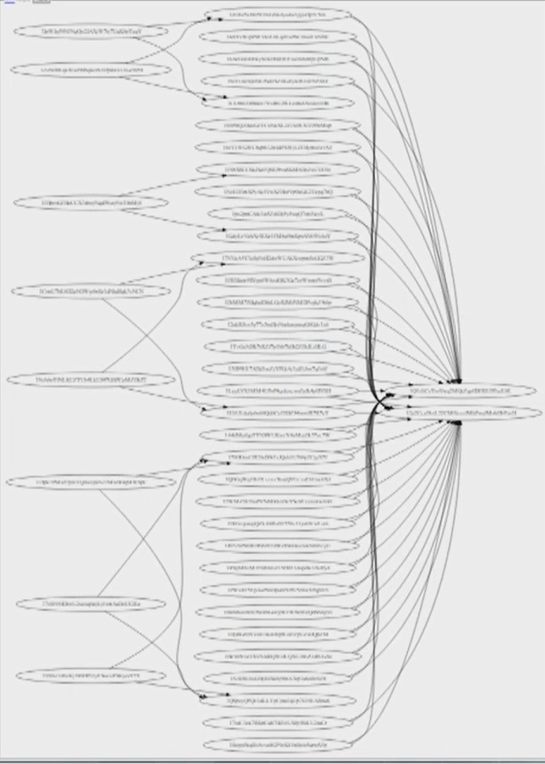

Slide 11
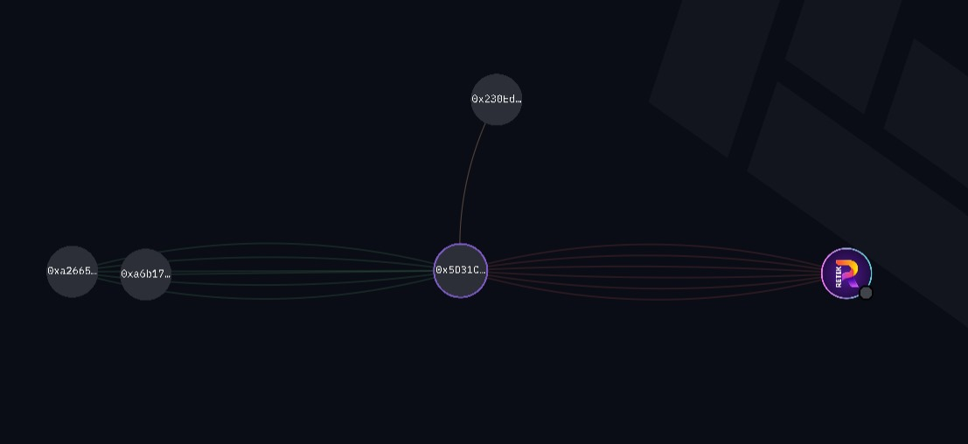

Slide 12
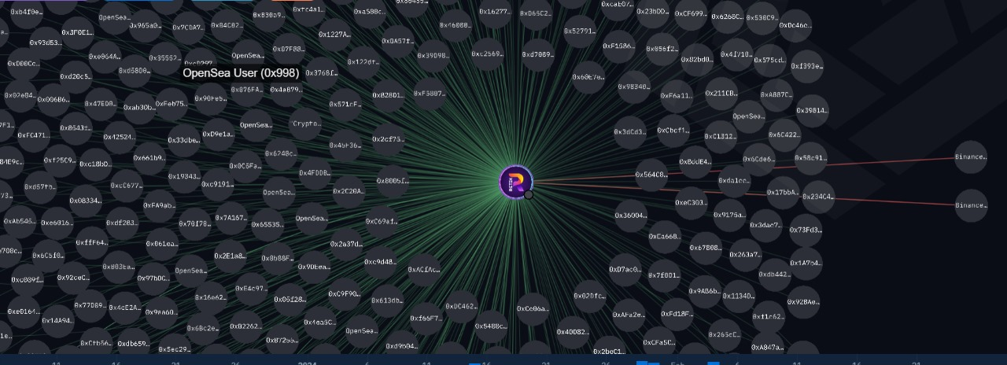

Slide 13
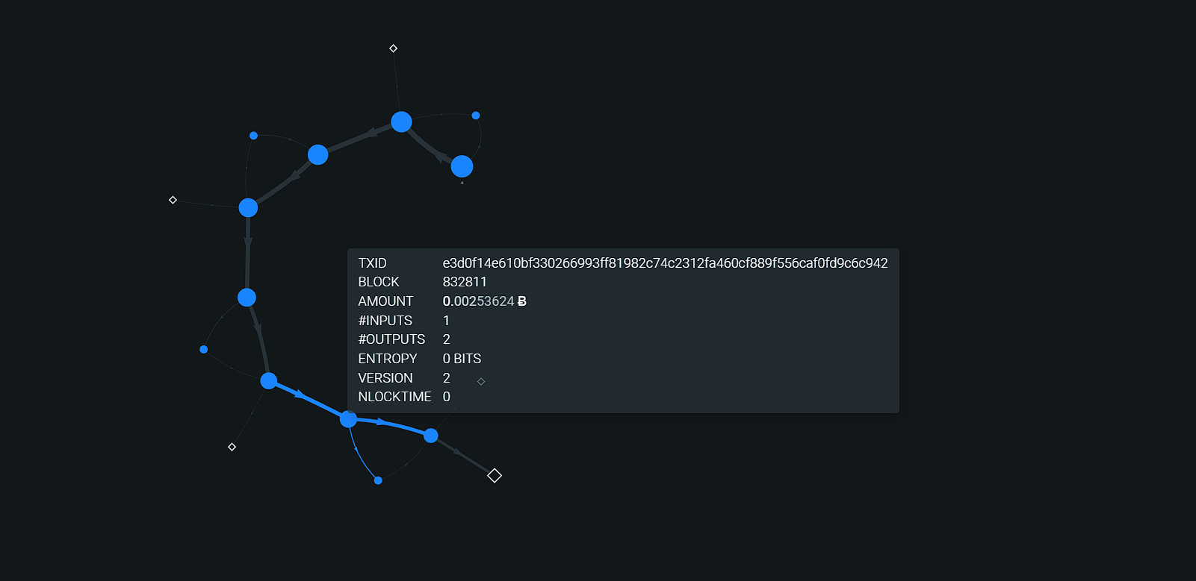
oxt.me

Slide 14
Crime in the name of crypto:
1] fraudulent initial coin offering : creating fake IOC to attract investment and disappear with funds
2] phishing : using fake websites or emails to trick users to reveal their private key 3] crypto jacking : malicious software to secreatly mine cryptocurrency in users device without their knowledge

Slide 15
This slide will introduce advanced tracing tools such as blockchain explorers, forensic software, and data visualization platforms. These tools play a pivotal role in cryptocurrency tracing investigations

Slide 16
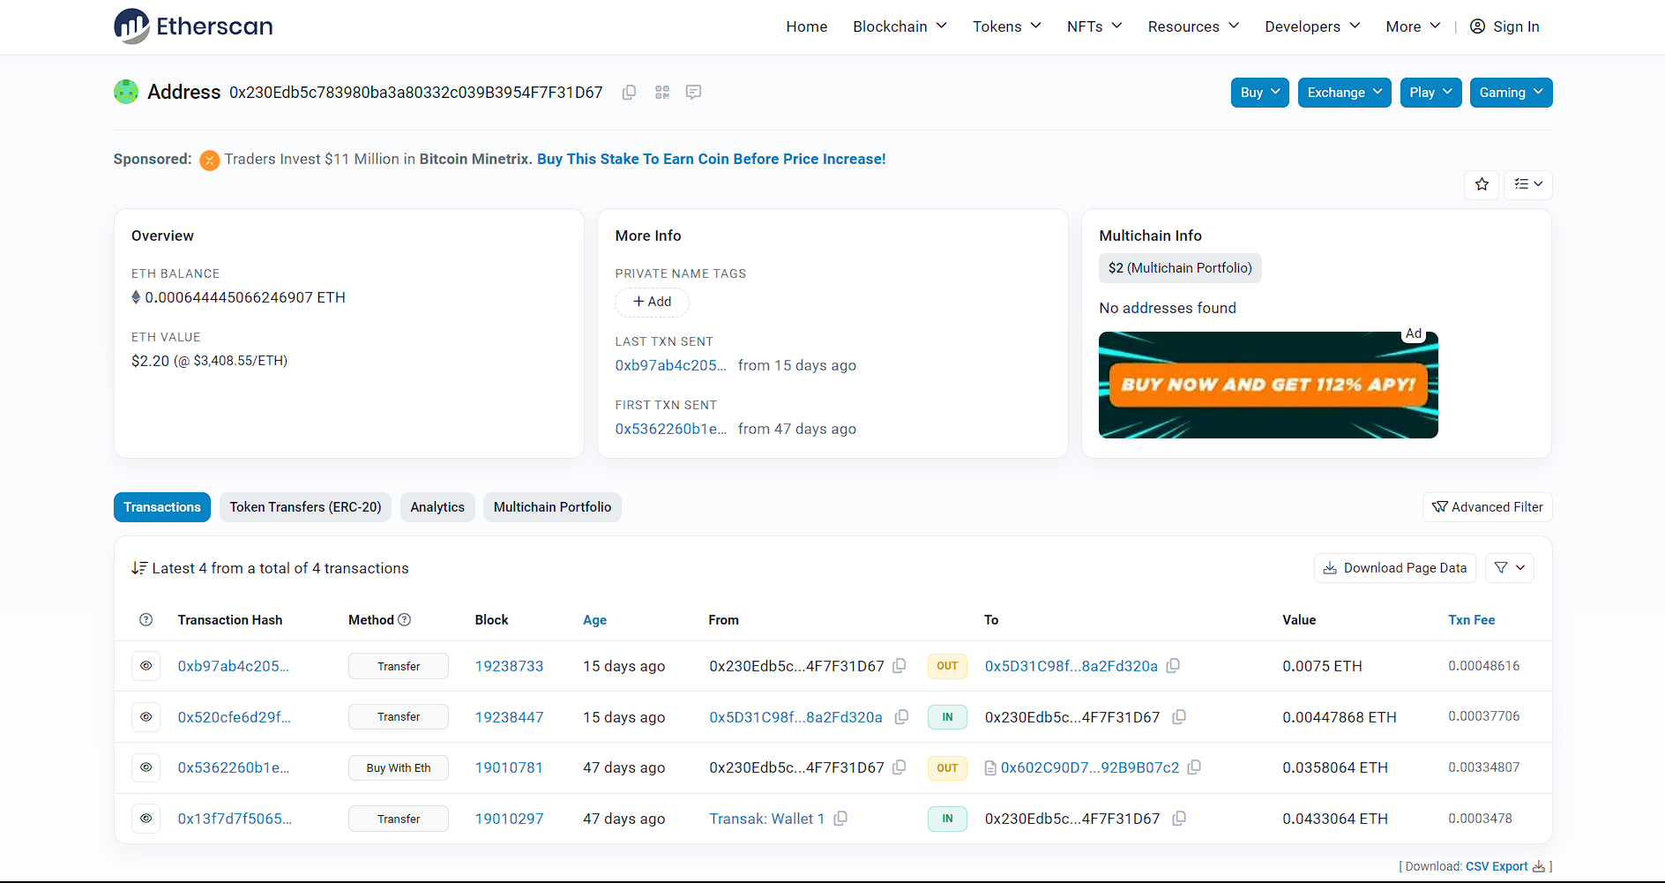

Slide 17
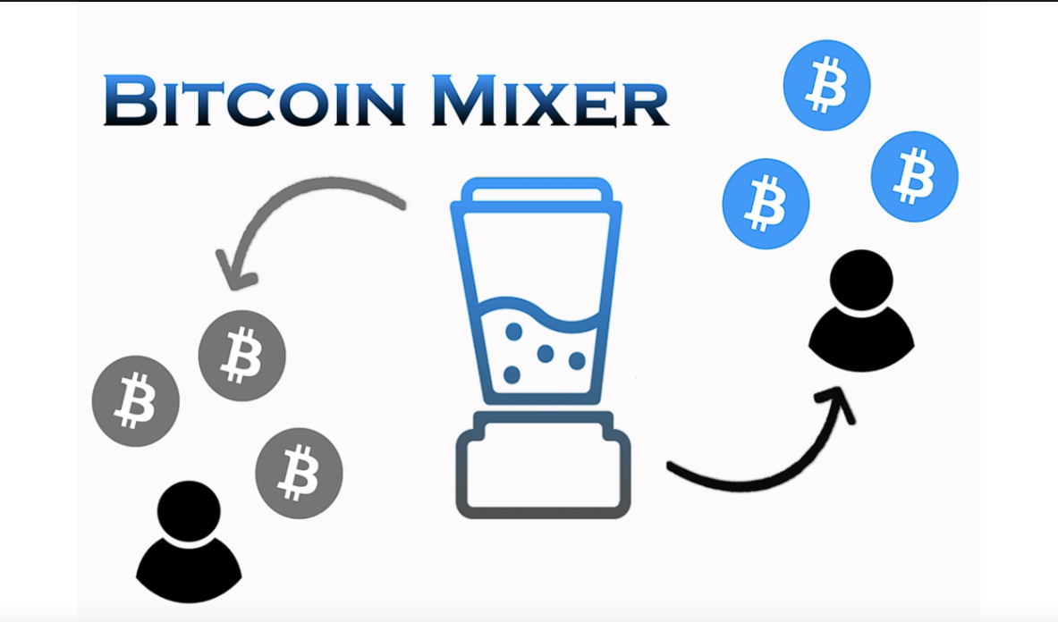

Slide 18






















Slide 19




































Slide 20
FINDING THE crypto EXCHANGE
1] CRYPTOCURRENCY EXCHANGE THROUGH WHICH TRANSACTION IS DONE
2] CONTACTING THE EXCHANGE FOR INFORMATION OF SPECIFIC WALLET HOLDER AS THE HOLDER HAS PROVIDER INFO TO THE EXCHANGE WHILE CREATING THE WALLET

Slide 21
OTHER ATTRIBUTES OF EXCHANGE
1] TOKEN SYMBOL
2] DECIMALS: NUMBER OF DECIMAL PLACES USED IN SMALLEST UNIT OF CRYPTOCURRENCY
3] BLOCKCHAIN PLATFORM : PLATFORM ON WHICH CRYPTO OPERATES

Slide 22
Thank youu

