Slide 1


Traffic Sign Detection System for Harsh Driving Analysis and Speed Compliance
Academic Year 2024-25 A Project Presentation on
Final Year Project By:
Nishad Harsulkar
Saurabh Autade
Sujal Koli
Guided By
Prof. Sarika N. Patil
Department of Electronics and Telecommunication Engineering,
Nutan Maharashtra Institute of Engineering and Technology, Talegaon Dabhade, Maharashtra 410507
Savitribai Phule Pune University, Pune.

Slide 2
Content
Introduction
Problem statement
Literature Review
Proposed System
Methodology
Hardware Components
Software Components
Data collection Strategy
Training and Implementation
Timelines
Results
Advantages, Disadvantages and Applications
Conclusion and Future scope
References
Profile

Slide 3
Introduction
Introduction:
Road safety has become increasingly critical due to the rise in traffic accidents, with harsh driving being a major contributor.
This project aims to develop an embedded system that detects rash driving by integrating IMU and GPS data with real-time analysis from a frontal-facing camera inside the car.
Leveraging these technologies, the system offers valuable insights into driving patterns to promote safer driving habits.
Aim of the Project:
The aim of this project is to develop an embedded system for detecting rash driving through the integration of IMU (Inertial Measurement Unit) and GPS data with real-time video analysis from a frontal-facing car camera. This system aims to enhance road safety by providing actionable insights into driving behavior.
Objective:
Integrate IMU, GPS, and real-time camera data to develop a system that detects harsh driving, analyzes driving behavior, and promotes safer habits through continuous monitoring and actionable feedback to enhance road safety.

Slide 4
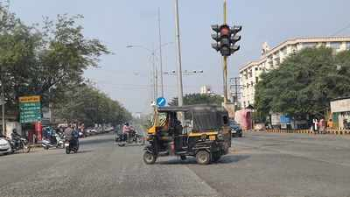
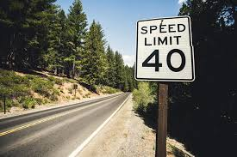
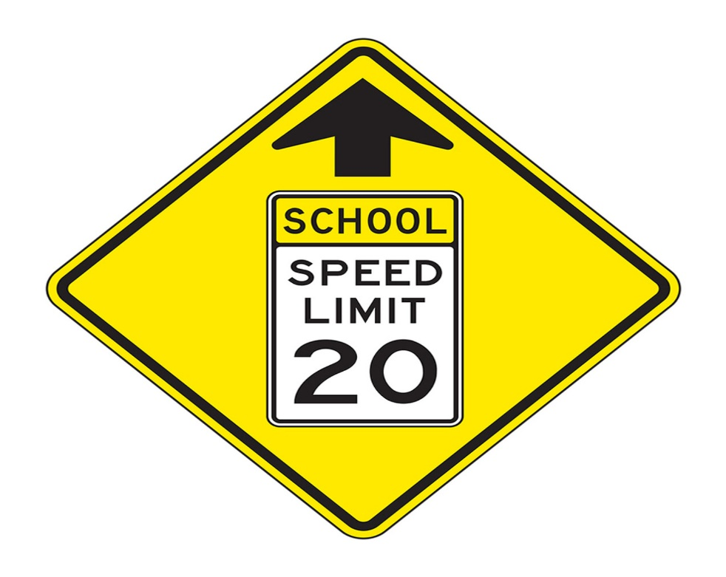
Motivation
The motivation for this project is to enhance road safety by developing a system that detects harsh driving behaviors through the integration of IMU and GNSS data with real-time camera analysis.
This approach aims to create a more accurate and comprehensive solution for identifying and mitigating risky driving, contributing to safer driving environments and advancing intelligent transportation systems.

Slide 5
Problem Statement
Harsh driving, characterized by sudden acceleration, hard braking, and rapid lane changes, poses a significant risk to road safety.
There is a need for a robust system that can accurately detect and analyze harsh driving by combining multiple data sources, including vehicle speed and visual cues from the surrounding environment.
This project addresses this need by developing a system that integrates IMU and GNSS with camera inputs to detect and evaluate instances of rash driving in real-time.

Slide 6
Literature Review
Previous studies such as [1] have used LiDAR and Camera both to detect signboards with high accuracy(83.4%)
Rajesh Kannan Megalingam’s[3] study on RM R-CNN demonstrated 97.08% precision for Indian traffic signs, outperforming conventional models and showcasing adaptability to varied conditions, enhancing autonomous vehicle safety and traffic management.
Dr. Rahul Patil et al.[7] highlighted CNNs' transformative role in traffic sign detection, improving accuracy and handling real-world conditions. The challenges faced during the implementation consist of different lighting conditions, bad weather, partial occlusion, damaged signs, complex scenes, poor image quality, and regional-specific issues.
Paper [8] consists of a table which provides a summary of solutions for all the challenges or problems being faced by the system.
[9] developed a low cost system using IR and GSM module. It conveys real-time vehicle data to authorities, thus helping in identifying rash driving.
There are various research and implementations of IMU and GNSS and LiDAR for ADAS scenario but none for the scope of this project.

Slide 7
Proposed System
We propose an embedded system designed to address the key challenges in traffic sign detection comprehensively.
The system integrates various sensors, including a camera, accelerometer, and GPS, to create a robust real-time monitoring solution.
Data collected from these sensors will be processed in real-time and analyzed against predefined scenarios to produce actionable outputs. For example, if a red traffic signal is detected, the system will verify that the accelerometer and GPS indicate a speed of ≤10 km/h to ensure compliance.
This system will be built to function independently on a microcontroller capable of managing the computational workload required for software processing while supporting all necessary hardware components.
The proposed solution aims to enhance road safety by ensuring prompt detection and analysis, leading to safer driving behavior and better traffic management

Slide 8
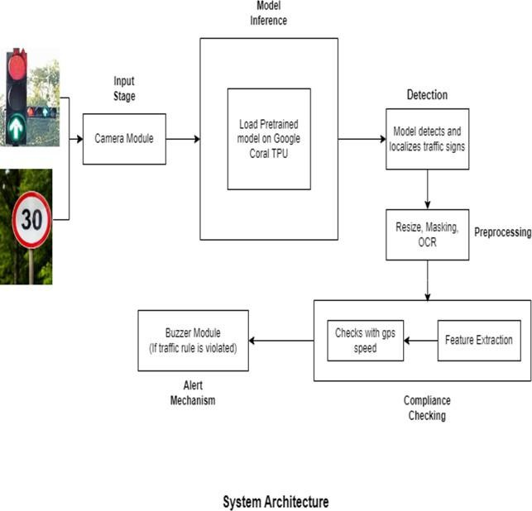
System Architecture

Slide 9
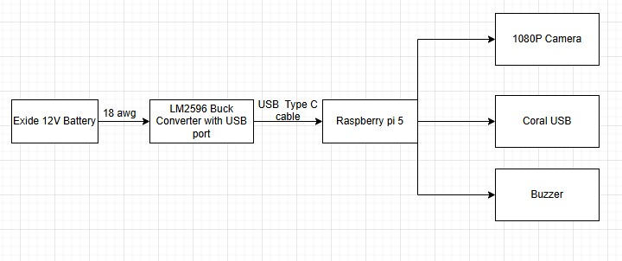
Hardware Setup

Slide 10
Methodology
Hardware Components :
Raspberry Pi 5
Coral USB Accelerator
Inertial Measurement Unit
Global Navigational Satellite System
Dash Cam
Battery
Software :
Raspberry Pi Operating System
Model – YOLO Object Detection
Custom Dataset
Some things such as GPU are not included.

Slide 11
Data Collection Strategy
Identify the required road signs:
Start by identifying the types of road signs relevant to the project (e.g., speed limit signs, stop signs, traffic signals).
Data Sources:
Public Datasets: GTSRB (German Traffic Sign Recognition Benchmark) dataset with over 39,000 training images.
Custom Dataset: Gathering Data according to the requirements.
Data Annotations:
Annotate the collected data using tools like LabelImg.

Slide 12
Training and Implementation
Prepared Dataset
Model Training
Model Deployment on Raspberry Pi
Multi-Sensor Data Integration
Performance Evaluation and Logging
Data Comparison and Logging

Slide 13
Timelines
Identifying components and software required –
Implementing software and hardware individually –
Data Collection for model –
Model Training -
Prototype Level Implementation –
Fine-tuning Model and Re-implementation –
System Testing –
System Deployment –

Slide 14
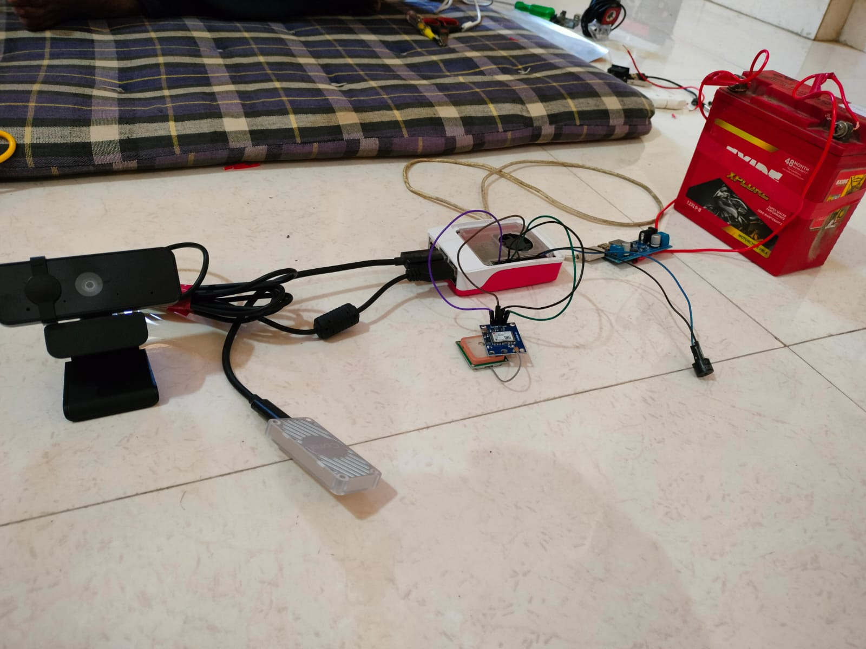
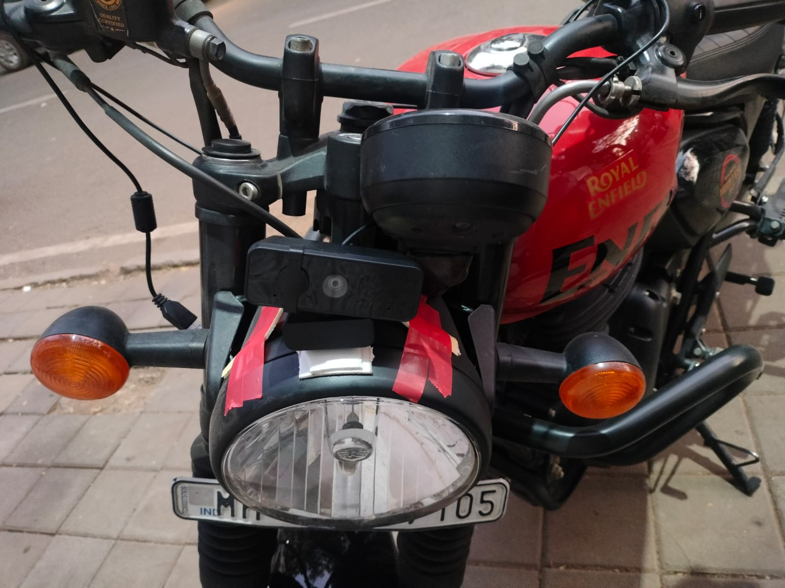
Project Implementation
Fig 1. Hardware Setup of the Project
Fig 2. Actual implementation of the system on Ego vehicle

Slide 15
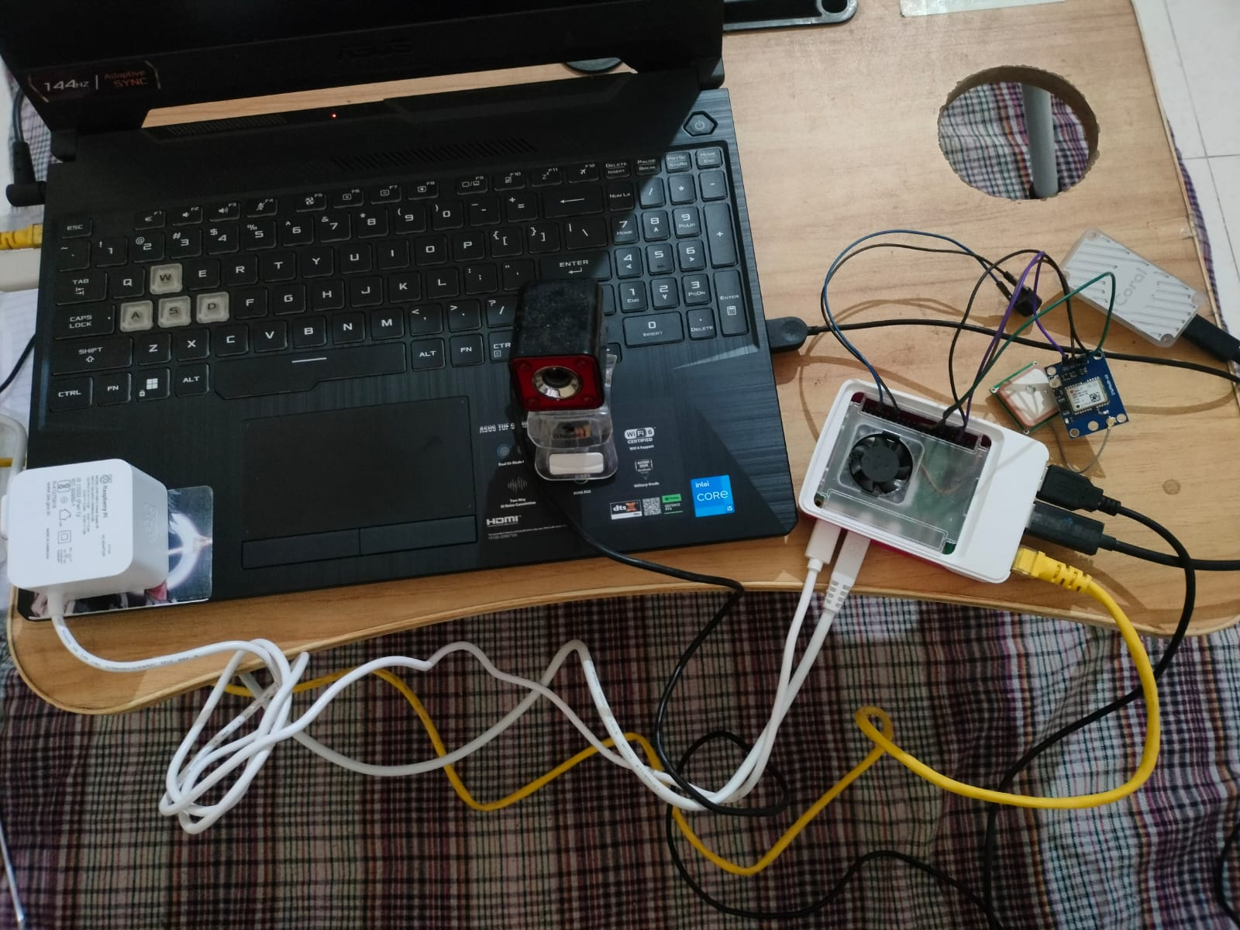
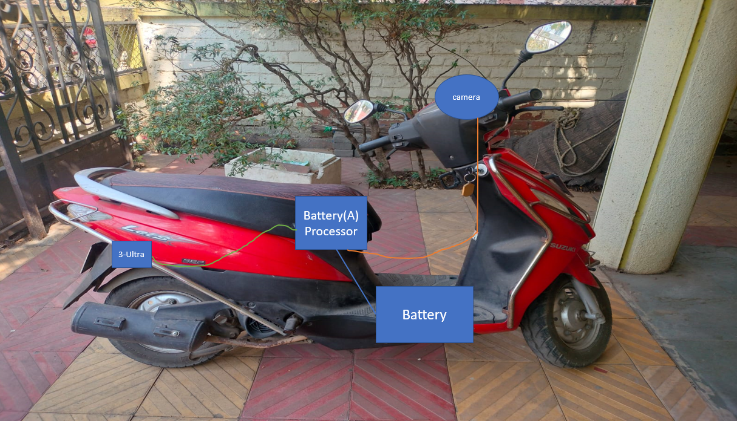
Fig 3. Project setup without Battery
Fig 4. Ideal Project Setup on Ego Vehicle

Slide 16
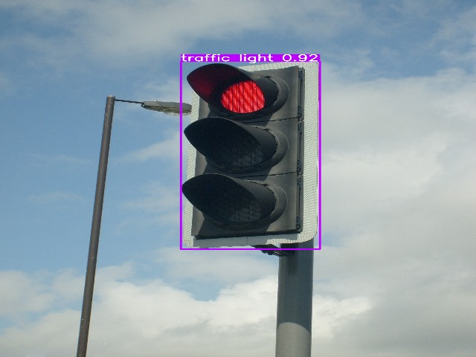
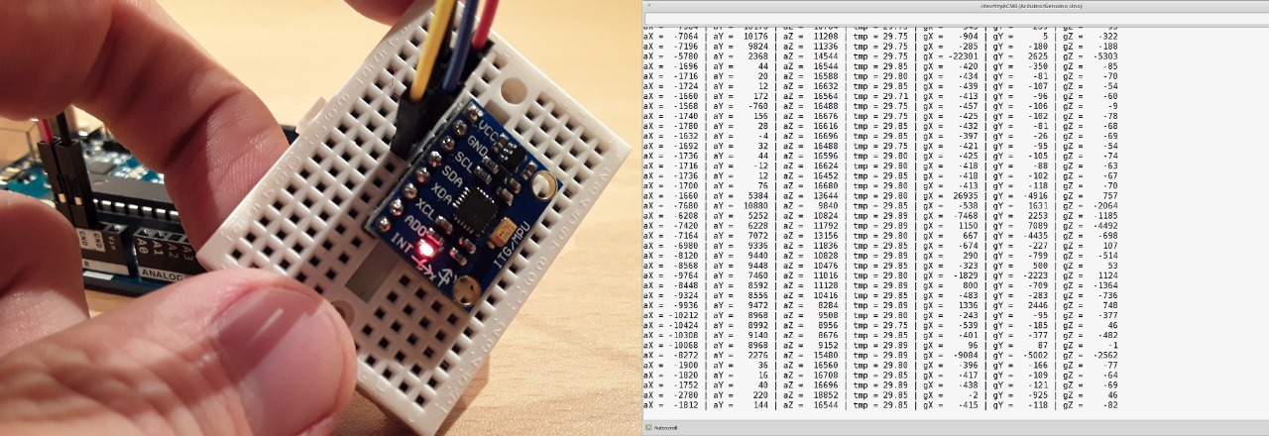
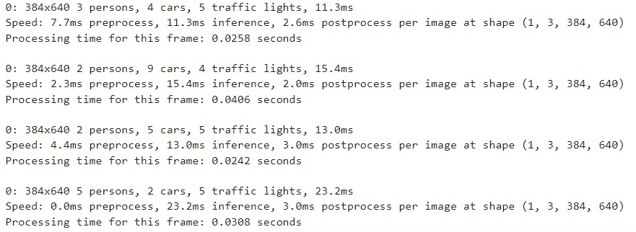
Results
Fig 5. Yolov8s Model Detecting Traffic Signal
Fig 6. Accelerometer Raw Data collection
Fig 7. Output of Yolo model as Text

Slide 17
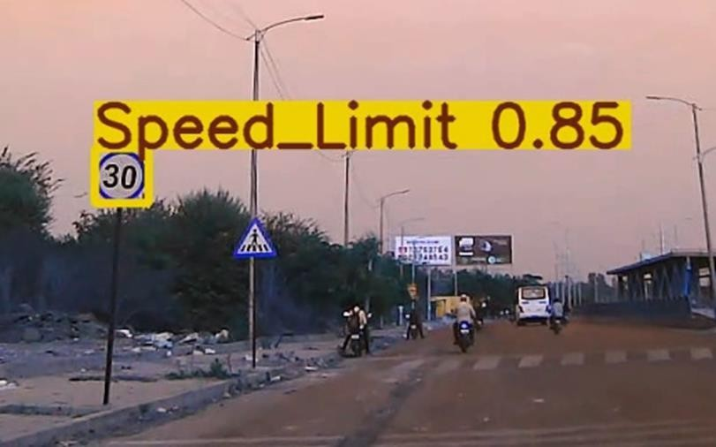
Speed Sign 40 | 59 | 93.124218 | 43.889325
Yellow | 59 | 93.124218 | 43.889325
Yellow | 59 | 93.124218 | 43.889325
Yellow | 59 | 93.124218 | 43.889325
Red | 3 | 93.124218 | 43.889325
Yellow | 36 | 93.124218 | 43.889325
Speed Sign 30 | 36 | 93.124218 | 43.889325
Red | 36 | 93.124218 | 43.889325
Speed Sign 30 | 64 | 93.124218 | 43.889325
Speed Sign 40 | 64 | 93.124218 | 43.889325
Red | 64 | 93.124218 | 43.889325
Fig 8. Yolov8s Model Detecting Speed Limit in Real Time Environmet
Fig 9. Code Output in form of CSV for Analysis

Slide 18
Advantages, Disadvantages and Applications
Advantages:
Real-Time Monitoring: Provides immediate feedback on driving behavior.
Comprehensive Data Integration: Combines IMU, GPS, and camera data for a holistic view of driving patterns.
Enhanced Safety: Identifies rash driving behaviors to prevent accidents.
Driver Awareness: Promotes safer driving habits through feedback.
Data-Driven Insights: Enables fleet operators to monitor and improve driver performance.
Customizable Alerts: Tailors notifications based on specific driving behaviors.
Real-time processing: With advancements in hardware and optimization techniques, ML models can process images in real-time
Disadvantages:
Initial Cost: Higher upfront investment for hardware and implementation.
Privacy Concerns: Potential issues with data collection and user privacy.
Environmental Limitations: Performance may be affected by poor weather or lighting conditions
User Resistance: Drivers may be resistant to being monitored or receiving feedback.

Slide 19
Applications:
Personal Vehicles: For individual drivers to promote safe driving habits.
Fleet Management: Used by companies to monitor and improve driver safety and efficiency.
Insurance Companies: For risk assessment and premium adjustments based on driving behavior.
Transportation: Enhances safety in buses and taxis through real-time monitoring.
Driver Training Programs: Assists in evaluating and improving driving skills for new drivers
Research and Development: Provides valuable data for studies on driving behavior and safety improvements.

Slide 20
Conclusion and Future Scopes
Conclusion:
Our project embodies a significant step forward in traffic management technology. The successful integration of cutting-edge computer vision algorithms with practical edge computing platforms makes this system a valuable tool in contributing to road safety and efficiency. Its timely and accurate feedback mechanisms support proactive driving, ultimately fostering safer roads and a well-informed driving community. This advancement can lead to broader implications in autonomous vehicle technology and smart city initiatives.
Future Scopes:
Incorporation of more sophisticated machine learning models for better prediction and classification of driving behaviour's.
Collaboration with existing vehicle systems (e.g., OBD-II) for deeper insights into vehicle health and performance.
Utilizing cloud computing for enhanced data storage, processing, and analysis, allowing for broader datasets and improved algorithms.
Collaborating with traffic management systems to contribute to smarter urban mobility solutions, such as adaptive traffic signals based on real-time driving data.

Slide 21
References
[1] Zhang, F.; Zhang, J.; Xu, Z.; Tang, J.; Jiang, P.; Zhong, R. Extracting Traffic Signage by Combining Point Clouds and Images. Sensors 2023
[2] Real-Time Traffic Sign Detection and Recognition System using Computer Vision and Machine Learning by Dr. Rahul Patil ,Dr. Prashant Ahire ,Dr. Kalyan Bamane ,Dr. Abhijit Patankar ,Dr. Pramod D. Patil ,Saomya Badoniya ,Resham Desai ,Gautam Bhandari ,Bikramjeet Singh Dhami.
[3] Indian traffic sign detection and recognition using deep learning by Rajesh Kannan Megalingam, Kondareddy Thanigundala, Sreevatsava Reddy Musani, Hemanth Nidamanuru, Lokesh Gadde.
[4] A. Avramović, D. Sluga, D. Tabernik, D. Skočaj, V. Stojnić and N. Ilc, "Neural-Network-Based Traffic Sign Detection and Recognition in High-Definition Images Using Region Focusing and Parallelization," in IEEE Access, vol. 8, pp. 189855-189868, 2020, doi: 10.1109/ACCESS.2020.3031191.
[5] C. Dewi, R. -C. Chen, Y. -T. Liu, X. Jiang and K. D. Hartomo, "Yolo V4 for Advanced Traffic Sign Recognition With Synthetic Training Data Generated by Various GAN," in IEEE Access, vol. 9, pp. 97228- 97242, 2021, doi: 10.1109/ACCESS.2021.3094201.
[6] D. C. Santos et al., "Real-Time Traffic Sign Detection and Recognition using CNN," in IEEE Latin America Transactions, vol. 18, no. 03, pp. 522-529, March 2020, doi: 10.1109/TLA.2020.9082723.
[7] AnuraagVelamatia , Gopichand Gb(2021). Traffic Sign Classification Using Convolutional Neural Networks and Computer Vision. Turkish Journal of Computer and Mathematics Education (TURCOMAT), 12(3), 4244–4250
[8] Flores-Calero, M.; Astudillo, C.A.; Guevara, D.; Maza, J.; Lita, B.S.; Defaz, B.; Ante, J.S.; Zabala-Blanco, D.; Armingol Moreno, J.M. Traffic Sign Detection and Recognition Using YOLO Object Detection Algorithm: A Systematic Review. Mathematics 2024
[9] System Development and Assessment For Road Vehicles Speed Detection Using GSM

Slide 22
Guide Profile
Guide Name: Prof . Mrs Sarika N Patil
Designation: Assistant Professor
Qualification: PhD (Pursuing), M. Tech. (Embedded-VLSI), B. E. (Electronics. Engg.)
Experience: 16 Years
Industry Experience: 2 Years
Expertise: Microcontroller, Embedded System
Publication: 1 International Paper,3 National
Copyright & Patent: 01 Patent filled
Email: sarikan.patil@nmiet.edu.in

