Slide 1

U&M Designs Production Planning Software
Vendor : Data Brilliance Business Solutions LLP

Slide 2
U&M Production Planning Objectives
Automate the Entire Production Planning Process to make the process Accurate, Fast, Simple and Efficient.
Resolve the issue of time taken by multiple department managers to work on the planning for each PO.
Integrate the ERP and New Production Planning software so that there is a seamless connect.
Create an Effective Dash Board visibility for the Leadership to make day to decisions on execution of each customer order.
Create alerts for timely response without getting into crisis points

Slide 3
World-Class Dashboard Features
Digital factory map showing each production area with live status and WIP counts.
Interactive Gantt chart for production schedules, allowing planners to drag-and-drop jobs and immediately see capacity impacts.
Heat maps highlighting overloaded departments, overdue work orders, and critical inventory shortages.
What-if simulation to evaluate scenarios such as adding overtime, changing priorities, or machine downtime before finalizing a plan.
AI recommendations suggesting the optimal production sequence, predicting shipment risks, and identifying likely bottlenecks before they occur.
Barcode and QR code integration so WIP updates automatically as products move through each stage. (Ideal) - LED Screen in each department with dash board
Real-time mobile alerts for department heads when critical thresholds are exceeded.

Slide 4
Scope of Work
S.NO | RESOURCE | DEPARTMENT | INPUT DOCUMENTS | SUPPORT TEAM
1 | CUSTOMER ORDER EXECUTION PLANNING | CRM ONLY FOR 1ST ORDER | CUSTOMER PO, SALES ORDER, DELIVERY DEADLINE | MERCHANDISING
2 | MATERIAL PLANNING | PPC/PURCHASE | MRP BOM SALES ORDER AND SP SUPPLIER | PDE/PRODUCTION/ STORE
3 | MANPOWER PLANNING | PRODUCTION | DEPLOYMENT CHART REGULAR MANHOURS OVERTIME | HUMAN RESOURCE
4 | MACHINERY SCHEDULING | PLANNING PRODUCTION | FLOW CHART CAPACITY PLAN | MAINTENANCE
5 | MONEY | PURCHASE ACCOUNTS | PAYMENT SCHEDULE CASH FLOW PLANNING | MD/ACCOUNTS/ AUDITOR

Slide 5
What should the MD’s Dash Board Contain?
□ Order Schedule
□ WIP Status
□ Delayed Jobs
□ Machine Status
□ Labour Availability
□ Material Shortage
□ Purchase Status
□ Quality Status
□ Dispatch Status
□ Customer Commitments

Slide 6
MD’s Dash Board
Is the Factory On Track today?
KPI | Target | Actual | Status
Orders Running | 4 | 4 | 🟢
OTIF | 95% | 90% | 🔴
Daily Production | 80 Units | 75 Units | 🟡
WIP Value | Rs.24,50,000/- | Rs.21,50,000/- | 🟡
Production Efficiency | 100% | 93.75% | 🟡
Rejections | 2% | 1% | 🟢
Material Shortages | 2% | 0% | 🟢
Delayed Orders | 1% | 0% | 🟢
Containers Ready | 30 | 30 | 🟢

Slide 7
What should MD’s Dashboard Look like?

Slide 8
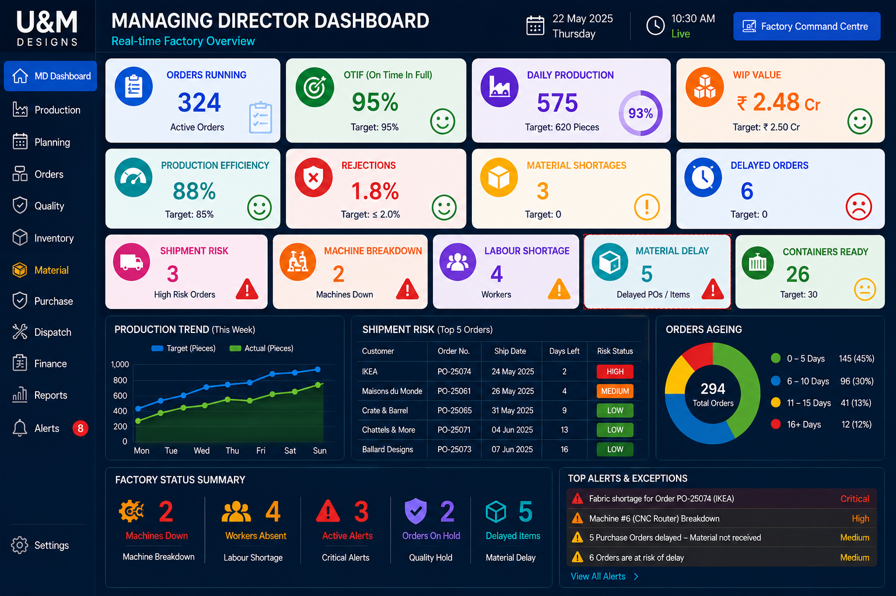

Slide 9
What Should Production Overview Look like?

Slide 10
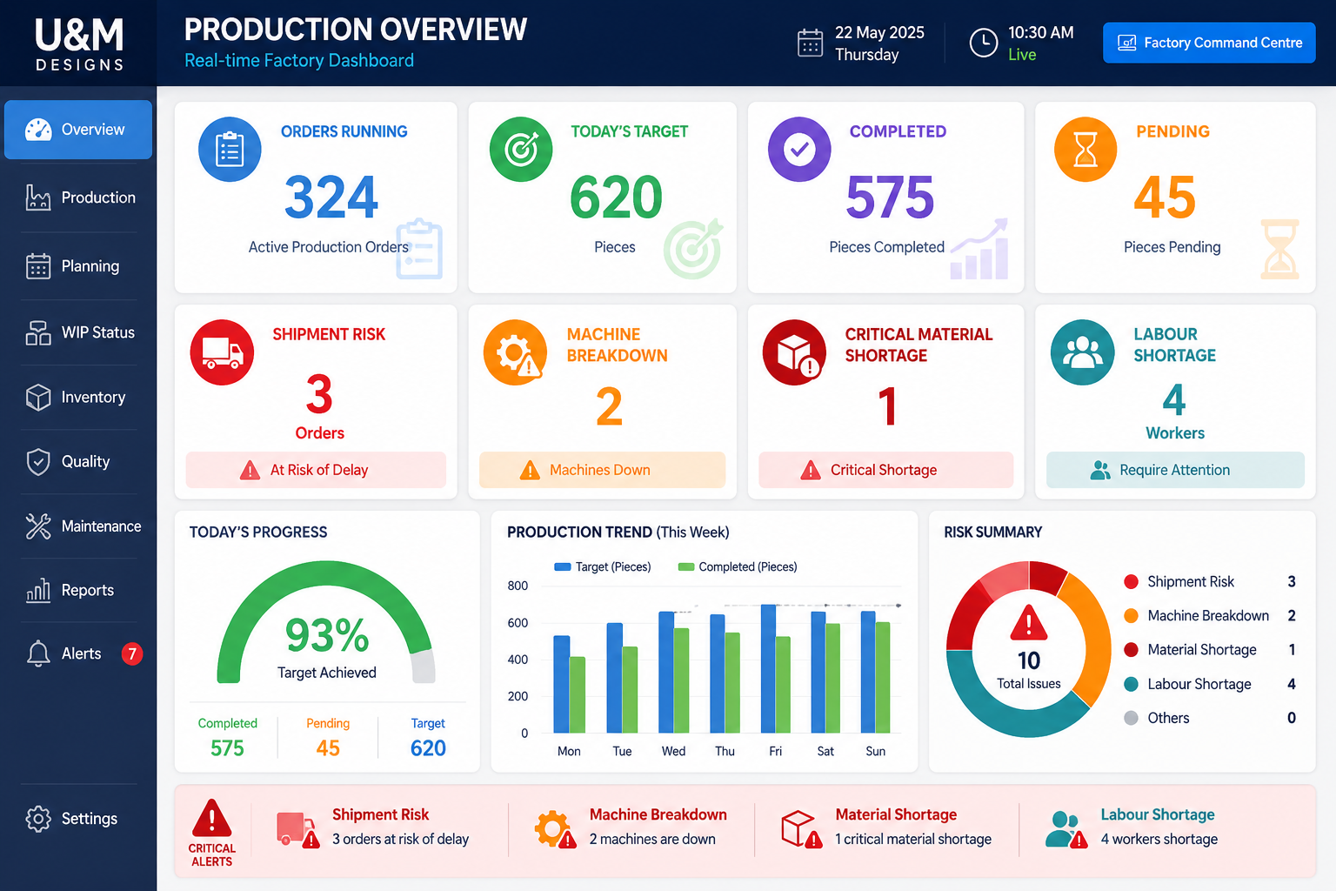

Slide 11
What should Production Real time performance view looklike?

Slide 12
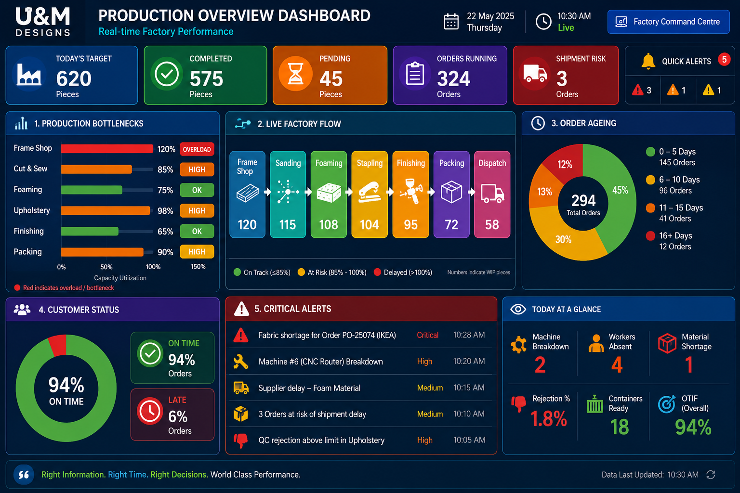

Slide 13
What should Manpower Real time Status look like?

Slide 14
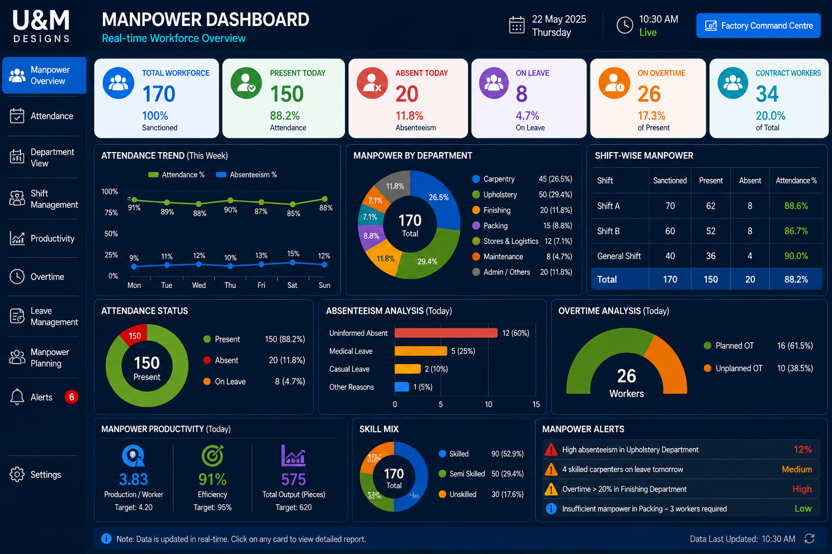

Slide 15
What should Material Real time Status looklike?

Slide 16
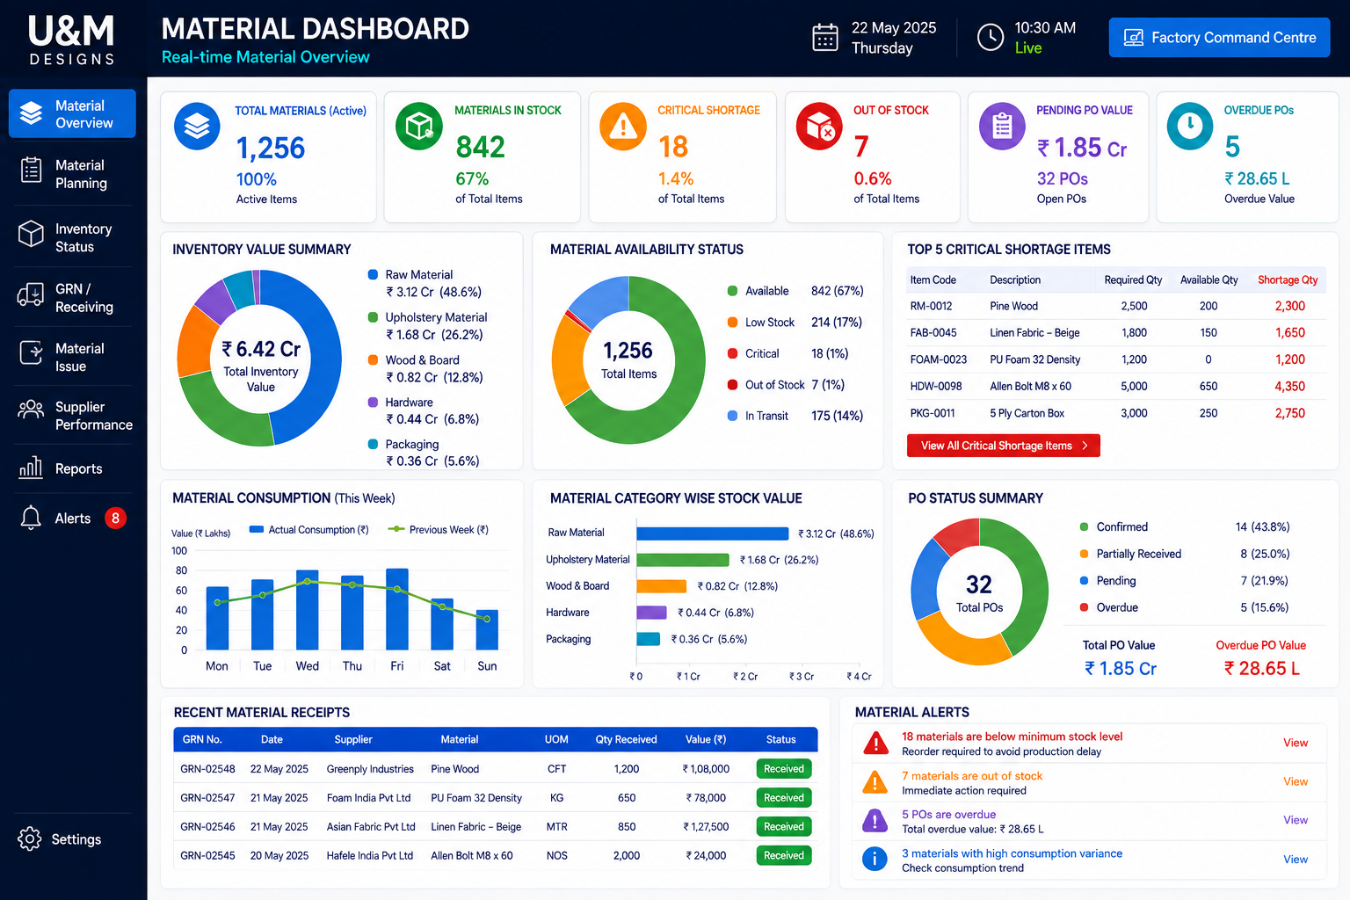

Slide 17
What should Quality Real time Status look like?

Slide 18
Immediate Followups for PPC Software
Merchandiser :
Logic for Date commitment for a Customer order.
D minus Article wise (As every article takes different production time)
PPC:
Material ordering date to the supplier
D minus Articlewise (Raw material, Fabric and Metal)
Purchase:
Material timelines Articlewise from each supplier
Production:
Article wise production capacity per day with average manpower numbers
Daily production update on google sheet
HR:
Google sheet update of manpower and overtime

Slide 19
