Slide 1
GRAPH THEORY ESSENTIALS
Dijkstra's Algorithm
Finding the shortest path. Dodging the negative edges.

Slide 2

The Core Concept
Check all
paths
Use greedy
logic
Greedy Pathfinding
Single-source shortest path algorithm.
Always picks the nearest unvisited node.
Guarantees optimal route.

Slide 3



DAA Core: The Greedy Paradigm
Local Choice
Global Optimal
Data Structures
Always picks the immediate minimum edge weight.
Local greed safely guarantees the shortest total path.
Relies heavily on Min-Heaps and Adjacency Lists.

Slide 4

The 4-Step Process
1
Initialize
Distances to infinity. Source to 0.
2
Select Node
Pick unvisited node with minimum distance.
3
Relax Edges
Update distances to adjacent neighbors.
4
Mark Visited
Repeat until target reached.
Can't have a slow path
if you always greedily pick the shortest one.

Slide 5
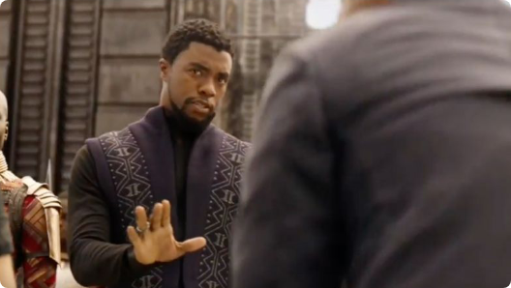
The Achilles Heel
Greedy failure: Assumes paths only get longer.
Infinite loops: Negative cycles break the logic.
The Alternative: Bellman-Ford algorithm required.
"Negative Edge Weights?
We don't do that here."

Slide 6
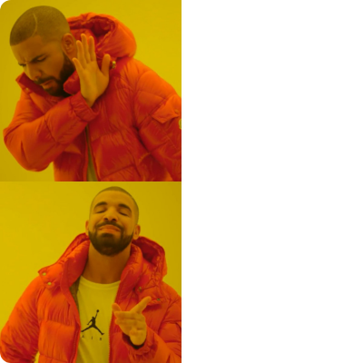
Time Complexity Optimization
Standard Array
O(V²)
Searching entire array for minimums.
Priority Queue (Min-Heap)
O(E + V log V)
Instant access to shortest distance node.

Slide 7
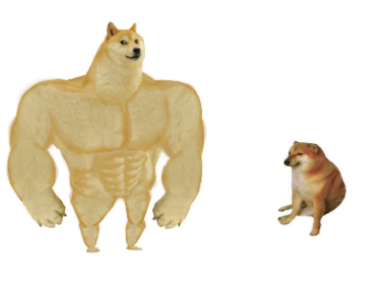
Algorithm Showdown
A* Search
Dijkstra's
Uses heuristics. Directly targets the destination.
Blind search. Explores evenly in all directions.
"I know exactly where to go."
"I must check every node."

Slide 8
Foundational. Fast. Reliable.
The cornerstone of modern routing technology.
Questions?

Slide 9





Image Sources
https://cdn-useast1.kapwing.com/static/templates/multiple-buttons-meme-template-full-084fd503.webp
Source: www.kapwing.com
https://en.meming.world/images/en/2/2c/Roll_Safe.jpg
Source: en.meming.world
https://supermeme-space-prd.ams3.cdn.digitaloceanspaces.com/templates/We-dont-do-that-here.png
Source: supermeme.ai
https://supermeme-space-prd.ams3.cdn.digitaloceanspaces.com/templates/Drake-Hotline-Bling.png
Source: supermeme.ai
https://supermeme-space-prd.ams3.cdn.digitaloceanspaces.com/templates/Big-dog-small-dog.png
Source: supermeme.ai

