Slide 1




Image Recognition as a Service

Slide 2
Engineering Requirements & Constraints
Face-Recognition API ➔ Serves deep learning model inference over HTTP.
Target Performance ➔
Handle 1000 concurrent requests.
Achieve an average latency of 2 seconds. (or better)
Constraints ➔
Strictly ultra cost-effective system design. (broke grad student)
Highly scalable and fault tolerant solution.
Notes:
building, we established clear performance targets and constraints

Slide 3
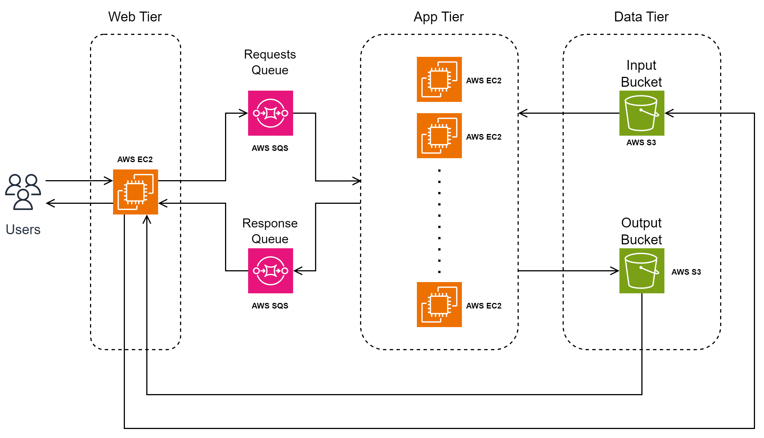
High-Level System Architecture
Notes:
decoupled, three-tier architecture

Slide 4
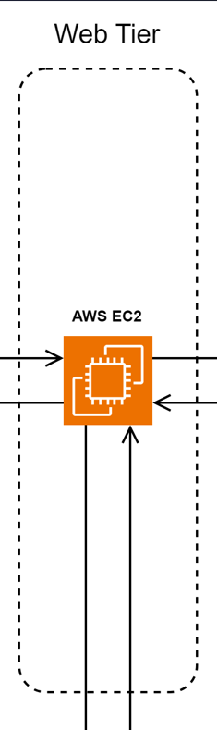
Web Tier
FastAPI ➔ Offloads blocking S3/SQS I/O to background threads.
Greedy Autoscaler ➔ Scales workers based on SQS backlog.
Response Resolution➔ Polls the Responses SQS repeatedly to resolve requests.
S3 Output Bucket Cache ➔ Bypasses App Tier for duplicate requests
Notes:
Boto3 is a synchronous library, so fastAPI uses ThreadPool

Slide 5
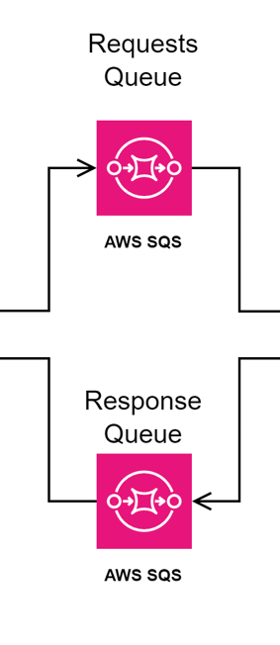
AWS SQS Configuration choices
Standard SQS Queue ➔ Delivers near-infinite throughput at lower operational cost.
Tuned VisibilityTimeout ➔ Prevents duplicate processing
10s Long Polling ➔ Eliminates CPU busy-waiting and lowers SQS API billing
Notes:
prevents in-flight messages from becoming visible again and being double-processed
Long polling so that the queue doesn’t get polled way to often

Slide 6
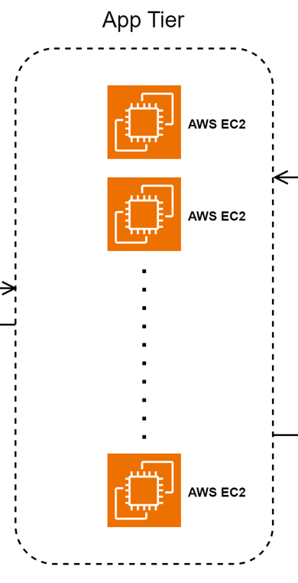
App Tier
Pre-Baked Custom AMI ➔ Minimizes cold-start times.
Decoupled Payloads ➔ Downloads from S3 to keep SQS light.
Instances automatically scale in ➔ When no pending requests remain.
Dual-Output Pattern
S3 output bucket for persistent results.
SQS response queue for serving requests immediately.
Notes:
The AMI was stored in the AWS ECR service

Slide 7
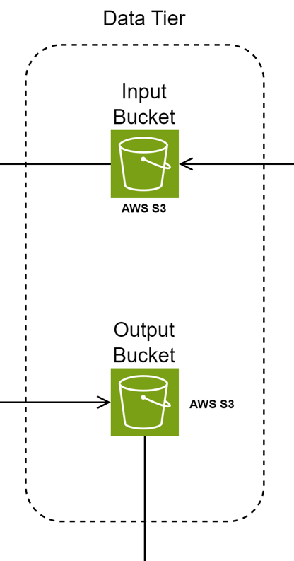
AWS S3 Design Decisions
Dual-Bucket Structure ➔ Isolates untrusted user inputs from results
Predictable Key Schemas ➔ Allows instant direct-lookup caching by filename

Slide 8
Thank You

